Slide 1


CHRIST’S IS THE WORLD IN WHICH WE MOVE
Christ’s is the world in which we move, Christ’s are the folk we’re summoned to love, Christ’s is the voice which calls us to care, And Christ is the one who meets us here.
To the lost Christ shows his face;
To the unloved he gives his embrace; To those who cry in pain or disgrace,
Christ makes, with his friends, a touching place.
Feel for the people we most avoid, strange or bereaved or never employed; feel for the women, and feel for the men Who fear that their living is all in vain.

Slide 2

CHRIST’S IS THE WORLD IN WHICH WE MOVE
Feel for the lives by life confused, Riddled with doubt, in loving abused; Feel for the lonely heart, conscious of sin,
Which longs to be pure but fears to begin.
To the lost Christ shows his face;
To the unloved he gives his embrace; To those who cry in pain or disgrace,
Christ makes, with his friends, a touching place.
John Bell & Graham Maule, Copyright © WGRG / The Iona Community

Slide 3





Slide 4

OPENING PRAYER
SIDE ONE
O blessed God, giver of peace,
ruler of justice, the hope of all people:
look with favour upon the world you have made and for which your Chosen One, Jesus Christ, gave his life that all might be
reconciled to you and to one another.
SIDE TWO
Bless the people of this planet, that we may live as one family
in the peace that you intend for your creation.

Slide 5
Give unto the peoples of this earth
the will to provide food abundantly that all may eat, the desire to protect and shelter every family,
SIDE ONE
the open hand to enable those left behind by technology to participate fully and with equality in the changes
and opportunities of the future.
SIDE TWO
Teach us to seek your justice and to put aside our warring ways.
Embolden us to speak out against all evil that oppresses the peoples of this planet.

Slide 6
OPENING PRAYER
Inspire our hearts
by the grace of your Holy Spirit, that we may praise you
as we seek ways to act justly, love tenderly
and walk humbly with our God.

Slide 7
LOVE IN ACTION

Slide 8
LOVE IN ACTION

Slide 9
LOVE IN ACTION

Slide 10
BIBLICAL JUSTICE
What word, phrase or image comes
to mind when you hear the word
JUSTICE?

Slide 11
BIBLICAL JUSTICE
&OLD TESTAMENT NEW TESTAMENT
B I B L I C A L
JUSTICE

Slide 12
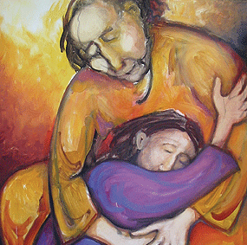
BIBLICAL JUSTICE
LOVE
UNITY
FORGIVENESS
SHOWING MERCY

Slide 13
BIBLICAL JUSTICE
SPIRITUALITY
& JUSTICE

Slide 14

MATTHEW 20:1-16
PARABLE OF THE LABOURERS
FAITH SHARING
In what instance in my life have I personally experienced God’s way not being mine?
What is the challenge in this gospel reading for me? How do I respond to it?

Slide 15
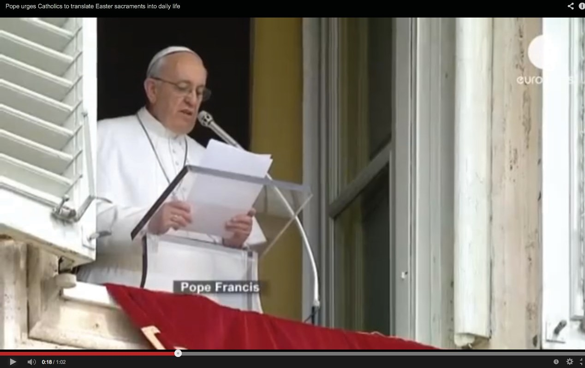
THE VISION OF POPE FRANCIS
t
http://www.youtube.com/watch?v=2p0Bd2mD1Pg

Slide 16
HOW DO WE RESPOND
What does it mean to live Easter/Sacraments in daily life?
What does Pope Francis hope the people of the Church will do? What does ‘Go in peace, glorifying the Lord by your life' mean?

Slide 17
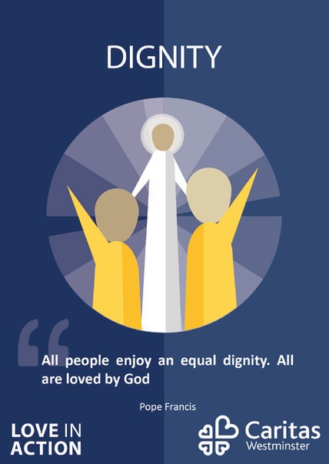




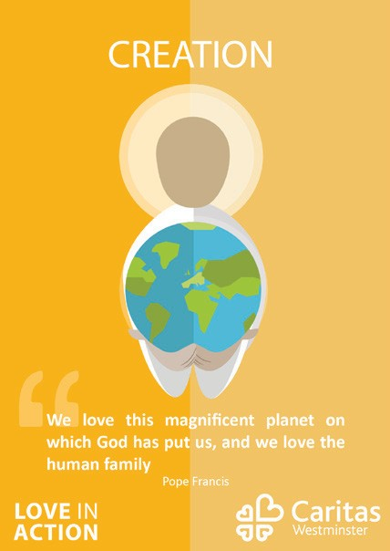
Go into groups – look at the postcards. Which principles resonate with you?
HOW DO WE RESPOND
Do any of them surprise you?
How do they relate to what we have already discussed?
How might these principles be most beneficial to the world today?

Slide 18

TAKE A
BREAK

Slide 19



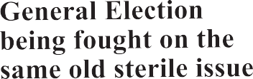
CATHOLIC SOCIAL TEACHING
SHOULD RELIGION
& POLITICS MIX?
y
Church leaders encourage politics
Christians in Herefordshire must "do politics" according to a new leaflet

Slide 20

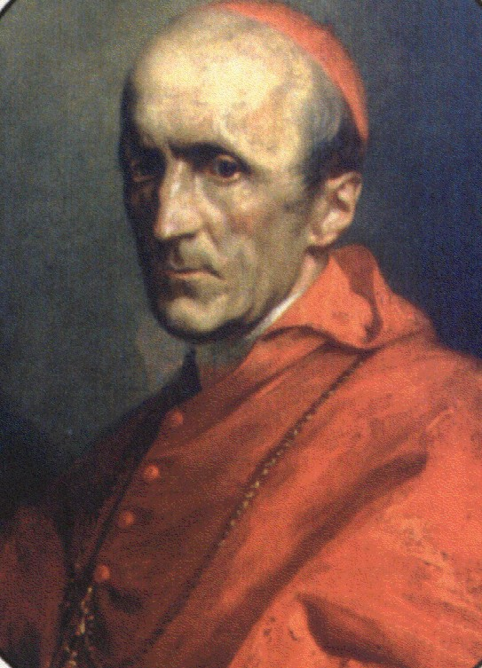
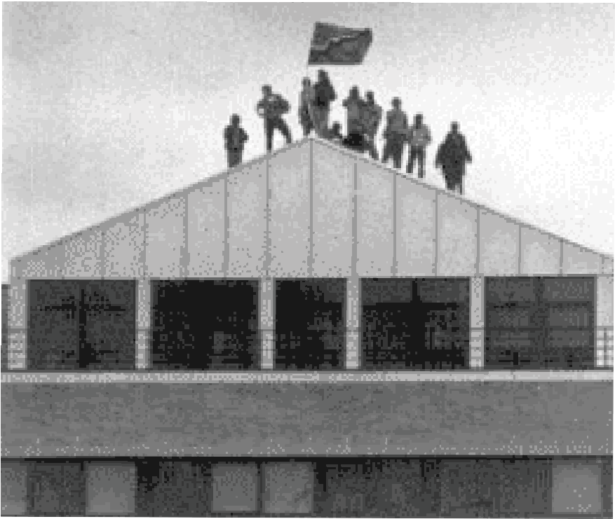
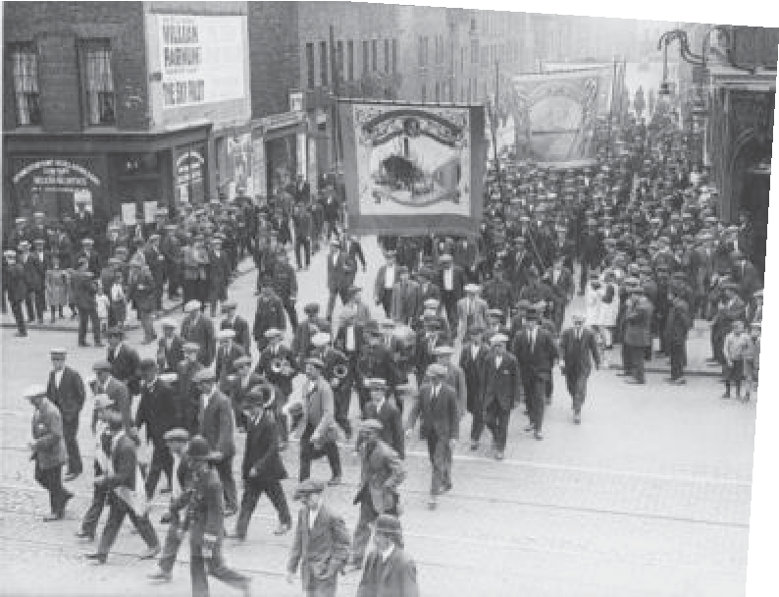
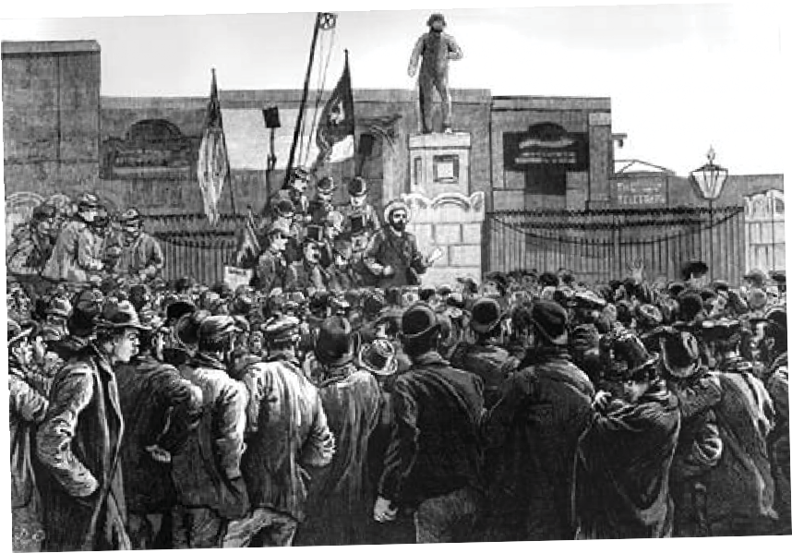
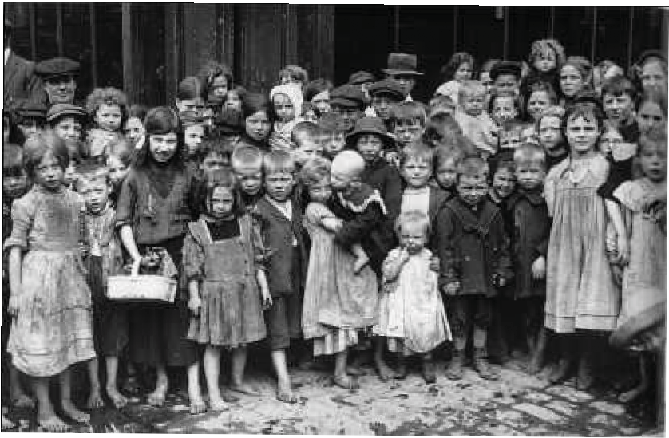
CATHOLIC SOCIAL TEACHING

Slide 21


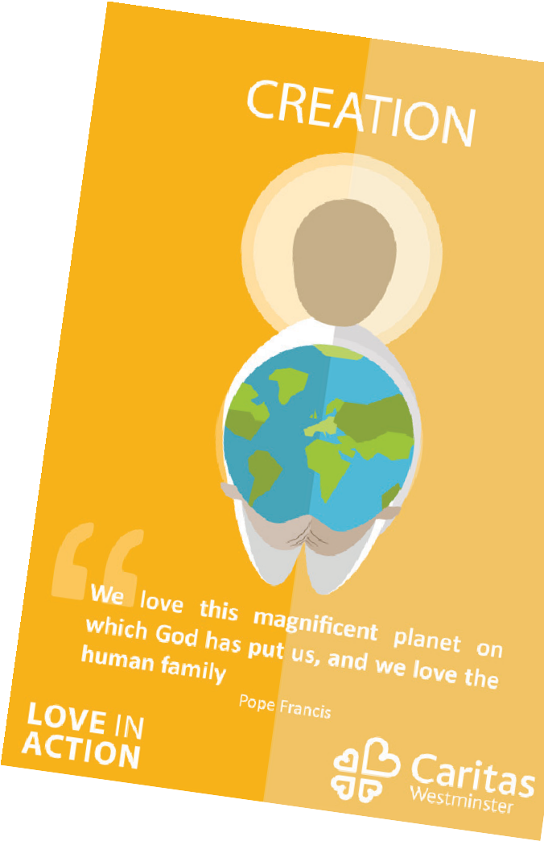

CATHOLIC SOCIAL TEACHING IS
A reflection on the message of Jesus
Informed by Scripture and Church tradition Principles for guidance
Criteria for judgement Directives for action

Slide 22
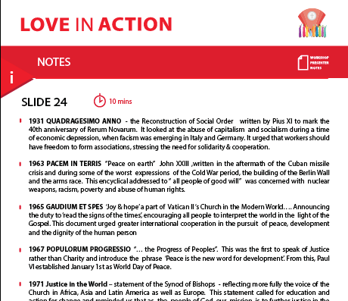
DOCUMENTS
The Reconstruction of Social Order (Quadragesimo anno, 1931) Peace on Earth (Pacem in terris, 1963)
Joy and Hope (Gaudium et spes, 1965)
The Progress of Peoples (Populorum progressio, 1967) Justice in the World, Synod of Bishops, 1971
On Human Work (Laborem exercens, 1981) Charity in Truth (Caritas in Veritate, 2009)
The Joy of the Gospel, (Evangelii Gaudium, 2013) The Care of our Common Home (Laudato Si' 2015)

Slide 23


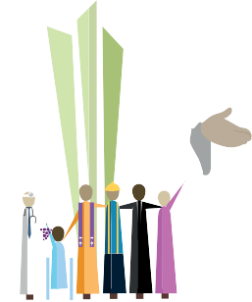






DIGNITY

Slide 24
WARNING
THE JOY OF THE GOSPEL
The study, practice, and spirituality of Catholic social justice teachings may be hazardous to hard-heartedness, complacency, scepticism, indifference and hubris.
PROCEED AT YOUR OWN RISK!

Slide 25


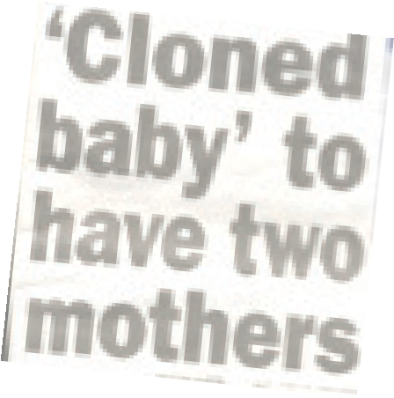

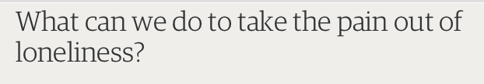

DIGNITY
The beauty products from the skin of executed Chinese prisoners
Cosmetics firm targets UK market Lack of regulation puts users at risk
UK health alert for over-50s as isolation looms for two million
YOU CAN HAVE BABIES BUT YOU CAN’T KEEP THEM

Slide 26



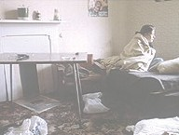

WithdrawalofSupport for families
COMMUNITY AND PARTICIPATION
100,000 CHILDREN ARE HOMELESS
Nearly a third of people visiting Shelter with housing problems last year had children, according to new figures. And more than half of these families were homeless, it said. Recent Government figures reveal that about 100,000 children across the country are homeless.
Councils are failing thousands of young people on the verge of homelessness
HOMELESS FAMILIES HIT CRISIS LEVELS

Slide 27
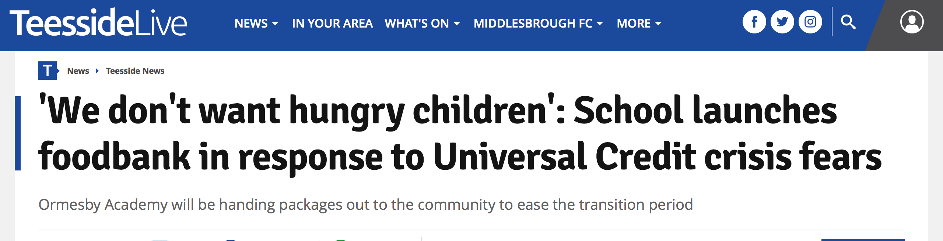

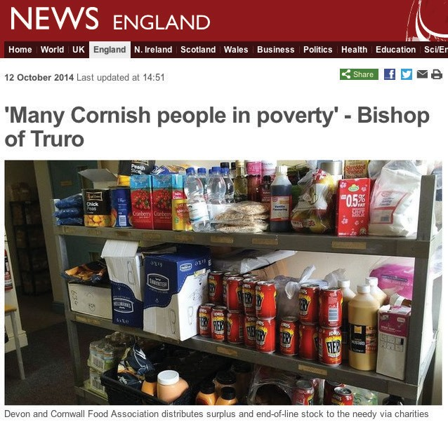


OPTION FOR THE POOR
This is not just another act of God- This is ingrained poverty

Slide 28
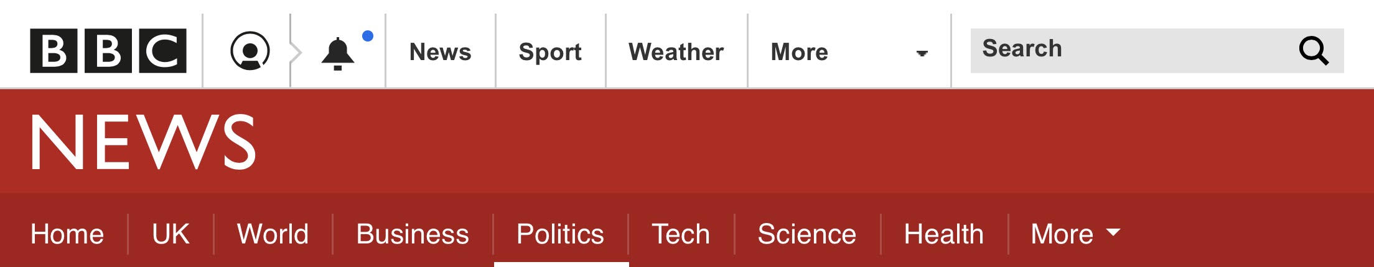

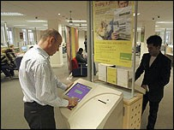
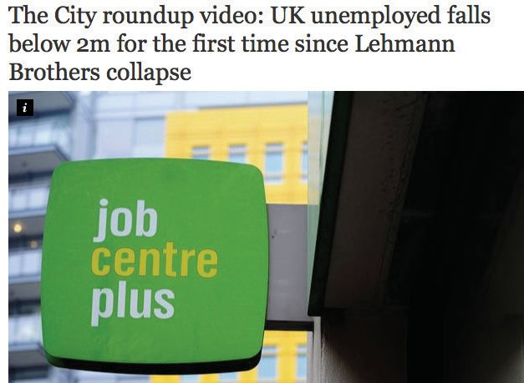
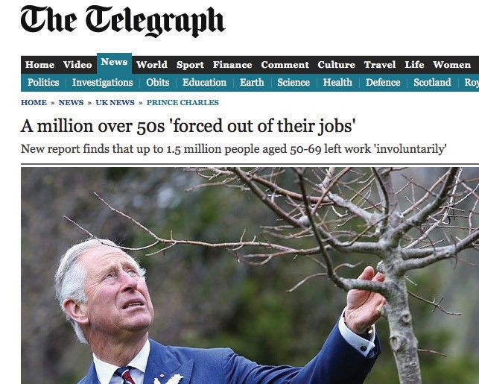
UK temp workers get 'poor deal'
DIGNITY OF WORKERS
BA CATERER DIGS DEEP ON PAYOFFS
Unequal pay could cost councils
Temporary workers must be protected from "cowboy" job agencies and employers that pay them less than permanent staff, the TUC has said.

Slide 29

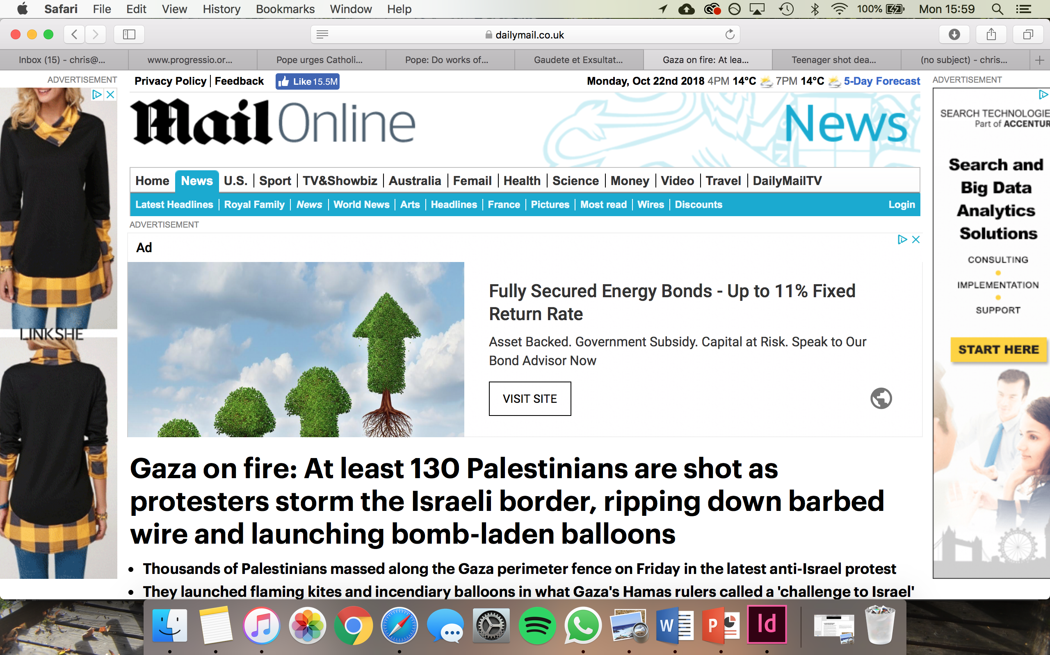
SOLIDARITY AND PEACE
Teenager shot dead in second London youth murder within 24 hours
Yemen civil war: The facts about the world's 'forgotten war'

Slide 30


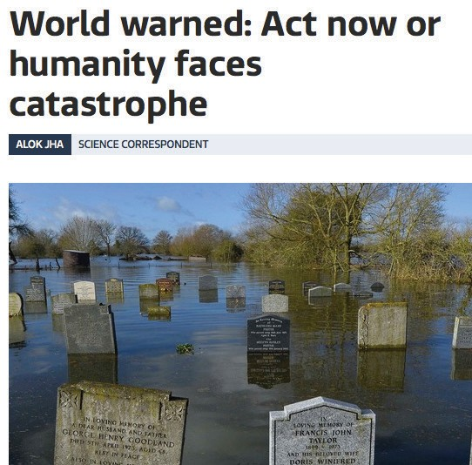
CARE OF CREATION
CHRISTIANS SHOULD BE INVOLVED WITH THE WHOLE OF GOD'S CREATION
Andy Atkins, Tearfund
IPCC: Climate scientists consider 'life changing' report
Church agencies to join major climate change coalition

Slide 31
CATHOLIC SOCIAL TEACHING AND A FRAMEWORK FOR ACTION
SEE
JUDGE
ACT

Slide 32
ACTIVITY ONE

Slide 33
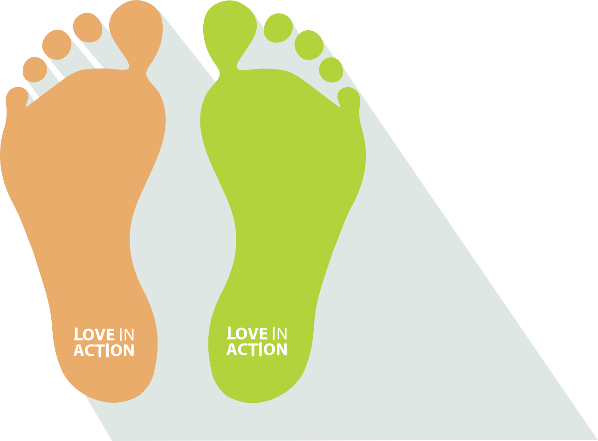
TWO FEET OF CATHOLIC SOCIAL ACTION
SOCIAL
JUSTICE
CHARITABLE
WORKS
F E E T
F E E T

Slide 34
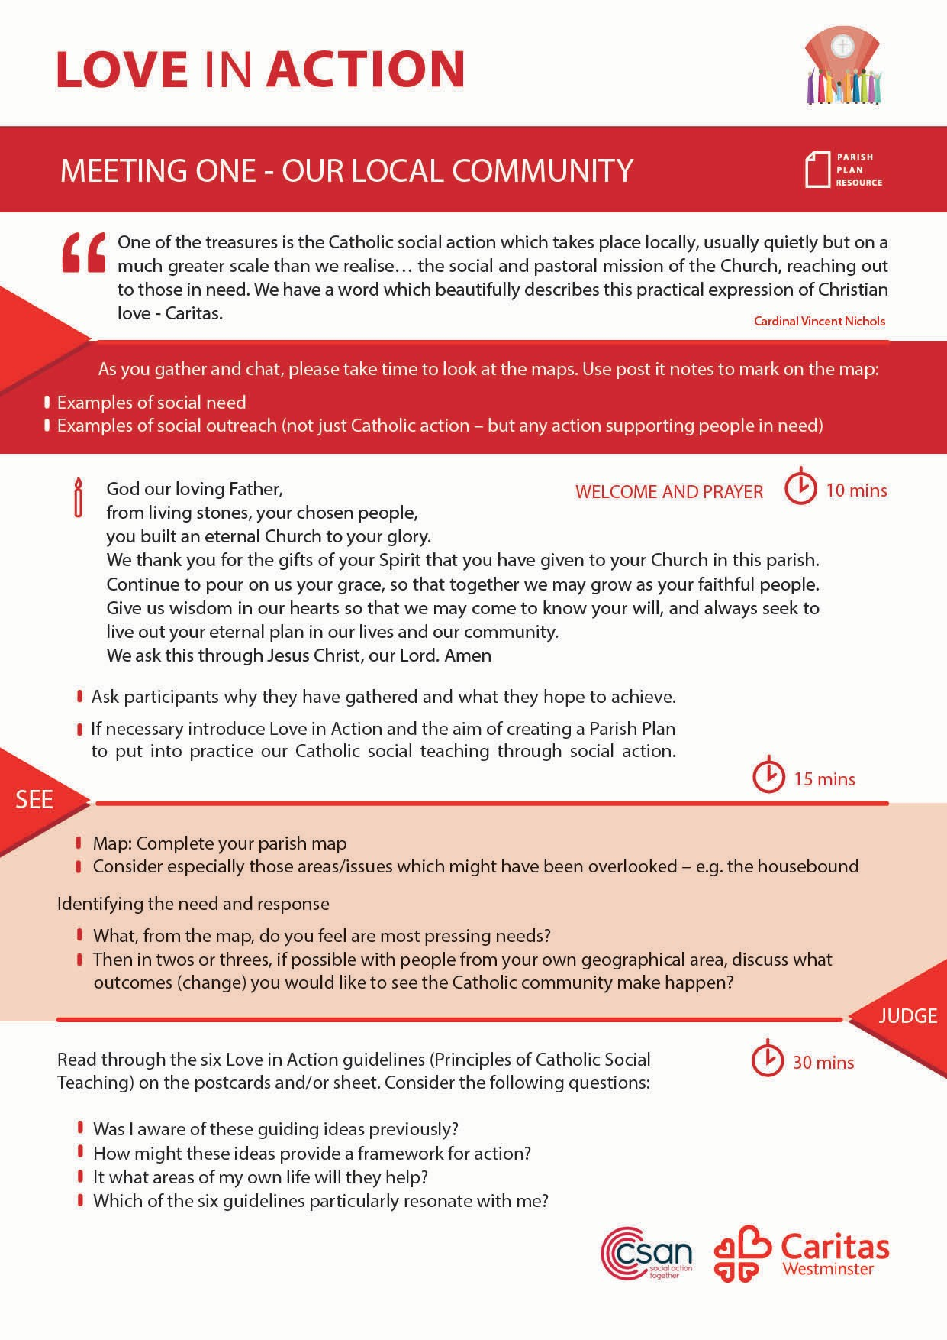
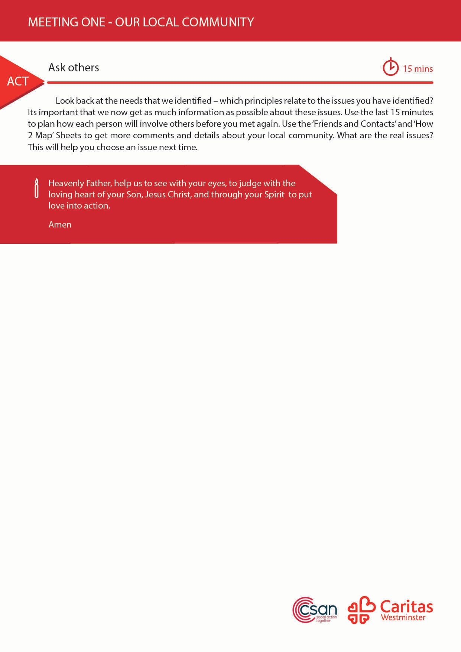
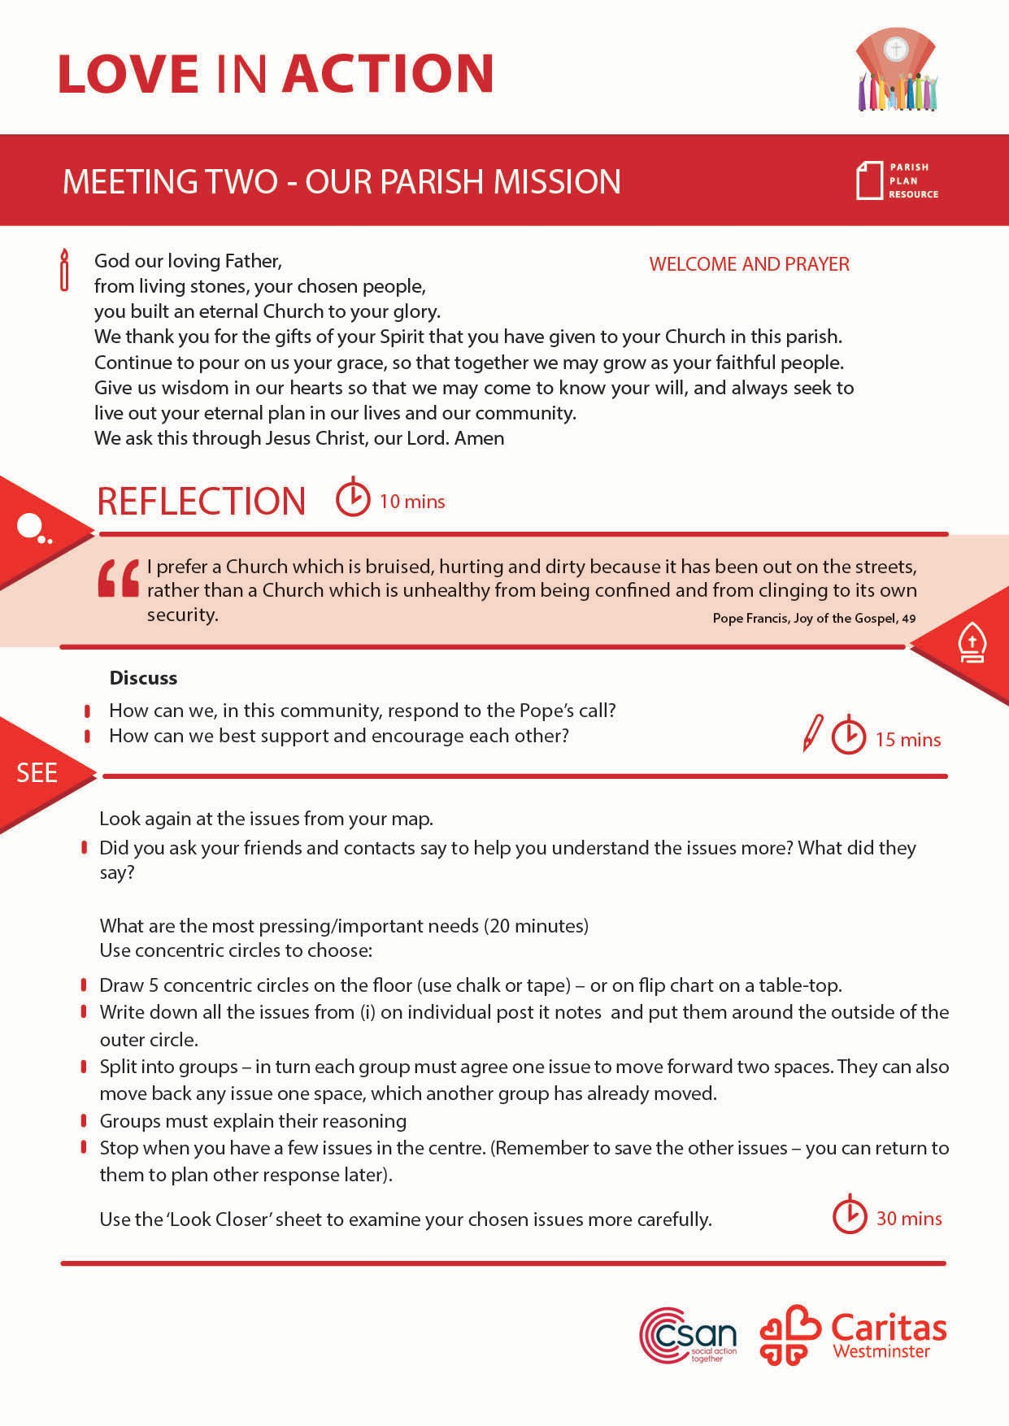
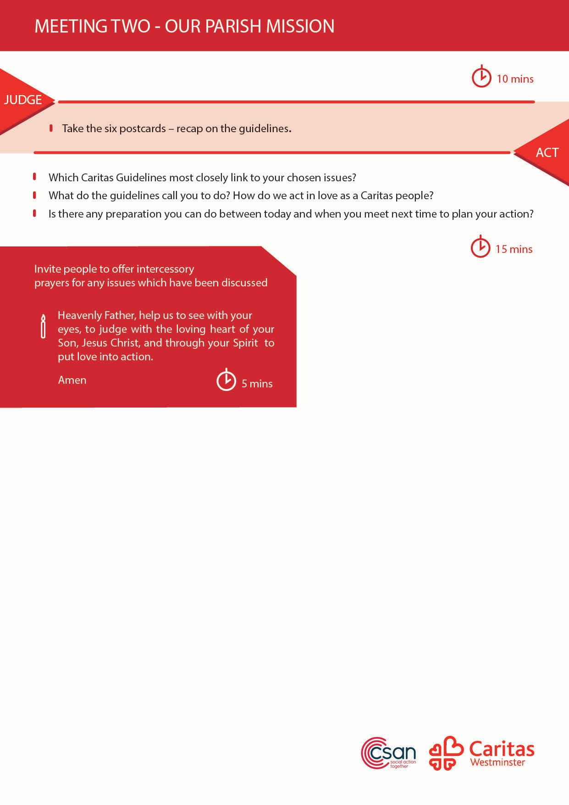
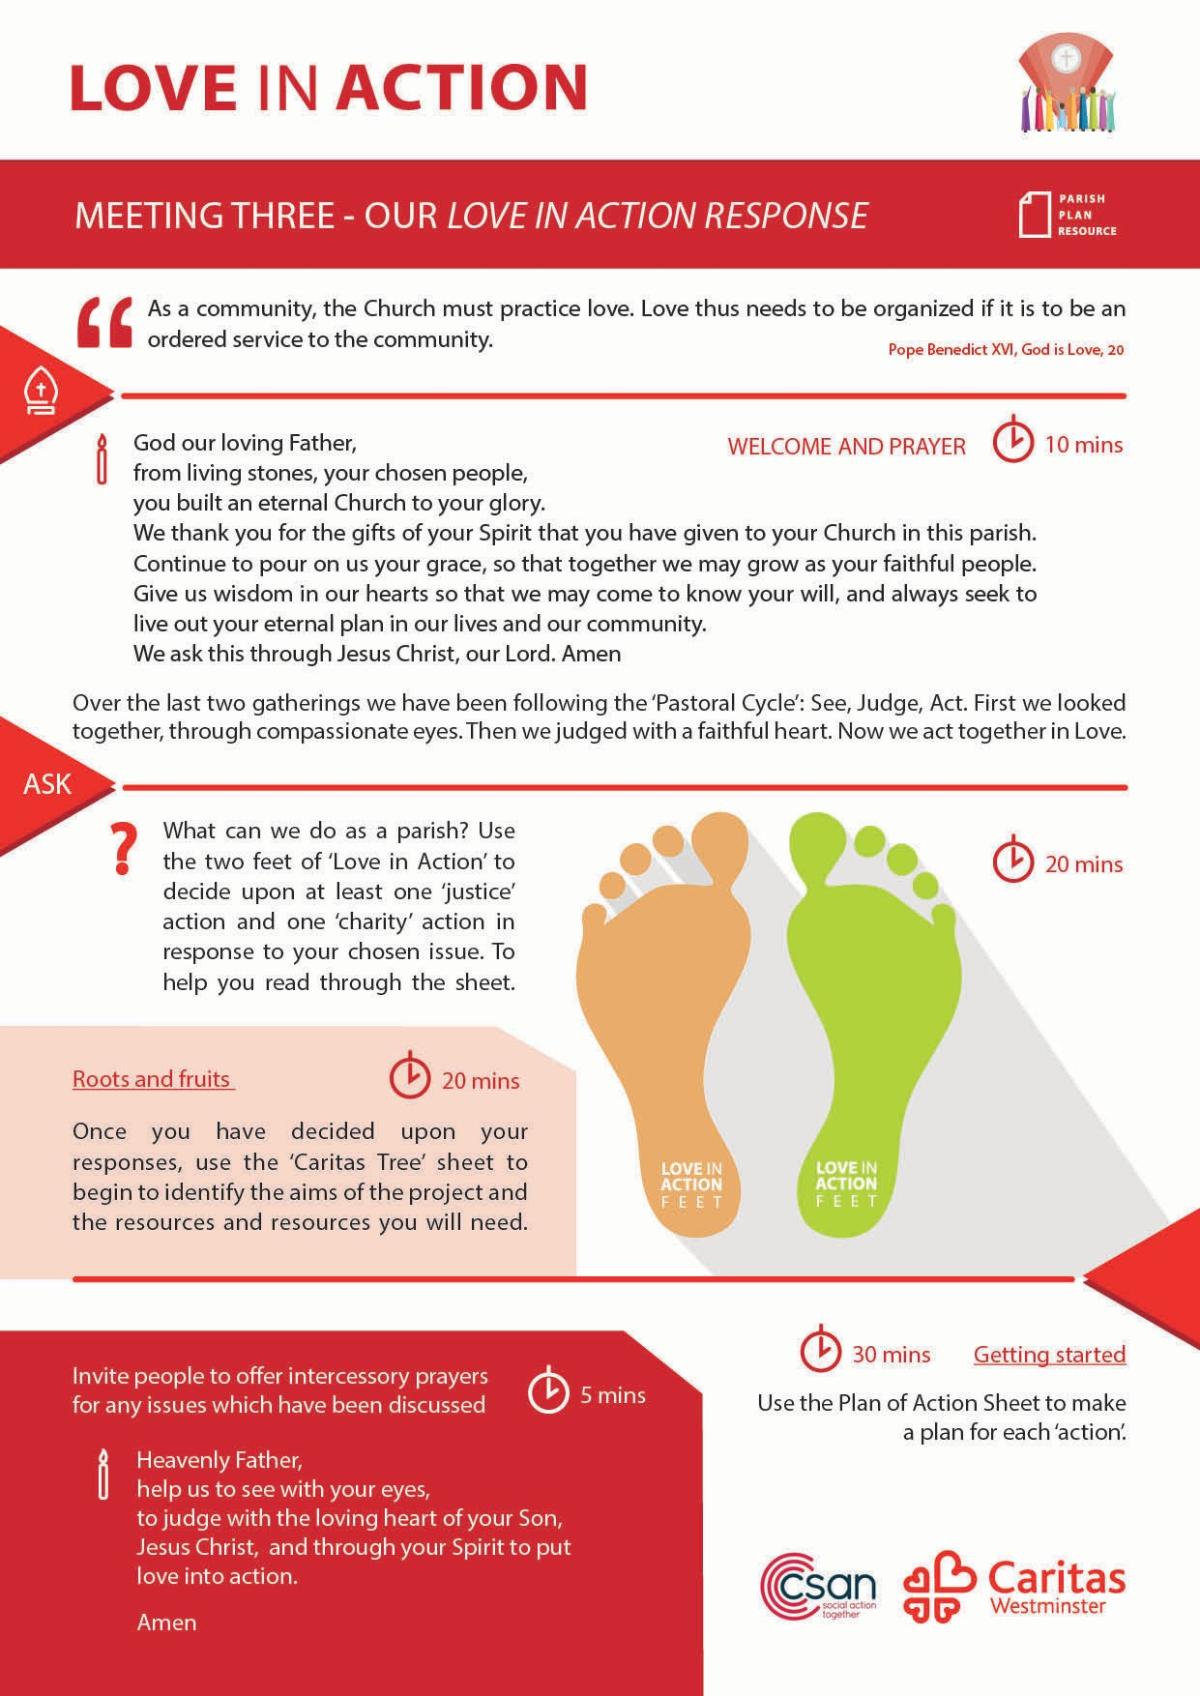
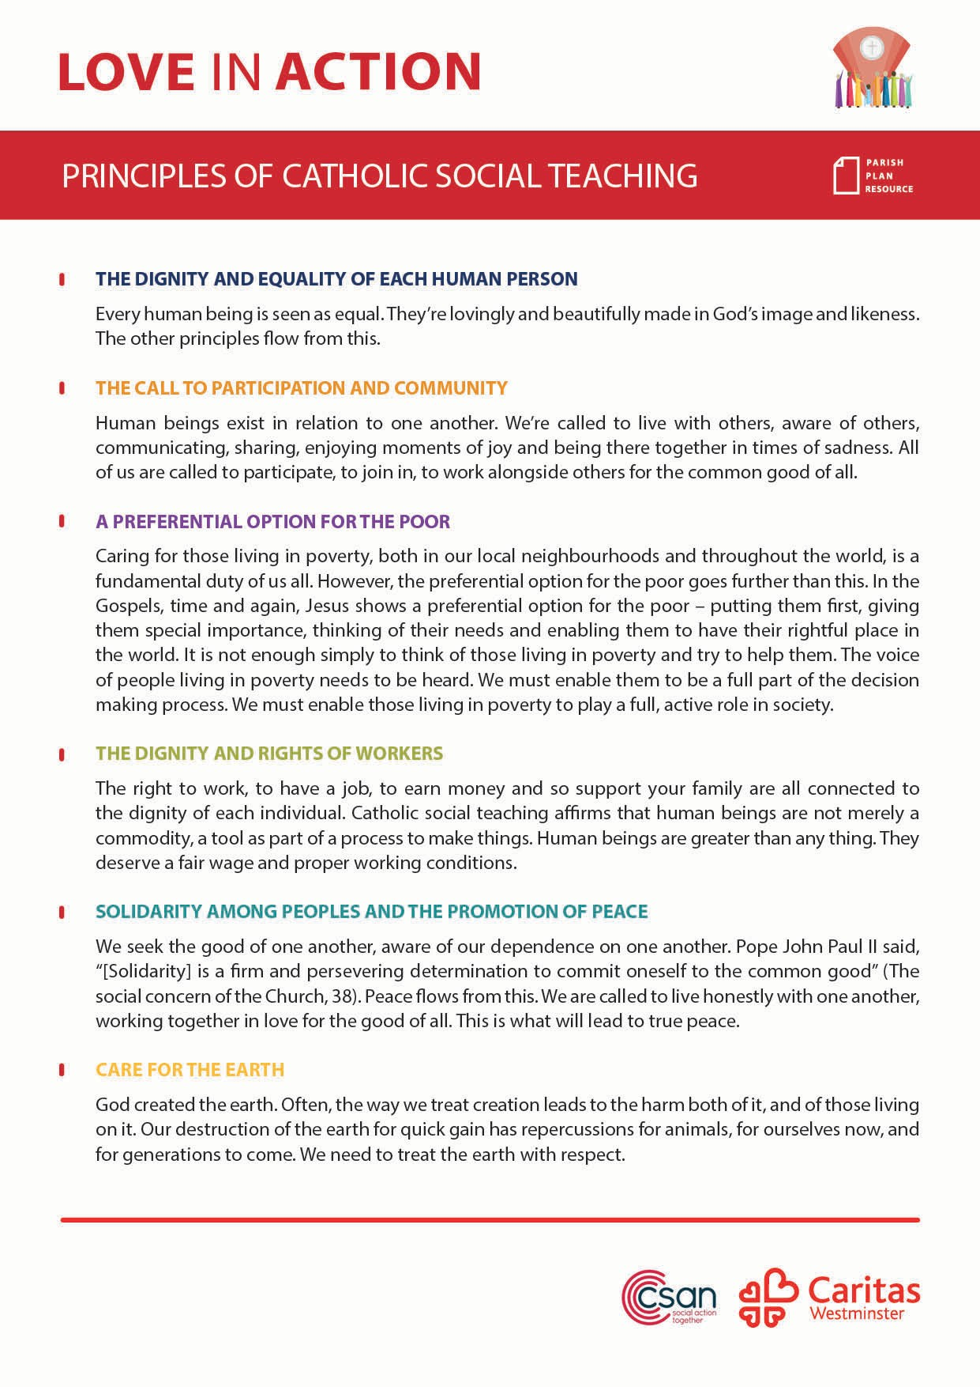
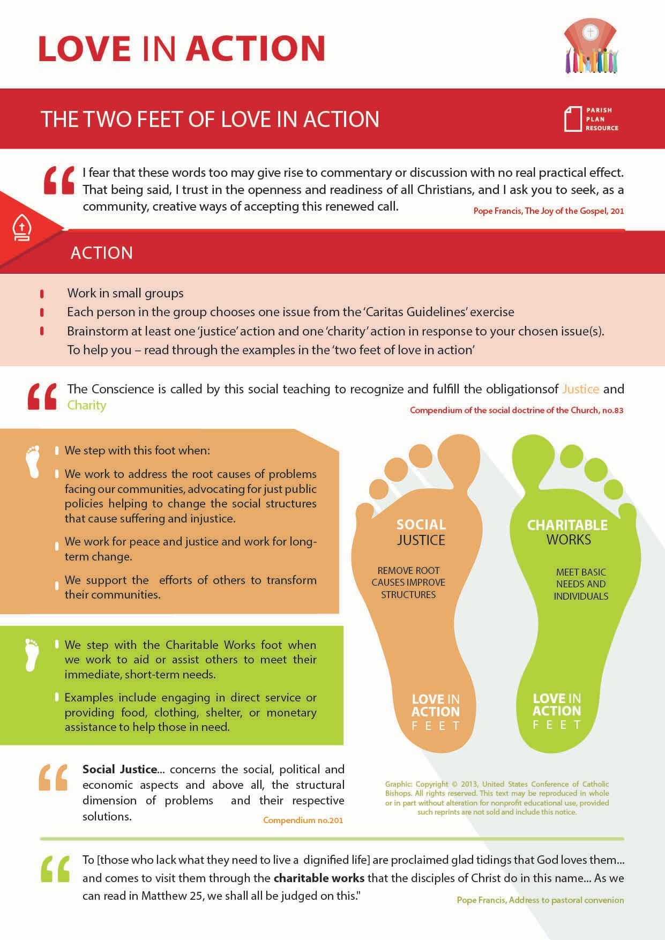
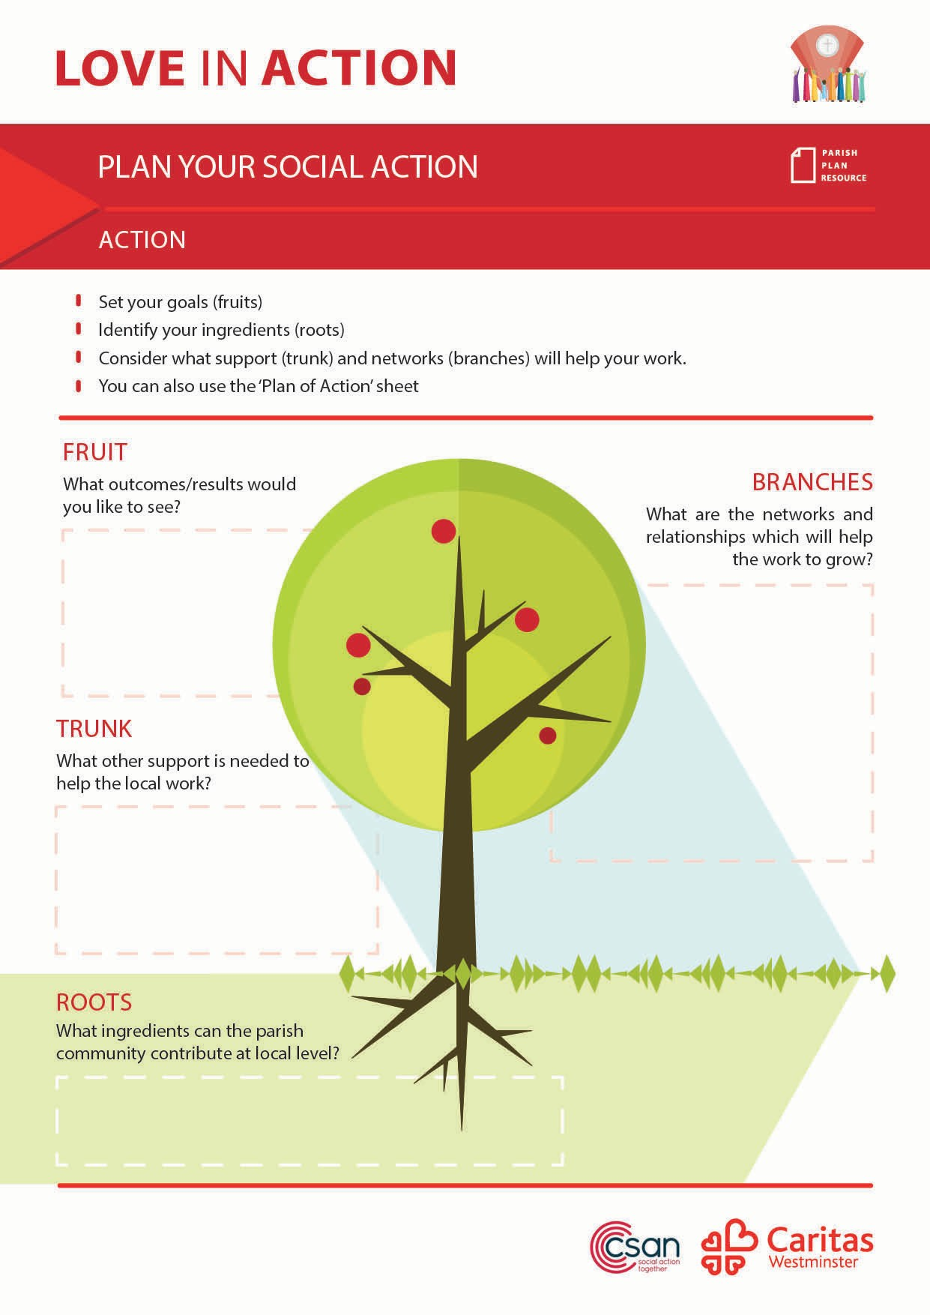

PARISH ACTION PLAN

Slide 35
QUESTIONS

Slide 36
EVALUATION
YOUR FEEDBACK

Slide 37
CLOSING PRAYER
Dear Lord
Open our hearts to the needs of our world.
Give us the courage to reach outbeyond our comfortable lives and look into the suffering faces of your people.
We are grateful for the abundance of blessings and insights you have given us.
Strengthen us to act as your instruments of caring
in a world where injustice and disregard for the sacred human dignity of every person is often the rule.
Create in us hearts ready for your vineyard, And hands able to work for you. Send your spirit into our lives to make us loving women and men so your Kingdom will be established on earth as it is in heaven.
Amen

Slide 38

A MAGNIFICENT
My soul proclaims you, mighty God, my spirit sings your praise.
You look on me, you lift me up, and gladness fills my days.
All nations now will share my joy; your gifts you have outpoured.
Your little one you have made great; I magnify my God.
For those who love your holy name, your mercy will not die.
Your strong right arm puts down the proud and lifts the lowly high.

Slide 39
A MAGNIFICENT
You fill the hungry with good things, the rich you send away.
The promise made to Abraham is filled to endless day.
Then let all nations praise our God, the Father and the Son,
The Spirit blest who lives in us, while endless ages run.

Slide 40

Heavenly Father,
Help us to see with your eyes,
to judge with the loving heart of your Son, Jesus Christ,
and, through your Spirit, to put love into action.
Amen

