Slide 2
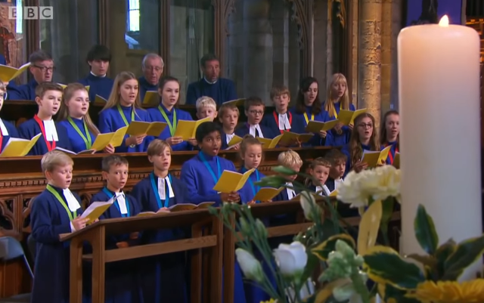
Hymn
Notes:
https://www.youtube.com/watch?v=fExR7eOhJO0

Slide 3
‘If anyone is well off in worldly possessions and sees their sister or brother in need but closes their heart to them, how can the love of God be remaining in them?’
-1 John 3.17-18

Slide 4
‘Prayer to God and solidarity with the poor and suffering are inseparable.’
-Pope Francis

Slide 5
‘Speak up for those who cannot speak for themselves, for the rights of all who are in need. Speak up and be fair; defend the rights of the poor and needy.’
-Proverbs 31:8-9

Slide 6
We often talk about offering a preferential option to those in need.
What might this mean?

Slide 7
In the Gospels, Jesus shows a preferential option for the poor by putting them first. He gives them special importance by thinking of their needs and helping them have their rightful place in the world.

Slide 8
Who might feel isolated?
Who might be feeling excluded?
Who might need to feel the love of their community?
Homeless
Elderly
Self-isolating
Refugees
Who else could you add to this list?
Who else can you see in need in your community?

Slide 9
Think about the people in need in your community.
How could you stretch forth your hand to them, this Advent?
What could you do to help them?
How could you speak up for them and their needs?

Slide 10
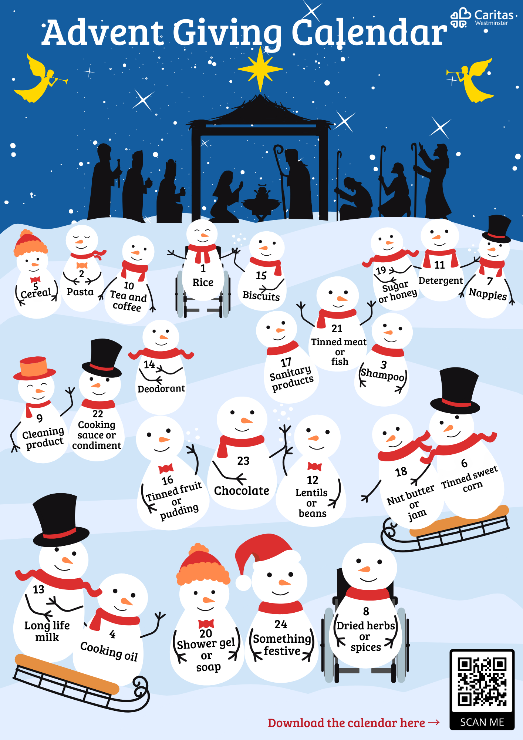
Caritas Advent Giving Calendar
Could you join in with our Advent Giving Calendar?
Where could you donate your collected food?
Could you include little luxuries like chocolates
or sweets?

Slide 11
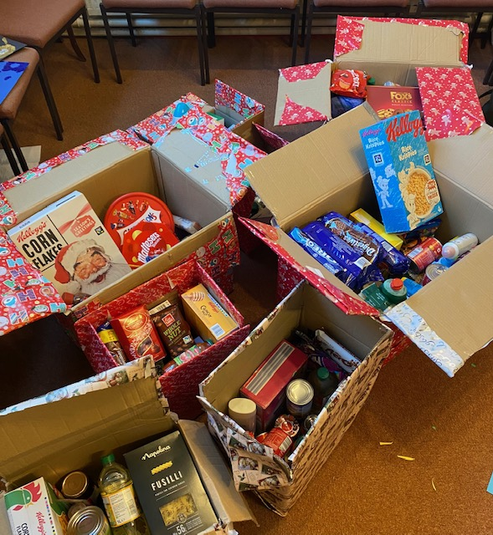
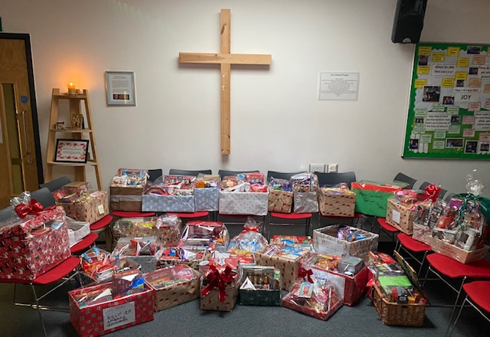
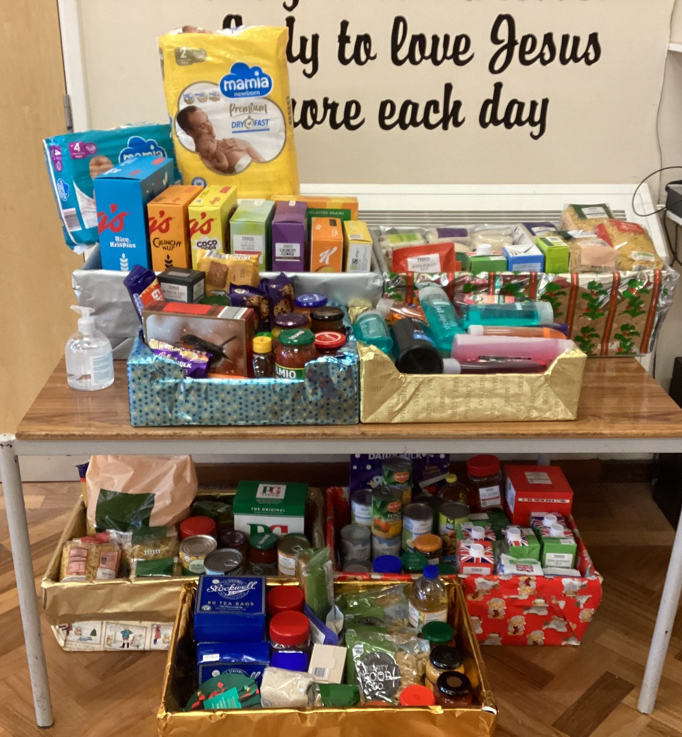
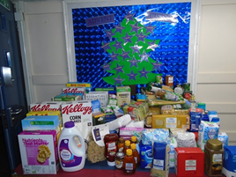
Caritas Advent Calendar
Notes:
Thanks to the following schools for providing the photographs of their efforts in 2022:
St Gregory’s Catholic Science College
Cardinal Wiseman Catholic School
St Mary’s Primary School, Royston
St Vincent’s School, Marylebone
Our Lady of Victories Catholic Primary School

Slide 12
Write encouraging and loving notes and send them to local homeless shelters or food banks to be included in food parcels or Christmas gifts.
What could you write in your note?

Slide 13
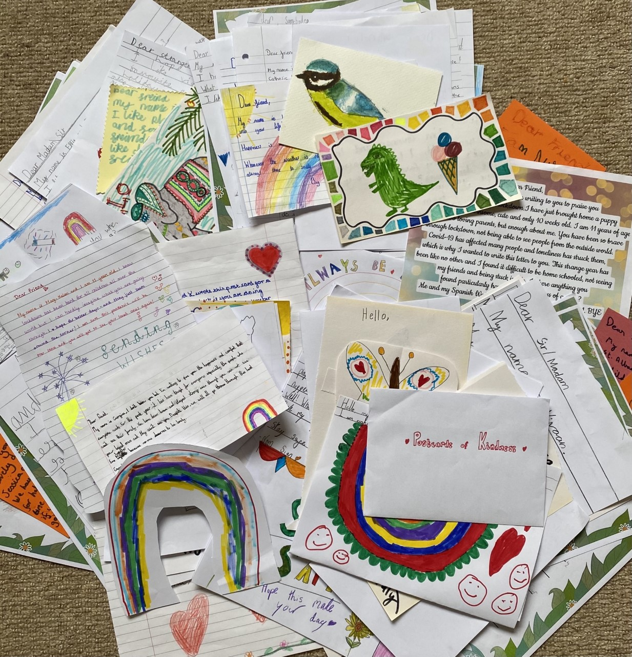
Postcards of Kindness
The pupils of St John Fisher Primary School, St Albans, wrote postcards to send to their local care homes.
Could you organise a Christmas card version?
What could you write in your note?

Slide 14
Listening to Your Local Community
It’s important to listen to the people you are trying to help. Why do you think this is the case?
How could you listen to the people in need in your community? How could you help their voices be heard by others?
What could you and your school do to make them feel more loved?

Slide 15
Prayer
Dear Lord,
At Your birth, You called people of all social backgrounds to celebrate Your Nativity.
Help us to see You in everyone around us and recognise their innate dignity.
Grant us eyes to see and hearts to love those in most need in our communities.
Amen

