Slide 1
Imagining Futures:
Working with Young People to Sow Hope

Slide 2
Sowing Seeds of Hope
Hope lets new life blossom, like a plant that grows from the seed fallen on the earth.
- Pope Francis
To plant a garden is to believe in tomorrow.
- Audrey Hepburn

Slide 3
Project
Two separate strands to the term-long project
Imagining a Future
Creative Arts-based
Young people to work together and create a ‘best-possible’ vision for the future
Express above vision through selected medium
Art, design, drama, music, etc.
Option to present at Social Action Volunteering Awards in November
Hope for the Here and Now
Social Action-based
Young people take small but impactful steps towards their vision
Submit report/evidence to Caritas Westminster
Head, Heart, Hands

Slide 4
Resource Pack
Assemblies to ‘kick-off’ both sections of the project
Two fully-planned sessions for both parts
PowerPoints
Full lesson plans
Intention to be ‘plug and play’
Teachers’ Notes
Planning template materials
Caritas Westminster on hand for questions, comments and/or concerns

Slide 5
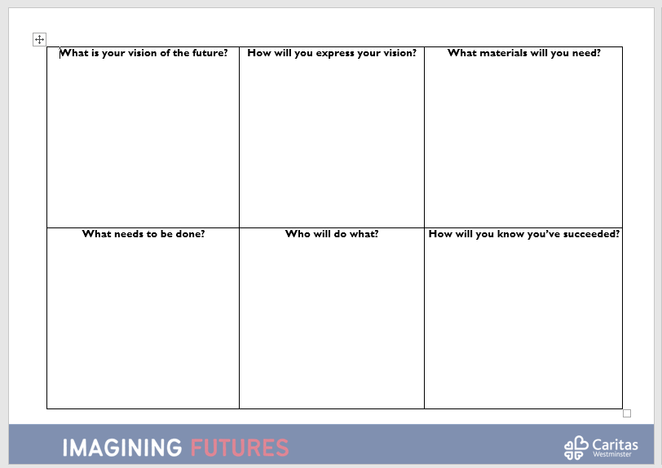
Resource Pack

Slide 6
Feedback and Celebrations
Collate images, videos, etc. of creative work into a PowerPoint for ease
Social Action Awards in November 2022
End of Academic Year celebration in 2023

Slide 7
caritaswestminster@rcdow.org.uk
francesmoore@rcdow.org.uk

