Slide 1
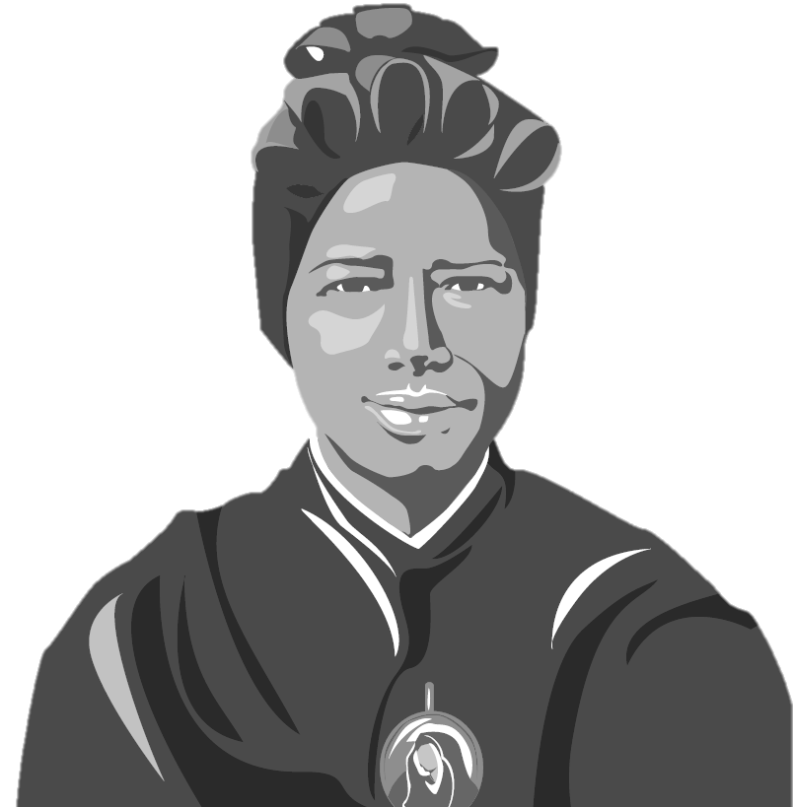
St Josephine Bakhita Day
8th February 2023

Slide 2
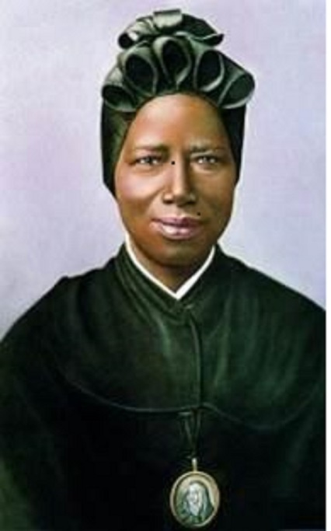
St Josephine Bakhita
St Josephine Bakhita is the patron saint of victims of modern slavery
Born 1869 in Darfur, Sudan
Kidnapped by slave traders when she was 7
Remained a slave until 1889
In 1893 joined the Canossian Sisters
Died 8 February 1947

Slide 3
St Josephine Bakhita said of her traffickers…
“If I was to meet those slave raiders that abducted me and those who tortured me, I'd kneel down to them to kiss their hands, because, if it had not have been for them, I would not have become a Christian and religious woman."

Slide 4
Who is Caritas?
Caritas Westminster works with schools and churches across the Diocese of Westminster to help those in need.
We believe everyone has a part to play in God’s plan for our world! We think we should all work to make the world a better place!
Notes:
Caritas exists in many forms all over the world as part of the Catholic Church helping those in need.
Caritas Westminster works across London and Hertfordshire to help parishes and schools help those in need.
They do this by working with people with disabilities, people who are poor, people who can’t find work and anyone who have been left out of society.
They have direct services, such as Bakhita House as well as fostering social enterprise and community development.
Caritas’ aim is to get a few more people involved in this wherever we can, bringing local communities together to support those in need.
We believe everyone has a part to play in God’s plan for our world, it involves every aspect of our lives from the things we pray about, to how we live day to day.

Slide 5
Notes:
Caritas and the Catholic Church uses a set of values called Catholic Social Teaching.
The writings of the Church and the Bible lead us to six key themes for how to live to create a good society
These help us to think about how we can create the society God wants us to, a perfect world where we treat each other with love and respect and act in the interests of the whole community not just ourselves.
These are: Dignity, Community and Participation, Creation, Solidarity and Peace, Option for the Poor, and Dignity of Workers
One way we deliver Dignity of Worker is through our Direct service: Caritas Bakhita House

Slide 6
Caritas Bakhita House
A safe house for women escaping human trafficking and modern slavery
Opened in the Diocese of Westminster 2015 at
an undisclosed location (for protection and safety)
Provides accommodation for 12 women at a time
Offers emotional, psychological, legal and financial support
Offers skills training
Helps women return home or claim asylum
‘My mental and physical health was poor when I arrived at Caritas Bakhita House, but by the time I left I was a different person.’
Quote from Caritas Bakhita House guest
Notes:
Bakhita House is a safe house we opened in 2015 for women who have been kept in slavery
The House exists to help them start living safe, happy lives
Since it opened in 2015, over 100 women have been rescued by the police and brought to safety at Bakhita House
They are shown love and compassion so they are able to live safely on their own again and get a chance to live in freedom.

Slide 7
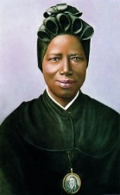
FEBRUARY
On 8 February, the Feast Day of St Josephine Bakhita, we celebrate Bakhita Day.
We pray for all the victims of modern slavery and human trafficking and for those who help to eradicate these terrible crimes.
We particularly think of all those linked
with Caritas Bakhita House
Notes:
Bakhita

Slide 8
Key terms
Modern Slavery: when someone is forced to do a job and does not get paid
Someone is a slave if they are:
Forced to work
Owned or controlled by someone
Restricted in their movement
Bought and sold as ‘property’
Reference: UK Human Trafficking Centre (UKHTC)
Notes:
Dignity is how you are treated by other people
If someone treats you with ‘dignity’ they’re showing you that they think you’re important
Talking to you nicely; sharing with you; helping you with your work, and being kind to you are all ways someone could treat you with dignity.
We believe that everyone is important so everyone should be treated with dignity

Slide 9
What is the process? (An example)
They are offered a ‘very good job’ in another town, city or country.
Those who offer these opportunities organise their travel and accommodation.
Once they have arrived, victims are told they must work a lot to pay back their travel and the cost of their accommodation.
The job they are offered turns out to be a lie. They are forced to work in difficult conditions, with no salary.
Victims are controlled by threats of violence, and by being told they owe money to their boss.

Slide 10
Slavery in the UK
It can’t be happening in the UK today, can it?

Slide 11
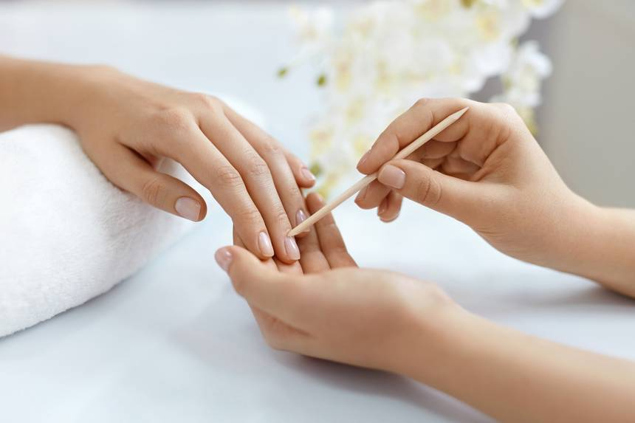
Current situation: United Kingdom 2021
In the UK 77% of victims were male
43% were children ( aged under 18)
Labour exploitation being the most common form (car washers, nail bars)
The top three trafficked nationalities were from the UK, Albania and Vietnam.

Slide 12
Some signs of exploitation
Dressed in the same clothes every day
A lot of people living at the same address
Don’t know their address
Sleep on the floor
Scared of the police
Cannot go wherever they want
Have no passport or ID

Slide 13
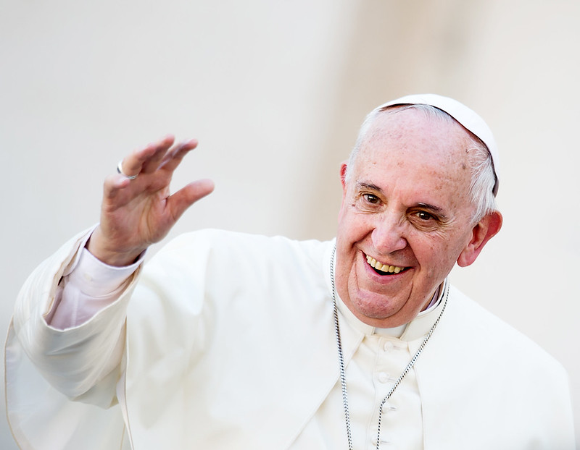
Recently Pope Francis has drawn particular attention to modern slavery which he describes as ‘a crime against humanity, it is a wound on the body of Christ!’. He has called the Church to focus on this issue and work together to eradicate human trafficking and modern slavery.
Call of Pope Francis
Picture credit Marcin Mazur © Mazur/catholicnews.org.uk
Notes:
Ask the chn to feedback to the whole group.

Slide 14
WHAT CAN WE DO AS A SCHOOL?

Slide 15
What can you do to help?
If you think someone is at risk of modern slavery speak to an adult (parent or teacher)
Talk about the issue with parents, friends, school
Use the car wash app
Pray for the victims of modern slavery
Use your gifts and talents to help others.
Get involved in school projects that help those in need.
Get involved in raising much needed funds for Caritas Bakhita House
Support Caritas Bakhita House through your prayers
Notes:
Adults: If you think someone is at risk Please call either 999 or the Modern Slavery Hotline on 0800 012 1700

Slide 16
Closing prayer
Heavenly Father,
We pray for the victims of human trafficking that they may be helped to rebuild their lives after the traumatic experiences they have gone through.
We pray that we will tell an adult if we spot the signs of Human Trafficking and help to raise awareness.

Slide 17
Closing prayer
We pray for those caring for the victims of human trafficking, that their efforts to help the vulnerable and traumatised may not go unrewarded.
St Josephine Bakhita Pray For Us
Prayer adapted from one by Santa Marta Group

Slide 18
www.caritaswestminster.org.uk
@CaritasWestm

Slide 19
Caritas Bakhita House
A safe house for women escaping human trafficking and modern slavery
Opened in the Diocese of Westminster 2015 at
an undisclosed location (for protection and safety)
Provides accommodation for 12 women at a time
Offers emotional, psychological, legal and financial support
Offers skills training
Helps women return home or claim asylum
‘My mental and physical health was poor when I arrived at Caritas Bakhita House, but by the time I left I was a different person.’
Quote from Caritas Bakhita House guest
Notes:
Bakhita House is a safe house we opened in 2015 for women who have been kept in slavery
The House exists to help them start living safe, happy lives
Since it opened in 2015, over 100 women have been rescued by the police and brought to safety at Bakhita House
They are shown love and compassion so they are able to live safely on their own again and get a chance to live in freedom.

Slide 20
One guest said…
At Bakhita House “everyone listened to my opinion. I had started to take back control of my life and found people would listen to my voice. I became human again, not an object.”

Slide 21
So far…
13 Babies born to women at Bakhita House
147 Years and 10 months imprisonment for traffickers because of the bravery of our women giving evidence
2000 Hours given by our amazing volunteers
170
Women from 46 countries

Slide 22
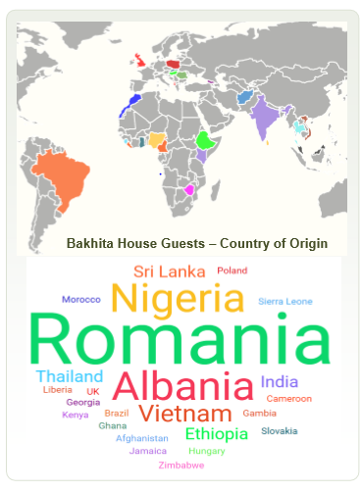

Slide 23
Watch this video – Caritas Bakhita House – A Journey to Recovery
A beautiful representation of the healing power of Caritas Bakhita House, filmed by a former guest.
Notes:
This video was recorded by a guest in 2022

