Slide 1
Care of Creation
LKS2

Slide 2
Starter
Talk Partners:
Think about how you started your day.
How did you get to school?
What did you eat for breakfast?
Where were your clothes made?
Notes:
Talk partners for 3 minutes
Gather responses

Slide 3
Starter
How could you have changed your morning to care for the environment more?
Notes:
Talk partners for 3 minutes
Gather responses

Slide 4
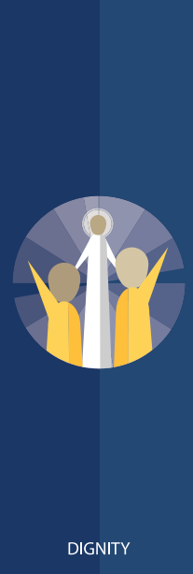
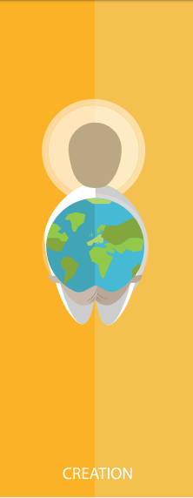
Catholic Social Teaching

Slide 5
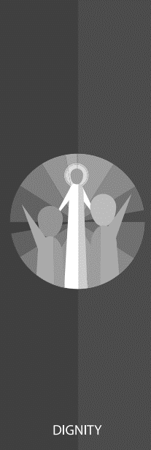
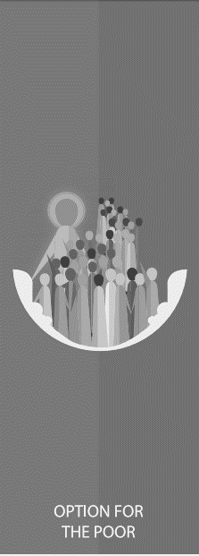
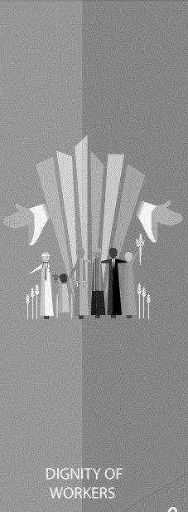
Catholic Social Teaching

Slide 6
Care of Creation
We are created by God to live in a community together.
God did not just create us but the whole of the world, and we must live in harmony with the whole of his creation.

Slide 7
Care of Creation
How we treat the Earth affects us now and will affect people in the future.
Why is it important to look after our world?

Slide 8
Care of Creation
‘In the beginning, God created the Heavens and the Earth… God saw everything that He had made, and indeed, it was very good.’
Genesis 1:1-4
‘The Lord God put humans in the Garden of Eden to work it and take care of it.’
Genesis 2:15

Slide 9
Care of Creation
‘Creation is a gift, it is a wonderful gift that God has given us, so that we care for it and we use it for the benefit of all.’
Pope Francis, Laudato Si’

Slide 10
Care of Creation
‘What kind of world do we want to leave to those who come after us, to children who are now growing up?’
Pope Francis, Laudato Si’

Slide 11
Care of Creation
Is looking after our world part of being a good Christian?
How do you know?

Slide 12
Care of Creation

Slide 13
Care of Creation

Slide 14
Care of Creation
Think about your local community and your local area.
How would caring for the environment change it for the better?
How would caring for your local environment make the people around you feel?

Slide 15
Main Activity
Use what you’ve learnt today to design a poster to encourage the people in your school to be better stewards of creation.
Think about including:
What the bible and Pope Francis tells us about caring for creation
What people could do to care for the environment

Slide 16
Plenary
‘What kind of world do we want to leave to those who come after us, to children who are now growing up?’
Pope Francis, Laudato Si
Imagine a world where everyone cares for the environment. What would that world look like?
What would it be like to live in?

