Slide 1




Care of Creation
UKS2

Slide 2


Starter
Talk Partners:
Think about how you started your day.
How did you get to school?
What did you eat for breakfast?
Where were your clothes made?
Notes:
Talk partners for 3 minutes
Gather responses

Slide 3
Starter
What effects could your choices have had on the environment?
What changes could you make to care for the environment more?
Notes:
Talk partners for 3 minutes
Gather responses

Slide 4



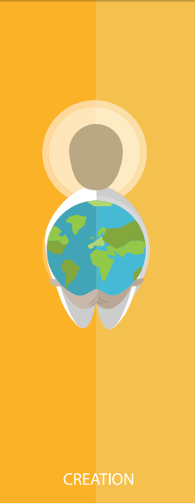



Catholic Social Teaching

Slide 5


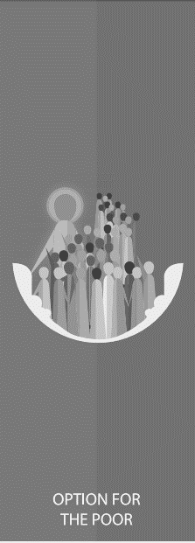




Catholic Social Teaching

Slide 6
Care of Creation
We are created by God with dignity and we live in a community together.
God did not just create us but the whole of the world, and we must live in harmony with the whole of his creation.

Slide 7
Care of Creation
How we have treated and continue to treat the Earth affects us now and will affect people in the future.
Have we always looked after the world as God intended?
How do you know this?

Slide 8

Care of Creation
‘In the beginning, God created the Heavens and the Earth… God saw everything that He had made, and indeed, it was very good.’
Genesis 1:1-4
‘The Lord God put humans in the Garden of Eden to work it and take care of it.’
Genesis 2:15

Slide 9

Care of Creation
‘Creation is a gift, it is a wonderful gift that God has given us, so that we care for it and we use it for the benefit of all.’
Pope Francis, Laudato Si’

Slide 10
Care of Creation
‘All is not lost. Human beings… are also capable of rising above themselves, choosing again what is good, and making a new start.’
Pope Francis, Laudato Si’
What do you think Pope Francis means by humans ‘rising above themselves’?

Slide 11
Care of Creation
What do these quotes tell us about our responsibility to our world?
Is being a good steward of creation part of being a good Christian?
How do you know?

Slide 12
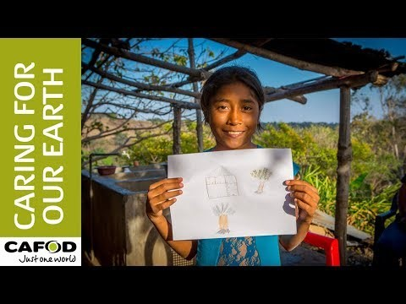
Care of Creation

Slide 13
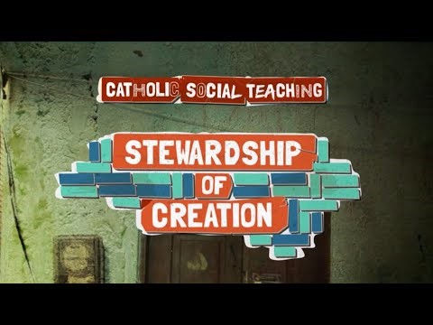
Care of Creation

Slide 14

Care of Creation
Think about your school community and your school environment.
What could you and your classmates do to be better stewards of your school environment?
How would this change your world for the better?

Slide 15

Main Activity
Use what you’ve learnt today to write a persuasive piece that could be included in your school’s newsletter encouraging people to be better stewards of creation.
Include:
What the bible and Pope Francis tells us about caring for creation
Why we should want to change the world for the better

Slide 16
Plenary
‘What kind of world do we want to leave to those who come after us, to children who are now growing up?’
Pope Francis, Laudato Si
Imagine a world where we are all good stewards of creation.
What would that world look like?
What would it be like to live in?

