Slide 1
Dignity
KS1

Slide 2
Starter
What makes the person next to you special?
Notes:
Talk partners for 3 minutes
Gather responses

Slide 3
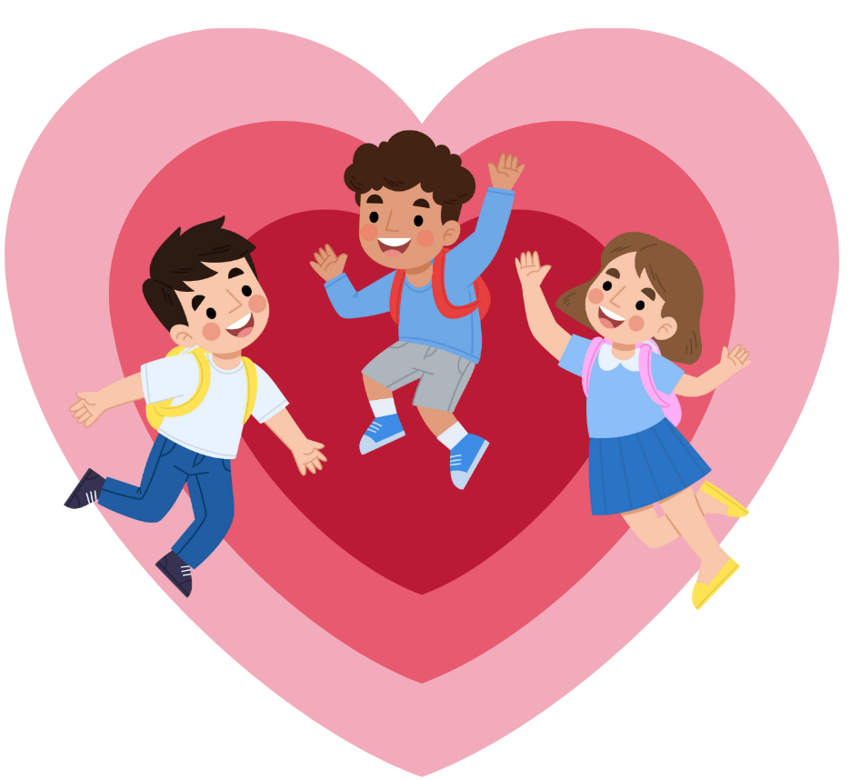
Starter
Remember that everyone is special!
Notes:
Talk partners for 3 minutes
Gather responses

Slide 4
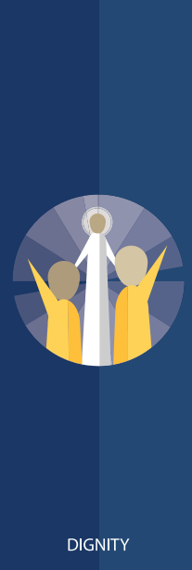
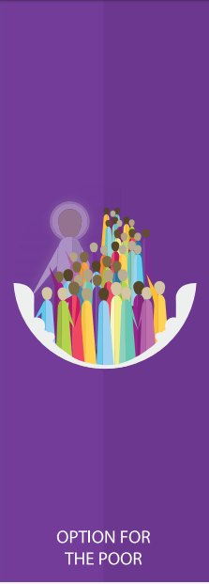
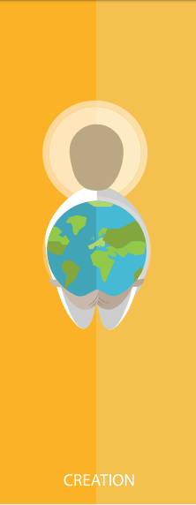
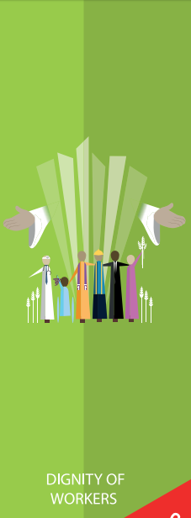
Catholic Social Teaching

Slide 5
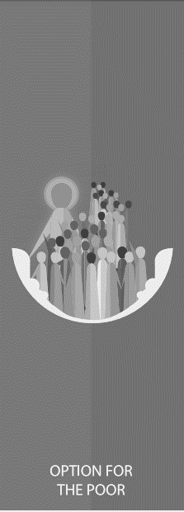
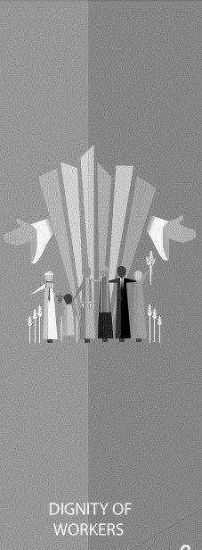
Catholic Social Teaching

Slide 6
Dignity of Workers
Being treated with dignity means being treated fairly and with love.

Slide 7
Dignity
‘God created everyone to be like Him
…
He said the world was very good.’
Genesis 1:27

Slide 8
Dignity
‘”You shall love your neighbour as yourself”.’
Mark 12:31
What do you think this means?

Slide 9
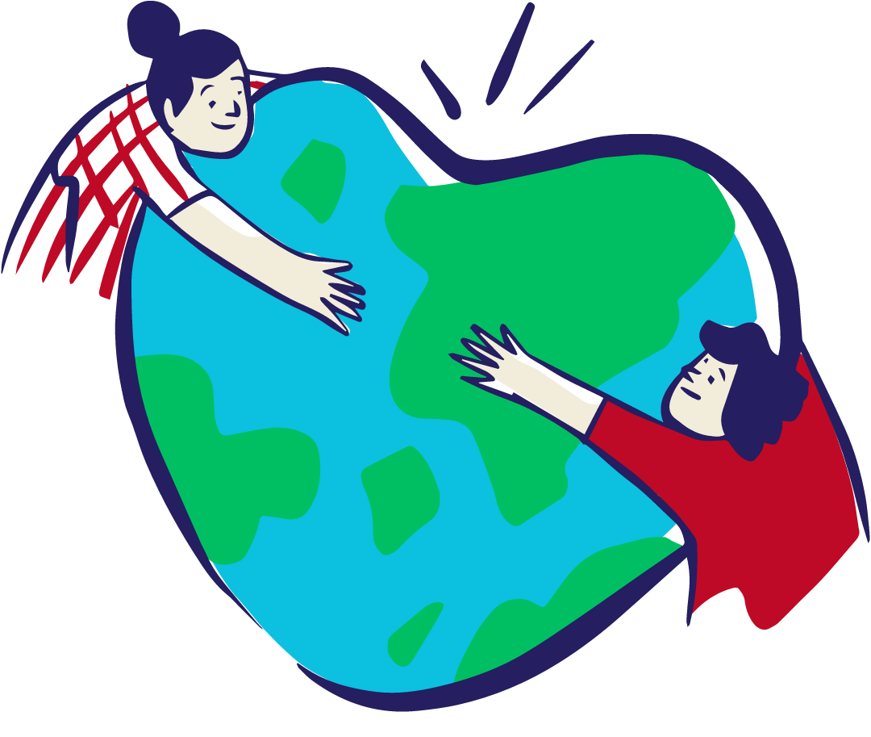
Dignity
Everybody is made and loved by God.
God gave everyone special gifts.
That means everybody is special.
Notes:
Talk partners for 3 minutes
Gather responses

Slide 10
Dignity
Think about your gifts and talents.
What makes you special?
Tell the person next to you.

Slide 11
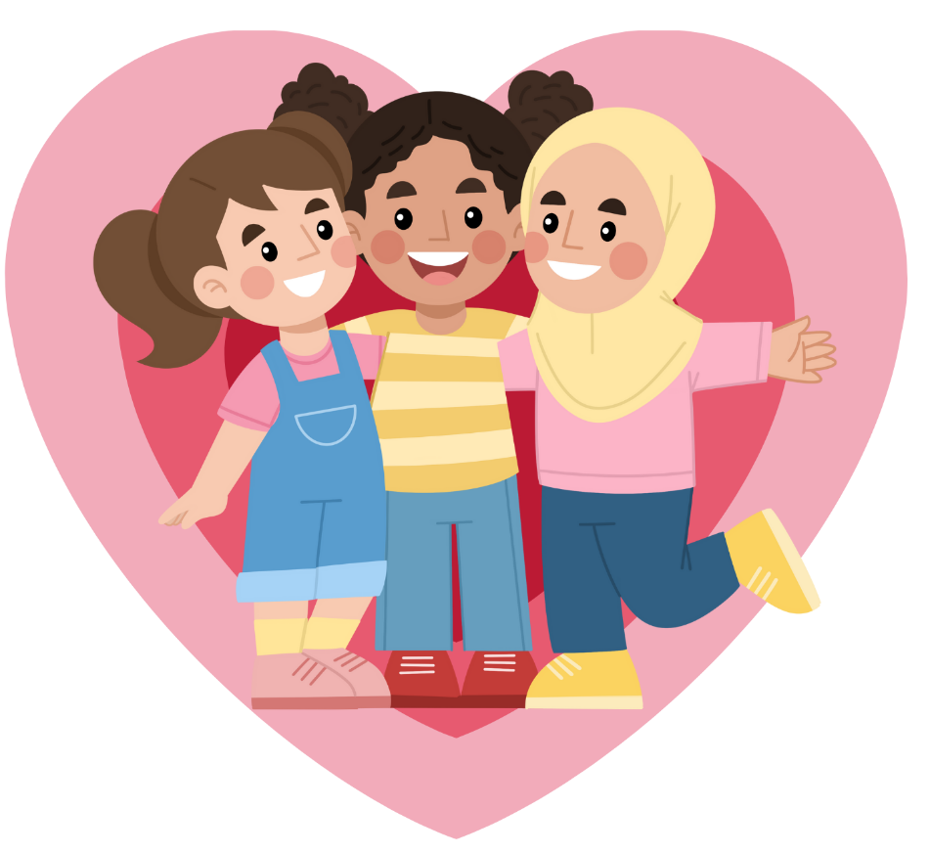
Dignity
God loves everybody because everybody is special.
How could we treat people to show they are special?

Slide 12
Main Activity
God loves you because you are special!
Write:
I am special because…
and list the things that make you special!
Then, draw a picture of you and your special gifts

Slide 13
Plenary
Sharing God’s love.
How could you show someone in your class that God loves them?
Write your idea down and draw a picture of it.

