Slide 1




Dignity
UKS2

Slide 2



Starter
Talk Partners:
Who is important?
Notes:
Talk partners for 3 minutes
Gather responses

Slide 3
Starter
Was this activity fair?
Is it right to say that some people are more important?
Notes:
Talk partners for 3 minutes
Gather responses

Slide 4



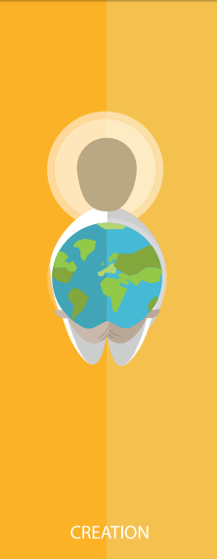



Catholic Social Teaching

Slide 5




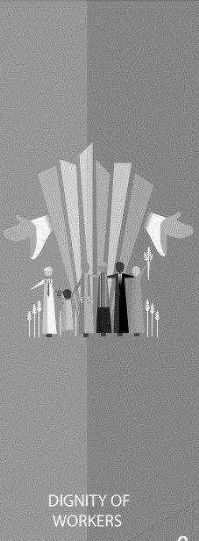

Catholic Social Teaching

Slide 6
Dignity
Treating someone with dignity means treating them with love, kindness and respect.
Everyone should be treated with dignity because we are all made in the image and likeness of God.
Notes:
Talk partners for 3 minutes
Gather responses

Slide 7
Dignity
Talk partners:
What might treating other people with dignity look like?

Slide 8

Dignity
‘So God created humankind in his own image, in the image of God he created them; male and female he created them.
…
God saw all that he had made, and it was very good.’
Genesis

Slide 9
Dignity
‘For we are God’s handiwork, created in Christ Jesus to do good works, which God prepared in advance for us to do.’
Ephesians 2:10

Slide 10
Dignity
Think about the quote on the last slide.
What do you think it means that we are ‘created to do good works’?
How might this be related to treating others with dignity?

Slide 11
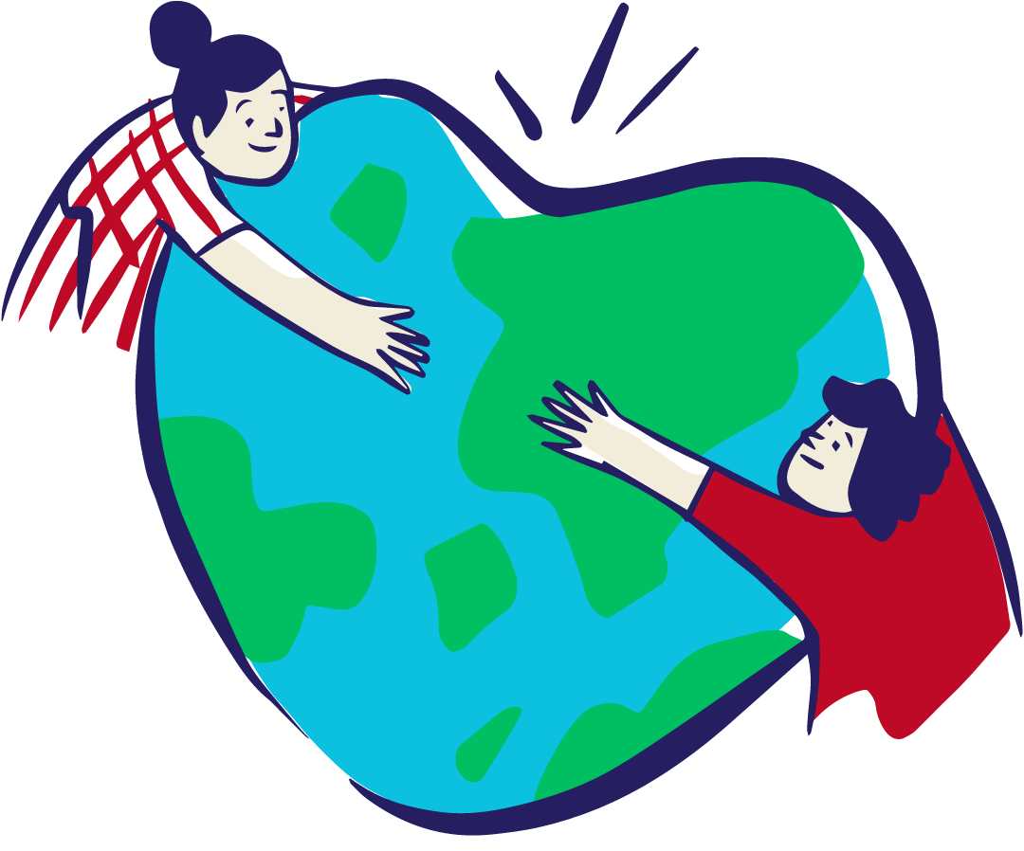
Dignity
‘Dear friends, let us love one another, for love comes from God. Everyone who loves has been born of God and knows God. Whoever does not love does not know God, because God is love.’
1 John 4:7-8
Think of the times you have respected the dignity of others.
Think of a time you have had your dignity respected.
Share with your Talk Partner and the class.

Slide 12

Main Activity
Use what we have talked about today to write an Acrostic poem about everyone’s special gifts, talents and inherent dignity.
You could use the words:
DIGNITY, SPECIAL, UNIQUE, LOVED
or any others that you can think of.

Slide 13
Plenary
‘Every person is immensely holy and deserves our love.’
Pope Francis, Joy of the Gospel
What does this quote from Pope Francis teach us about dignity?
Refer to the other bible passages we have read today in your answer.

