Slide 1
Dignity of Workers
LKS2

Slide 2
Starter
Talk Partners:
What do you think the word ‘dignity’ means?
Notes:
Talk partners for 3 minutes
Gather responses

Slide 3
Starter
Treating someone with dignity means treating them with love, kindness and fairness.
Everyone should be treated with dignity because God made and loves everyone.
Notes:
Talk partners for 3 minutes
Gather responses

Slide 4
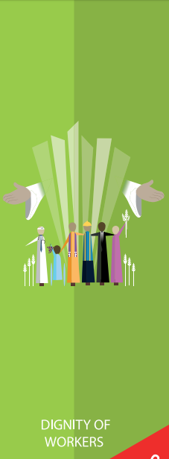
Dignity of Workers
Notes:
These are all the Catholic Teaching Principles

Slide 5
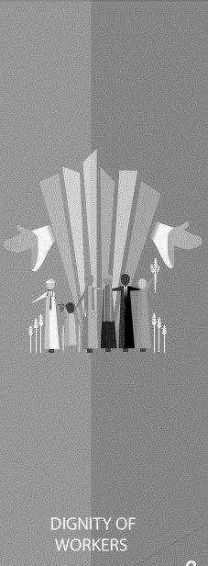
Title
Notes:
This is the CST principle we will be learning about today: Dignity of Workers

Slide 6
Dignity of Workers
Most people will have a job at some point in their lives.
A job is more than just making money. It is about being able to live happily.

Slide 7
Dignity of Workers
Dignity of Workers is about everyone finding something they are good at, and feeling important and needed.
Why is it important for everyone to feel like they are needed?

Slide 8
Dignity of Workers
‘Out of the ground, the Lord God caused to grow every tree that is pleasing to the sight and good for food . . . . Then the Lord God took the man and put him into the garden of Eden to work it and keep it’
Genesis 2:9,15

Slide 9
Dignity of Workers
‘By the seventh day God had finished the work he had been doing; so on the seventh day he rested from all his work. Then God blessed the seventh day and made it holy, because on it he rested from all the work of creating that he had done.’
Genesis 2:2-3

Slide 10
Dignity of Workers
Dignity of Workers is also about making sure that people’s dignity is respected in work.
What things do you think everyone should have in their jobs?

Slide 11
Dignity of Workers
What things do you think everyone should have in their jobs?
In order to answer this question, we’re going to learn some history!

Slide 12
Dock Workers’ Strike, 1889
Today, there are laws in place to make sure people have a safe and fair place to work but in the 1800s, this wasn’t the case.
Bosses could be cruel. They didn’t pay their workers fairly; made people work in dangerous conditions; didn’t give them a steady job; didn’t allow them time off to rest, and would fire them if they had to take time off sick.

Slide 13
Dock Workers’ Strike, 1889
In 1889, 100,000 London Dock workers went on strike because of this.
They wanted a fair wage of 6 pence an hour and proper working contracts so people knew when they would be working and how much they would earn.
Notes:
Why did the dock workers feel it was necessary for them to go on strike?

Slide 14
Dock Workers’ Strike, 1889
Cardinal Manning, the Archbishop of Westminster at the time, decided to support the dock workers and spoke up for them.
The Dockers won their strike and were allowed to protect their working conditions.
This led to the Pope writing a letter defending workers’ rights. His letter told governments to protect the rights of workers and told the Catholic Church to support the workers and respect their dignity.

Slide 15
Think Again
What things do you think give people dignity in their work?
Think about what the Dock Workers fought for.
Notes:
Gather responses before next slide

Slide 16
Dignity of Workers
Which of these contribute to the dignity of workers:
Fair wage
Free pizza
Time off to rest
Time off to recover from illness
Breaks during the work day
No toilet breaks
Limit on the time you’re expected to work
Knowing when you’re working
Insulted by your employer
Not being fired without a good reason
Notes:
Add any others that the students thought of

Slide 17
Dignity of Workers
Not everyone in the world has their dignity respected at work.
Not everyone gets the things that we just talked about.
What could we do to support them?
Notes:
Add any others that the students thought of

Slide 18
Dignity of Workers
Around the world, farmers and farm workers are not paid a fair wage for the work they put in.
The Fairtrade Foundation works to combat this.
Notes:
Although most people in the UK have fair working conditions, there are a lot of people around the world who do not.
This is especially true for farmers and farm workers in Developing Countries who very rarely get a fair wage for the hard work they put in.
Most of the money from certain products (such as bananas and cocoa) goes to the supermarket owners rather than the people who grew and harvested the products
The Fairtrade Foundation was set up in 1992 to promote Fairtrade products in the UK

Slide 19
Dignity of Workers
Fairtrade Facts:
Fairtrade Mark is recognised by over 80% of the UK population.
The first ever Fairtrade banana was sold in 2000, with one in three supermarket bananas now carrying the Mark.
Garstang was the first town in the world to achieve Fairtrade status. Over 600 communities across the UK have since followed suit.
The Fairtrade Foundation licenses the Fairtrade Mark to over 6,000 types of products in the UK; including coffee, tea, fruit, flowers, juice, wine, sugar, herbs, spices and so many more.
If you see the Fairtrade Mark with an arrow next to it, it means to look on the back of the packaging to learn more about the ingredients and sourcing method.
Notes:
Although most people in the UK have fair working conditions, there are a lot of people around the world who do not.
This is especially true for farmers and farm workers in Developing Countries who very rarely get a fair wage for the hard work they put in.
Most of the money from certain products (such as bananas and cocoa) goes to the supermarket owners rather than the people who grew and harvested the products
The Fairtrade Foundation was set up in 1992 to promote Fairtrade products in the UK

Slide 20
Dignity of Workers
Notes:
Although most people in the UK have fair working conditions, there are a lot of people around the world who do not.
This is especially true for farmers and farm workers in Developing Countries who very rarely get a fair wage for the hard work they put in.
Most of the money from certain products (such as bananas and cocoa) goes to the supermarket owners rather than the people who grew and harvested the products
The Fairtrade Foundation was set up in 1992 to promote Fairtrade products in the UK

Slide 21
Dignity of Workers
Notes:
Although most people in the UK have fair working conditions, there are a lot of people around the world who do not.
This is especially true for farmers and farm workers in Developing Countries who very rarely get a fair wage for the hard work they put in.
Most of the money from certain products (such as bananas and cocoa) goes to the supermarket owners rather than the people who grew and harvested the products
The Fairtrade Foundation was set up in 1992 to promote Fairtrade products in the UK

Slide 22
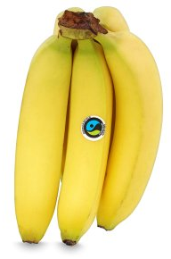
Dignity of Workers
Fairtrade products are often slightly more expensive than regular products.
This money goes to the people who grew or made the products so they get a fair amount of money.
How would everyone committing to buying Fairtrade products help towards The Common Good?

Slide 23
Main Activity
Use what you’ve learnt today to answer the questions.
What does the word ‘dignity’ mean?
What things give people dignity in their work?
How does buying Fairtrade products help give people dignity in their work?

Slide 24
Plenary
‘God blessed the seventh day and made it holy, because on it he rested from all the work of creating that he had done.’
Genesis 2:3 Why is it important that people who work be allowed to rest from their jobs?

