Slide 1
Dignity of Workers
Collective Acts of Worship

Slide 2
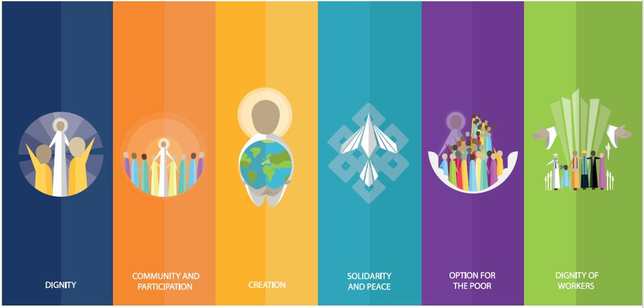
Starter

Slide 3
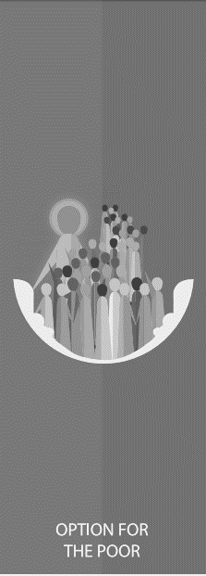
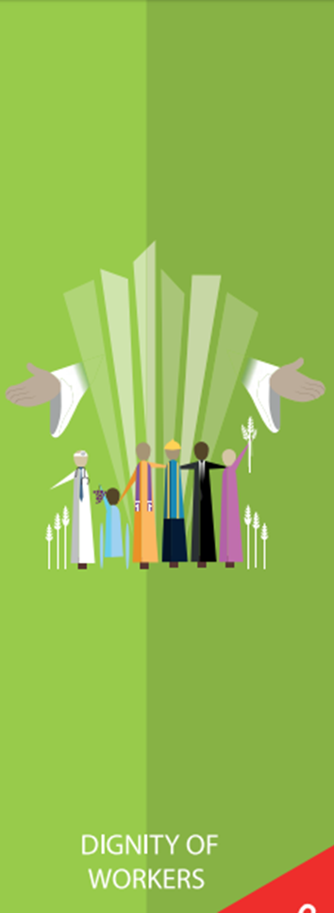
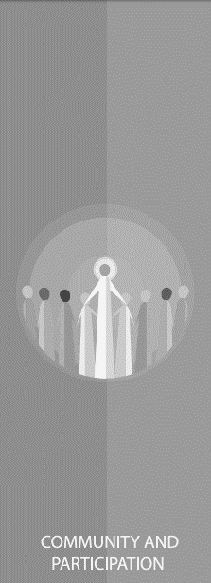
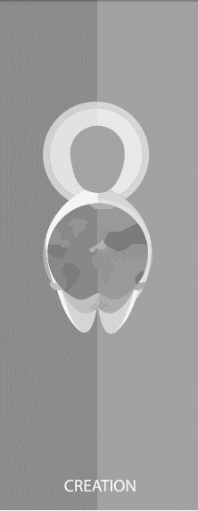
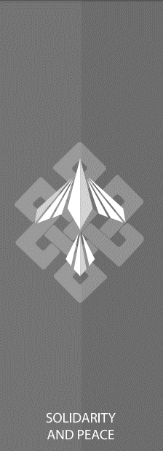
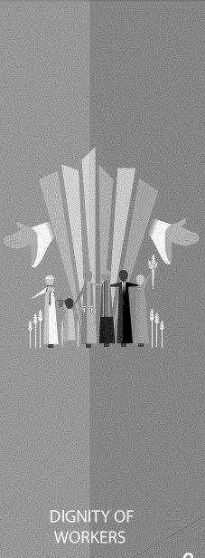

Slide 4
Dignity of Workers
‘Work is fundamental to the dignity of a person. Work anoints us with dignity, fills us with dignity, makes us similar to God, who has worked and still works, who always acts...’
Pope Francis
Feast of St Joseph the Worker, May 2013

Slide 5
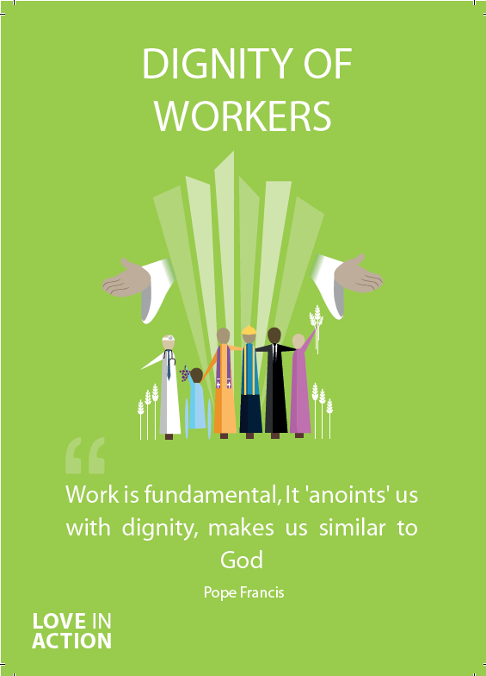
Dignity of Workers
What does the word ‘dignity’ mean?
So what do we mean by ‘dignity of workers’?

Slide 6
Dignity of Workers
Let us now listen to the Word of God.

Slide 7
Dignity of Workers
Read through one of more of the bible passages on the next few slides.
As a class, think about and discuss the meaning of each.​
How do the passages relate to Dignity of Workers?

Slide 8
Dignity of Workers
‘Thus the heavens and the earth were finished, and all the host of them. And on the seventh day God finished his work that he had done, and he rested on the seventh day from all his work that he had done. So God blessed the seventh day and made it holy, because on it God rested from all his work that he had done in creation.’
Genesis 2: 1-3

Slide 9
Dignity of Workers
‘Work is a good thing for a person - a good thing for their humanity - because through work a person not only transforms nature, adapting it to their own needs, but also achieves fulfilment as a human being and indeed, in a sense, becomes “more a human being.”’
St. John Paul II

Slide 10
Dignity of Workers
‘The Lord blesses our work so that we may share its fruits with others.’
Deuteronomy 14:28-29

Slide 11
Dignity of Workers
What does this tell you about how workers should be treated?
Are all workers treated fairly?
What could be done to help those workers who are not treated fairly?

Slide 12
Dignity of Workers
“I think that…”
Notes:
Holding slide for discussion/feedback if required.

Slide 13
Dignity of Workers
Let Us Pray…

Slide 14
Dignity of Workers
Loving God, we come together to
thank you for the grace of work.
You create each one of us with particular talents and gifts, and you call us to use them in the service of love and justice. Through work, we transform both the world and ourselves.
Let us give thanks for the gift of work and pray for the dignity of all workers throughout the world.

Slide 15
Dignity of Workers
We pray for those who do not earn enough money to care for their family’s needs.
O God, help us to create a more just world.

Slide 16
Dignity of Workers
We pray for those who work in dangerous
conditions without protection.
O God, help us to create a more just world.

Slide 17
Dignity of Workers
We pray for those who face discrimination,
harassment or abuse in the work place.
O God, help us to create a more just world.

Slide 18
Dignity of Workers
We pray for those children who must leave
school early in order to support their family.
O God, help us to create a more just world.

Slide 19
Dignity of Workers
We pray for all owners and managers, that they
might recognise the dignity of all workers.
O God, help us to create a more just world.

Slide 20
Dignity of Workers
Dear God,
we thank you for work.
Through our prayers, we dedicate our hearts and lives to a vision of life with dignity for all workers.

Slide 21
Dignity of Workers
Amen

Slide 22
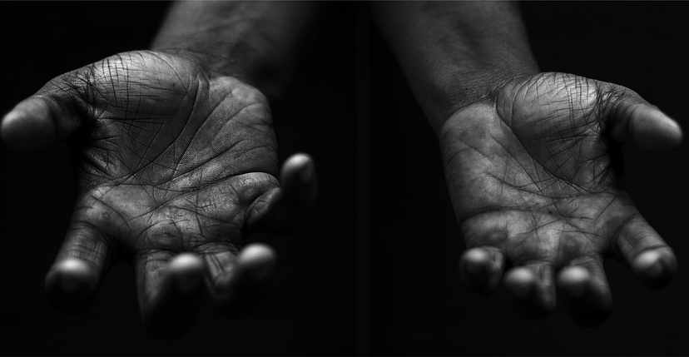
Dignity of Workers
Your Mission
Notes:
Using the Prayer Toolkit model, the mission ‘tasks’ on the following slide can be amended or supplemented as required.

Slide 23
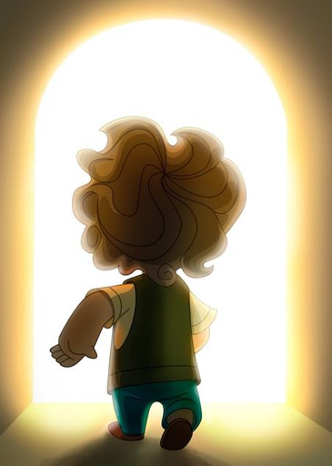
Dignity of Workers
Find out more about the feast of St. Joseph the Worker.
Write your own prayer for the dignity of workers.
Research:
International Workers Day (1st May)

Slide 24
Care of Creation

