Slide 1
Dignity
Collective Acts of Worship

Slide 2
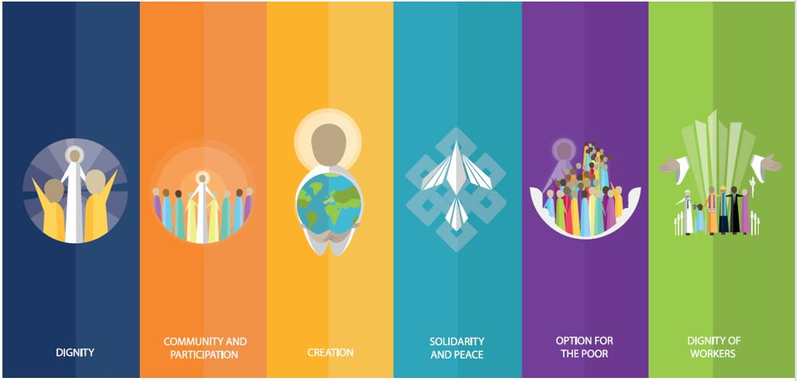
Starter

Slide 3
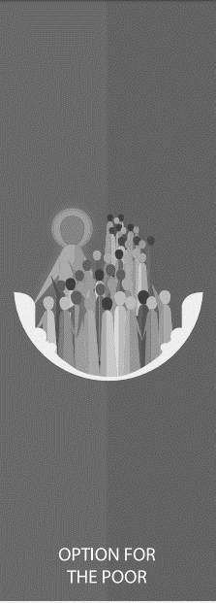
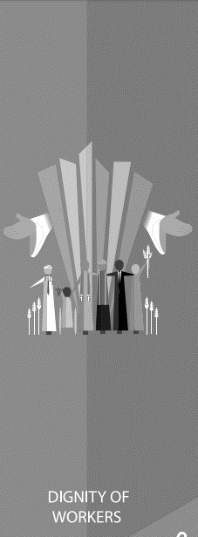
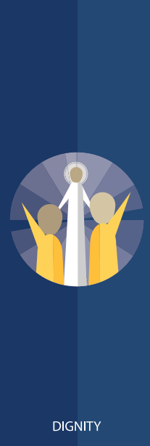

Slide 4
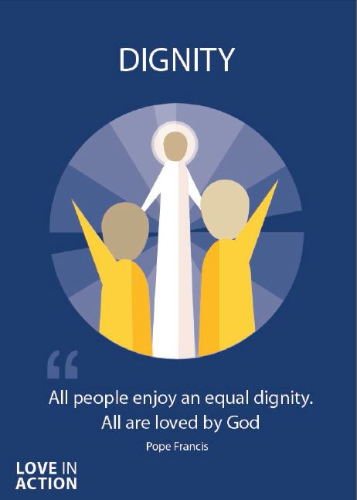
Dignity
Treating someone with dignity means treating them with love, kindness and respect.
Everyone should be treated with dignity because we are all made in the image and likeness of God.​

Slide 5
Dignity
‘Every person is immensely holy and deserves our love.’
Pope Francis
Joy of the Gospel
​

Slide 6
Dignity
Treating someone with dignity means treating them with love, kindness and respect.
Everyone should be treated with dignity because we are made in the image and likeness of God.​

Slide 7
Dignity
Think of a time when you felt loved and respected by someone.
What did they do that made you feel that way?
How could you make other people feel a similar way?

Slide 8
Dignity
Let us now listen to the Word of God.

Slide 9
Dignity
Read through one of more of the bible passages on the next few slides.
As a class, think about and discuss the meaning of each.​
How do the passages relate to Human Dignity?

Slide 10
Dignity
‘So God created humankind in his own image, in the image of God he created them; male and female he created them.
…
God saw all that he had made, and it was very good.’
Genesis
​

Slide 11
Dignity
‘”You shall love your neighbour as yourself.” There is no commandment greater than this.’
Mark 12:31
​

Slide 12
Dignity
‘For God so loved the world, that he gave his only Son, that whoever believes in him should not perish but have eternal life. For God did not send his Son into the world to condemn the world, but in order that the world might be saved through him.’
John 3:16-17

Slide 13
Dignity
What do these bible passages tell you about how we should treat people? How do we know that God wants us to act in this way?

Slide 14
Dignity
“I think that…”
Notes:
Holding slide for discussion/feedback if required.

Slide 15
Dignity
Let Us Pray…

Slide 16
Dignity
Loving God,
We come together to thank you for each other. You created each of us in Your image and likeness. Through Your Son, You taught us how to show everyone the love, respect and kindness they deserve.
Let us give thanks for the joy that those around us bring to our world.

Slide 17
Dignity
We pray for those whose dignity is not respected.
O God, help us to show love to those who feel unloved.

Slide 18
Dignity
We pray for those who do not believe in the dignity of everyone on Earth.
O God, help us to create a more just world.

Slide 19
Dignity
We pray for those who face discrimination,
harassment or abuse.
O God, help us to spread Your love.

Slide 20
Dignity
We pray that we may be able to show Your love to everyone we meet.
O God, help us to spread Your love.

Slide 21
Dignity
Amen

Slide 22
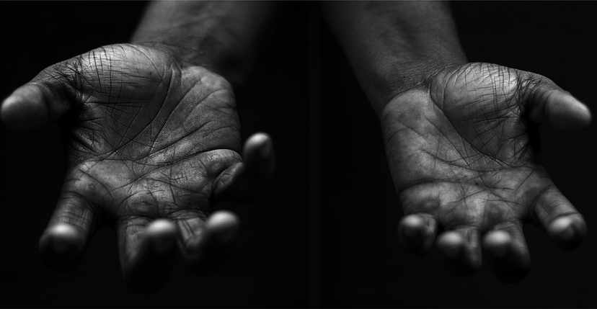
Dignity
Your Mission
Notes:
Using the Prayer Toolkit model, the mission ‘tasks’ on the following slide can be amended or supplemented as required.

Slide 23
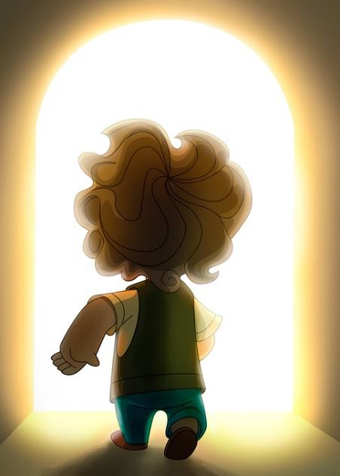
Dignity
Find out more about St Francis of Assisi and his prayer for peace.
Research:
World Refugee Day (20th June)
World Day for Grandparents and the Elderly (late July)
Notes:
The Catholic Church celebrates the World Day for Grandparents and the Elderly each year on the Sunday closest to the feast of Saints Joachim and Anne, Jesus' grandparents. In 2024 this is 28th July.

Slide 24
Care of Creation

