Slide 1




Solidarity and Peace
KS1

Slide 2


Starter
Talk Partners:
What does ‘peace’ mean?
Notes:
Talk partners for 3 minutes
Gather responses

Slide 3

Starter
What would your class look like if it was peaceful?
Notes:
Talk partners for 3 minutes
Gather responses

Slide 4



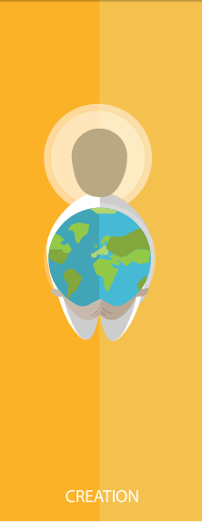

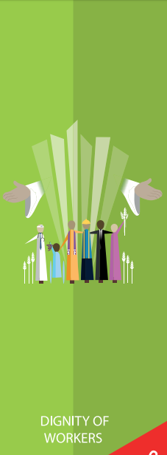

Catholic Social Teaching

Slide 5




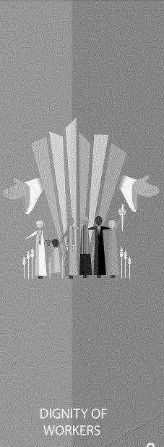

Catholic Social Teaching

Slide 6
Solidarity and Peace
To be at peace means to be calm and happy.
Can you remember a time when you felt peaceful?

Slide 7

Solidarity and Peace
‘Live in harmony with one another. Help those in need.’
Romans 12:16

Slide 8
Solidarity and Peace
‘Blessed are the peacemakers, for they will be called sons and daughters of God.’
Matthew 5:9
Who do you think ‘the peacemakers’ are?

Slide 9
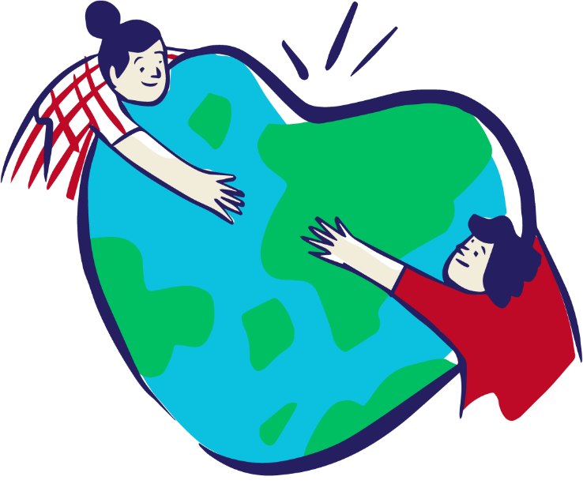
Solidarity and Peace
Peacemakers are people who are trying to make the world more peaceful.
They help people in need and help people to stop arguing.

Slide 10
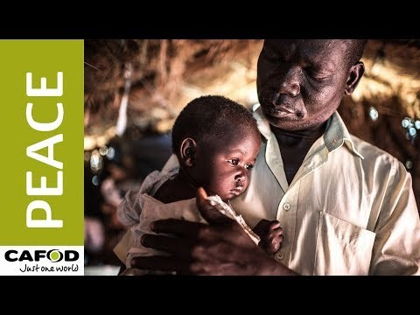
Solidarity and Peace

Slide 11

Solidarity and Peace
How could you be a Peacemaker in your class?

Slide 12

Main Activity
Write your Peacemaker Pledge on your dove.
Think about how you could make your class, school or home a kinder, calmer place.
As a Peacemaker, I will…

Slide 13
Plenary
‘Peace I leave with you; my peace I give you.’
John 14:27
This is said during the Mass.
What happens after this is said?
Why does Jesus want us to live in peace?

