Slide 1




Solidarity and Peace
LKS2

Slide 2


Starter
Talk Partners:
What do you think of when you hear the word ‘peace’?
Notes:
Talk partners for 3 minutes
Gather responses

Slide 3

Starter
Peace is more than just ‘no war’.
Peace can mean a lot of things.
Think of a time you felt at peace.
Notes:
Talk partners for 3 minutes
Gather responses

Slide 4







Catholic Social Teaching

Slide 5




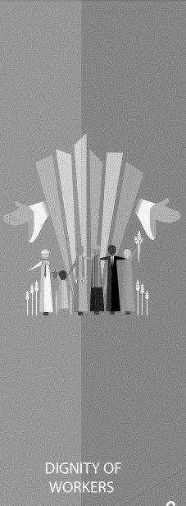

Catholic Social Teaching

Slide 6
Solidarity and Peace
There are many ways to define peace.
Freedom from disturbance – freedom to live your life as you wish
Free from anxiety or distress – being happy and calm
Make peace – forgiving others when they have done things wrong
At peace with the world – to live in a state of harmony with others all around us

Slide 7

Solidarity and Peace
‘Blessed are the peacemakers, for they will be called sons and daughters of God.’
Matthew 5:9
Who do you think ‘the peacemakers’ are?

Slide 8
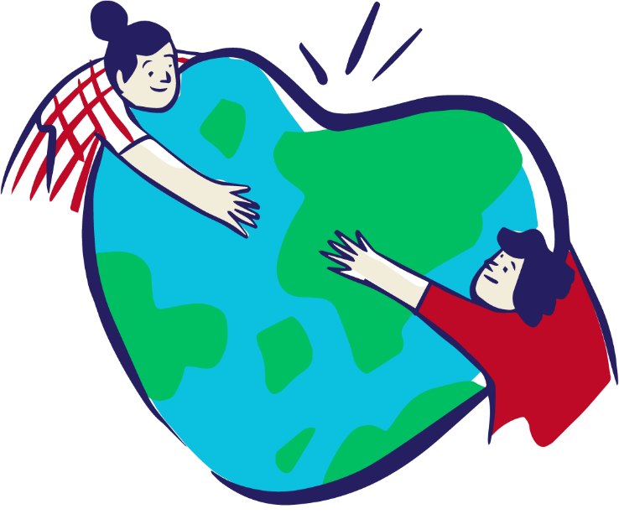
Solidarity and Peace
Peacemakers are people who dedicate their lives and work to making the world more peaceful.
They help reconcile people with God and with one another.

Slide 9
Solidarity and Peace
What do you think ‘solidarity’ means?

Slide 10
Solidarity and Peace
Solidarity means to stand up for each other.
If we stand up for and speak out on behalf of those in need in our world, we can make the world a fairer and more peaceful place.

Slide 11
Solidarity and Peace
‘[Solidarity] is not a feeling of vague compassion or shallow distress at the misfortunes of others.
It is a firm and persevering determination to commit oneself to…the good of all…because we are all really responsible for all.’
St John Paul II, Sollicitudo Rei Socialis

Slide 12
Solidarity and Peace
‘Live in harmony with one another. Do not be proud, but associate with those in need.’
Romans 12:16

Slide 13
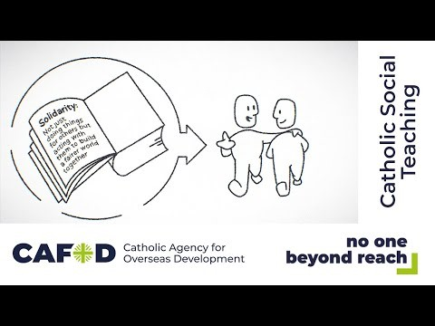
Solidarity and Peace

Slide 14
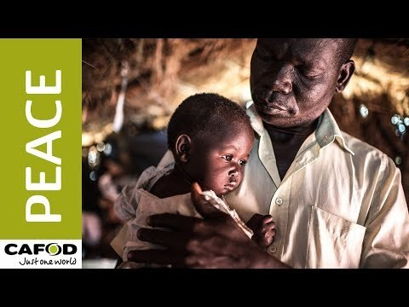
Solidarity and Peace

Slide 15

Main Activity
Design a poster promoting solidarity and peace to be hung up in your school.
Think about including:
What ‘solidarity’ means
What the bible tells us about living in solidarity with each other
Ideas for how your school could be more peaceful

Slide 16
Plenary
‘Peace I leave with you; my peace I give you. I do not give to you as the world gives. Do not let your hearts be troubled and do not be afraid.’
John 14:27
Explain what you think is meant by this.

