Slide 1
Care of Creation
Year 5

Slide 2
MUSIC of the SPHERES
(World tour)
COLDPLAY
Notes:
What do you see? Hear? Notice? (Encourage the children to see the spectacle of the show)

Slide 3
Catholic Social Teaching

Slide 4
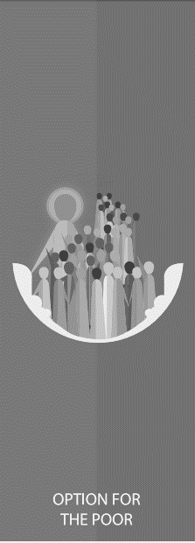
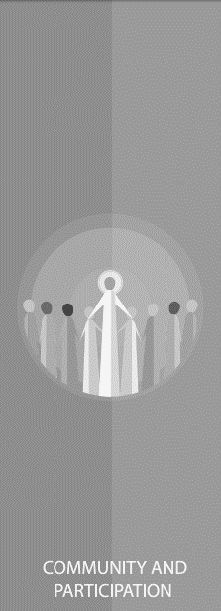
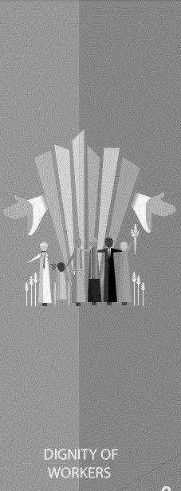
Catholic Social Teaching

Slide 5
Care of Creation
We are created by God with dignity and we live in a community together.
God did not just create us but the whole of the world, and we must live in harmony with the whole of his creation.

Slide 6
Paired Task
What are Coldplay committing to?
https://sustainability.coldplay.com/
Sustainable Solutions
Environmental Issues
Notes:
Children to use mini whiteboards to make a note of what the band are committing to. Then they populate the other column with the issues that this solution is trying to combat e.g. electric vehicles > air pollution

Slide 7
Care of Creation
‘In the beginning, God created the Heavens and the Earth… God saw everything that He had made, and indeed, it was very good.’
Genesis 1:1-4
‘The Lord God put humans in the Garden of Eden to work it and take care of it.’
Genesis 2:15

Slide 8
Care of Creation
‘Creation is a gift, it is a wonderful gift that God has given us, so that we care for it and we use it for the benefit of all.’
Pope Francis, Laudato Si’

Slide 9
Care of Creation
‘All is not lost. Human beings… are also capable of rising above themselves, choosing again what is good, and making a new start.’
Pope Francis, Laudato Si’
What do you think Pope Francis means by humans ‘rising above themselves’?

Slide 10
Care of Creation
‘All is not lost. Human beings… are also capable of rising above themselves, choosing again what is good, and making a new start.’
Pope Francis, Laudato Si’
Are the people working on this tour ‘rising above themselves’?

Slide 11
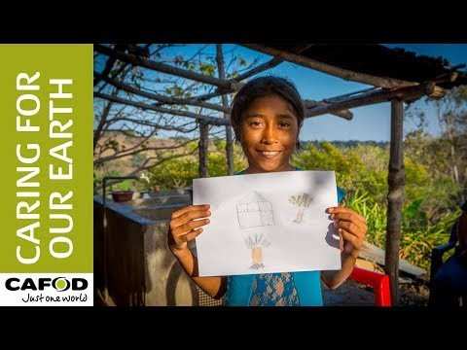
Care of Creation

Slide 12
Care of Creation

Slide 13
Main Activity
Write a speech to your favourite artist/band encouraging them to make their next tour as sustainable as possible.
Include:
What stewardship means
Scripture references to show where the idea of stewardship comes from
References to ‘Laudato Si’ to bring stewardship into a modern day context

