Slide 1
Care of Creation
EYFS

Slide 2
Starter

Slide 3
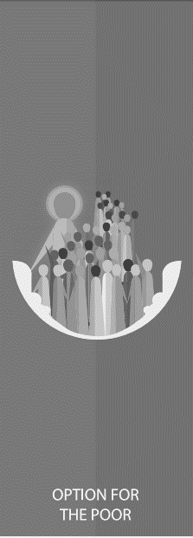
Catholic Social Teaching
Starter

Slide 4
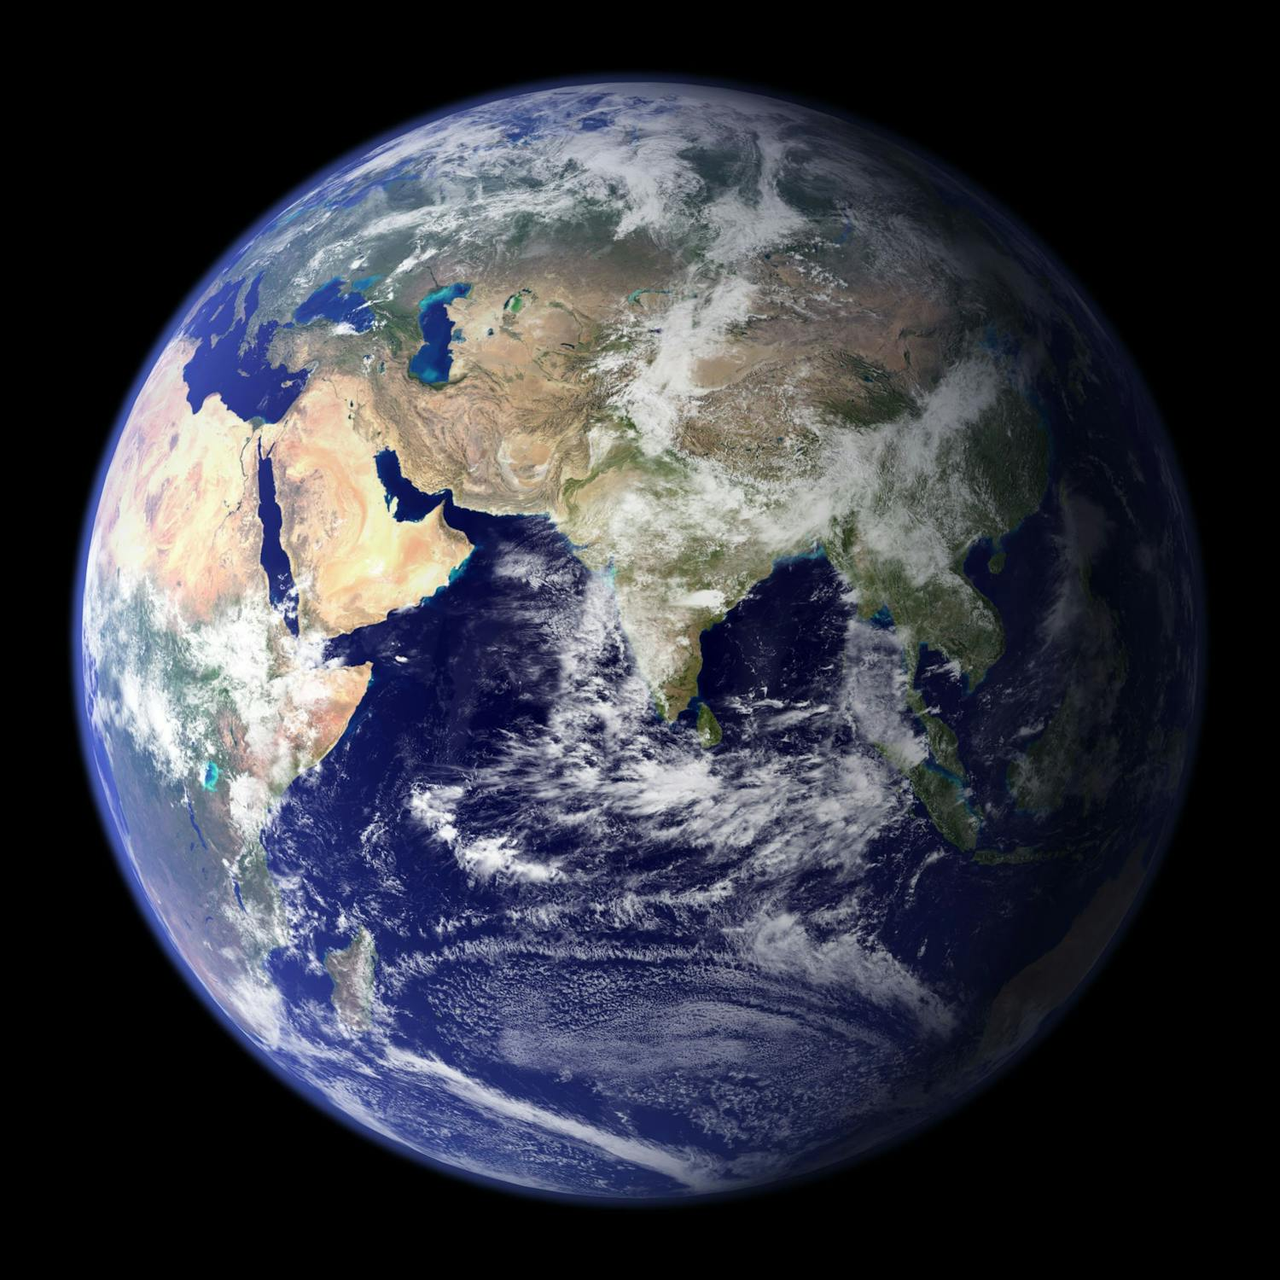
Care of Creation
Notes:
Assess children’s understanding of earth; what it is and who created it. Explain that because God created it, we have to look after it. How do children think we could/do look after the world?

Slide 5
Genesis 1
Creation
http://www.youtube.com/watch?v=teu7BCZTgDs
Notes:
Share this clip of creation story. Remind children that God created the world and so we have to look it. How might we look after the world? Get some ideas from children.

Slide 6
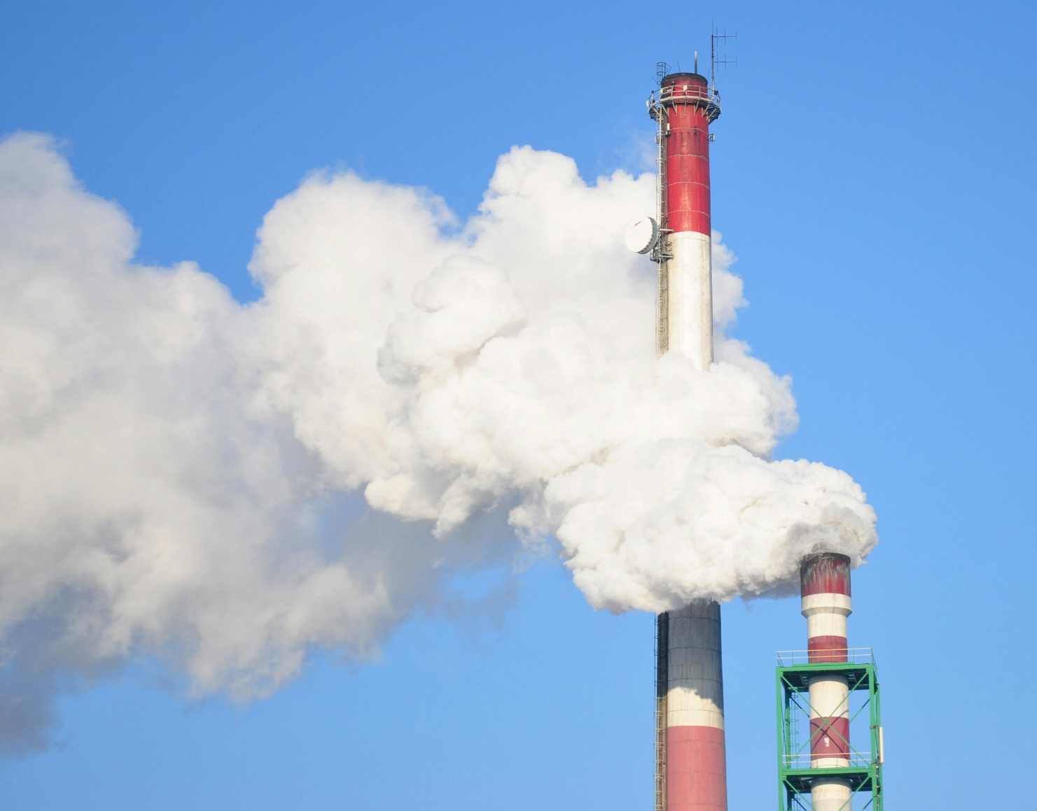
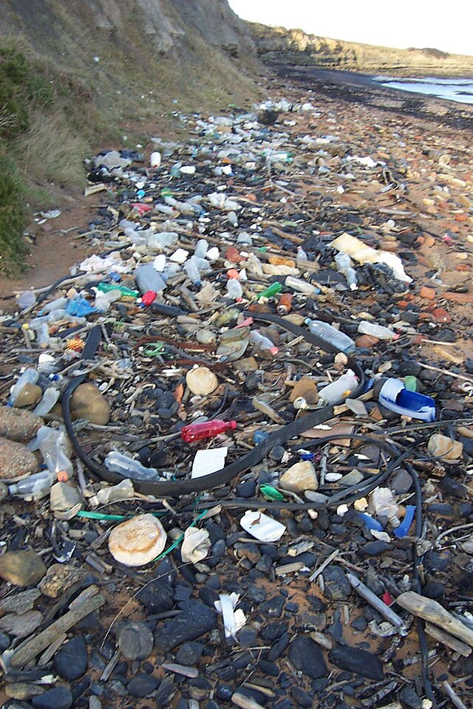
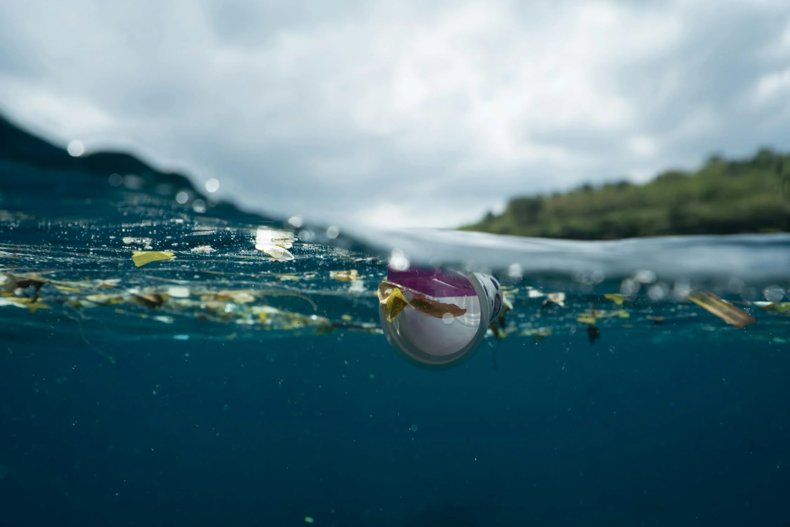
Care of Creation
​
Notes:
Explain that humans don’t always look after the world as they should. Explain what’s happening in each image or ask the children to say what they think is happening.

Slide 7
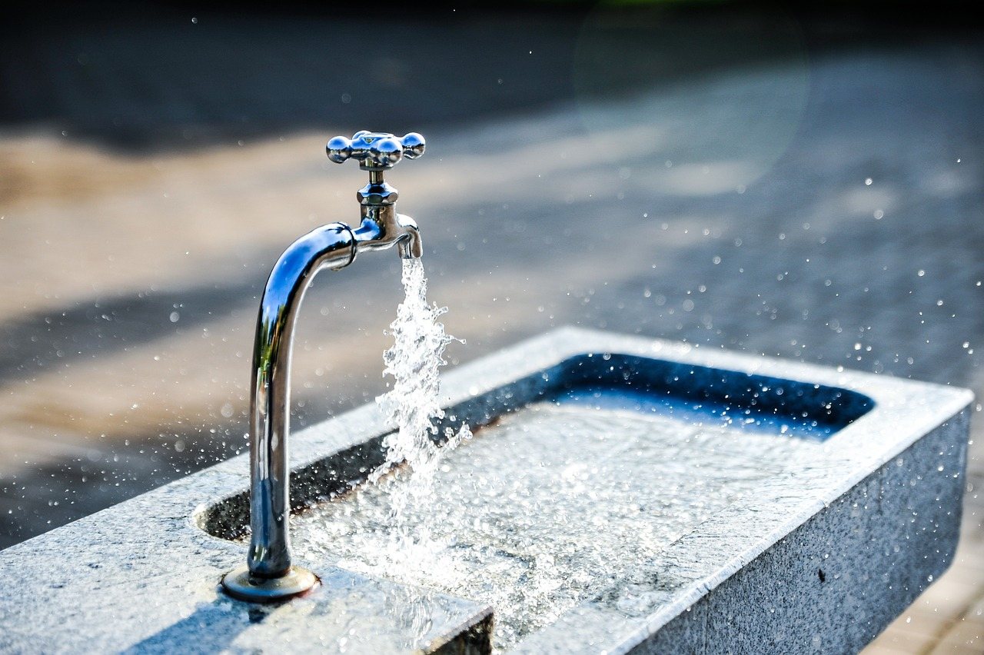
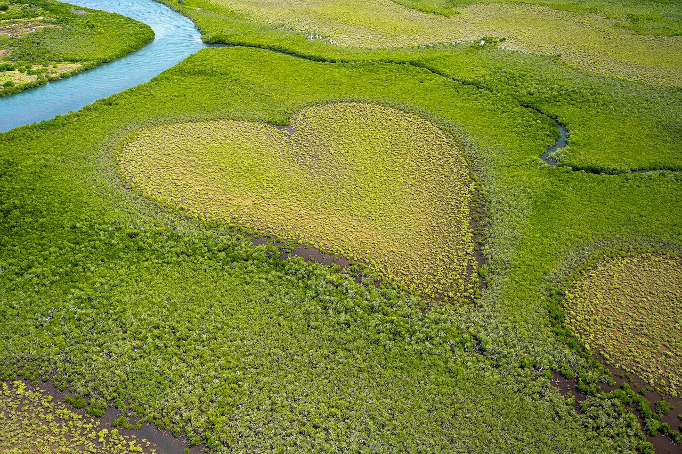
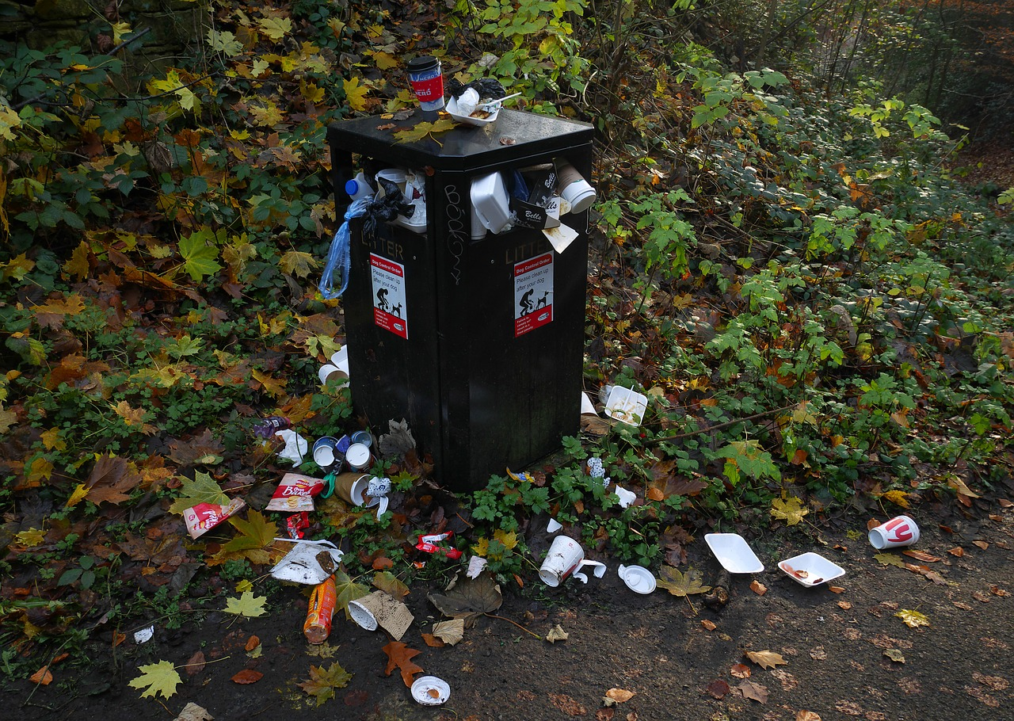
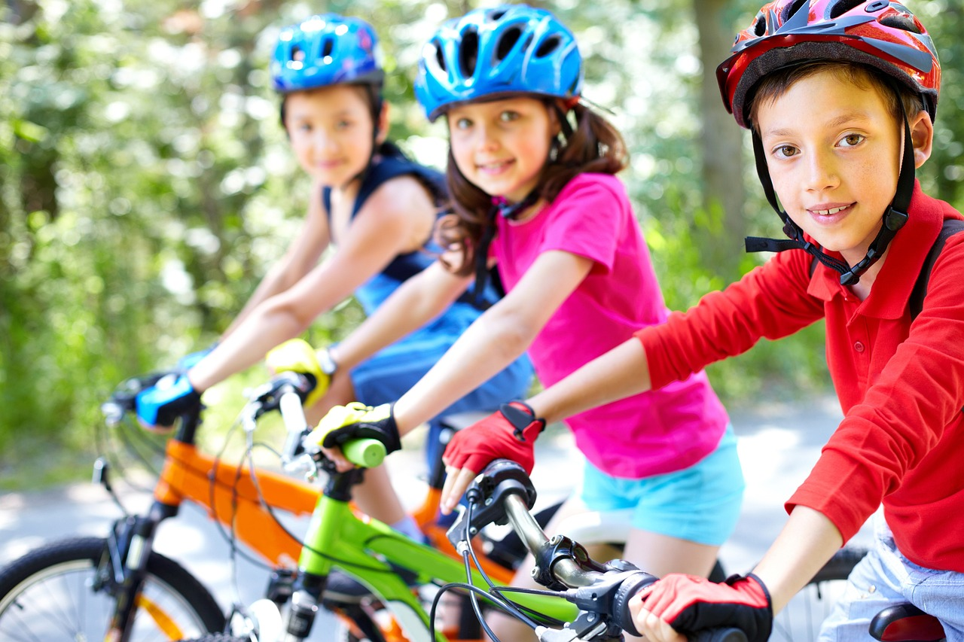
Care of Creation
Notes:
Explain that we, as Christians need to make sure we’ll always doing our bit to protect the earth. Start giving examples of what children can do e.g. turn off lights, taps, recycle, don’t litter, walk to school etc. Can children think of any on their own?

Slide 8
Care of Creation
Let Us Pray…

Slide 9
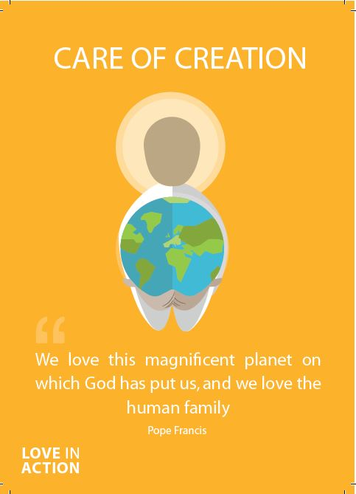
Care of Creation
Loving Father we praise you:
For the beautiful sun,
For the rain which makes things grow,
For the bush and the paddocks,
For the sea and the sky,
For the flowers and the birds,
And for your gifts to us.
Everything around us sings with joy.
With all you made we sing for joy too!

Slide 10
Care of Creation
Amen

Slide 11
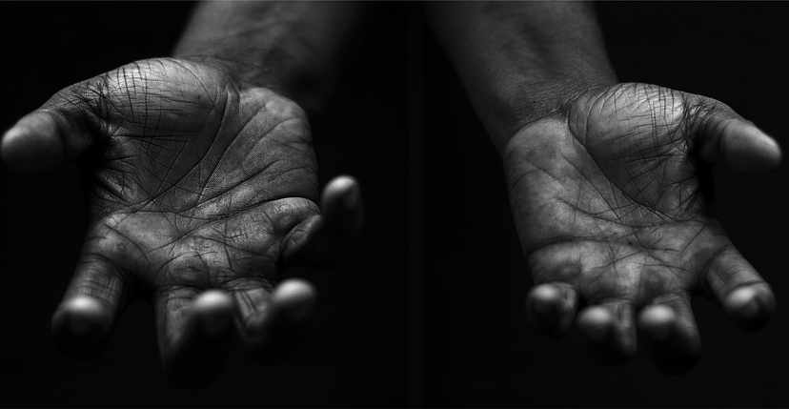
Care of Creation
Your Mission
Notes:
Using the Prayer Toolkit model, the mission ‘tasks’ on the following slide can be amended or supplemented as required.

Slide 12
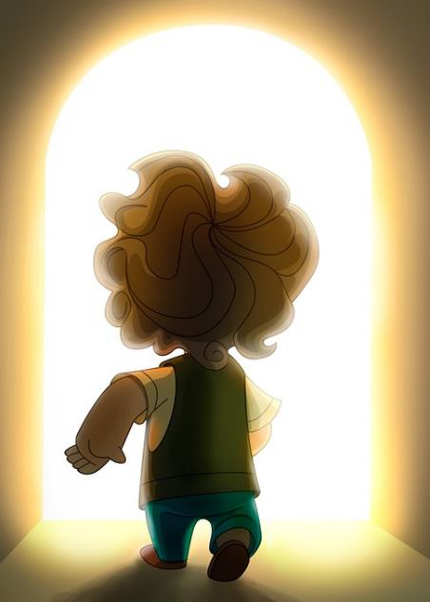
Care of Creation
What can your school do for the Harvest Festival?
Research:
World Day of Prayer for the Care of Creation (1st September)
Season of Creation (1st Sept – 4th Oct)
COP29 (begins 11th November 2024)

Slide 13
Care of Creation

