Slide 1
Care of Creation
EYFS

Slide 2
Catholic Social Teaching

Slide 3
Catholic Social Teaching

Slide 4
Genesis 26
Then God said, “Let us make human beings in our image and likeness. And let them rule over the fish in the sea and the birds in the sky. Let them rule over the tame animals, over all the earth and over all the small crawling animals on the earth.”
Notes:
Talk partners for 3 minutes
Gather responses

Slide 5
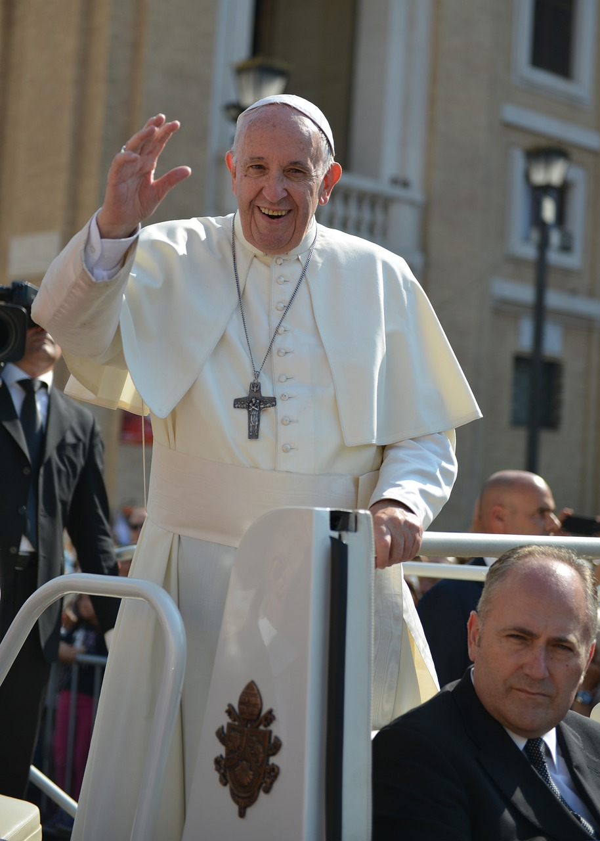
Pope Francis
‘Creation is a gift, it is a wonderful gift that God has given us, so that we care for it and we use it for the benefit of all.’
Pope Francis, Laudato Si’
Notes:
Talk partners for 3 minutes
Gather responses
Image: Pixabay

Slide 6
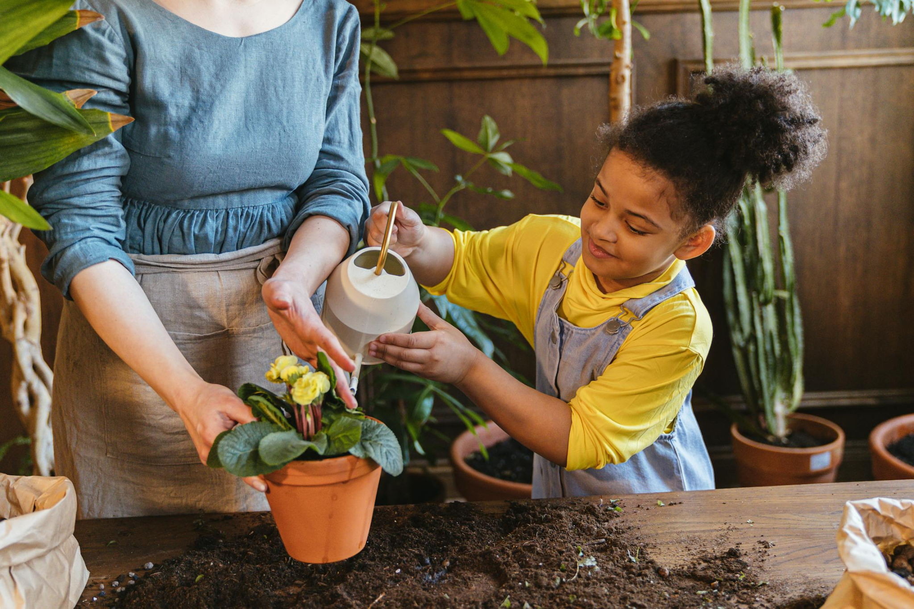
Care for Creation
Growing plants
Notes:
Talk partners for 3 minutes
Gather responses

Slide 7
Care for Creation
Recycling
Notes:
Talk partners for 3 minutes
Gather responses
Image: Pexels

Slide 8
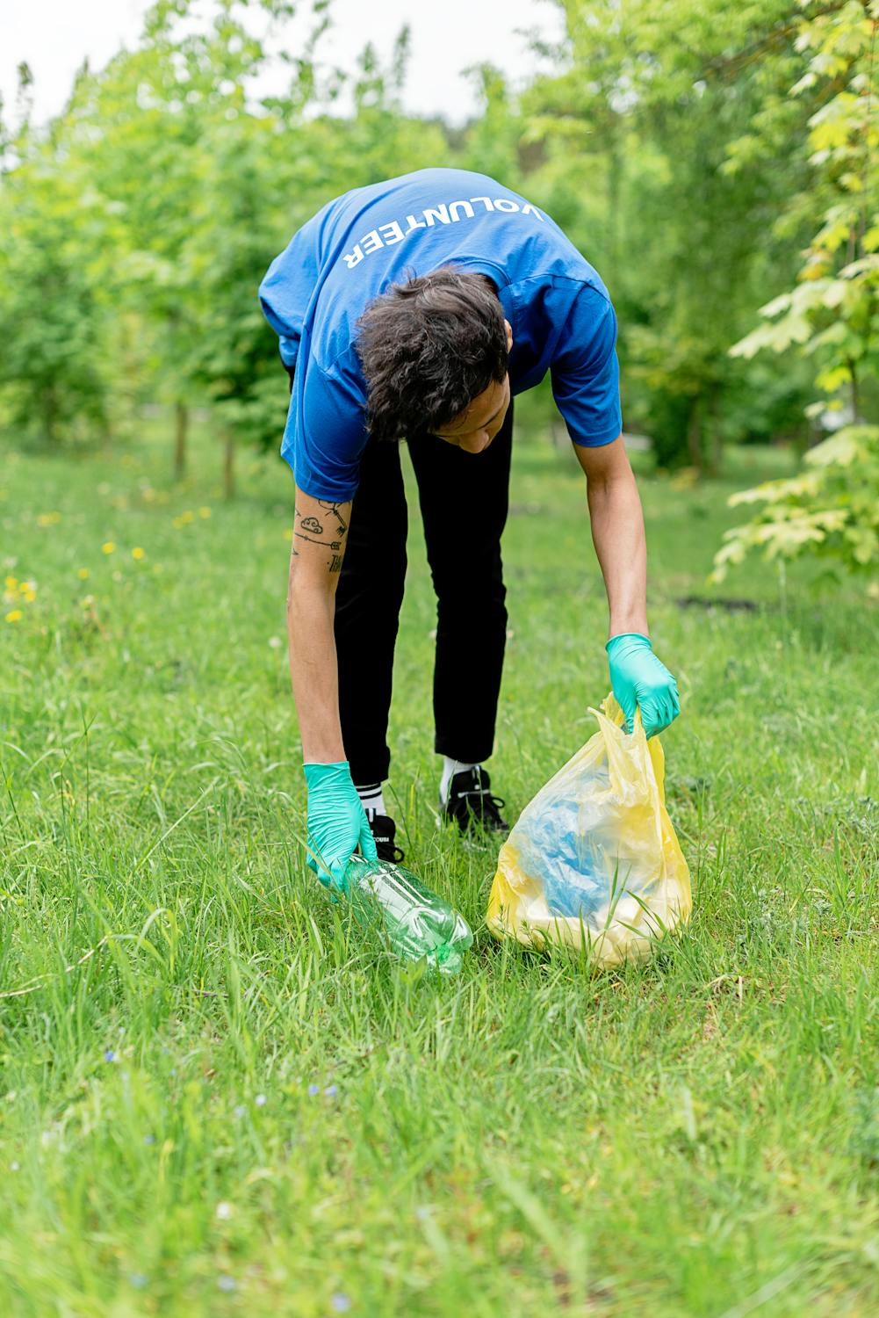
Care for Creation
Litter picking
Notes:
Talk partners for 3 minutes
Gather responses
Image: Pexels

Slide 9
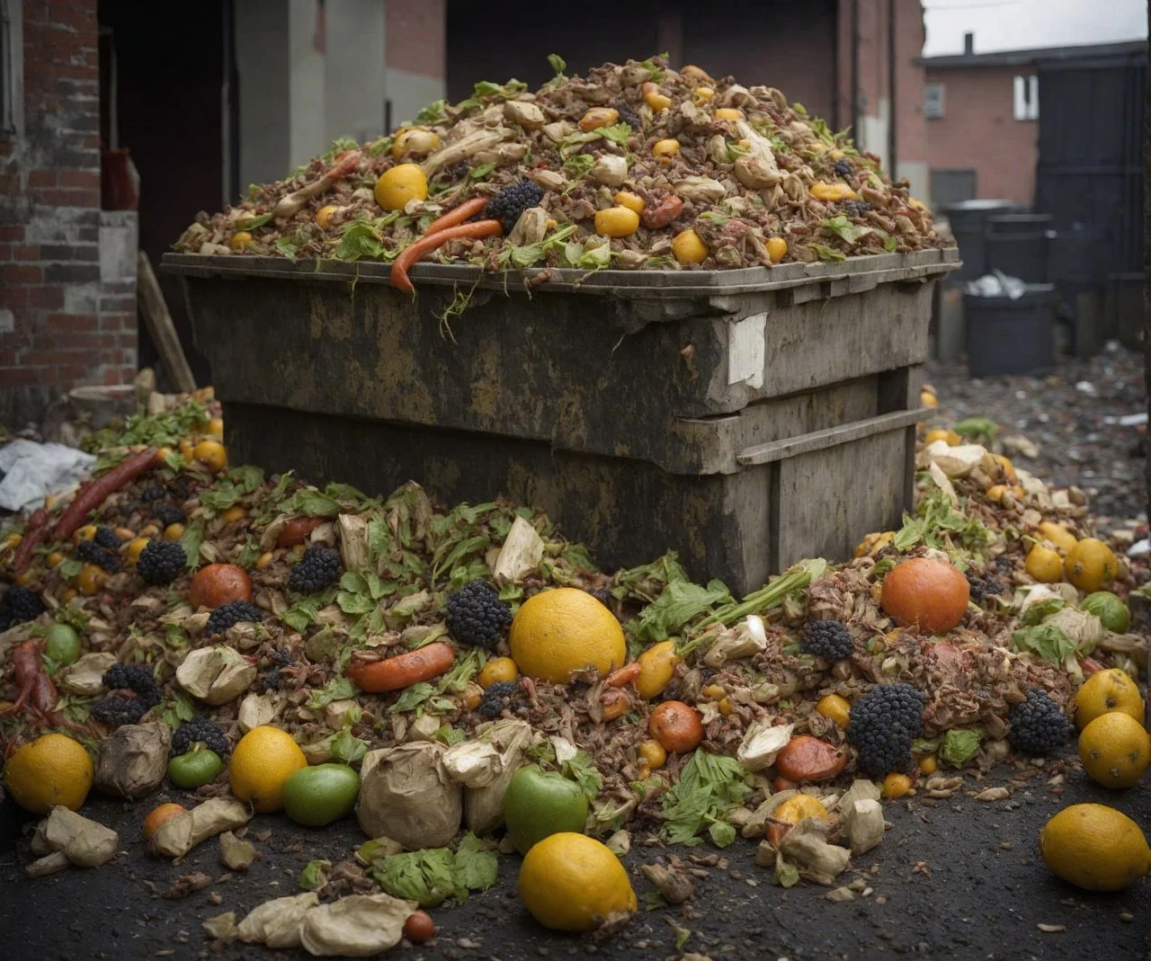
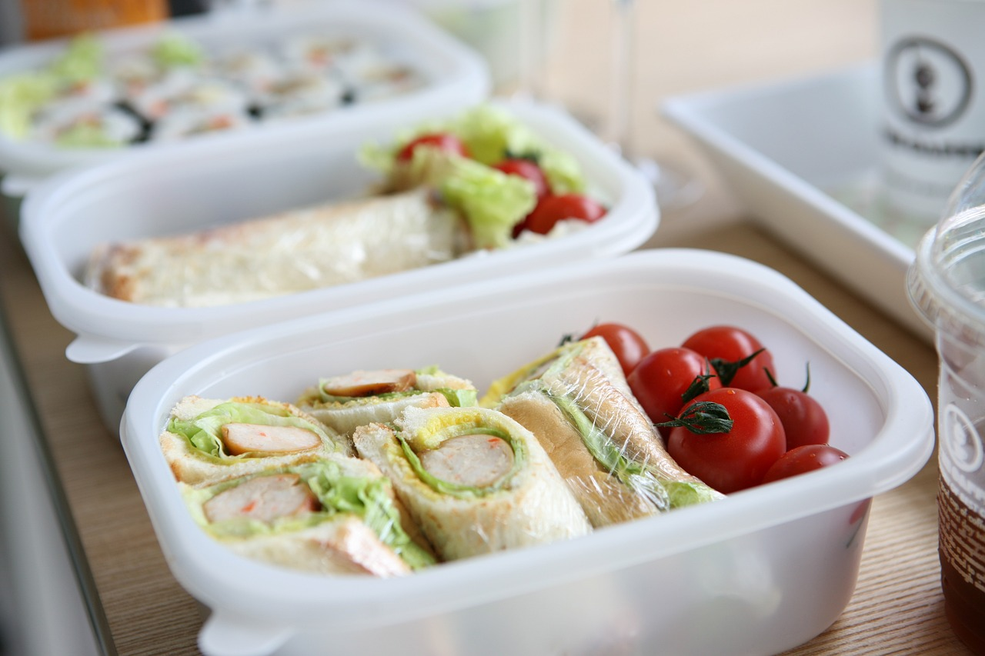
Care for Creation
Turn your leftovers into lunch!
Notes:
Talk partners for 3 minutes
Gather responses
Left photo: Pixabay

Slide 10
Care for Creation
Cycle to school!
Notes:
Talk partners for 3 minutes
Gather responses

Slide 11
Care for Creation
Swapping toys!
Notes:
Talk partners for 3 minutes
Gather responses

Slide 12
Let’s Sing!

Slide 13
Let us pray
Loving Father, We praise you for the beautiful sun and the rain which makes things grow. For the bush and the paddocks, for the sea and the sky, for the flowers and the birds and for your gifts to us. Everything around us sings with joy. With all you made, we sing for joy too!
Amen.

