Slide 1
Care of Creation
EYFS

Slide 2
Catholic Social Teaching

Slide 3
Catholic Social Teaching

Slide 4
Home for Grace by Kathryn White
Notes:
Do you think this is a true story? (Non-fiction) or not? (Fiction)
Sadly, there are children like Grace all around us

Slide 5
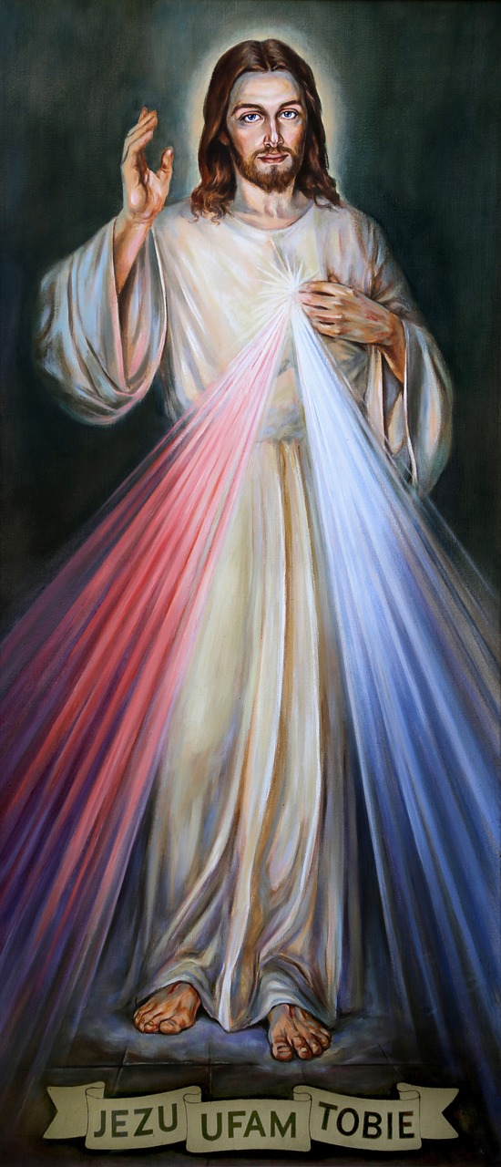
Notes:
Who is this?
What does he teach us?
How do we know where to find his teachings?

Slide 6
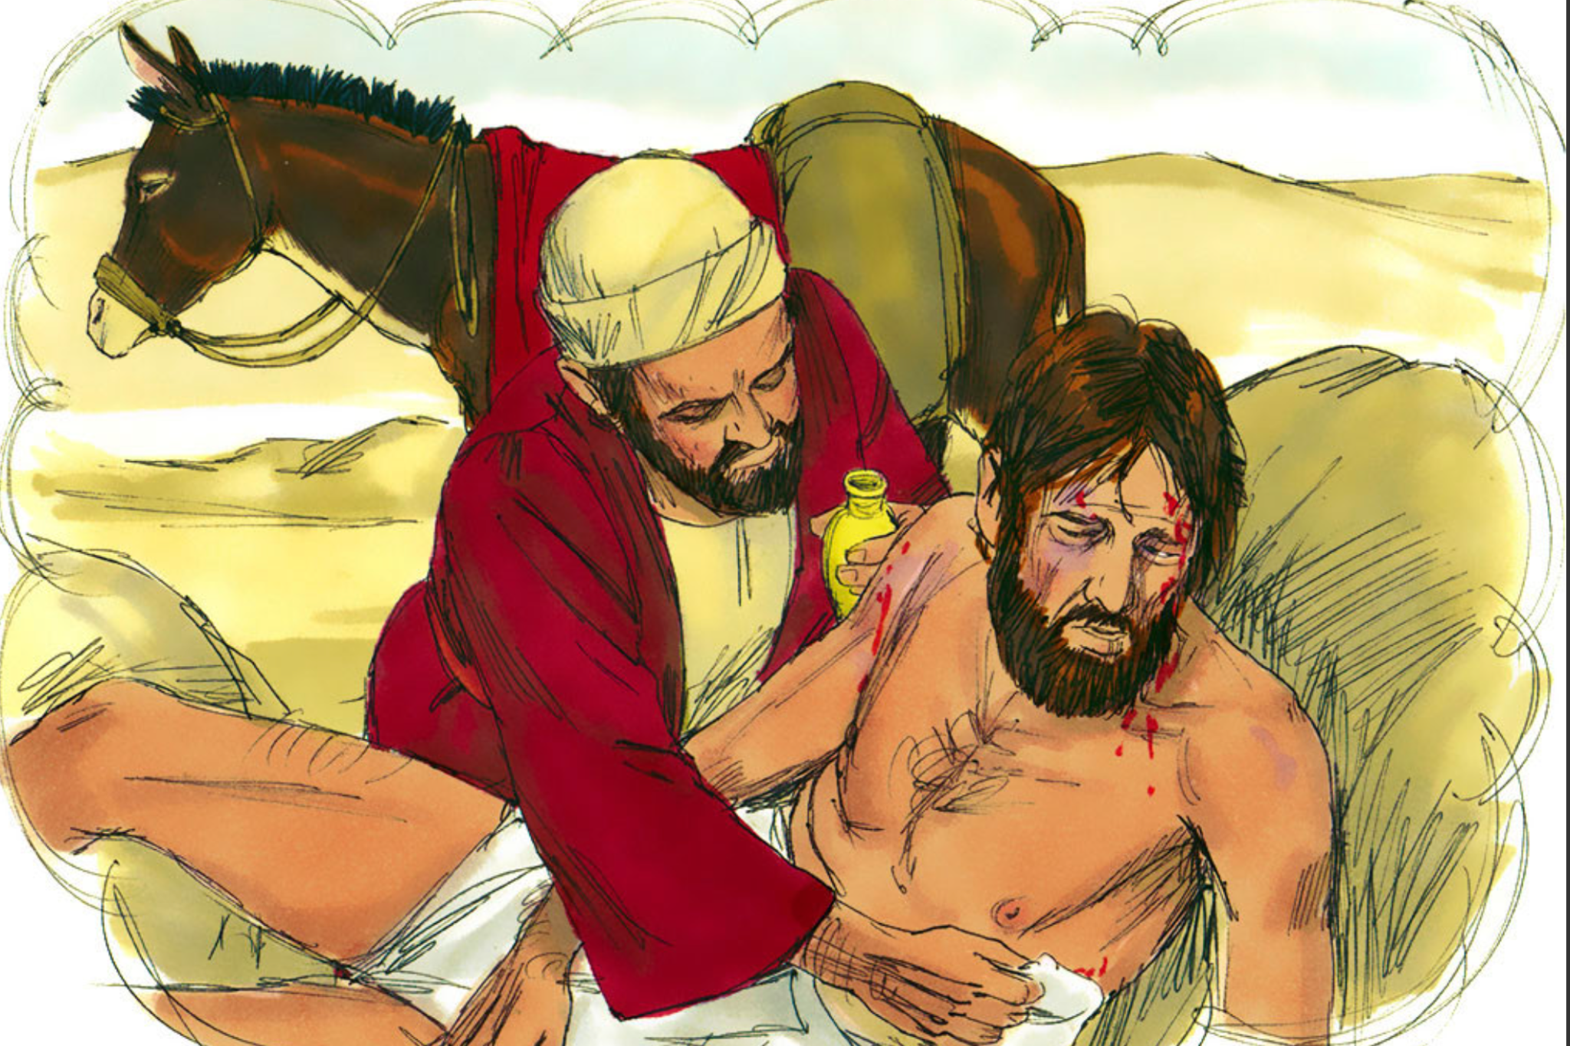
The Good Samaritan (Luke: 30-37)
Notes:
What is the message of this story?
Whose actions should we follow, in this story?
What does Jesus want us to do when we see someone in need?
Image taken from Sweet Publishing/Freebibleimages.org

Slide 7
What can you do?
Notes:
Talk partners: children to discuss the things they could do when they see someone in need

Slide 8
Heart-healing hand example (art area)

Slide 9
Let us sing and pray
Notes:
Children can sing along with We Are Waiting (Missio)

Slide 10
Jubilee Year 2025
Pope Francis has declared this year’s Jubilee theme to be: Pilgrims of Hope
Why might Pope Francis think ‘hope’ is an important thing to focus on in 2025?
Notes:
Pope Francis will open the Holy Door of St Peter’s Basilica on Christmas Eve 2024, marking the beginning of this jubilee year. Pope Francis has called for people of faith to pray for and have deep faith, lively hope and active charity. Explain to the children why this jubilee year is a great time to be very active in charity, which is what we’re working towards in our CST lessons.

