Slide 1
Care of Creation
KS1

Slide 2
Starter

Slide 3
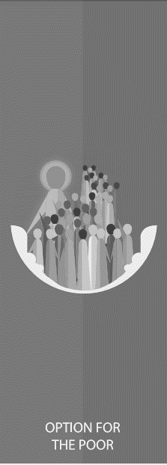
Catholic Social Teaching
Starter

Slide 4
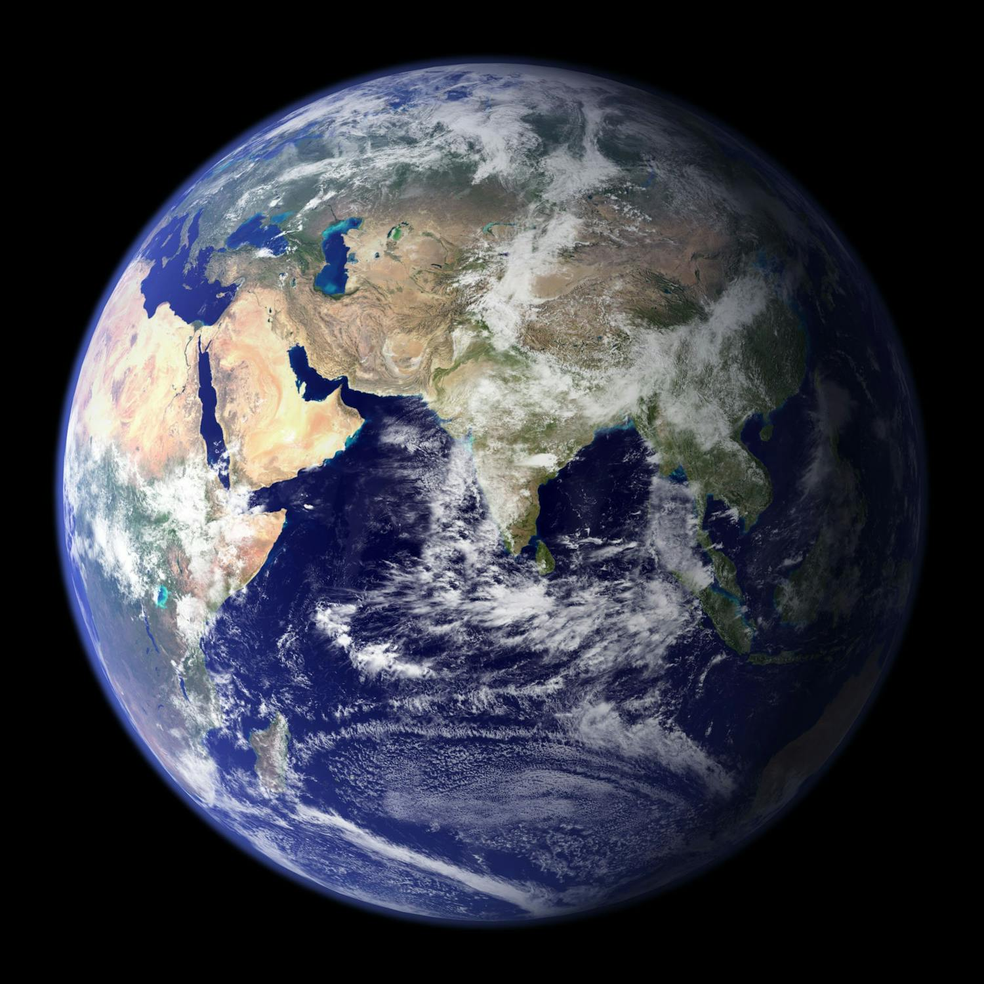
Care of Creation
Notes:
Assess children’s understanding of earth; where it sits in the solar system; what it contains and who created it.
Photo: NASA and GSFC (https://www.jpl.nasa.gov/news/news.php?release=2007-064)

Slide 5
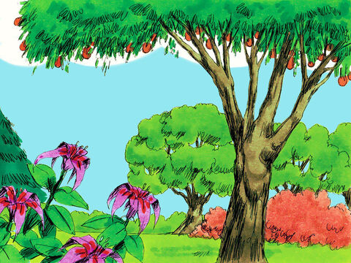
Genesis 1
Notes:
Play clip or read the story of creation from Genesis (children’s bible version). It might be nice to have pupil chaplaincy team to hold up pre-made symbols as the story is read e.g. sun, moon, stars, fish etc.
Image courtesy of Freebibleimages.com/Sweet Publishing

Slide 6
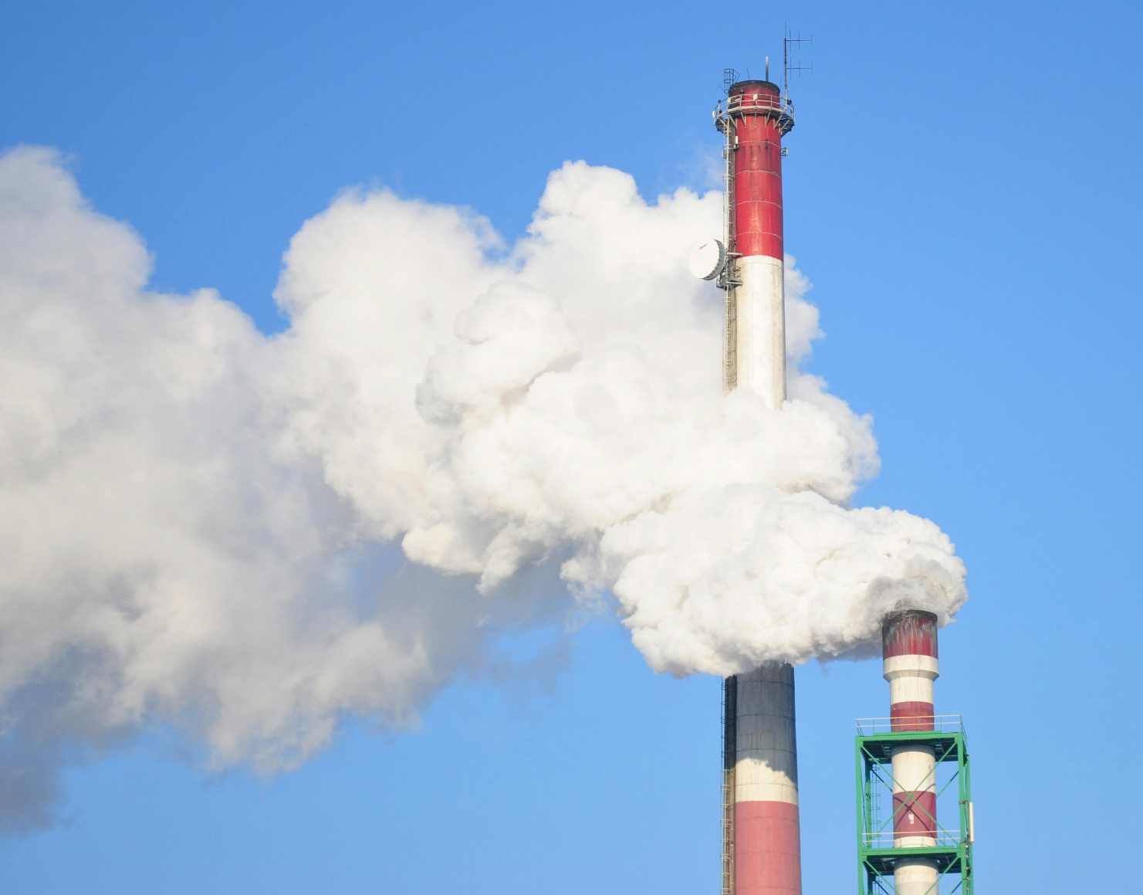
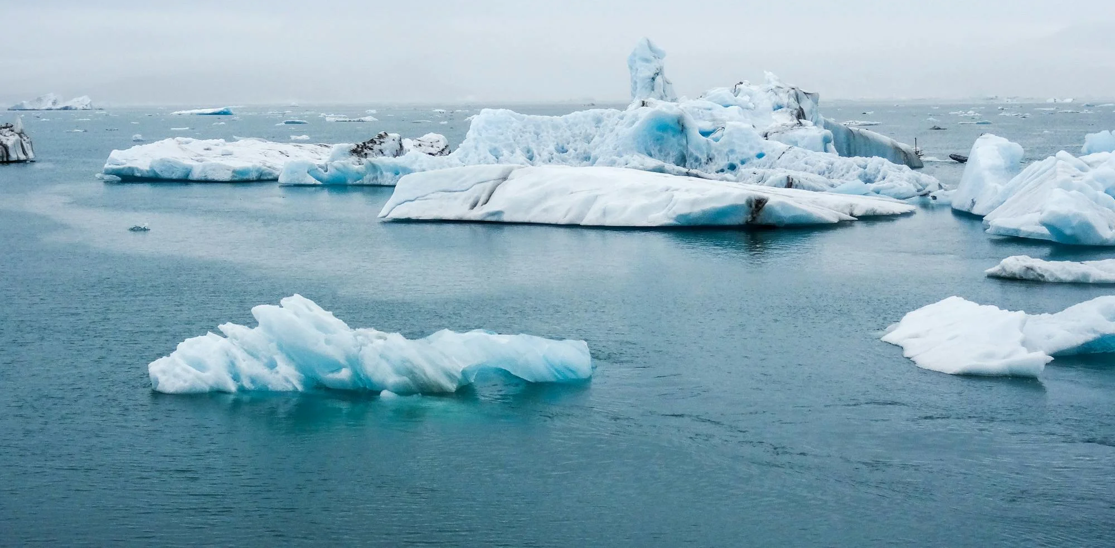
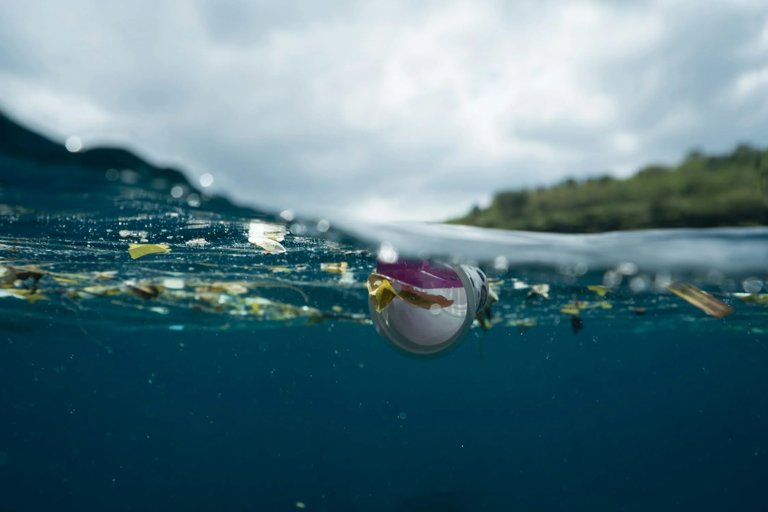
Care of Creation
Do humans always treat the earth with care, as God asks us to?
Think about times when humans have failed to do this duty.
​
Notes:
Get points from children
Photos (Top to bottom): Pexels, Pexels, Pexels

Slide 7
Be more rather than have more
Even if it’s only a small thing, what can you do to be a better steward of God’s creation?

Slide 8
Care of Creation
“I think that…”
Notes:
Holding slide for discussion/feedback if required.

Slide 9
Care of Creation
Let Us Pray…

Slide 10
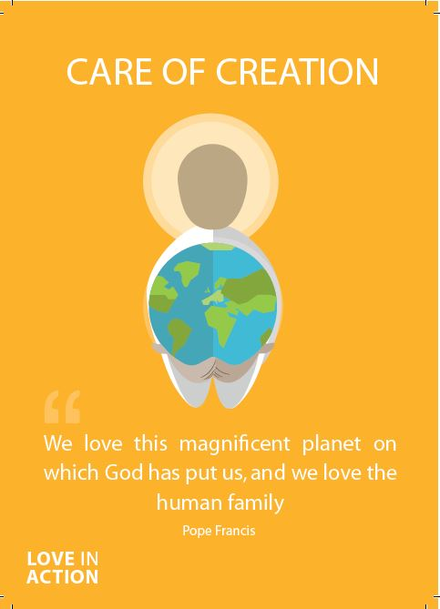
Care of Creation
Loving God,
We come together to thank you for our world. You created the Earth for us to live and prosper in. You taught us how to care for the world you created but we have not followed those laws.
Let us give thanks for the joy our world brings us, and pray that we become good stewards of creation.

Slide 11
Care of Creation
We pray for those who work hard to care for our world
O God, help us to follow their example

Slide 12
Care of Creation
We pray for those who do not care for the Earth in the way they should.
O God, help us to teach others how You want us to live.

Slide 13
Care of Creation
We pray for those who will face the worst consequences of our actions.
O God, help us to help those in need.

Slide 14
Care of Creation
We pray that we may be able to care for our world and reverse the damage we have done.
O God, help us to work together.

Slide 15
Care of Creation
Amen

Slide 16
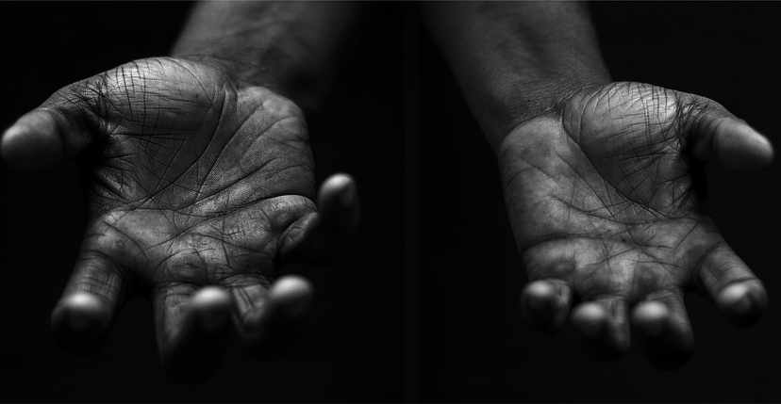
Care of Creation
Your Mission
Notes:
Using the Prayer Toolkit model, the mission ‘tasks’ on the following slide can be amended or supplemented as required.

Slide 17
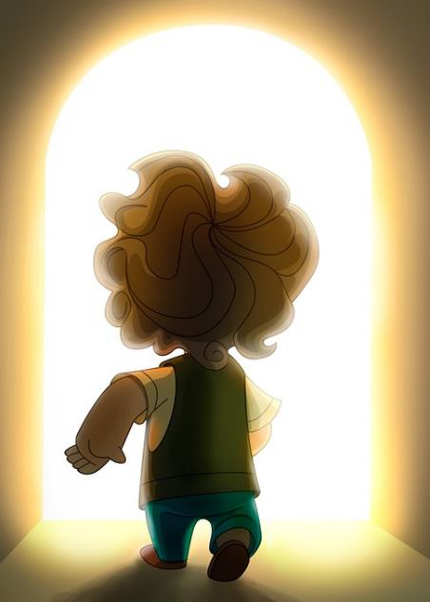
Care of Creation
What can your school do for the Harvest Festival?
Research:
World Day of Prayer for the Care of Creation (1st September)
Season of Creation (1st Sept – 4th Oct)
COP29 (begins 11th November 2024)

Slide 18
Care of Creation

