Slide 1
Preferential Option for the Poor
KS1 Assembly
Notes:
Play/sing God’s Spirit is in my Heart (Go Tell Everyone) as children enter and leave the assembly

Slide 2
Starter

Slide 3
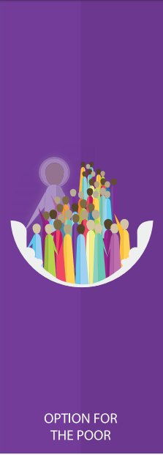
Notes:
Introduce this half term’s CST theme. What do the children think ‘preferential option’ means? Can you think of a scenario that shows someone giving a preferential option to a poor person?

Slide 4
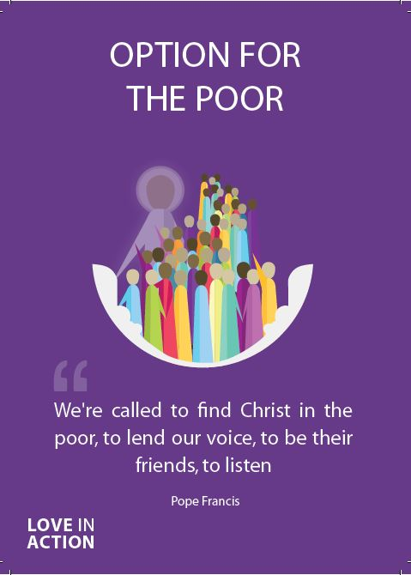
Preferential Option for the Poor
God calls us to look out for those in need and work hard to support them as best we can.
Notes:
Why do you think God wants us to help those in need so much? Encourage children to see everyone is made in God’s image so we must treat every human with dignity and respect, as our fellow brothers and sisters.

Slide 5
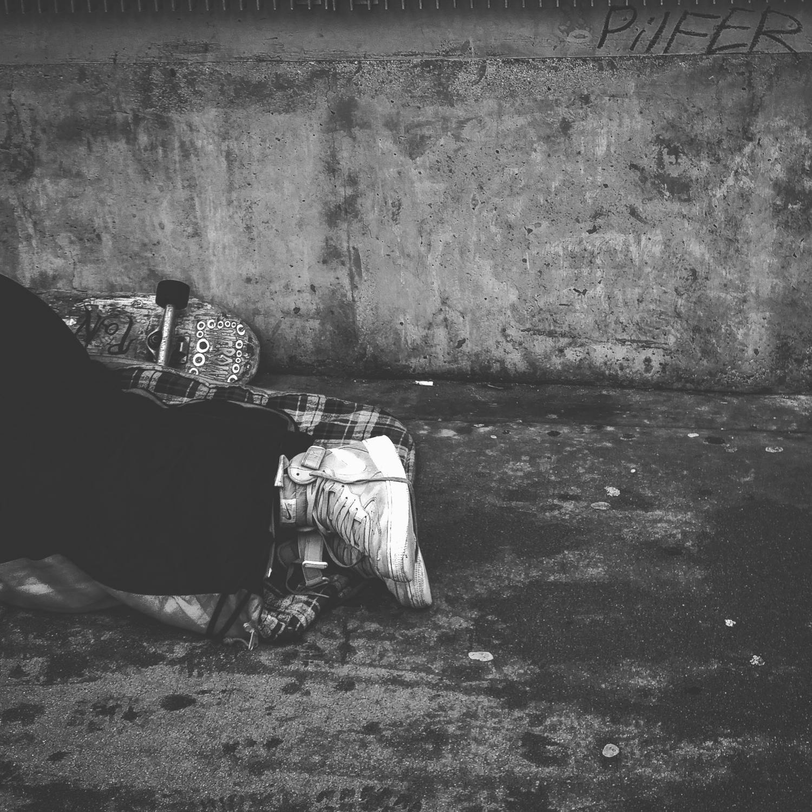
Preferential Option for the Poor
Notes:
Can you think of a time when you needed help and someone reached out to you with kindness? How did you feel? Do they feel able to do anything when they come across someone in need? Encourage children to share anecdotes of helping or perhaps not feeling able to. Encourage children to talk to the adults in their life about ways they can make a difference to the life of someone in need e.g. donating pocket money/clothes/food etc.

Slide 6
Preferential Option for the Poor
Notes:
Can children think of any organisations set up to help those in need? Introduce the concept of a charity; what it does and how it does it (how it gets money). Is there a charity children know of? Do they know people who work for; donate to specific charities?

Slide 7
Preferential Option for the Poor
Let us now listen to the Word of God.

Slide 8
Preferential Option for the Poor
12 Then Jesus said to his host, “When you give a luncheon or dinner, do not invite your friends, your brothers or sisters, your relatives, or your rich neighbors; if you do, they may invite you back and so you will be repaid. 13 But when you give a banquet, invite the poor, the crippled, the lame, the blind, 14 and you will be blessed. Although they cannot repay you, you will be repaid at the resurrection of the righteous.”
Luke 14: 12-14
Notes:
Why is Jesus encouraging you not to invite your friends, relative, rich neighbours? Encourage children to see that helping those in need must be done selflessly, not looking for anything back, because it’s our duty as Christians.

Slide 9
Preferential Option for the Poor
Let Us Pray…

Slide 10
Preferential Option for the Poor
Loving God,
We come together to thank you for our world. You created our world so that everyone may have enough but there are those who do not have enough.
Help us to follow the example of Your Son, Jesus Christ, and reach out our hands to those in need.

Slide 11
The Year of Jubilee 2025
Notes:
https://rcdow.org.uk/jubilee-2025/ Introduce the theme for the Jubilee year and the fact we are focusing on restoring hope to everyone, encouraging that through our actions towards others as well as being prayerful, praying that everyone feels a sense of hope. This ties in nicely with our CST theme this half term as we pray for hope and aim to bring hope to those in need, through our actions.

Slide 12
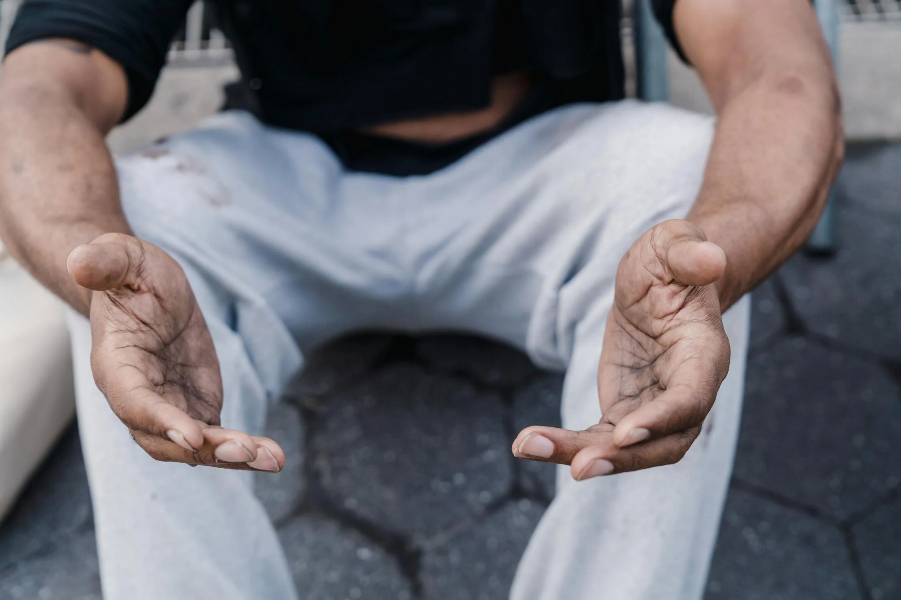
Our Open Hands
They are a symbol of affection for each other. Our open hands inspire healing and forgiveness. They remove barriers and chase away fears. Our open hands are raised in prayer. They build justice and peace between God and his people. Let us open our hands in this Jubilee Year. Amen.
Our open hands give confidence. They choose to value life. Our open hands share with the poor and the oppressed. They care for those who are hurt and in need. Our open hands invite conversation and understanding. They take responsibility for creation. Our open hands are a gesture of love and friendship.

Slide 13
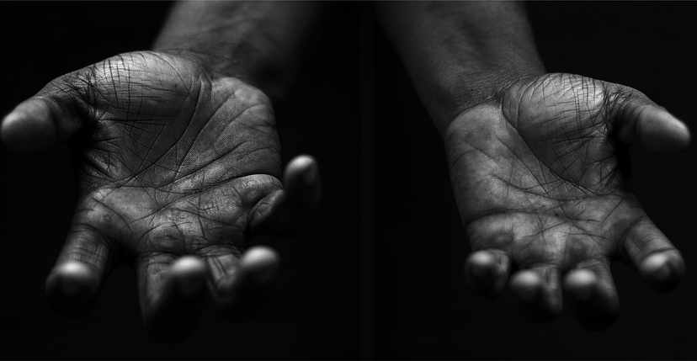
Preferential Option for the Poor
Your Mission
Notes:
Using the Prayer Toolkit model, the mission ‘tasks’ on the following slide can be amended or supplemented as required.

Slide 14
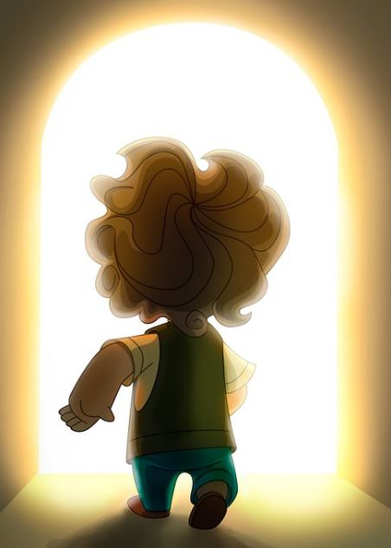
Preferential Option for the Poor
Find out more about the Jubilee Year of Hope and decide how you are going to pay attention to Pope Francis’ call.
Do something specific:
World Day of the Poor (17th November 2024)
Notes:
The World Day of the Poor is a Roman Catholic observance, set up by Pope Francis in 2017. It is celebrated on the 33rd Sunday of Ordinary Time, which is the Sunday before Christ the King.

Slide 15
Care of Creation

