Slide 1
Care of Creation
LKS2

Slide 2
Starter

Slide 3
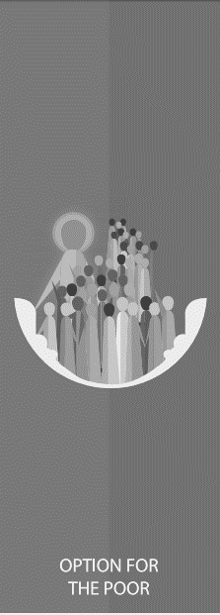
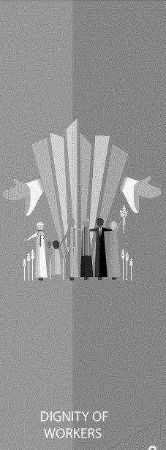
Catholic Social Teaching
Starter

Slide 4
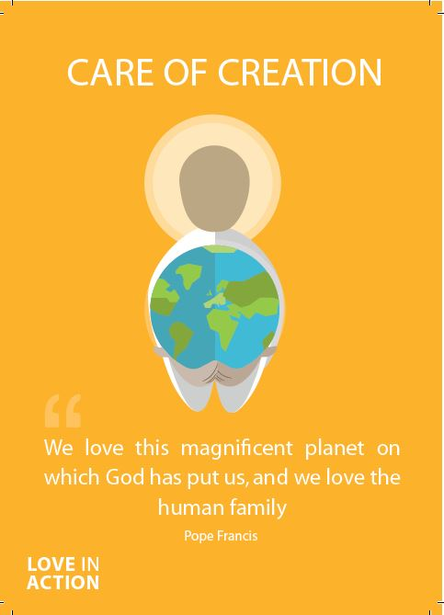
Care of Creation
As Christians, we are called to be good stewards of creation.
That means we are meant to look after the world that God created for us.
We must all work to leave our world in a better condition for the people who come after us.

Slide 5
Care of Creation
‘Creation is a gift, it is a wonderful gift that God has given us, so that we care for it and we use it for the benefit of all.’
Pope Francis
Laudato Si’
​

Slide 6
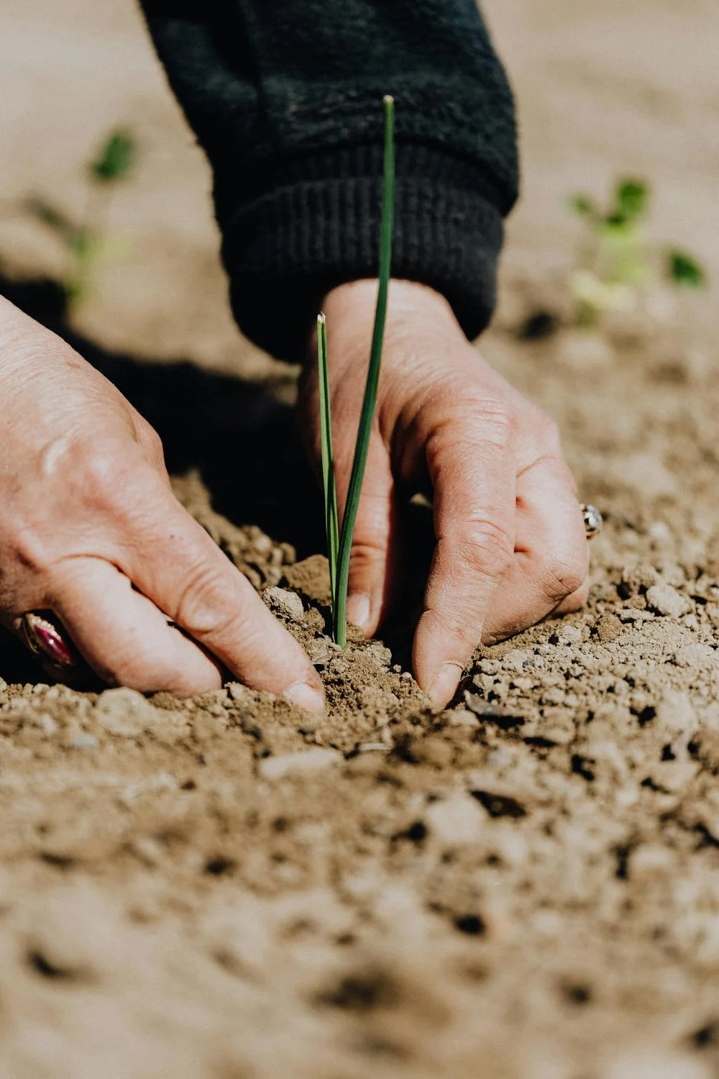
Care of Creation
Why does Pope Francis describe creation as a God-given ‘gift’?
Read Genesis 1- The Story of Creation
​

Slide 7
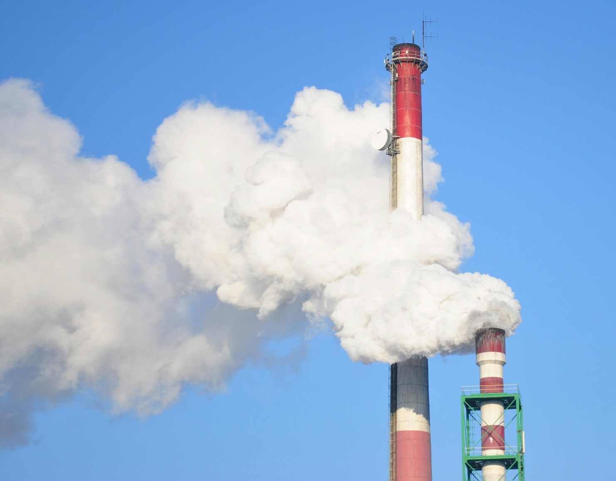
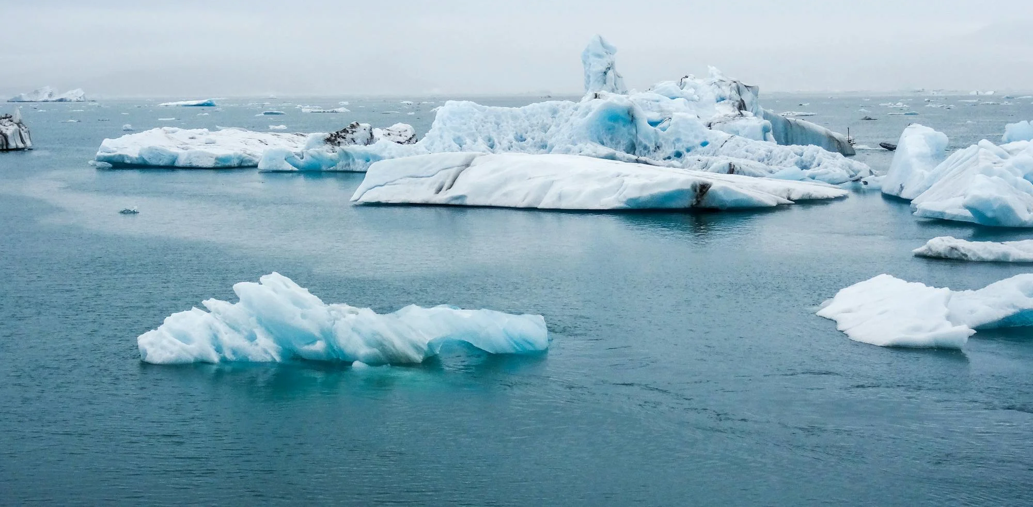
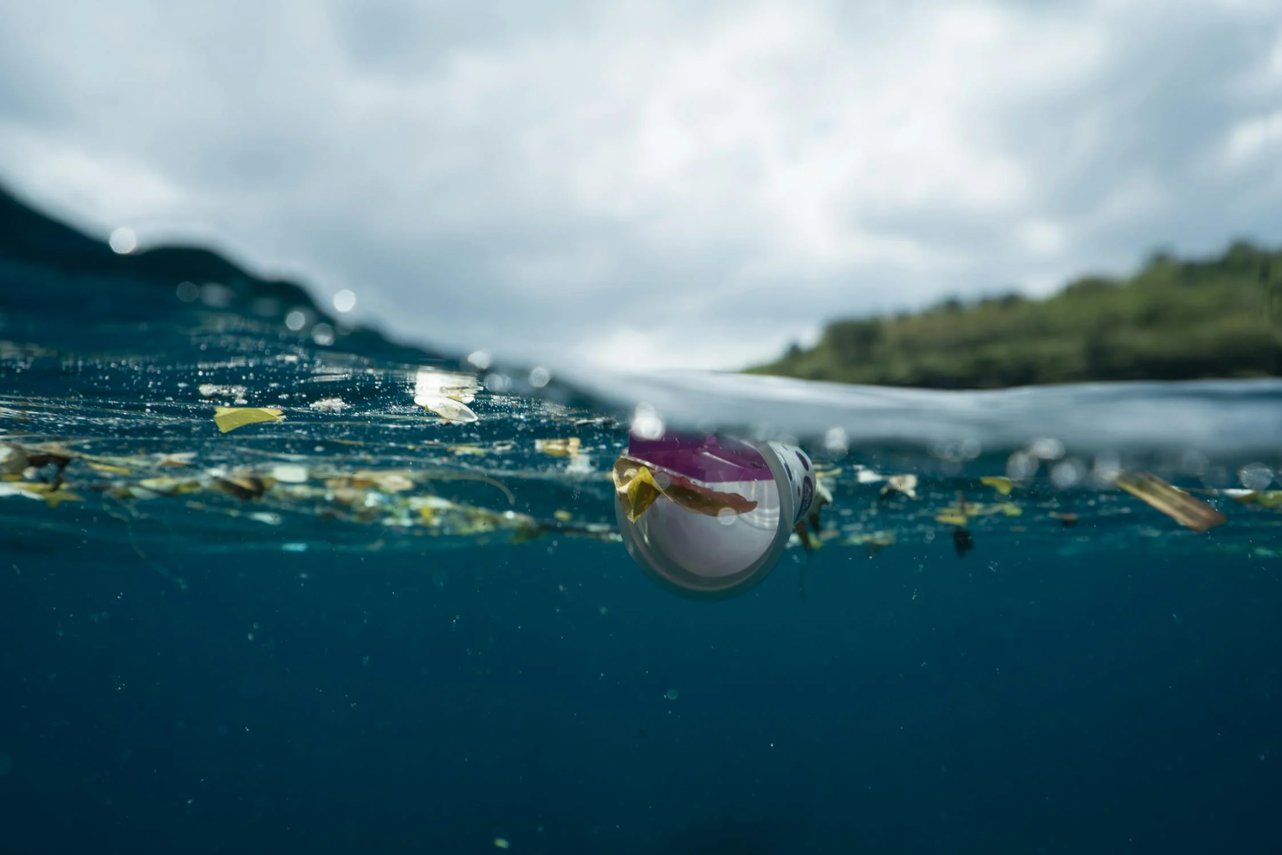
Care of Creation
Do humans always treat the earth with care, as God asks us to?
Think about times when humans have failed to do this duty.
​

Slide 8
Be more rather than have more
Even if it’s only a small thing, what can you do to be a better steward of God’s creation?

Slide 9
Care of Creation
“I think that…”
Notes:
Holding slide for discussion/feedback if required.

Slide 10
Care of Creation
Let Us Pray…

Slide 11
Care of Creation
Loving God,
We come together to thank you for our world. You created the Earth for us to live and prosper in. You taught us how to care for the world you created but we have not followed those laws.
Let us give thanks for the joy our world brings us, and pray that we become good stewards of creation.

Slide 12
Care of Creation
We pray for those who work hard to care for our world
O God, help us to follow their example

Slide 13
Care of Creation
We pray for those who do not care for the Earth in the way they should.
O God, help us to teach others how You want us to live.

Slide 14
Care of Creation
We pray for those who will face the worst consequences of our actions.
O God, help us to help those in need.

Slide 15
Care of Creation
We pray that we may be able to care for our world and reverse the damage we have done.
O God, help us to work together.

Slide 16
Care of Creation
Amen

Slide 17
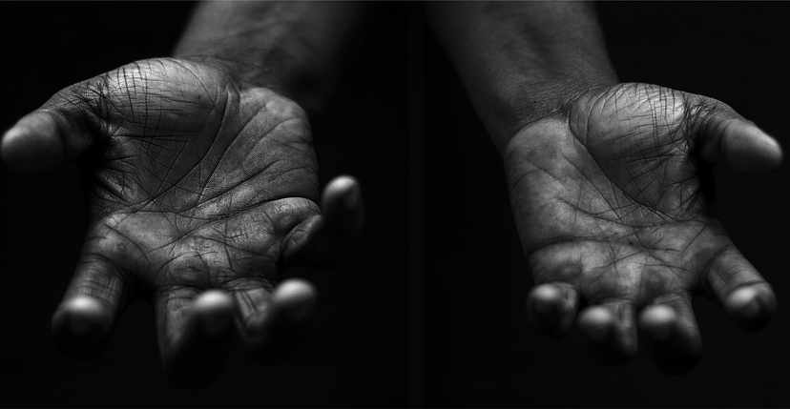
Care of Creation
Your Mission
Notes:
Using the Prayer Toolkit model, the mission ‘tasks’ on the following slide can be amended or supplemented as required.

Slide 18
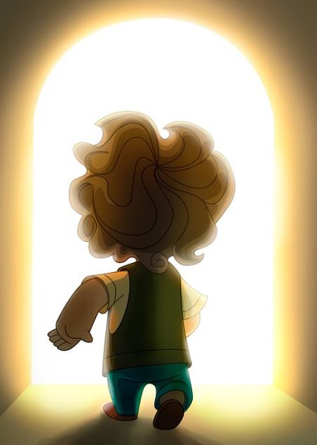
Care of Creation
What can your school do for the Harvest Festival?
Research:
World Day of Prayer for the Care of Creation (1st September)
Season of Creation (1st Sept – 4th Oct)
COP29 (begins 11th November 2024)

Slide 19
Care of Creation

