Slide 1
Care of Creation
UKS2 Assembly

Slide 2
Starter

Slide 3
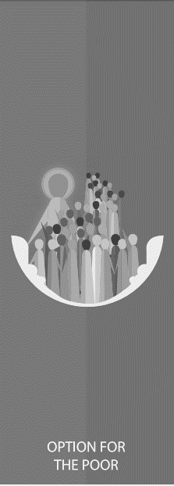
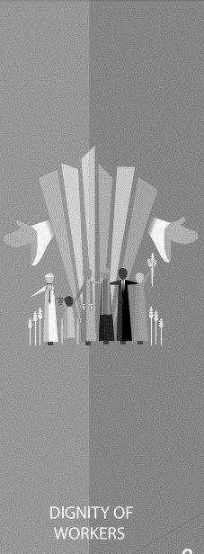
Catholic Social Teaching
Starter

Slide 4
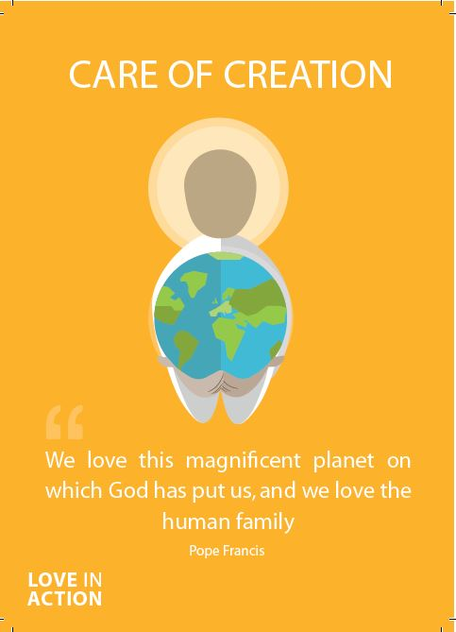
Care of Creation
As Christians, we are called to be good stewards of creation.
That means we are meant to look after the world that God created for us.
We must all work to leave our world in a better condition for the people who come after us.

Slide 5
Care of Creation
Pope Francis reminds us of our duty in Laudato Si

Slide 6
Care of Creation
‘Creation is a gift, it is a wonderful gift that God has given us, so that we care for it and we use it for the benefit of all.’
Pope Francis
Laudato Si’
​

Slide 7
Care of Creation
‘Living our vocation to be protectors of God’s handiwork is essential to a life of virtue; it is not an optional or a secondary aspect of our Christian experience.’
Pope Francis
Laudato Si’
What do you think Pope Francis means by this? Are we always protectors of God’s handiwork or could we do more? How?

Slide 8
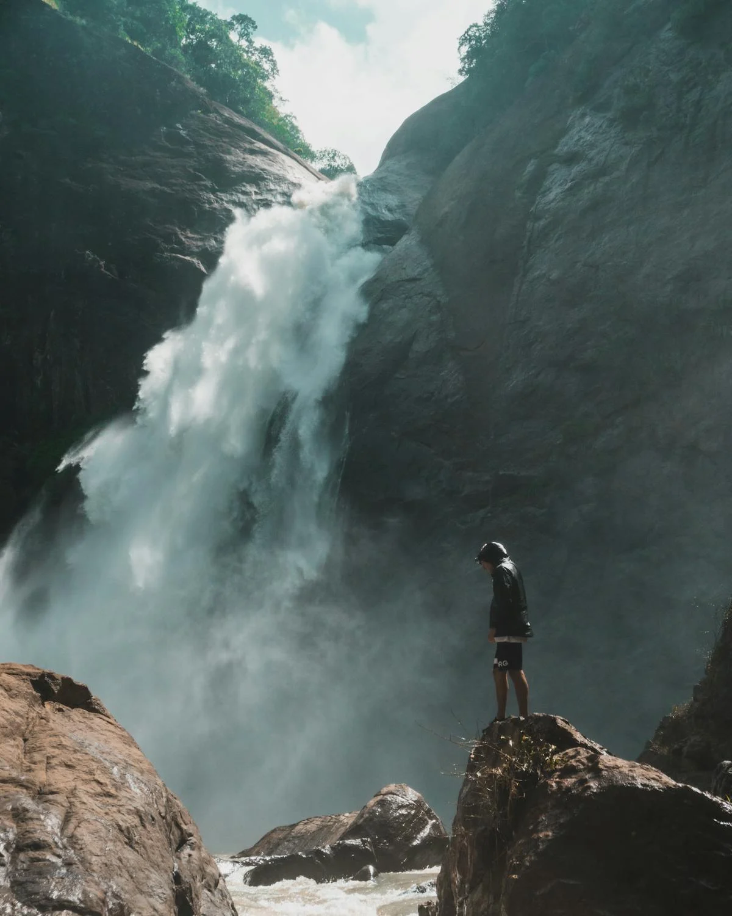
Care of Creation

Slide 9
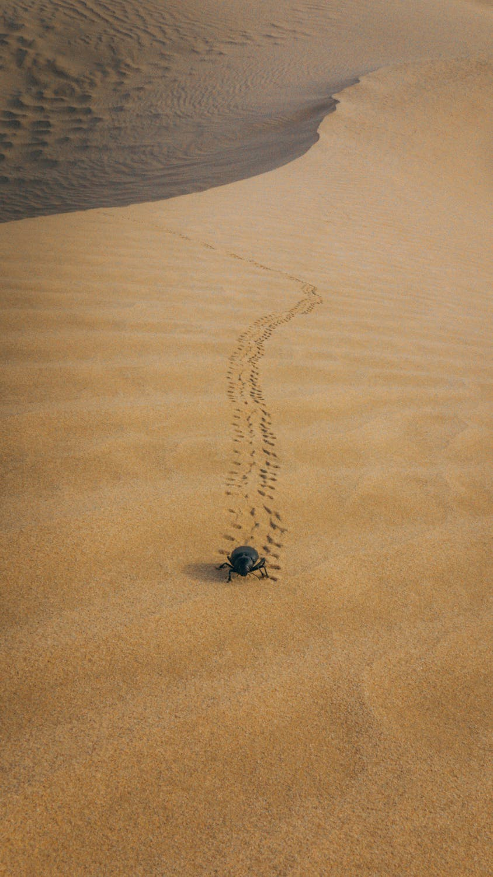
Care of Creation
Notes:
"Footprints in the sand create a classic picture" [Thar Desert, India/Pakistan], photograph by Mark Moxon. https://www.moxon.net/photo_library/index.php

Slide 10
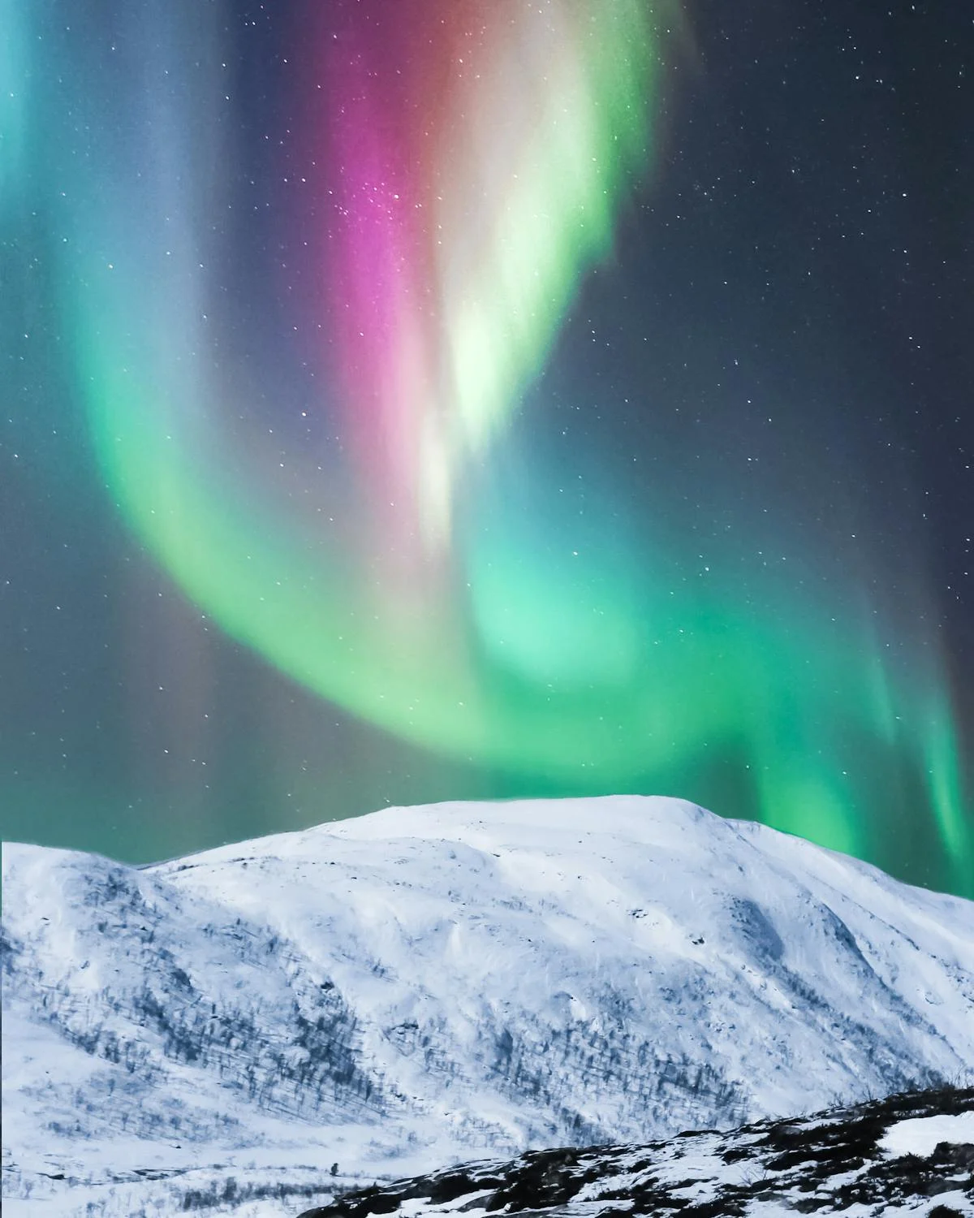
Care of Creation

Slide 11
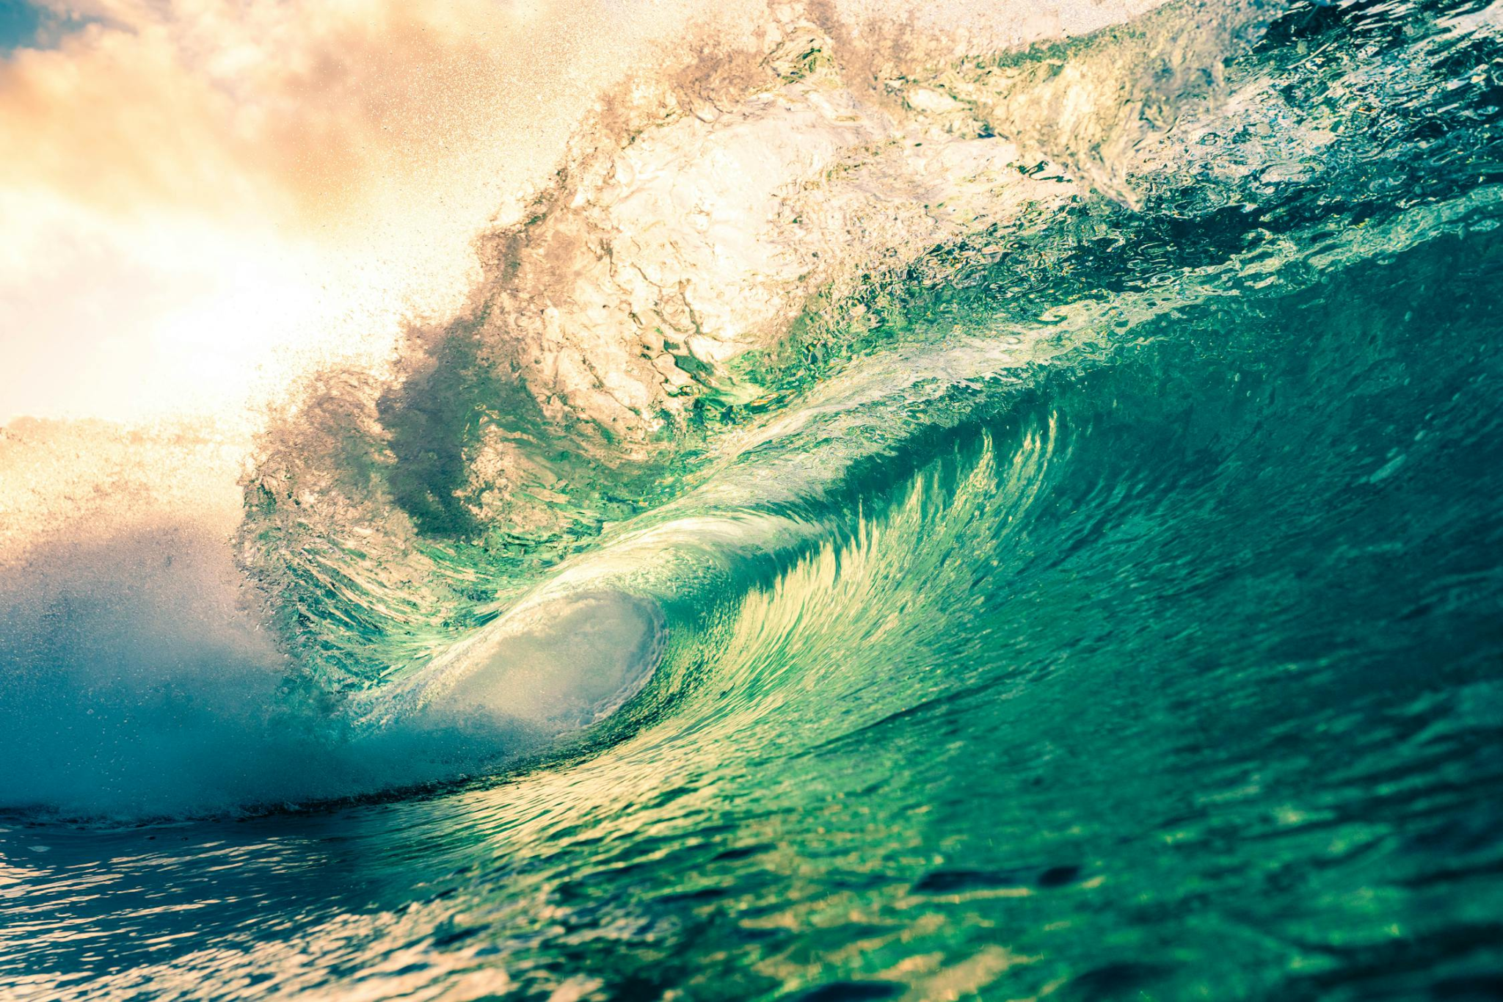
Care of Creation

Slide 12
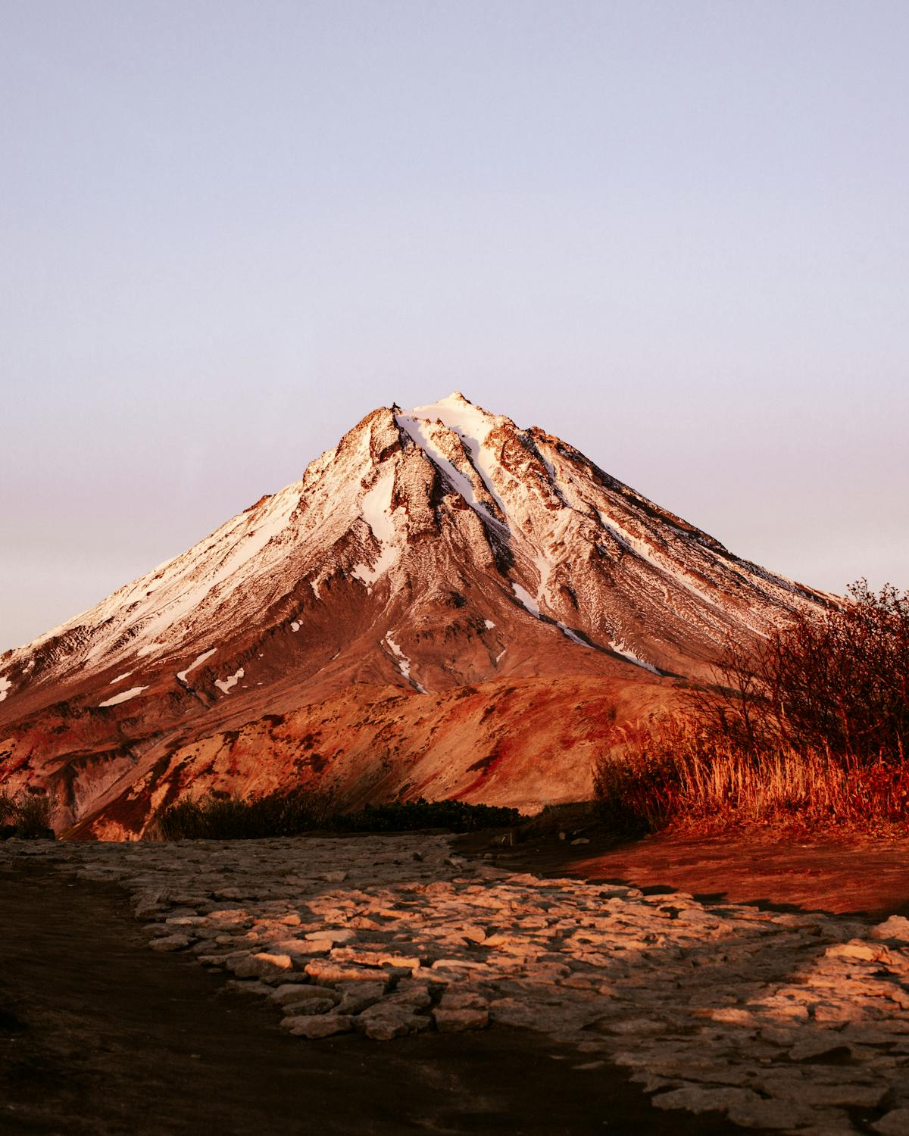
Care of Creation

Slide 13
Care of Creation
Think of a time when you felt in awe at the beauty of creation.
What made you feel that way?
What more could you do to look after our world?

Slide 14
Care of Creation
Let us now listen to the Word of God.

Slide 15
Care of Creation
Read through one or more of the bible passages on the next few slides.
How do the passages relate to Care of Creation?

Slide 16
Care of Creation
‘In the beginning, God created the Heavens and the Earth… God saw everything that He had made, and indeed, it was very good.’
Genesis 1:1-4

Slide 17
Care of Creation
‘The Lord God put humans in the Garden of Eden to work it and take care of it.’
Genesis 2:15
​

Slide 18
Care of Creation
‘What kind of world do we want to leave to those who come after us, to children who are now growing up?’
Pope Francis
Laudato Si’

Slide 19
Care of Creation
What do these bible passages and quote from Pope Francis tell you about how we should treat our world?
How do we know that God wants us to act in this way?

Slide 20
Care of Creation
“I think that…”
Notes:
Holding slide for discussion/feedback if required.

Slide 21
Care of Creation
Let Us Pray…

Slide 22
Care of Creation
Loving God,
We come together to thank you for our world. You created the Earth for us to live and prosper in. You taught us how to care for the world you created but we have not followed those laws.
Let us give thanks for the joy our world brings us, and pray that we become good stewards of creation.

Slide 23
Care of Creation
We pray for those who work hard to care for our world
O God, help us to follow their example

Slide 24
Care of Creation
We pray for those who do not care for the Earth in the way they should.
O God, help us to teach others how You want us to live.

Slide 25
Care of Creation
We pray for those who will face the worst consequences of our actions.
O God, help us to help those in need.

Slide 26
Care of Creation
We pray that we may be able to care for our world and reverse the damage we have done.
O God, help us to work together.

Slide 27
Care of Creation
Amen

Slide 28
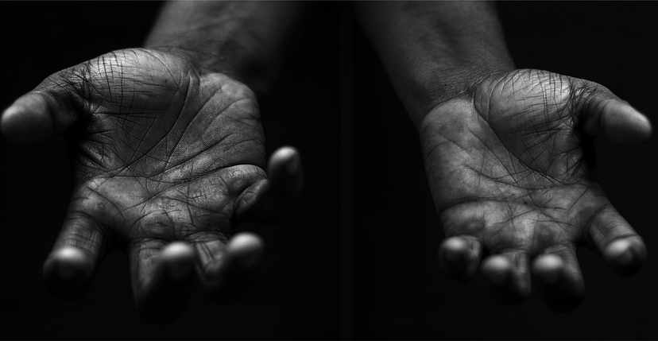
Care of Creation
Your Mission
Notes:
Using the Prayer Toolkit model, the mission ‘tasks’ on the following slide can be amended or supplemented as required.

Slide 29
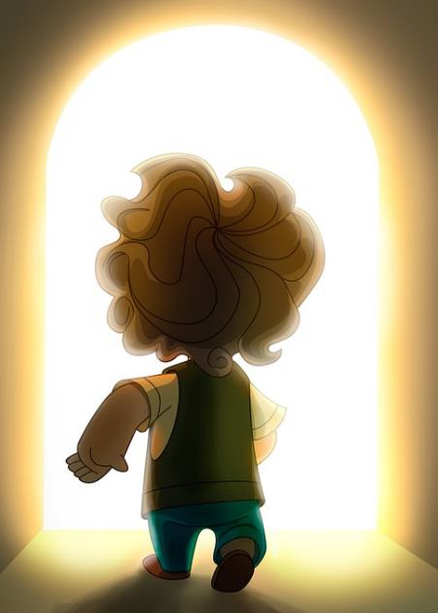
Care of Creation
What can your school do for the Harvest Festival?
Research:
World Day of Prayer for the Care of Creation (1st September)
Season of Creation (1st Sept – 4th Oct)
COP29 (begins 11th November 2024)

Slide 30
Care of Creation

