Slide 1
Preferential Option for the Poor
UKS2 Assembly
Notes:
Play/sing God’s Spirit is in my Heart (Go Tell Everyone) as children enter and leave the assembly

Slide 2
Starter

Slide 3
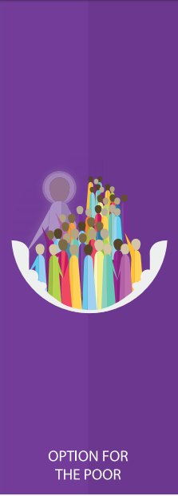
Notes:
Introduce this half term’s CST theme. What do the children think ‘preferential option’ means? Can you think of a scenario that shows someone giving a preferential option to a poor person?

Slide 4
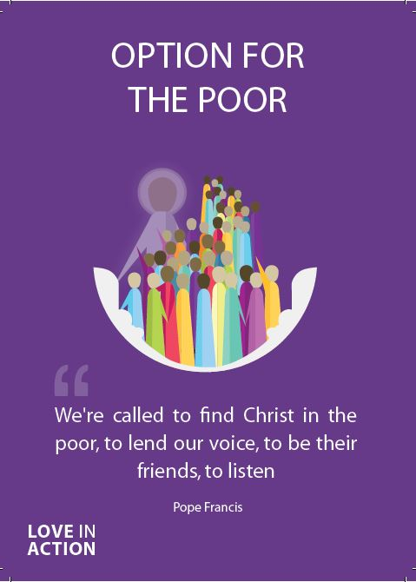
Preferential Option for the Poor
The ‘preferential option’ means allowing someone to have the first choice. It means giving someone the best that is available; not just the scraps or leftovers.
God calls us to look out for those in need and work hard to support them as best we can.

Slide 5
Preferential Option for the Poor
‘The poor do not need intermediaries, but the personal involvement of all those who hear their cry.’
Pope Francis
Second World Day Of The Poor
Notes:
Focus on the word ‘intermediaries’ and explain this is a person who gets involved as a kind of mediator. Pope Francis doesn’t want us to be just this but he wants us to ‘hear their cries’ and have empathy. In what way can we ‘hear their cries’ instead of just being an intermediary? Encourage children to say things like have conversations with the poor and understand the human being; give theme your time through volunteering etc.

Slide 6
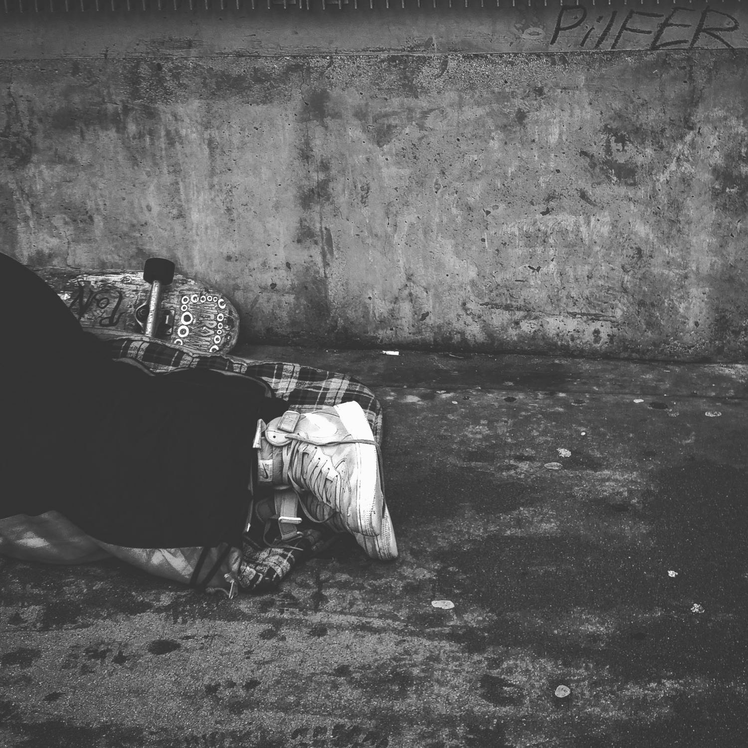
Preferential Option for the Poor
Notes:
Ask children to reflect on how often we walk past people who are homeless on the streets. Sometimes we may feel like we can’t help them so we walk past and continue with our day. What are things we could do if we cannot give them money or food e.g. alert a local homeless charity; donate or volunteer to that charity. Can you think of a time when you needed help and someone reached out to you with kindness? How did you feel?

Slide 7
Preferential Option for the Poor
Let us now listen to the Word of God.

Slide 8
Preferential Option for the Poor
Read through one or more of the bible passages on the next few slides.
As a class, think about and discuss the meaning of each.​
How do the passages relate to Preferential Option for the Poor?

Slide 9
Preferential Option for the Poor
‘Sell your possessions and give to the poor. Provide purses for yourselves that will not wear out, a treasure in heaven that will never fail, where no thief comes near and no moth destroys.’
Luke 12:33

Slide 10
Preferential Option for the Poor
‘If anyone is well off in worldly possessions and sees their sister or brother in need but closes their heart to them, how can the love of God be remaining in them?’
1 John 3.17-18

Slide 11
Preferential Option for the Poor
‘Speak up for those who cannot speak for themselves, for the rights of all who are destitute. Speak up and judge fairly; defend the rights of the poor and needy.’
Proverbs 31:8-9

Slide 12
Preferential Option for the Poor
What do these bible passages tell you about how we should treat the poor? How do we know that God wants us to act in this way?

Slide 13
Preferential Option for the Poor
“I think that…”
Notes:
Holding slide for discussion/feedback if required.

Slide 14
Preferential Option for the Poor
Let Us Pray…

Slide 15
Preferential Option for the Poor
Loving God,
We come together to thank you for our world. You created our world so that everyone may have enough but there are those who do not have enough.
Help us to follow the example of Your Son, Jesus Christ, and reach out our hands to those in need.

Slide 16
Preferential Option for the Poor
We pray for those in need, that they may get all that they need to thrive.
O God, help us to serve those around us.

Slide 17
Preferential Option for the Poor
We pray for those in power, that they may make the right choices to better help everyone.
O God, help those in power to serve their people.

Slide 18
Preferential Option for the Poor
We pray for those who have more than their fair share, that they may choose to give to those in need.
O God, help us to recognise what we need and what others need.

Slide 19
Preferential Option for the Poor
We pray that everyone in our world may one day be able to thrive, not just survive.
O God, help us to spread Your love.

Slide 20
Preferential Option for the Poor
Amen

Slide 21
The Year of Jubilee 2025
Notes:
https://rcdow.org.uk/jubilee-2025/ Introduce the theme for the Jubilee year; the historical context of jubilee years and the fact we are focusing on restoring hope to everyone, encouraging that through our actions towards others as well as being prayerful, praying that everyone feels a sense of hope. This ties in nicely with our CST theme this half term as we pray for hope and aim to bring hope to those in need, through our actions.

Slide 22
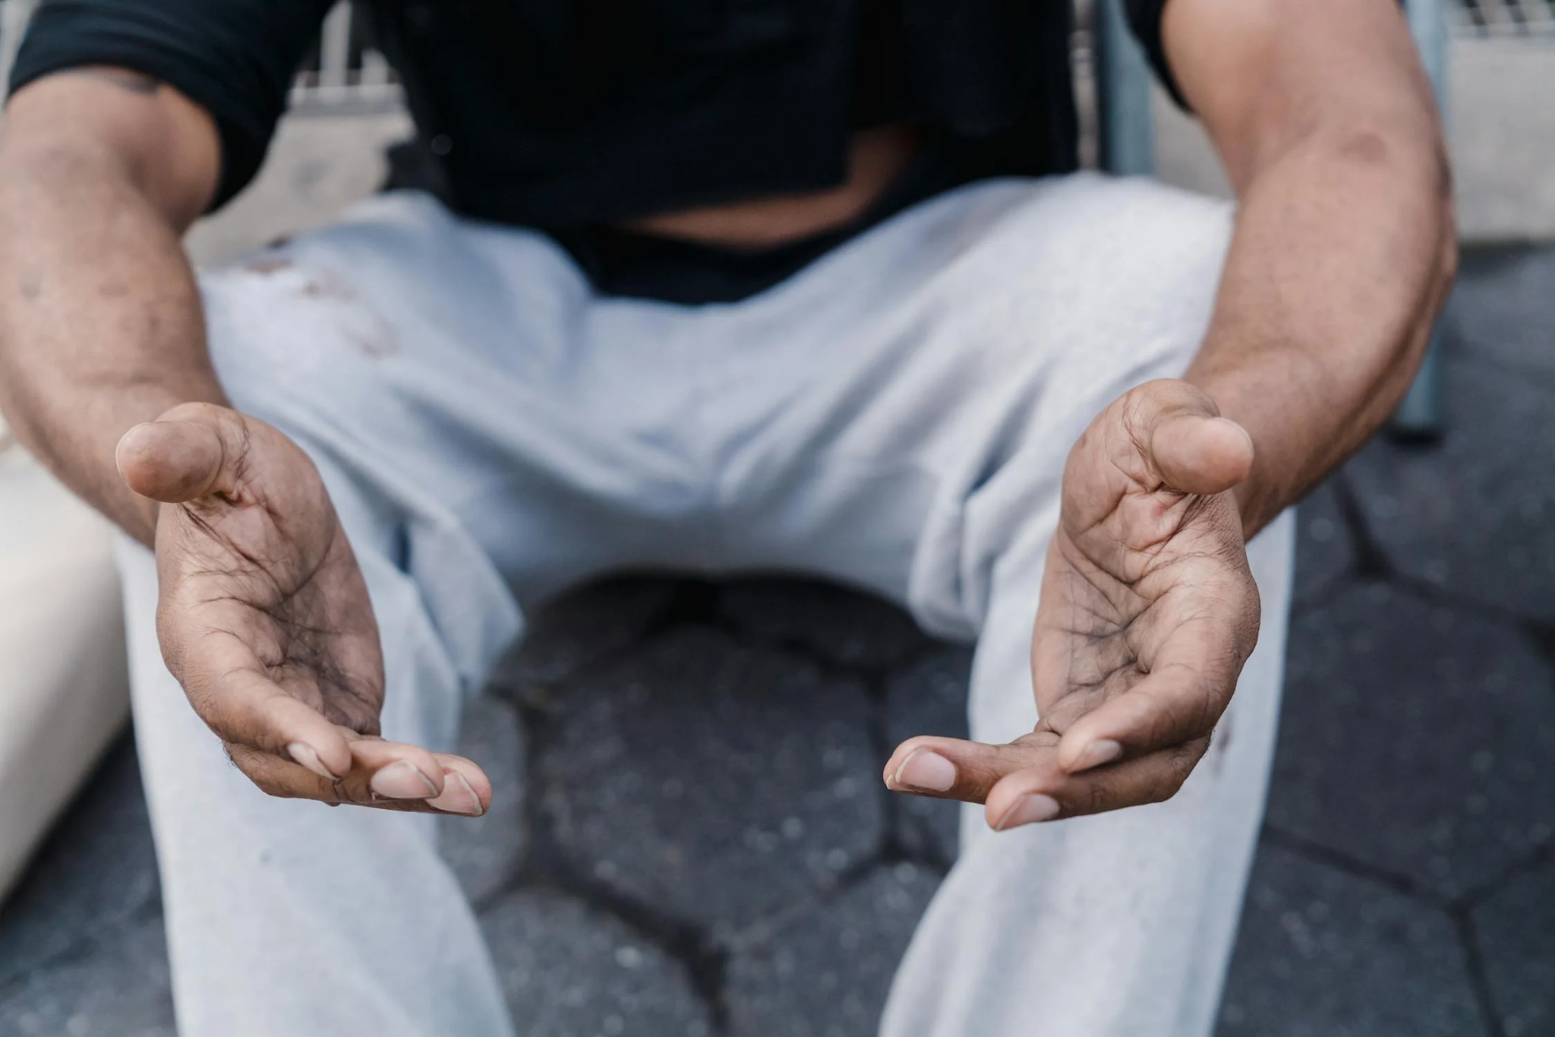
Our Open Hands
They are a symbol of affection for each other. Our open hands inspire healing and forgiveness. They remove barriers and chase away fears. Our open hands are raised in prayer. They build justice and peace between God and his people. Let us open our hands in this Jubilee Year. Amen.
Our open hands give confidence. They choose to value life. Our open hands share with the poor and the oppressed. They care for those who are hurt and in need. Our open hands invite conversation and understanding. They take responsibility for creation. Our open hands are a gesture of love and friendship.

Slide 23
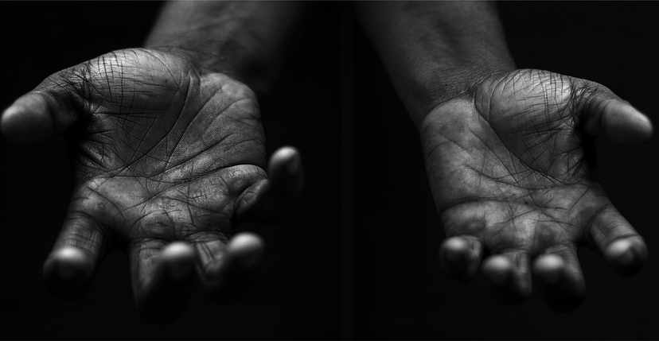
Preferential Option for the Poor
Your Mission
Notes:
Using the Prayer Toolkit model, the mission ‘tasks’ on the following slide can be amended or supplemented as required.

Slide 24
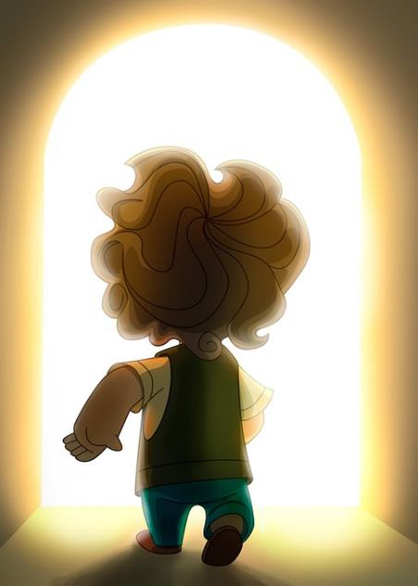
Preferential Option for the Poor
Find out more about the Jubilee Year of Hope and decide how you are going to pay attention to Pope Francis’ call.
Do something specific:
World Day of the Poor (17th November 2024)
Notes:
The World Day of the Poor is a Roman Catholic observance, set up by Pope Francis in 2017. It is celebrated on the 33rd Sunday of Ordinary Time, which is the Sunday before Christ the King.

Slide 25
Care of Creation

