Slide 1
Care of Creation
Year 1

Slide 2
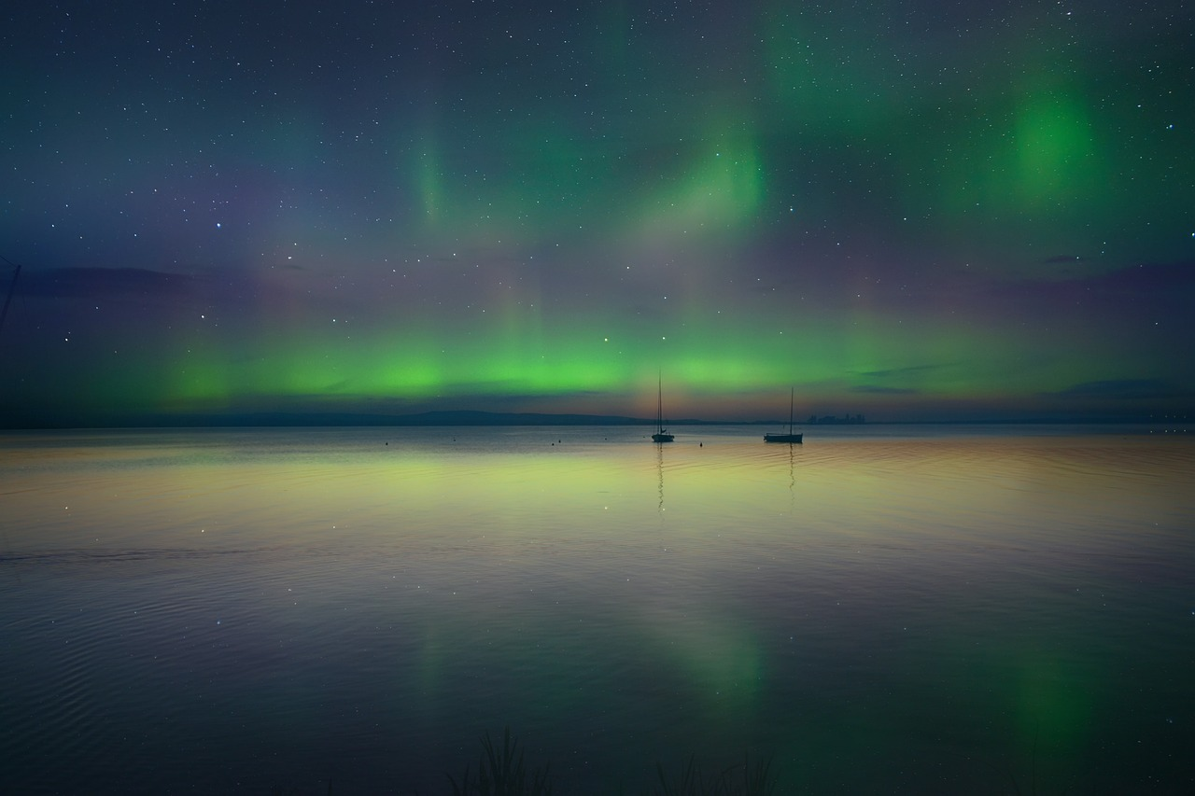
Awe and Wonder
Notes:
Talk partners for 3 minutes
Gather responses

Slide 3
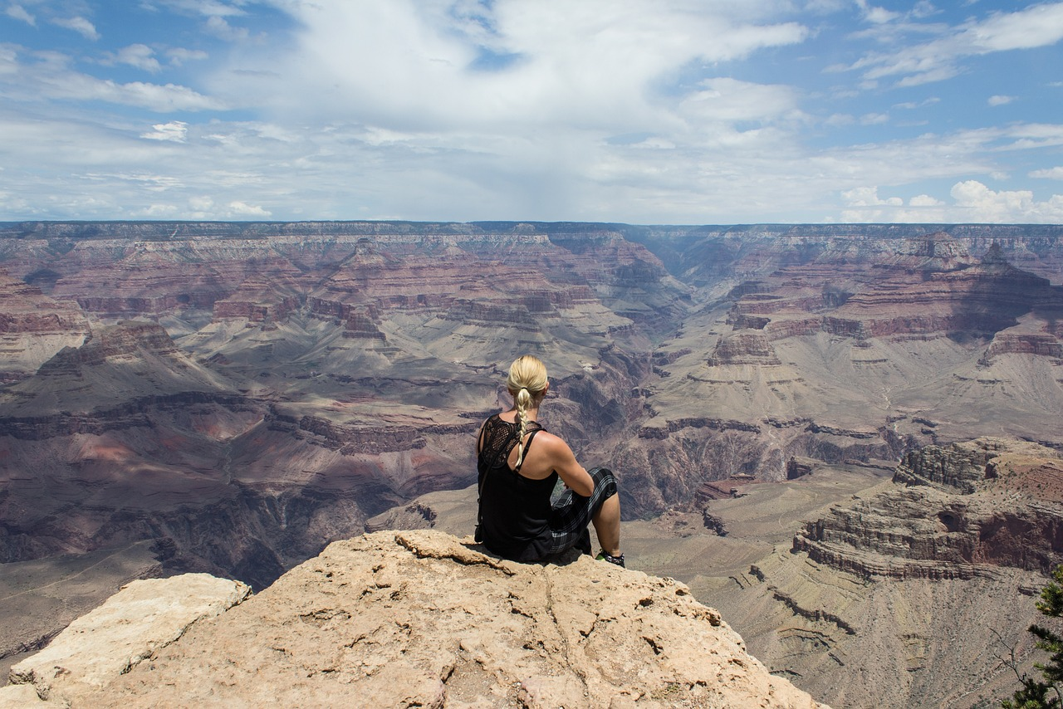
Awe and Wonder
Notes:
Talk partners for 3 minutes
Gather responses

Slide 4
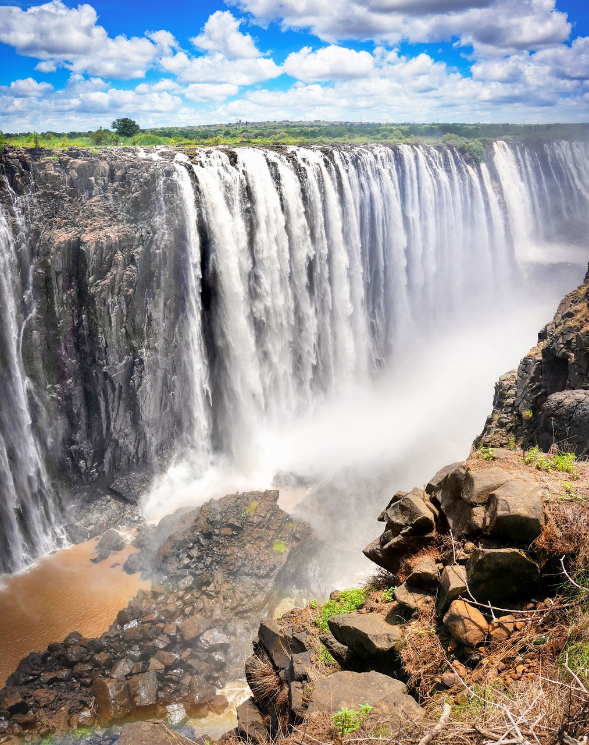
Awe and Wonder
Notes:
Talk partners for 3 minutes
Gather responses

Slide 5
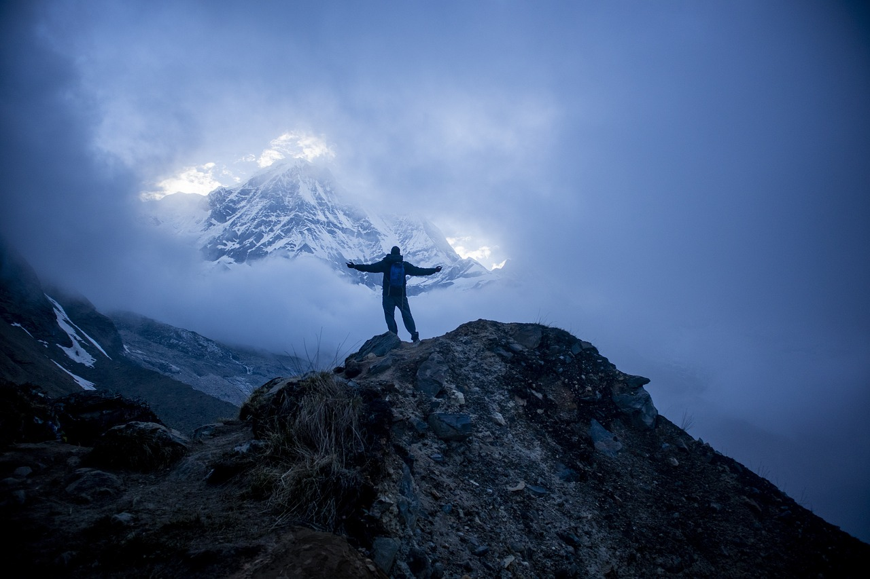
Awe and Wonder
Notes:
Talk partners for 3 minutes
Gather responses

Slide 6
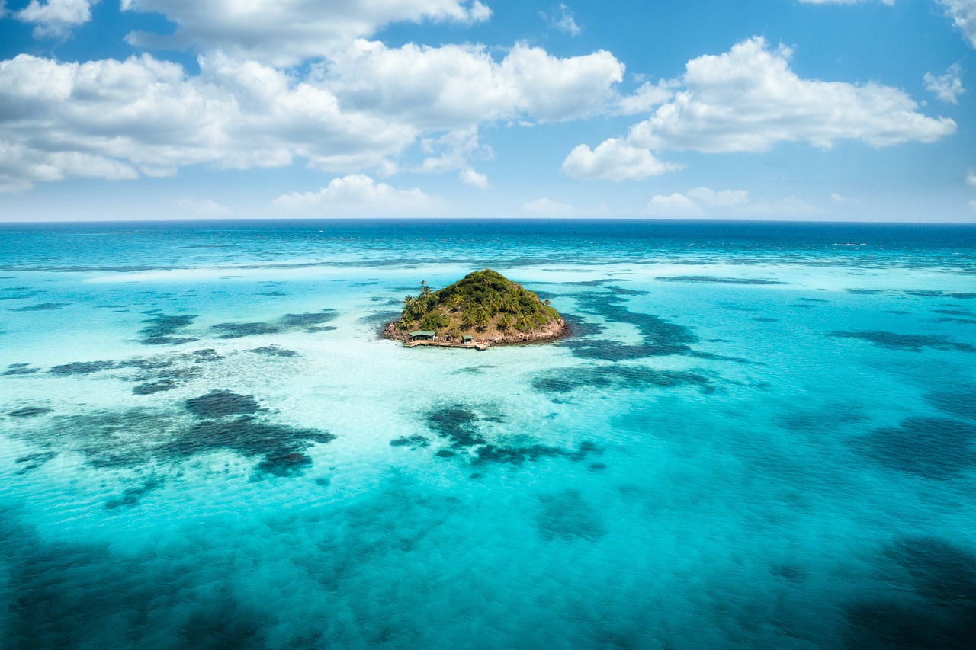
Awe and Wonder
Notes:
Talk partners for 3 minutes
Gather responses

Slide 7
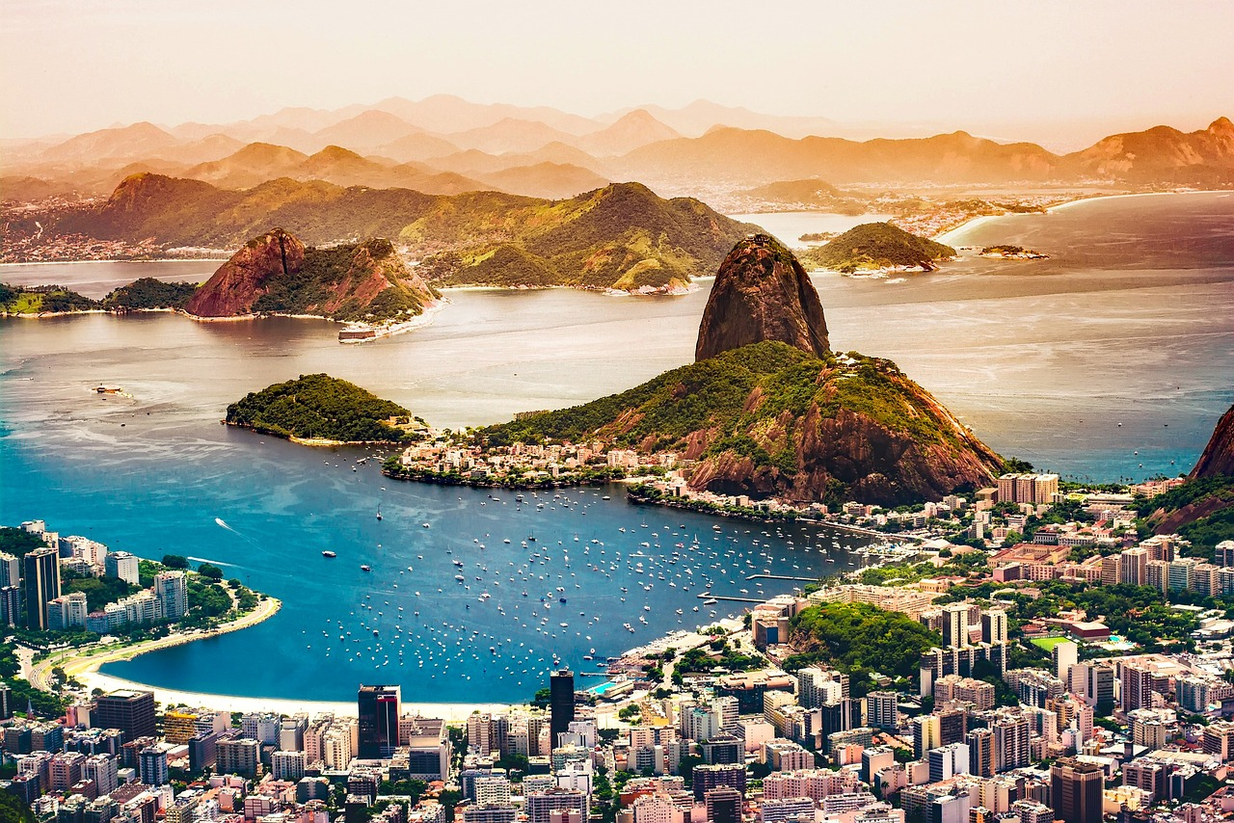
Awe and Wonder
Notes:
Talk partners for 3 minutes
Gather responses

Slide 8
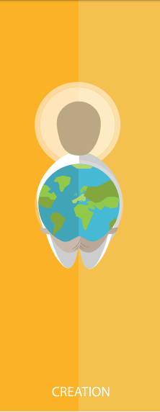
Catholic Social Teaching

Slide 9
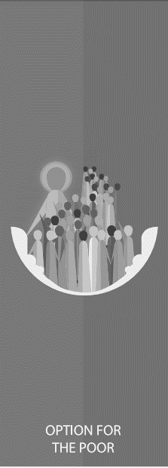
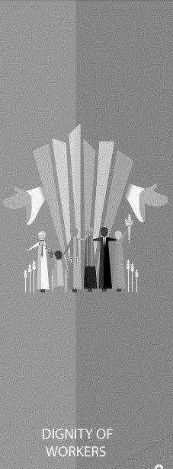
Catholic Social Teaching

Slide 10
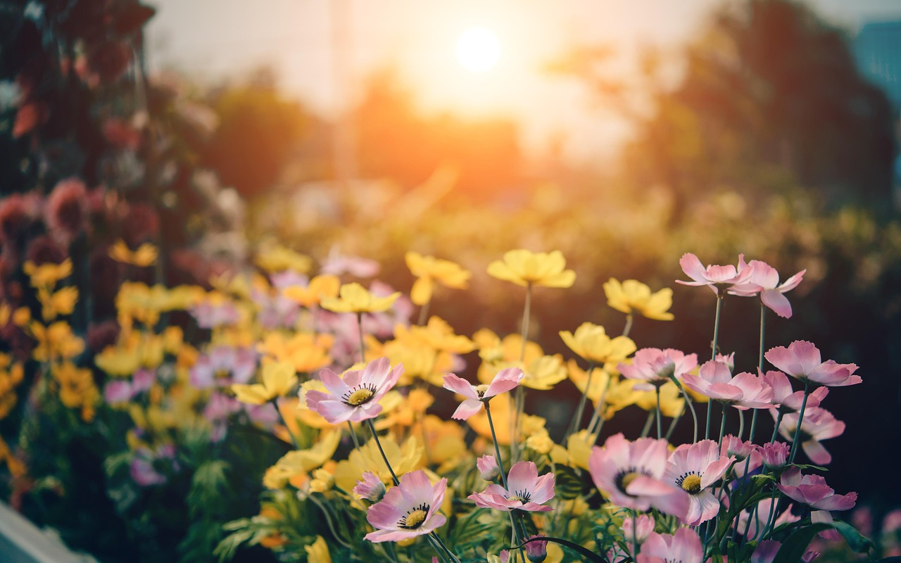
Reading Scripture
‘God put people in the Garden of Eden to take care of it.’
Genesis 2:15

Slide 11
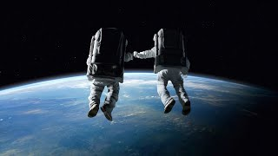
The World is Awesome

Slide 12
Care of Creation
Our world is a wonderful place.
What do you love about our world and the environment?

Slide 13
Care of Creation
God made the world for us.
The world is everyone’s home.
We need to look after it.

Slide 14
Care of Creation
Being a steward of creation means being someone who cares for the world.

Slide 15
Care of Creation
What can we do to look after our world?
What can we do to be good stewards of creation?

Slide 16
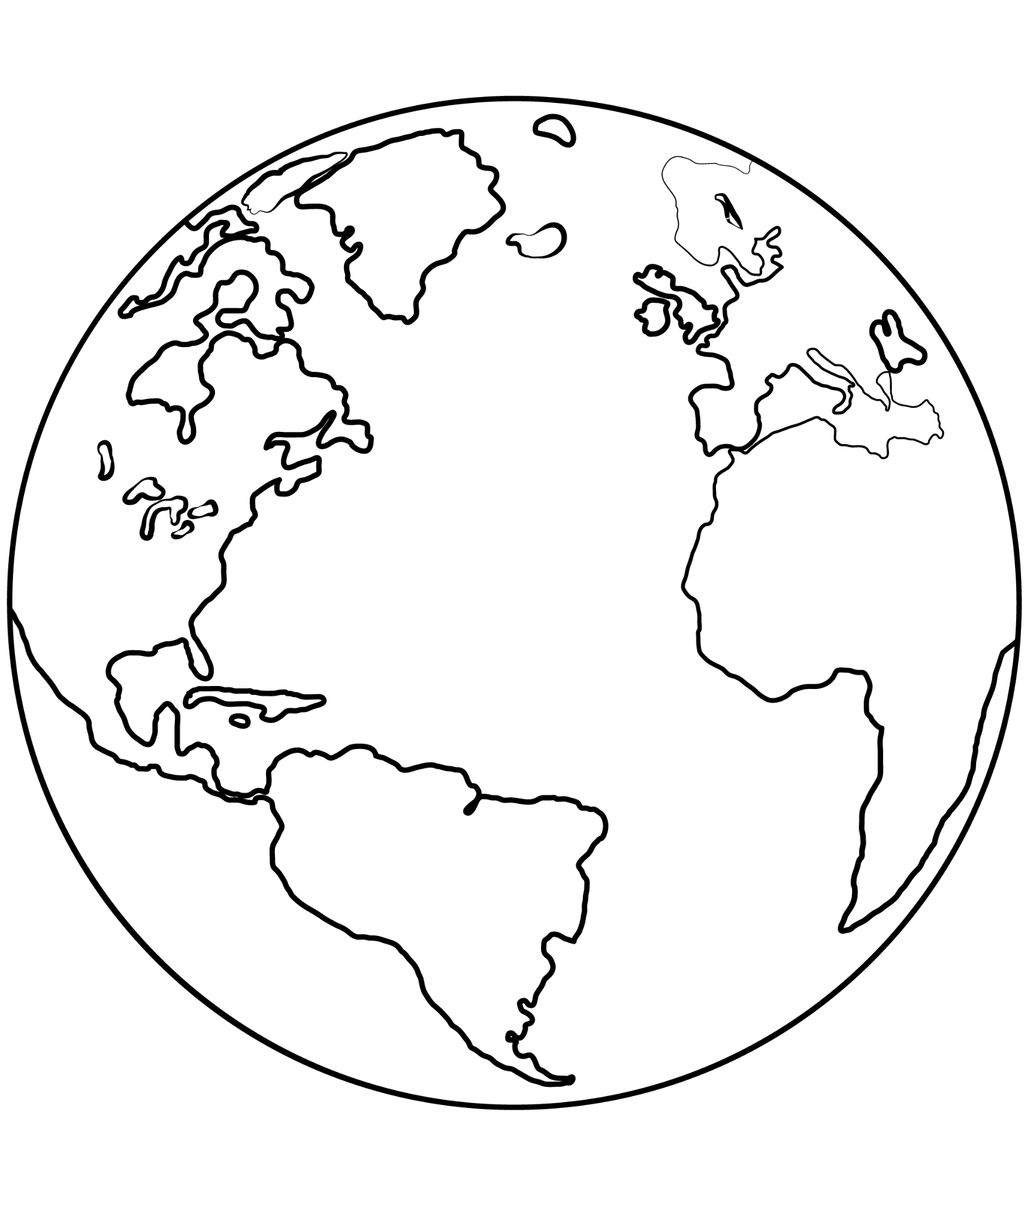
Main Activity
Inside the template, write all the things you love about the planet.
Outside the template, write down all the things you do or will do to look after the planet.
Include why you do these things, linking to Genesis.

Slide 17
Main Activity
3. Retell the story of the Garden of Eden from Genesis by acting it out.
Frame your scene with someone not doing right by the planet. Act out the story for them, to show them why it is our Christian duty to be good stewards of the earth.

Slide 18
Let’s Sing!

Slide 19
Let us pray
Loving Father, We praise you for the beautiful sun and the rain which makes things grow. For the bush and the paddocks, for the sea and the sky, for the flowers and the birds and for your gifts to us. Everything around us sings with joy. With all you made, we sing for joy too!
Amen.

