Slide 1
Preferential Option for the Poor
Year 1

Slide 2
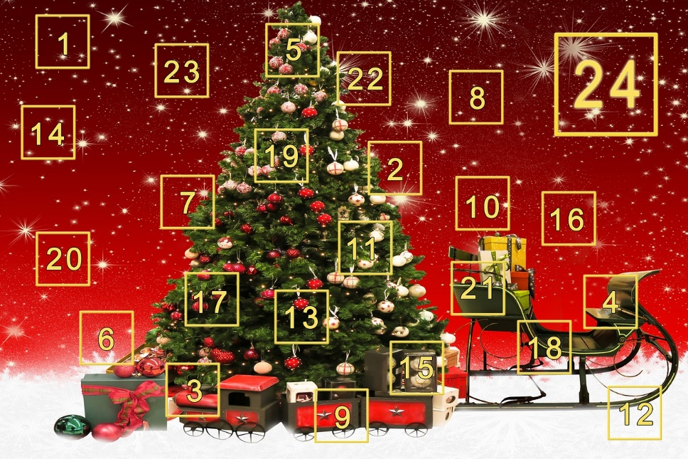
Starter
Notes:
What do these symbols mean to you? What happens during Advent and Christmas? What is this season for?

Slide 3
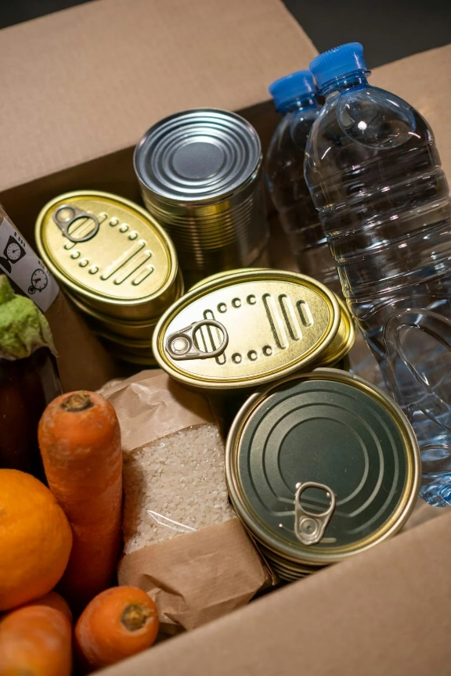
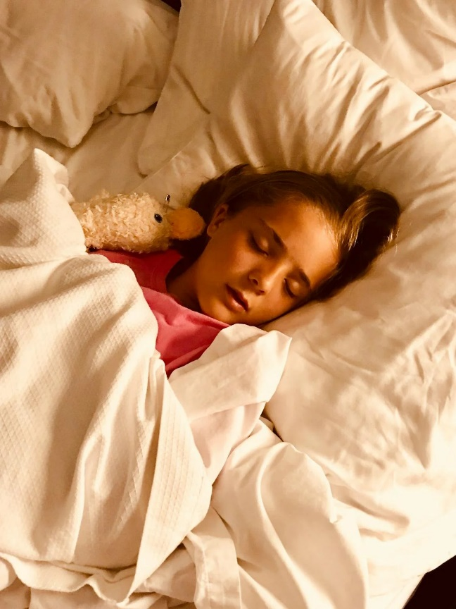
Starter
Notes:
Some people go without even their basic needs so this Christmas, all they’ll be looking for are things like food, clothes, a warm place to shelter

Slide 4
Starter
Notes:
Explain that charities exist to help these people. But where do they get their money from? Why do people give to charity? Why is it important?

Slide 5
Catholic Social Teaching

Slide 6
Catholic Social Teaching

Slide 7
Preferential Option for the Poor
God wants us to help those in need, like Jesus did.
Can you think of the ways Jesus helped those in need?

Slide 8
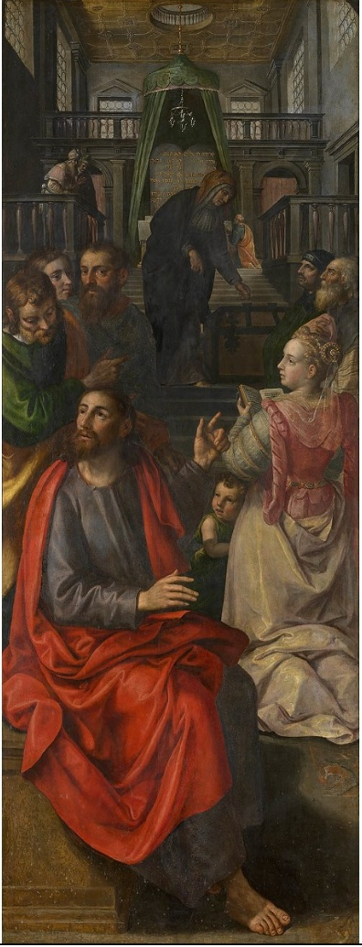
The Widow’s Offering (Mark 12: 41-44)
Notes:
Share this story from your children’s bible and at the end ask, what happened? Why did Jesus say the woman’s offering was worth more?

Slide 9
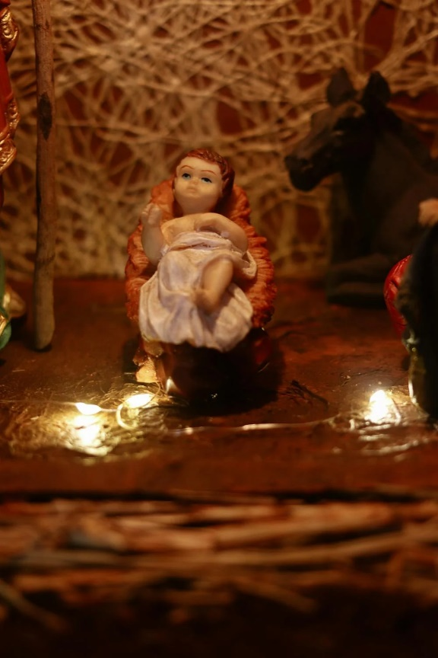
Preferential Option for the Poor
Notes:
Explain to the children that Christ’s birth reminds us that we need to live more simply and think about others; even if don’t give a lot, it’s our intention to help those in greater need that means we are doing our duty as Catholics.

Slide 10
My Friend Andy by Emma Chinnery
Notes:
Read this story. Why might Lilly’s mum not have wanted Fluffy to play with Andy? Explain the importance of seeing everyone as being made in God’s image so we should treat every fellow human with love and respect, especially those in greater need.

Slide 11
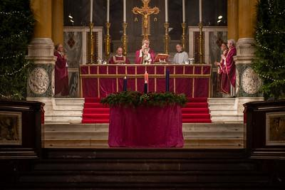
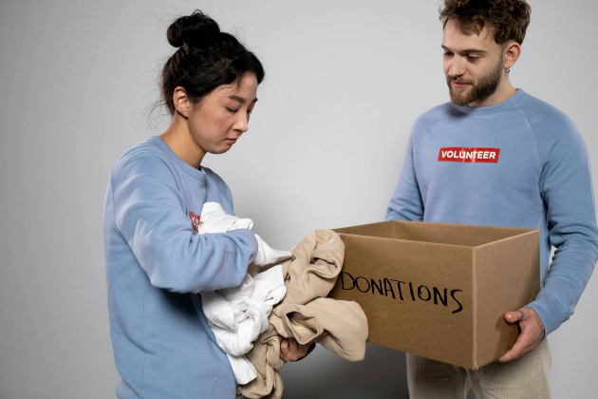
What can you do?
Notes:
Get children to discuss ideas for what they and their families could do this Advent e.g. save coins in a jar and donate at the end of the Christmas season; donate food/clothes to foodbanks; sacrifice a gift off your list and exchange that for a toy for a child in need. Share pictures of these things to prompt thinking and encourage children to verbalise what these actions are to their partners.

Slide 12
Main Activity
Record a video message for your school website, explaining that Advent is a time of giving and what you and they could do to help those less fortunate.
Include:
-What Advent and Christmas is about
-How your own experience of Advent and Christmas might be different to theirs
-How The Widow’s Offering story helps us understand what God wants of us
Notes:
Children can use My Friend Andy to frame their response. Perhaps some could do a role play of the story as part of their video and explain why it’s important to help those in need, especially during Advent. Children working at greater depth should be linking to Scripture. Other scripture stories could include: The Good Samaritan

Slide 13
Plenary
‘Be generous and willing to share.’
1Timothy 6:18
Can you tell your partner about a time when you were generous or someone was generous to you?
Notes:
Finish with a prayer with generosity and helping those in need as a theme

Slide 14
Jubilee Year 2025
Pope Francis has declared this year’s Jubilee theme to be: Pilgrims of Hope
Why might Pope Francis think ‘hope’ is an important thing to focus on in 2025?
Notes:
Pope Francis will open the Holy Door of St Peter’s Basilica on Christmas Eve 2024, marking the beginning of this jubilee year. Pope Francis has called for people of faith to pray for and have deep faith, lively hope and active charity. Explain to the children why this jubilee year is a great time to be very active in charity, which is what we’re working towards in our CST lessons.

