Slide 1
Care of Creation
Year 2

Slide 2
What’s in the box?
Notes:
Talk partners for 3 minutes
Gather responses

Slide 3
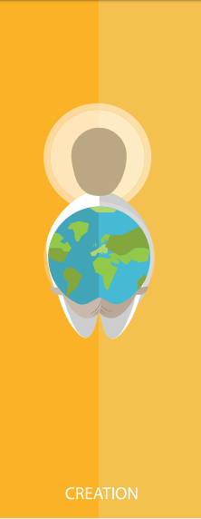
Catholic Social Teaching

Slide 4
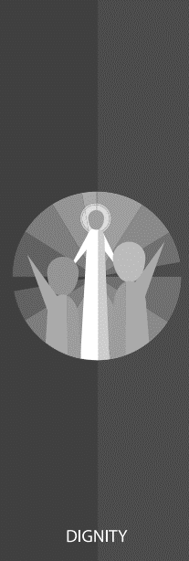
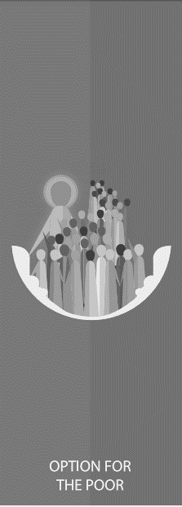
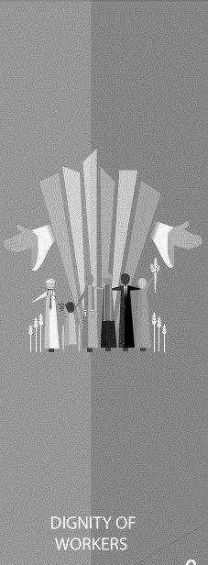
Catholic Social Teaching

Slide 5
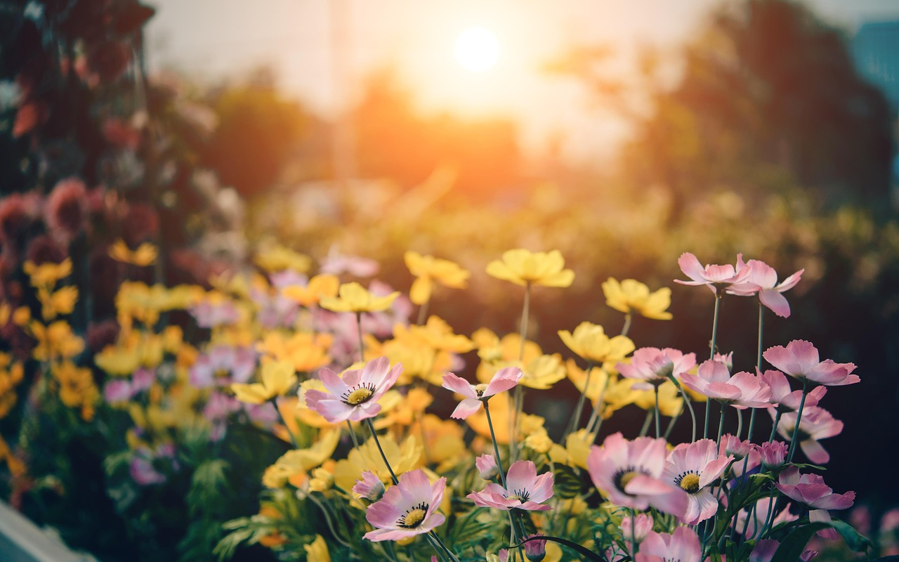
Care of Creation
‘God put people in the Garden of Eden to take care of it.’
Genesis 2:15

Slide 6
Stewardship
Click me!
What is the problem?
Who is responsible?
How is it resolved?
Greta and the Giants

Slide 7
Care of Creation
Our world is a wonderful place.
What do you love about our world?
What do you love about the environment?

Slide 8
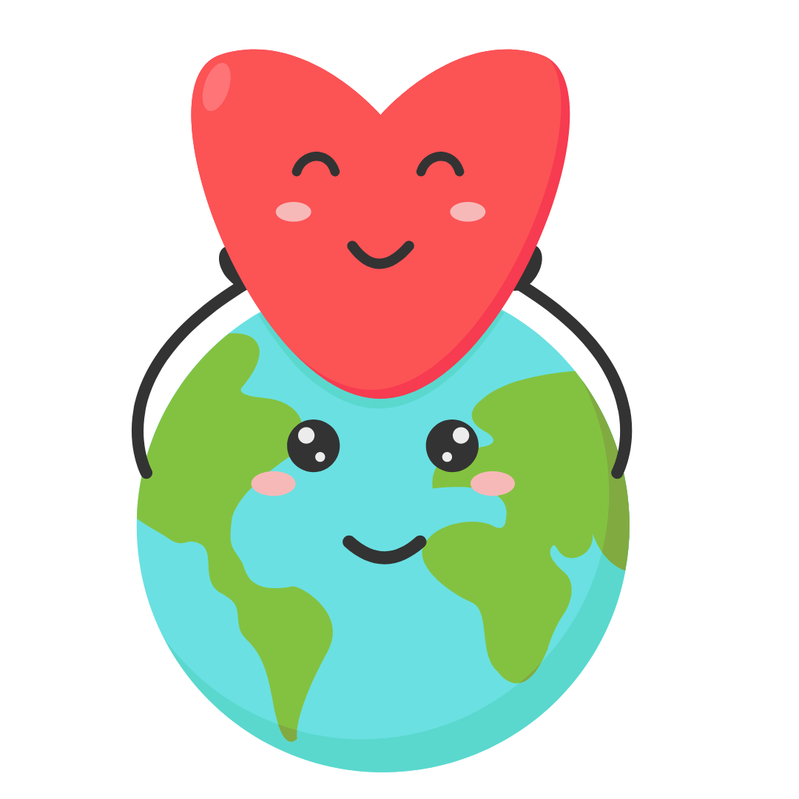
Care of Creation
God made the world for us.
The world is everyone’s home.
We need to look after it.

Slide 9
Care of Creation
Being a steward of creation means being someone who cares for the world.

Slide 10
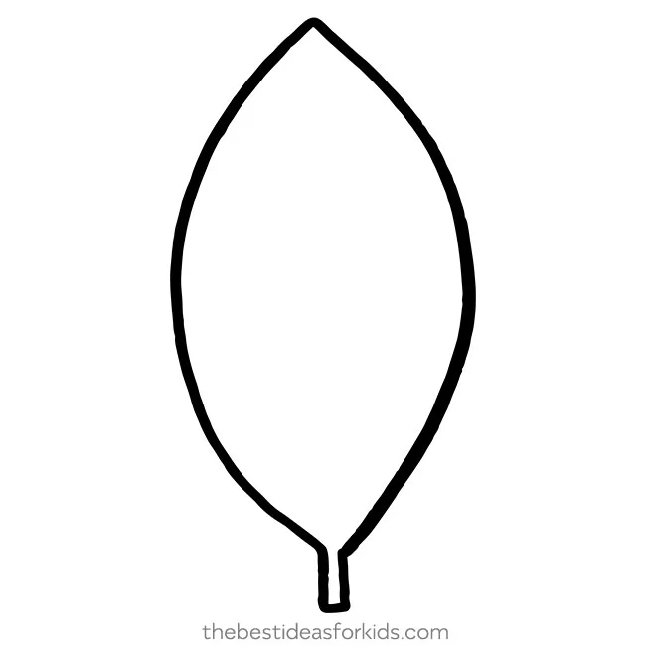
Main Activity
Draw/write about your favourite natural space
-What do you love about it? Why?
-What would it be like if this place wasn’t there? How would you feel?
-What is one thing you can do to protect this place?
Write a thank you note to one of the characters from Greta and the Giants
-Use some religious words to say why this matters to you so much
-Say why this matters to you by linking to Genesis and stewardship
Scripture
Genesis
Stewardship
Made in God’s image
Creation
Duty
Prayer

Slide 11
What would you like to do next?
Click me!
Greta and the Giants

