Slide 1
Preferential Option for the Poor
Year 2

Slide 2
What’s in the stocking?
Notes:
Why might we be pulling out these toys? (Often people get new, exciting things at Christmas but there are many people who not only go without new toys but without their basic needs)

Slide 3
Catholic Social Teaching

Slide 4
Catholic Social Teaching

Slide 5
Preferential Option for the Poor
God wants us to help those in need, like Jesus did.
Can you think of the ways Jesus helped those in need?

Slide 6
Preferential Option for the Poor
Jesus showed us how to care for those in need.
He showed us how to love and give to them.

Slide 7
Preferential Option for the Poor
‘Be generous and willing to share.’
1Timothy 6:18
What does ‘be generous’ mean?

Slide 8
Preferential Option for the Poor
‘Blessed are you who are poor, for yours is the kingdom of God. Blessed are you who hunger now, for you will be satisfied. Blessed are you who weep now, for you will laugh.’
Luke 6:20-21

Slide 9
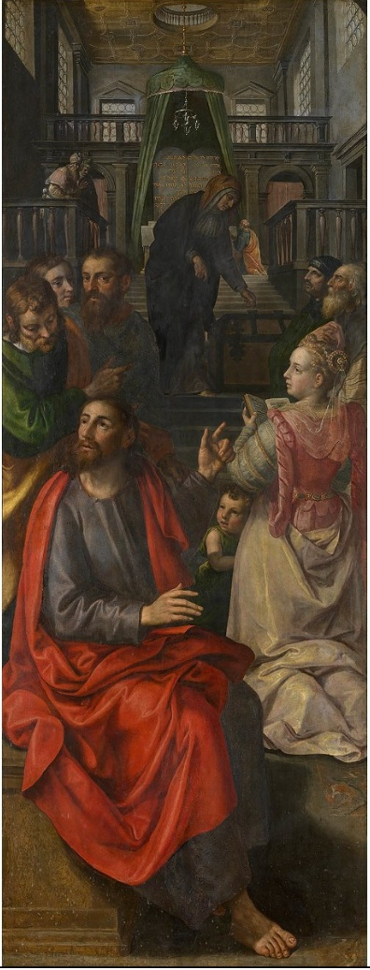
The Widow’s Offering (Mark 12: 41-44)
Notes:
Read this story from your school children’s bible. What happened in the story? Why did Jesus say the Widow’s offering was worth more? What can we learn from this?

Slide 10
Jubilee Year 2025
Pope Francis has declared this year’s Jubilee theme to be: Pilgrims of Hope
Why might Pope Francis think ‘hope’ is an important thing to focus on in 2025?
Notes:
Pope Francis will open the Holy Door of St Peter’s Basilica on Christmas Eve 2024, marking the beginning of this jubilee year. Pope Francis has called for people of faith to pray for and have deep faith, lively hope and active charity. Explain to the children why this jubilee year is a great time to be very active in charity, which is what we’re working towards in our CST lessons.

Slide 11
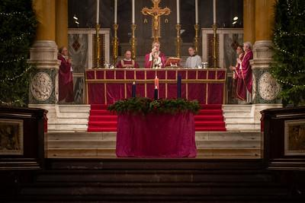
Preferential Option for the Poor
During Advent, we often think about what we would like for Christmas.
Instead, think:
What could you do for those in need?

Slide 12
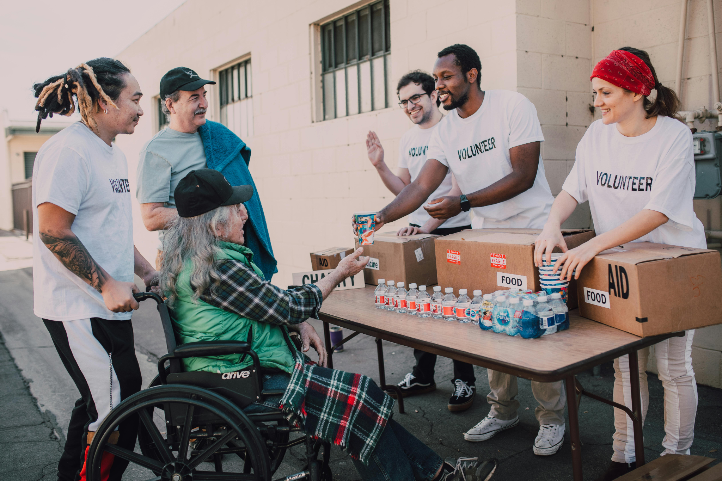
Main Activity
Create a Reverse Christmas List.
Write/draw a list of what you could collect and give to a local charity for those in need.
Include:
-The true meaning of Advent as a time of preparation, reflection, forgiveness, giving
-Questions of wonder about why the meaning of Advent may now be lost and how giving during this season can help bring it back

Slide 13
What’s in the stocking now?
Notes:
Pull out charity logos from another stocking, discussing their work. Pin them up as you go. Which charity is interesting to the children? Why might they want to support them this Advent?

