Slide 1
Care of Creation
Year 3

Slide 2
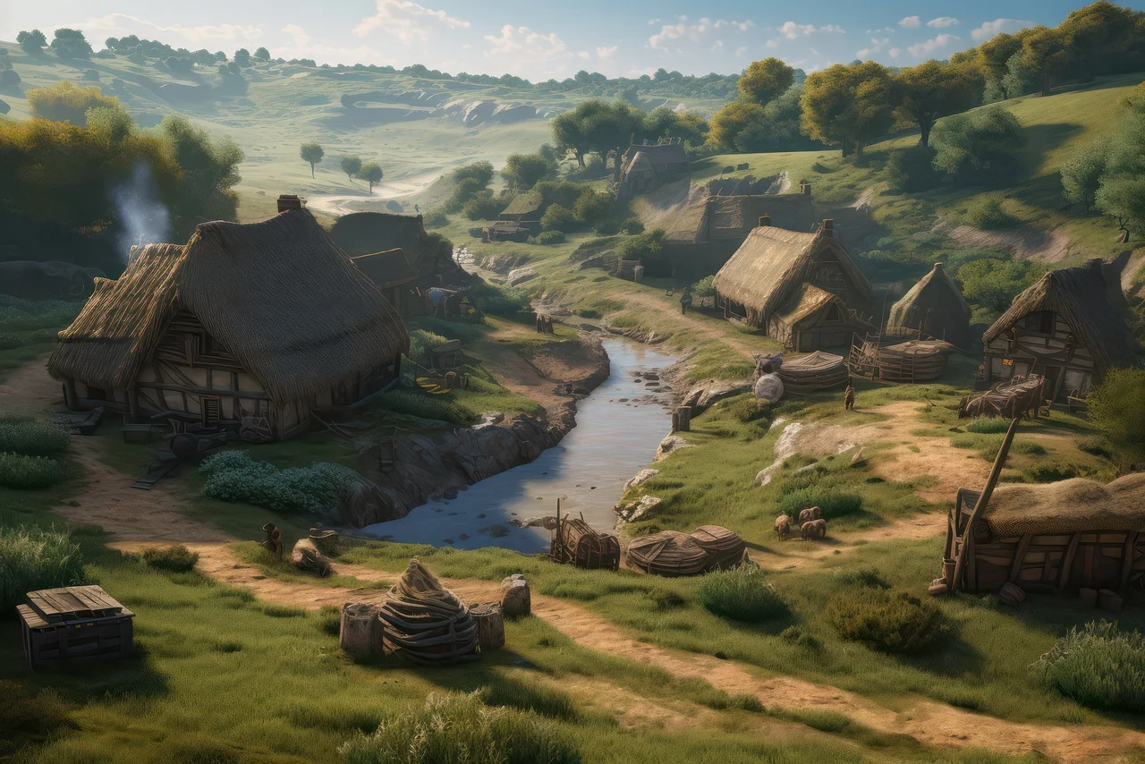
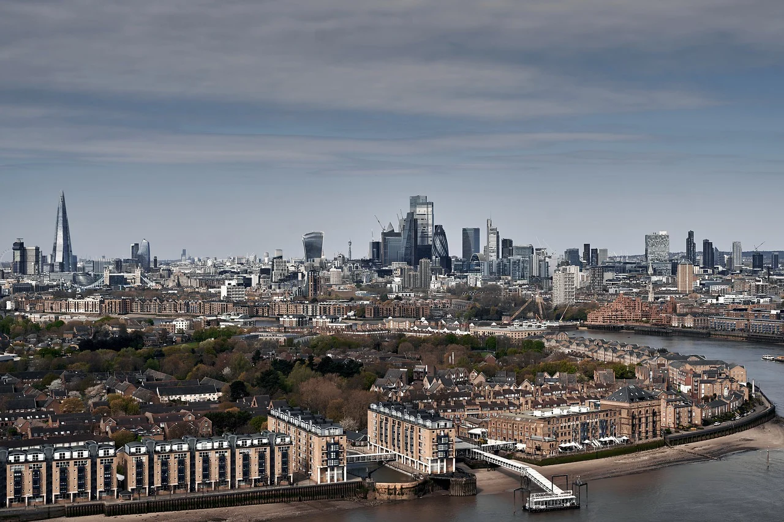
Then and Now… What do you notice?
Notes:
Talk partners for 3 minutes
Gather responses

Slide 3
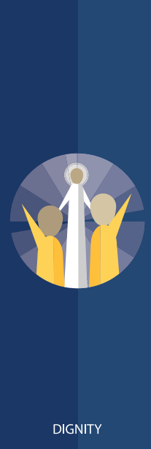
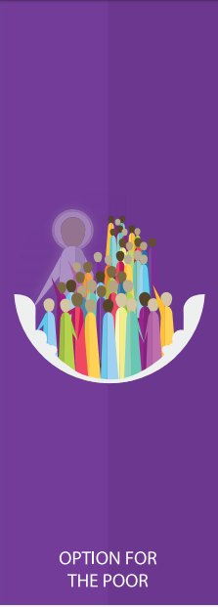
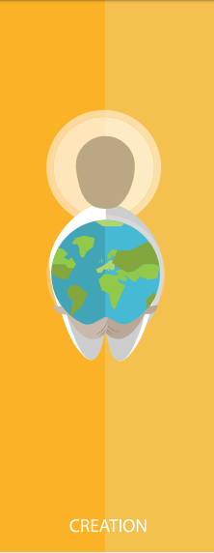
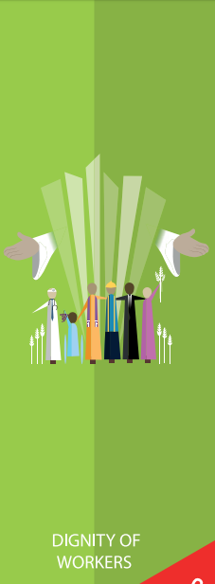
Catholic Social Teaching

Slide 4
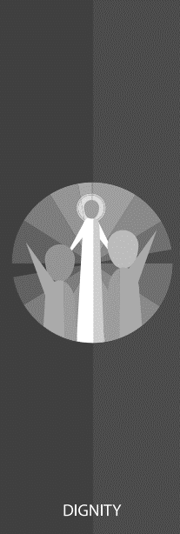
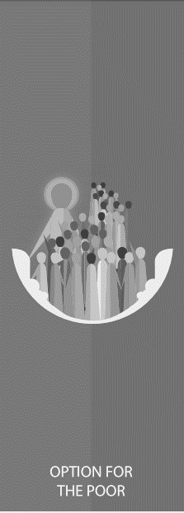
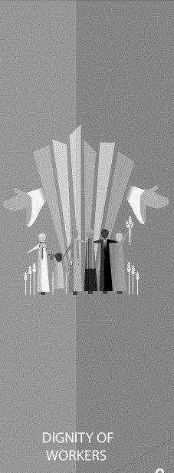
Catholic Social Teaching

Slide 5
Care of Creation
We are created by God to live in a community together.
God did not just create us but the whole of the world, and we must live in harmony with the whole of his creation.

Slide 6
Care of Creation
How we treat the Earth affects us now and will affect people in the future.
Why is it important to look after our world?

Slide 7
Care of Creation
‘In the beginning, God created the Heavens and the Earth… God saw everything that He had made, and indeed, it was very good.’
Genesis 1:1-4
‘The Lord God put humans in the Garden of Eden to work it and take care of it.’
Genesis 2:15

Slide 8
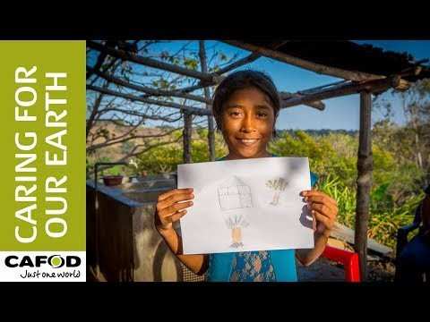
What kind of prayer is this?

Slide 9
Main Activity
Write your own prayer of petition, asking God for different characteristics you need to be the best steward of His planet.
Try to include:
References to Genesis as a source for knowing about being a steward of God’s creation.
How your Christian beliefs inform your actions now, in order to help future generations

Slide 10
Young people CAN!
‘What kind of world do we want to leave to those who come after us, to children who are now growing up?’
Pope Francis, Laudato Si
Click me!
How YOU can make change

