Slide 1
Preferential Option for the Poor
Year 3

Slide 2
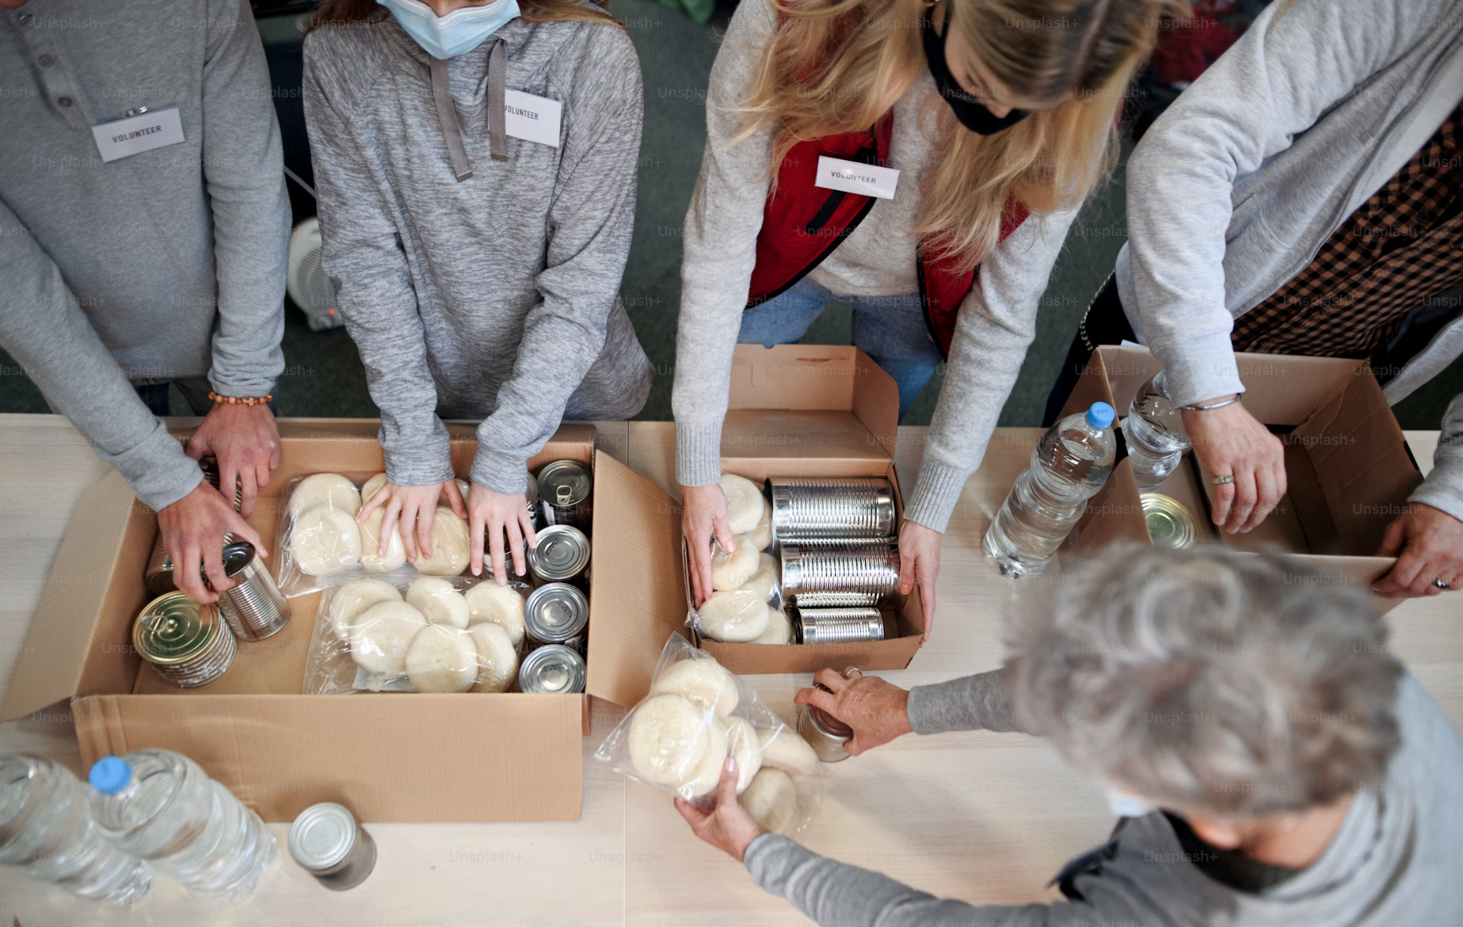
Notes:
What is this picture of? What is happening? Why do you think people are queuing for a food bank? What does this service provide? What does this picture tell us about how people are living in the UK in 2024?

Slide 3
Catholic Social Teaching

Slide 4
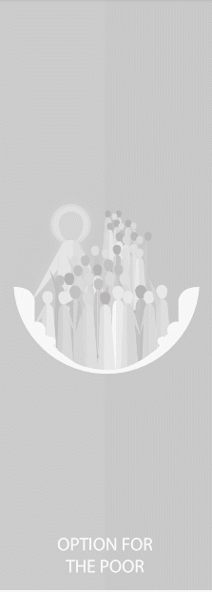
Catholic Social Teaching

Slide 5
Jubilee Year 2025
Pope Francis has declared this year’s Jubilee theme to be: Pilgrims of Hope
Why might Pope Francis think ‘hope’ is an important thing to focus on in 2025?
Notes:
Pope Francis will open the Holy Door of St Peter’s Basilica on Christmas Eve 2024, marking the beginning of this jubilee year. Pope Francis has called for people of faith to pray for and have deep faith, lively hope and active charity. Explain to the children why this jubilee year is a great time to be very active in charity, which is what we’re working towards in our CST lessons.

Slide 6
Preferential Option for the Poor
What might the word ‘preferential’ mean?
What might it mean to give someone the ‘preferential option’?

Slide 7
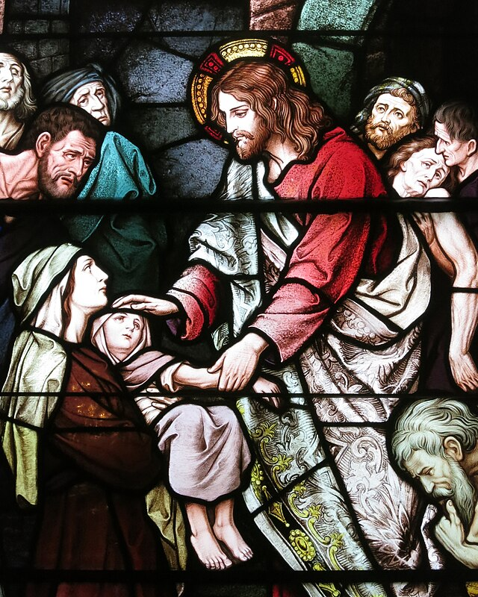
Preferential Option for the Poor
In the Gospels, Jesus shows a preferential option for the poor by putting them first. He gives them special importance by thinking of their needs and helping them have their rightful place in the world.
Jesus
Father of the Poor

Slide 8
Preferential Option for the Poor
‘If anyone is well off in worldly possessions and sees their sister or brother in need but closes their heart to them, how can the love of God be remaining in them?’
1 John 3.17-18

Slide 9
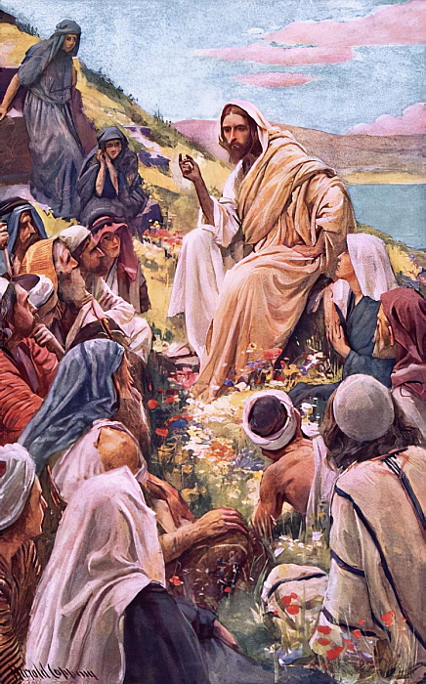
Preferential Option for the Poor
‘Looking at his disciples, he said: ‘Blessed are you who are poor, for yours is the kingdom of God. Blessed are you who hunger now, for you will be satisfied. Blessed are you who weep now, for you will laugh.’
Luke 6:20-21

Slide 10
Preferential Option for the Poor
‘Speak up for those who cannot speak for themselves, for the rights of all who are destitute. Speak up and judge fairly; defend the rights of the poor and needy.’
Proverbs 31:8-9
Why are we called to speak up on behalf of those in need?

Slide 11
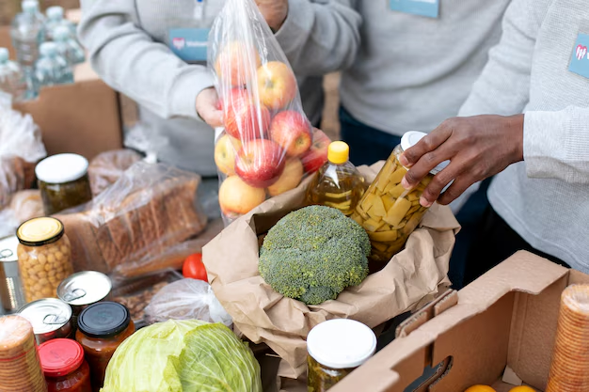
What can you do to help?

Slide 12
Main Activity
Create your own Advent giving calendar, including something they should bring into the school food bank each day.
Think about including:
Food and toiletries that are needed by your local foodbank
Relevant Scripture extracts that could accompany some of the items
Writing a piece for the school newsletter about what you’re doing and why it’s important, as Catholics, to give a preferential option to the poor.

Slide 13
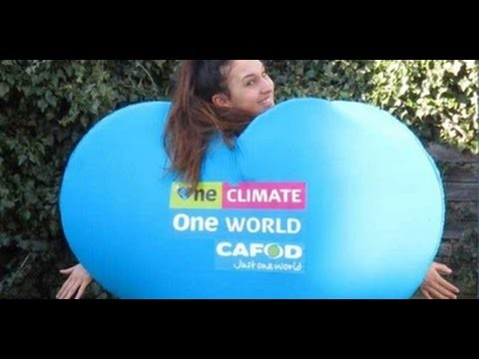
Am I doing that?

Slide 14
Jubilee Prayer
Father in heaven,
may the faith you have given us
in your son, Jesus Christ, our brother,
and the flame of charity enkindled
in our hearts by the Holy Spirit,
reawaken in us the blessed hope
for the coming of your Kingdom.
May your grace transform us
into tireless cultivators of the seeds of the Gospel.
May those seeds transform from within both humanity and the whole cosmos
in the sure expectation
of a new heaven and a new earth,
when, with the powers of Evil vanquished,
your glory will shine eternally.
May the grace of the Jubilee
reawaken in us, Pilgrims of Hope,
a yearning for the treasures of heaven.
May that same grace spread
the joy and peace of our Redeemer
throughout the earth.
To you our God, eternally blessed,
be glory and praise for ever.
Amen
Notes:
Finish with the Jubilee prayer, reflecting on today’s learning

