Slide 1
Care of Creation
Year 4

Slide 2
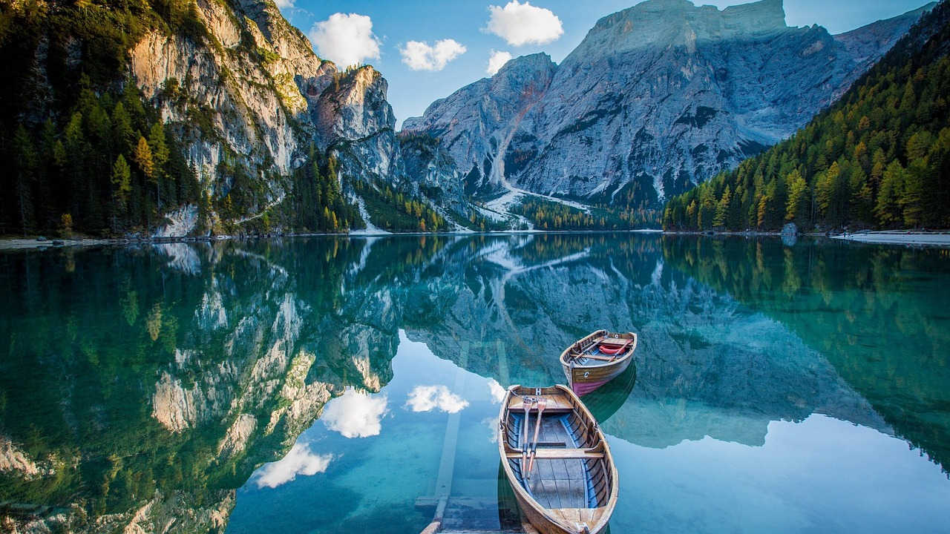
What does David mean: work with nature?
David Attenborough
Notes:
Talk partners for 3 minutes
Gather responses

Slide 3
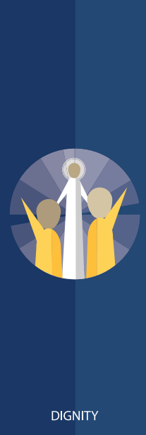
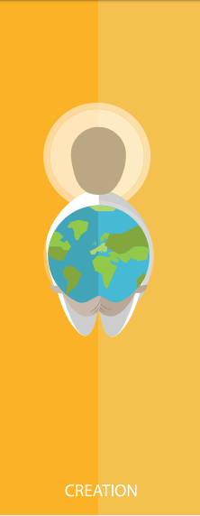
Catholic Social Teaching

Slide 4
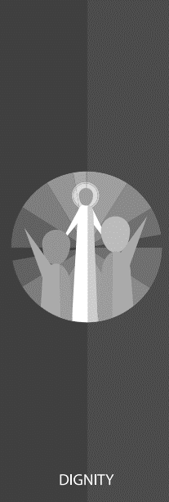
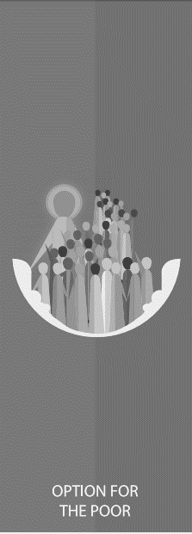
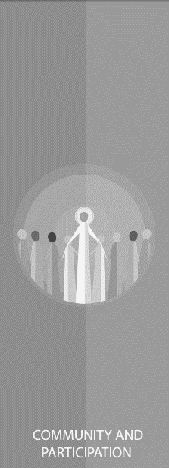
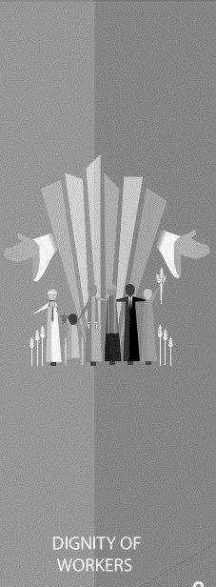
Catholic Social Teaching

Slide 5
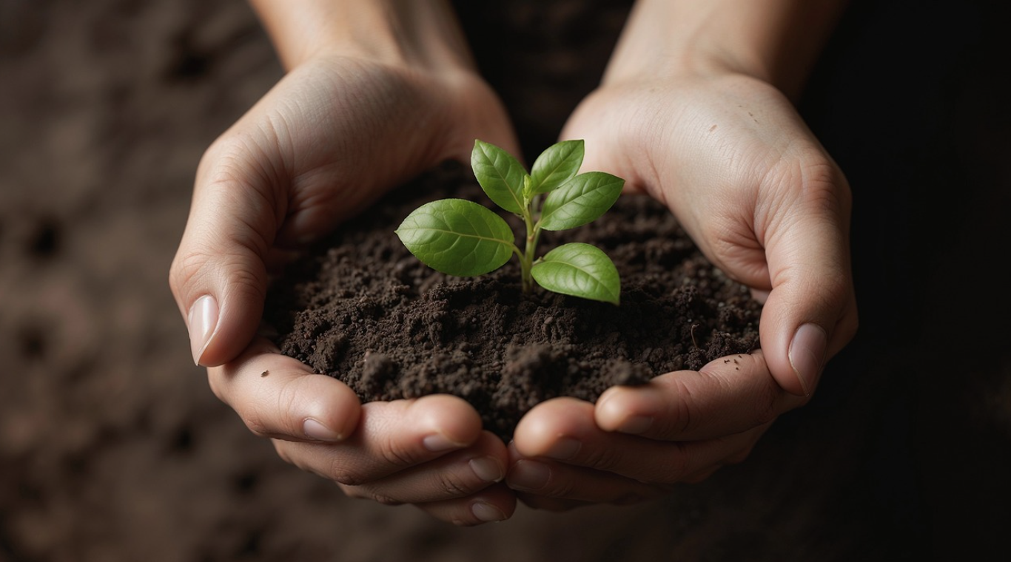
The Responsibility of Stewardship

Slide 6
Care of Creation
‘In the beginning, God created the Heavens and the Earth… God saw everything that He had made, and indeed, it was very good.’
Genesis 1:1-4
‘The Lord God put humans in the Garden of Eden to work it and take care of it.’
Genesis 2:15

Slide 7
The Garden of Eden in Art
Can you see Scripture in these paintings?

Slide 8
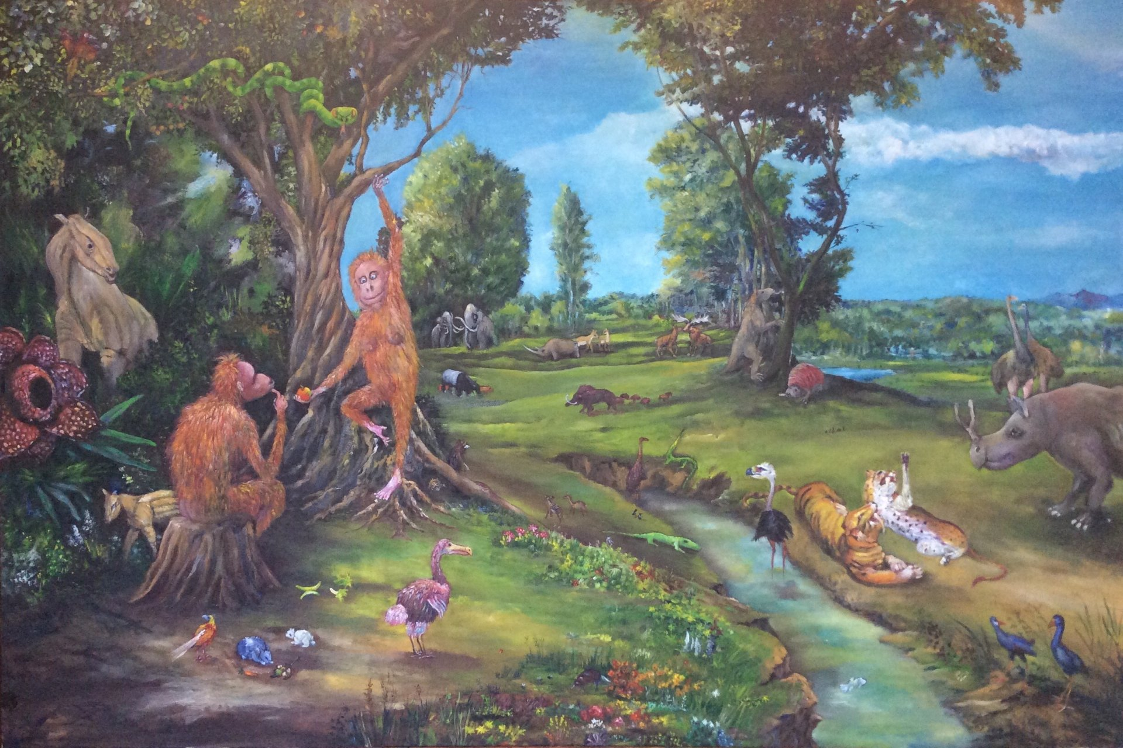
The Garden of Eden in Art
Notes:
Note from the artist: the basic composition and original inspiration come from a Rubens work. I was light-heartedly exploring the link between Darwinian theory and The Creation as in Genesis. As an artist, I find The Old Testament has the best stories. Image courtesy of Mark Pender Art

Slide 9
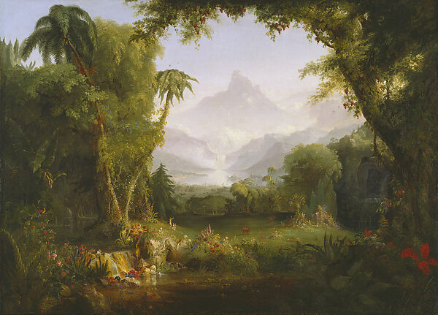
The Garden of Eden in Art

Slide 10
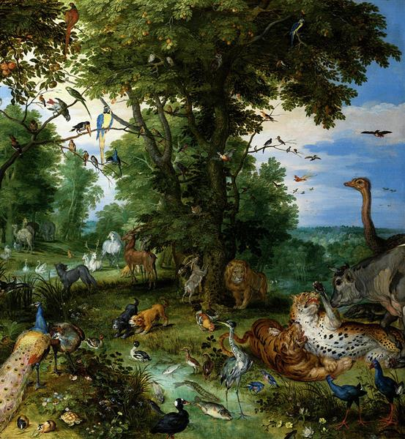
The Garden of Eden in Art

Slide 11
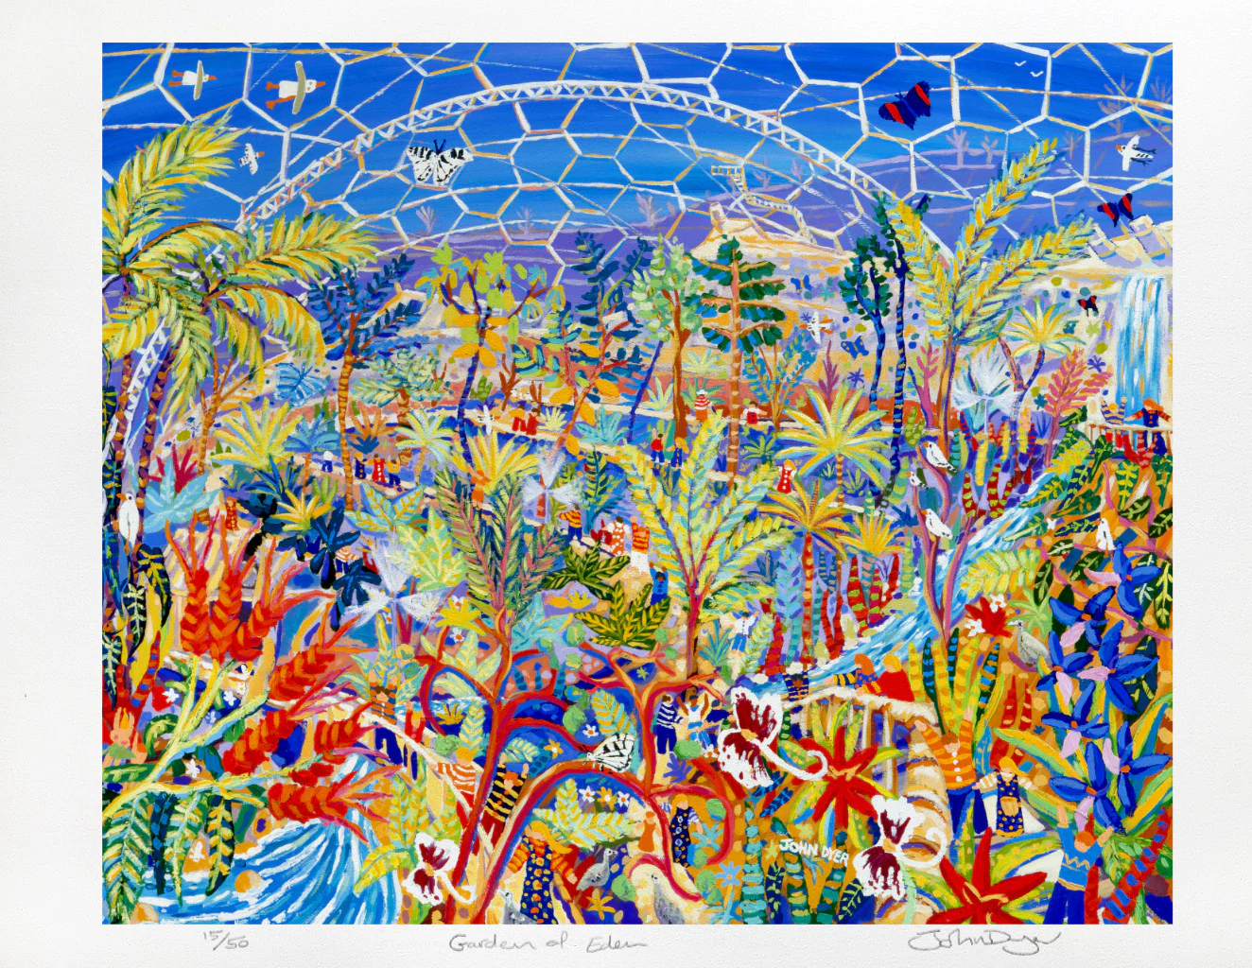
The Garden of Eden in Art
Notes:
Image courtesy of The John Dyer Gallery

Slide 12
Main Activity
Annotate each painting, making reference to where it is (or is not) directly influenced by Genesis. Include:
Christian beliefs and duty to care for the environment e.g. ‘God made beautiful trees grow.’ This is why we re-plant…
Your painting preference because of its Scriptural influence and relevance to environmental issues today.

Slide 13
Plenary
‘What kind of world do we want to leave to those who come after us, to children who are now growing up?’
Pope Francis, Laudato Si
What would that world look like?
What would it be like to live in?

Slide 14
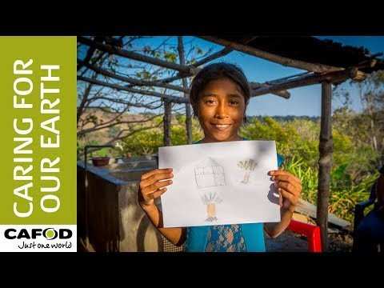
Care of Creation

