Slide 1
Preferential Option for the Poor
Year 4

Slide 2
Starter
Fair Share Game
Notes:
You will need 10 paper money notes from the resource pack
Ask for 10 volunteers to stand in a line. This line represents the entire population of the UK. These 10 notes represent all of the wealth of the UK, so each one represents 10% of UK wealth.
Ask the group how the wealth should be divided up amongst the group and pass out the money. Why?
Then ask how they think it is divided up and redistribute the money. Why?
Then show them how it is actually divided:
4 people get 1 note to share between them (10% of UK wealth between 40% of people)
2 people get 1 note to share between them (10% of UK wealth between 20% of people)
2 people get 2 notes each (20% of UK wealth between 20% of people)
1 person gets 2 notes(20% of UK wealth between 10% of people)
1 person gets 4 notes (40% of UK wealth between 10% of people)

Slide 3
Starter
Do you think this is fair?
How would you feel if you had the four notes to yourself?
How would you feel if you had to share one with four other people?

Slide 4
Catholic Social Teaching

Slide 5
Catholic Social Teaching

Slide 6
Jubilee Year 2025
Pope Francis has declared this year’s Jubilee theme to be: Pilgrims of Hope
Why might Pope Francis think ‘hope’ is an important thing to focus on in 2025?
Notes:
Pope Francis will open the Holy Door of St Peter’s Basilica on Christmas Eve 2024, marking the beginning of this jubilee year. Pope Francis has called for people of faith to pray for and have deep faith, lively hope and active charity. Explain to the children why this jubilee year is a great time to be very active in charity, which is what we’re working towards in our CST lessons.

Slide 7
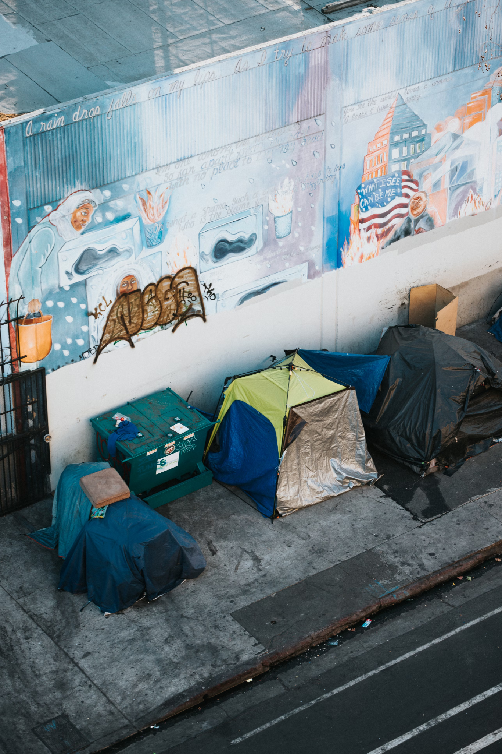
Preferential Option for the Poor

Slide 8
Preferential Option for the Poor
‘If anyone is well off in worldly possessions and sees their sister or brother in need but closes their heart to them, how can the love of God be remaining in them?’
1 John 3.17-18

Slide 9
Preferential Option for the Poor
“The King will reply, ‘Truly I tell you, whatever you did for one of the least of these brothers and sisters of mine, you did for me.’”
Matthew 25: 40

Slide 10
Preferential Option for the Poor
‘Looking at his disciples, he said: ‘Blessed are you who are poor, for yours is the kingdom of God. Blessed are you who hunger now, for you will be satisfied. Blessed are you who weep now, for you will laugh.’
Luke 6:20-21

Slide 11
Preferential Option for the Poor
‘Speak up for those who cannot speak for themselves, for the rights of all who are destitute. Speak up and judge fairly; defend the rights of the poor and needy.’
Proverbs 31:8-9

Slide 12
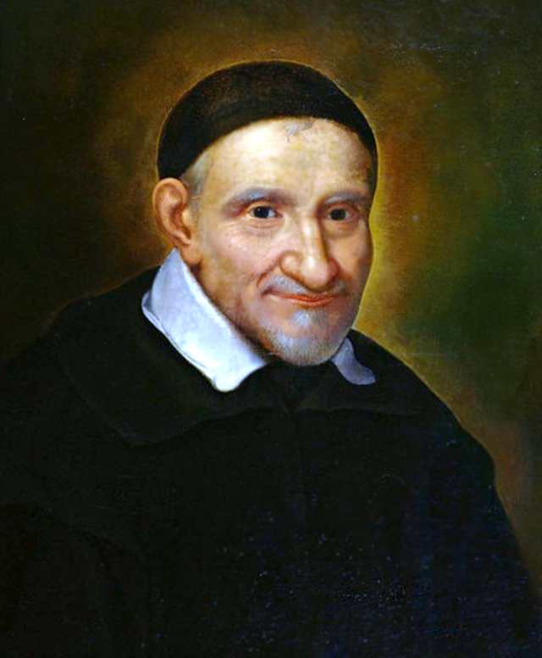
St Vincent de Paul Society

Slide 13
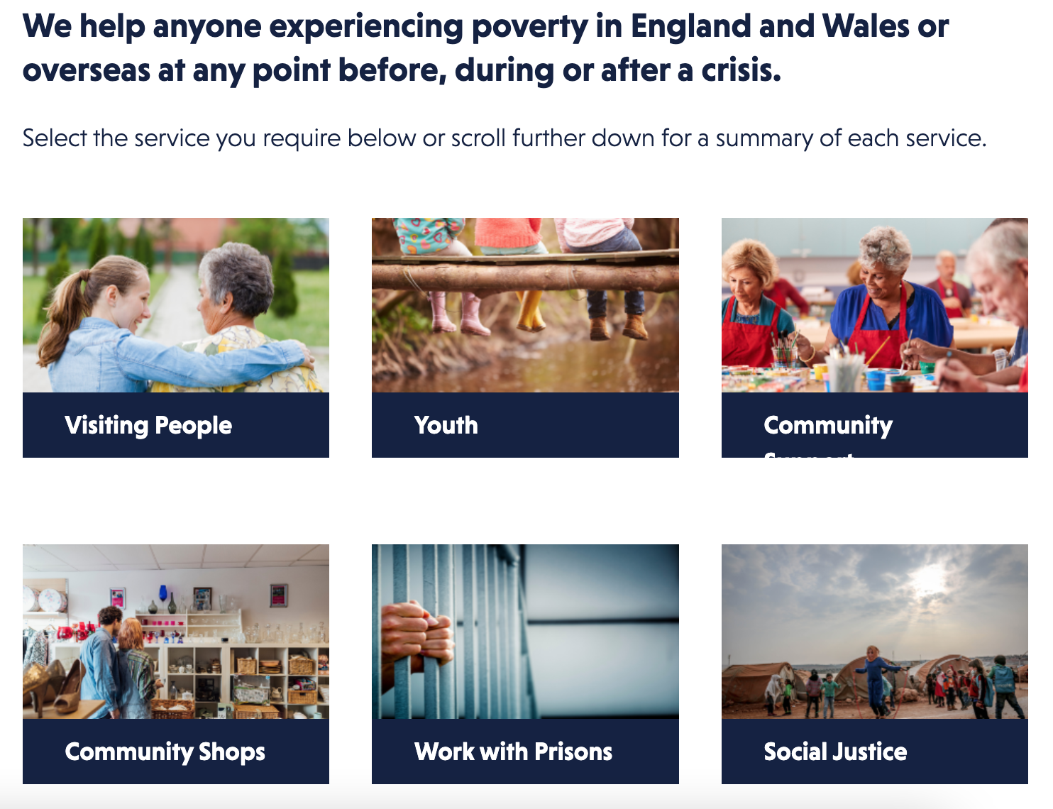
St Vincent de Paul Society

Slide 14
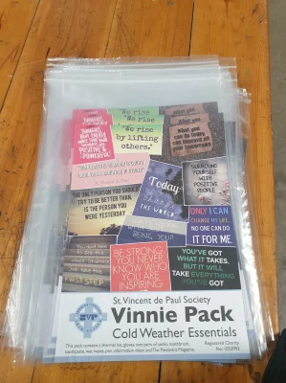
St Vincent de Paul Society
What to include:
Notes:
Explain that we’ll be making our own, using donations brought in by our school community. We will call them Kindness Packs.

Slide 15
Main Activity
Create a flyer calling for donations for Kindness Packs.
Include:
What’s needed
When and where to leave donations
Could include:
Why Catholics want to help the poor
The work of the SVP
Why this is important to you, as a Catholic, linking with Jesus’ teaching in Scripture

Slide 16
Let’s Reflect
"I have set you an example that you should do as I have done for you".
We hold these words as a reminder of our Vincentian vocation and journey together towards holiness.

Slide 17
Let’s Reflect
We pray that you inspire others to hear your call for compassionate service
R. God of love hear us

Slide 18
Let’s Reflect
We pause to offer any personal intentions...
Lord, we ask you to hear all these prayers and those that dwell within our hearts as we pray:
Glory be to the Father, and to the Son, and to the Holy Spirit, as it was in the beginning, is now, and ever shall be, world without end.
Amen.

Slide 19
Jubilee Prayer
Father in heaven,
may the faith you have given us
in your son, Jesus Christ, our brother,
and the flame of charity enkindled
in our hearts by the Holy Spirit,
reawaken in us the blessed hope
for the coming of your Kingdom.
May your grace transform us
into tireless cultivators of the seeds of the Gospel.
May those seeds transform from within both humanity and the whole cosmos
in the sure expectation
of a new heaven and a new earth,
when, with the powers of Evil vanquished,
your glory will shine eternally.
May the grace of the Jubilee
reawaken in us, Pilgrims of Hope,
a yearning for the treasures of heaven.
May that same grace spread
the joy and peace of our Redeemer
throughout the earth.
To you our God, eternally blessed,
be glory and praise for ever.
Amen
Notes:
Finish with the Jubilee prayer, reflecting on today’s learning

