Slide 1
Preferential Option for the Poor
Year 5

Slide 2
Fair Share
50 counters
30 counters
20 counters
5 counters
15 counters
5 counters
2 counters
1 counter
Notes:
Children to get different amounts of counters
What can you buy?
How can you afford to buy the more expensive items?
Children pool their money to afford more expensive items
Discussion about whether everyone should have put in the same amount of counters etc.

Slide 3
Catholic Social Teaching

Slide 4
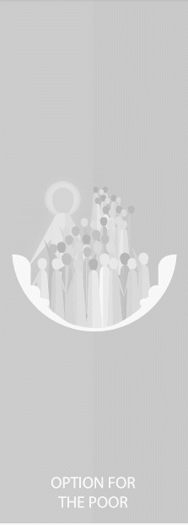
Catholic Social Teaching

Slide 5
Jubilee Year 2025
Pope Francis has declared this year’s Jubilee theme to be: Pilgrims of Hope
Why might Pope Francis think ‘hope’ is an important thing to focus on in 2025?
Notes:
Pope Francis will open the Holy Door of St Peter’s Basilica on Christmas Eve 2024, marking the beginning of this jubilee year. Pope Francis has called for people of faith to pray for and have deep faith, lively hope and active charity. Explain to the children why this jubilee year is a great time to be very active in charity, which is what we’re working towards in our CST lessons.

Slide 6
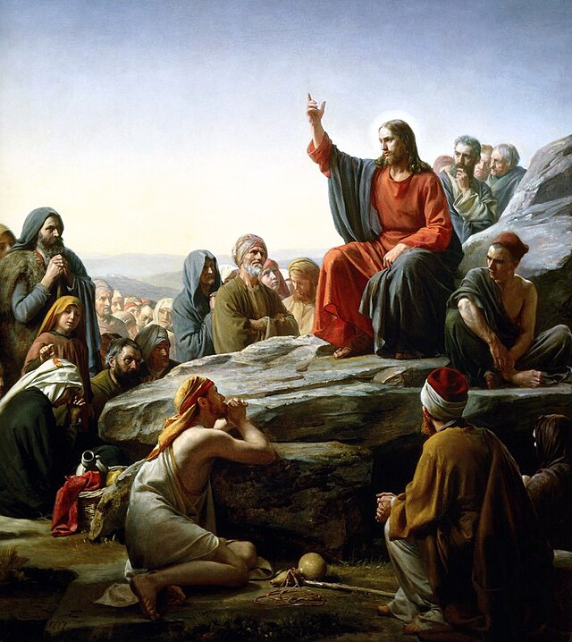
Preferential Option for the Poor
What does Scripture say?

Slide 7
Preferential Option for the Poor
"If anyone is well off in worldly possessions and sees their sister or brother in need but closes their heart to them, how can the love of God be remaining in them?”
1 John 3.17-18

Slide 8
Preferential Option for the Poor
"The King will reply, ‘Truly I tell you, whatever you did for one of the least of these brothers and sisters of mine, you did for me.’”
Matthew 25: 40

Slide 9
Preferential Option for the Poor
‘Looking at his disciples, he said: ‘Blessed are you who are poor, for yours is the kingdom of God. Blessed are you who hunger now, for you will be satisfied. Blessed are you who weep now, for you will laugh.’
Luke 6:20-21

Slide 10
Preferential Option for the Poor
‘Speak up for those who cannot speak for themselves, for the rights of all who are destitute. Speak up and judge fairly; defend the rights of the poor and needy.’
Proverbs 31:8-9
Why are we called to advocate for those in need?

Slide 11
Main Activity: Choose a Charity
Find out about them; what they do and ways you can support them during Advent. Write a school newsletter entry/blog/instagram/X post to tell your school community how you’re supporting this charity.
Include:
Make links between your action and one piece of Scripture
Construct an argument about why putting the poor first is better for the world
Use Scripture and quotes from Pope Francis to arrive at your own judgement about whether your action is putting the poor first

Slide 12
Plenary
Which Scripture passage resonates with you most, in terms of Preferential Option for the Poor.
Why did you choose this one?
Try to memorise it and speak it every time your actions are following Jesus’ teaching about how we should treat the poorest of us.

Slide 13
Jubilee Prayer
Father in heaven,
may the faith you have given us
in your son, Jesus Christ, our brother,
and the flame of charity enkindled
in our hearts by the Holy Spirit,
reawaken in us the blessed hope
for the coming of your Kingdom.
May your grace transform us
into tireless cultivators of the seeds of the Gospel.
May those seeds transform from within both humanity and the whole cosmos
in the sure expectation
of a new heaven and a new earth,
when, with the powers of Evil vanquished,
your glory will shine eternally.
May the grace of the Jubilee
reawaken in us, Pilgrims of Hope,
a yearning for the treasures of heaven.
May that same grace spread
the joy and peace of our Redeemer
throughout the earth.
To you our God, eternally blessed,
be glory and praise for ever.
Amen
Notes:
Finish with the Jubilee prayer, reflecting on today’s learning

