Slide 1
Preferential Option for the Poor
Year 6

Slide 2
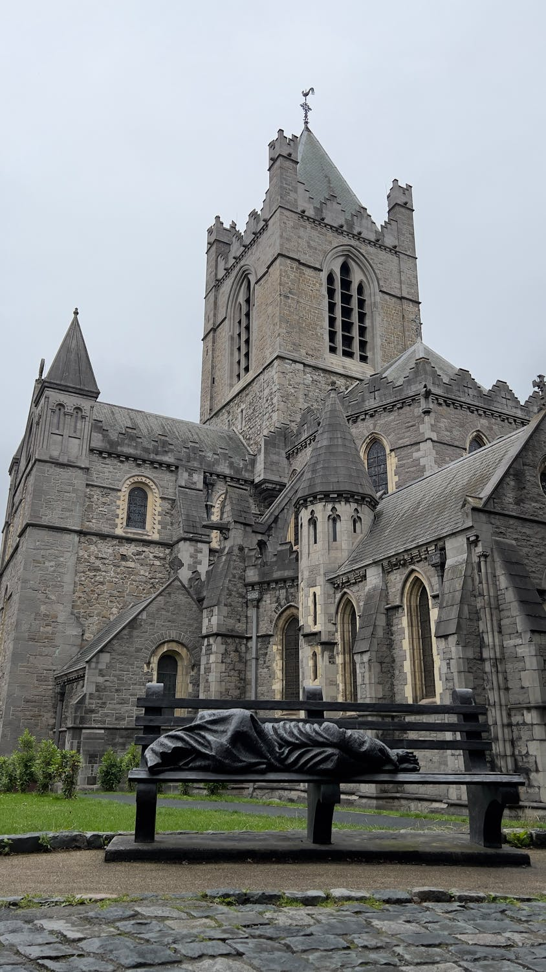
Notes:
Click the link to view images of this sculpture in many different places around the world

Slide 3
What do people think?
“I think a homeless person can feel disconnected to the ideas of Jesus that have been represented as ‘Mr Perfect’ and ‘everything’s fine’. And so I think this lets them in.” -Timothy Schmalz (creator)
“It depicts Jesus in a very human way. Some iconography is very grand and glorious. This is earthy and speaks of the fragility of the human condition.’
-Martyn Atkins (Methodist Central Hall)

Slide 4
Catholic Social Teaching

Slide 5
Catholic Social Teaching

Slide 6
Preferential Option for the Poor
What does ‘preferential’ mean?
What might it mean to give someone the ‘preferential option’?
Is it important to give those in need this option? Why?

Slide 7
Jubilee Year 2025
Pope Francis has declared this year’s Jubilee theme to be: Pilgrims of Hope
Why might Pope Francis think ‘hope’ is an important thing to focus on in 2025?
Notes:
Pope Francis will open the Holy Door of St Peter’s Basilica on Christmas Eve 2024, marking the beginning of this jubilee year. Pope Francis has called for people of faith to pray for and have deep faith, lively hope and active charity. Explain to the children why this jubilee year is a great time to be very active in charity, which is what we’re working towards in our CST lessons.

Slide 8
Preferential Option for the Poor
"If anyone is well off in worldly possessions and sees their sister or brother in need but closes their heart to them, how can the love of God be remaining in them?”
1 John 3.17-18

Slide 9
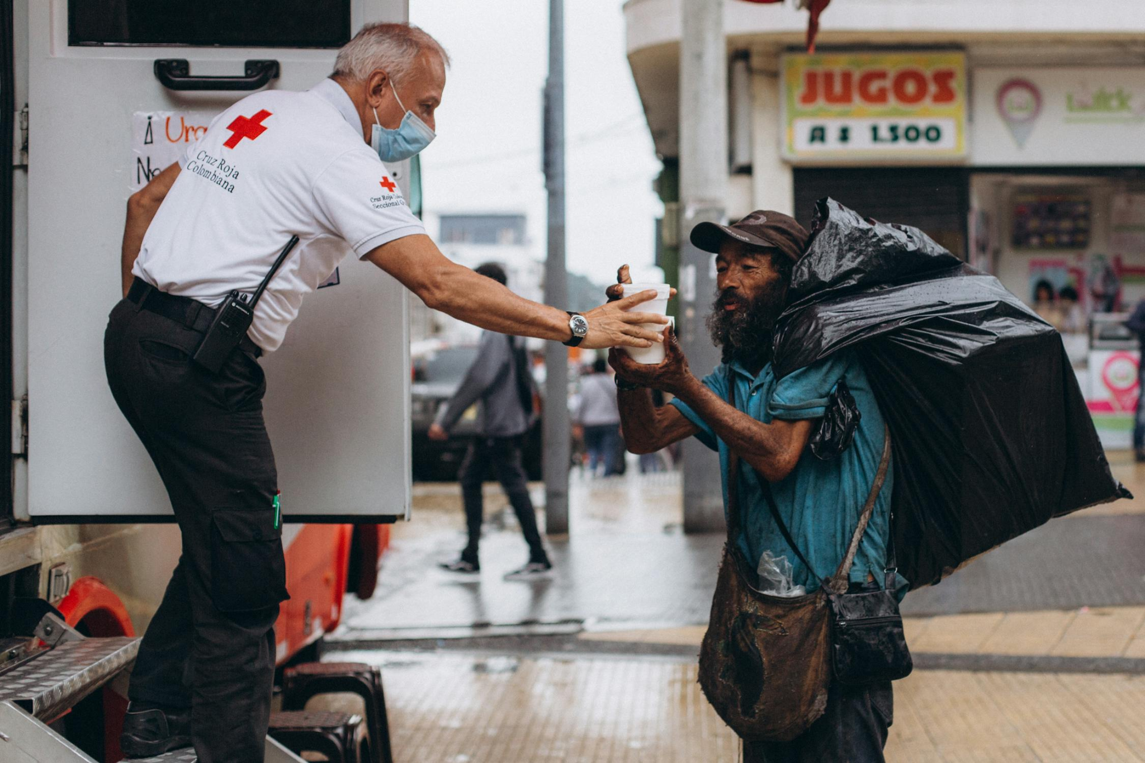
Alex Stephany: Beam
Notes:
Play until 2:17

Slide 10
Preferential Option for the Poor
"Truly I tell you, whatever you did for one of the least of these brothers and sisters of mine, you did for me”
Matthew 25: 40

Slide 11
“insulting”
“lowers the tone of the area”
“demeaning”
“waste of money”
“could attract more homeless people”
“creepy”

Slide 12
Preferential Option for the Poor
‘Looking at his disciples, he said: ‘Blessed are you who are poor, for yours is the kingdom of God. Blessed are you who hunger now, for you will be satisfied. Blessed are you who weep now, for you will laugh.’
Luke 6:20-21

Slide 13
Preferential Option for the Poor
‘Speak up for those who cannot speak for themselves, for the rights of all who are destitute. Speak up and judge fairly; defend the rights of the poor and needy.’
Proverbs 31:8-9

Slide 14
Hot Seating
Roles:
2 x interviewers
2 x local council members
2 x members of the local church
Question Examples:
What do you understand this sculpture to represent?
Do you think homelessness is an issue in your area?
How do you feel about the sculpture’s installation outside the House of Parliament? Why?
What are benefits of this sculpture’s installation?
What are the negatives?

Slide 15
Hot Seating
Include
Links between what Christians believe about caring for the poor and what Jesus tells us in Scripture
Compare and try to understand your answer and that of the opposition, with a focus on what Jesus tells us in Scripture
Evaluate your own points against others and arrive at your own opinion. Use what Jesus tells us in Scripture to support what you say; the work of different charities and what Pope Francis says on the issue

Slide 16
Mission: What will you do?
Notes:
Encourage children to commit to one action this Advent that supports their learning from today. It could be donating to different charities; raising money; making flyers to support SVP Vinnie Packs which they could share with people after school or after mass.
Alternatively, add the images of the Homeless Jesus sculpture to a slideshow (pictures available in a separate doc) and have children reflect on it, with reflective music playing

Slide 17
Jubilee Prayer
Father in heaven,
may the faith you have given us
in your son, Jesus Christ, our brother,
and the flame of charity enkindled
in our hearts by the Holy Spirit,
reawaken in us the blessed hope
for the coming of your Kingdom.
May your grace transform us
into tireless cultivators of the seeds of the Gospel.
May those seeds transform from within both humanity and the whole cosmos
in the sure expectation
of a new heaven and a new earth,
when, with the powers of Evil vanquished,
your glory will shine eternally.
May the grace of the Jubilee
reawaken in us, Pilgrims of Hope,
a yearning for the treasures of heaven.
May that same grace spread
the joy and peace of our Redeemer
throughout the earth.
To you our God, eternally blessed,
be glory and praise for ever.
Amen
Notes:
Finish with the Jubilee prayer, reflecting on today’s learning

