Slide 1
Care of Creation
Year 6

Slide 2
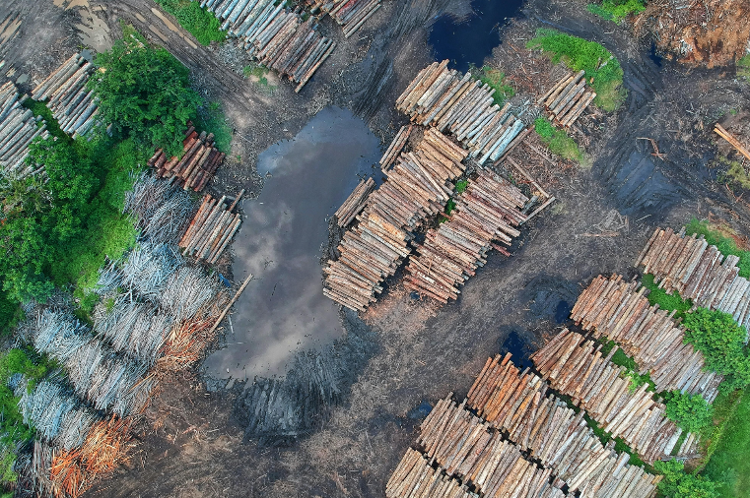
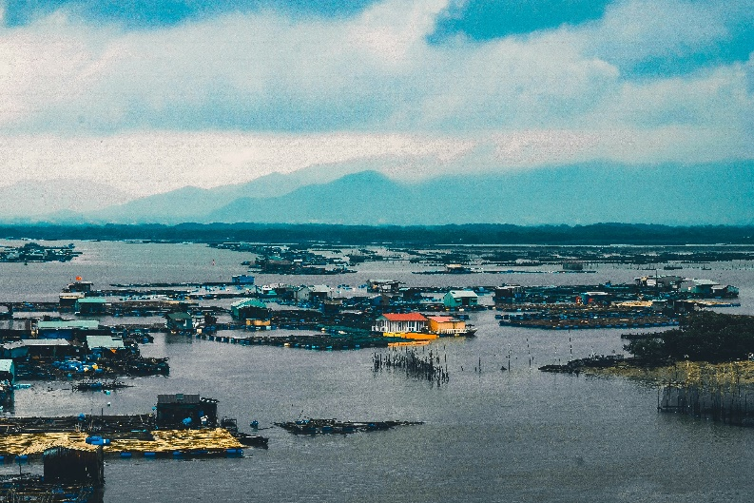
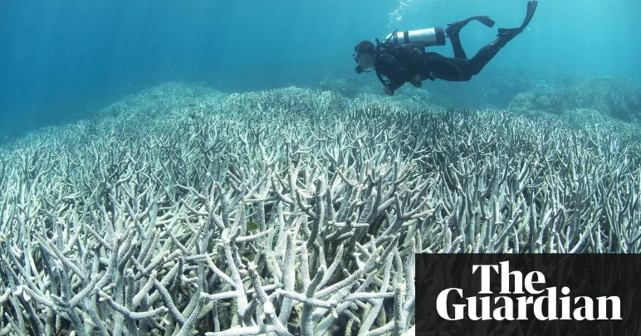
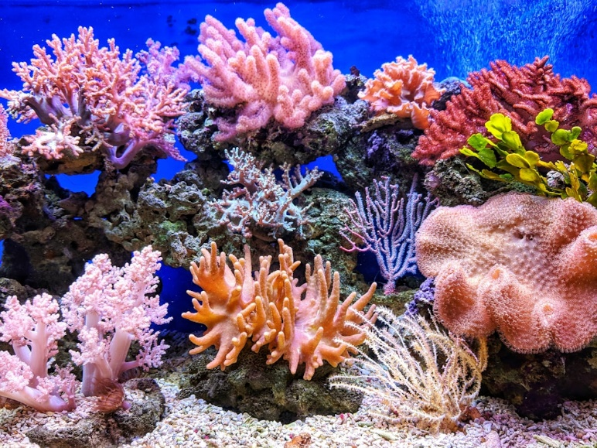
Starter: What are these pictures saying?
Notes:
Talk partners for 3 minutes
Gather responses
Top right image: credit: The Ocean Agency / XL Catlin Seaview Survey / Richard Vevers

Slide 3
Catholic Social Teaching

Slide 4
Catholic Social Teaching

Slide 5
What Does Scripture Say?
‘The Lord God put humans in the Garden of Eden to work it and take care of it.’
Genesis 2:15

Slide 6
What Does Scripture Say?
You made him ruler over the works of your hands; you put everything under his feet:
all flocks and herds, and the beasts of the field,
the birds of the air, and the fish if the sea, all that swim in the paths of the seas.”
Psalm 8: 3-8

Slide 7
In the News…

Slide 8
Laudato Si
‘Creation is a gift, it is a wonderful gift that God has given us, so that we care for it and we use it for the benefit of all.’
Pope Francis, Laudato Si’

Slide 9
Care of Creation
‘All is not lost. Human beings… are also capable of rising above themselves, choosing again what is good, and making a new start.’
Pope Francis, Laudato Si’
What do you think Pope Francis means by humans ‘rising above themselves’?

Slide 10
Care of Creation
Click me
Be part of this movement
Notes:
Image on left by Clker-Free-Vector-Images from Pixabay

Slide 11
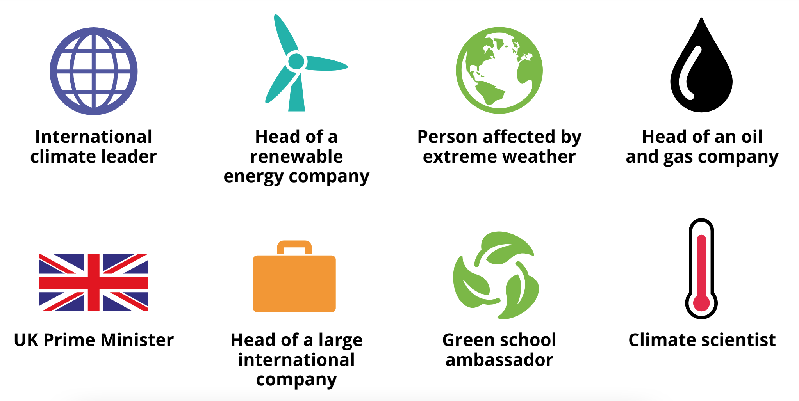
The Big Debate
Notes:
The Big Debate, resources created by WWF

Slide 12
The Big Debate: Questions
Should we spend money on new technologies to replace fossil fuels with renewable energy sources?

Slide 13
The Big Debate: Questions
2. How can we transport people locally and globally in an environmentally friendly way?

Slide 14
The Big Debate: Questions
3. What will climate change do to our food supplies? How will we deal with this?

Slide 15
The Big Debate: Questions
4. How will tackling climate change affect jobs, how much money we have and how we live?

Slide 16
The Big Debate: Questions
5. How can we support people, animals and nature that are affected by climate change?

Slide 17
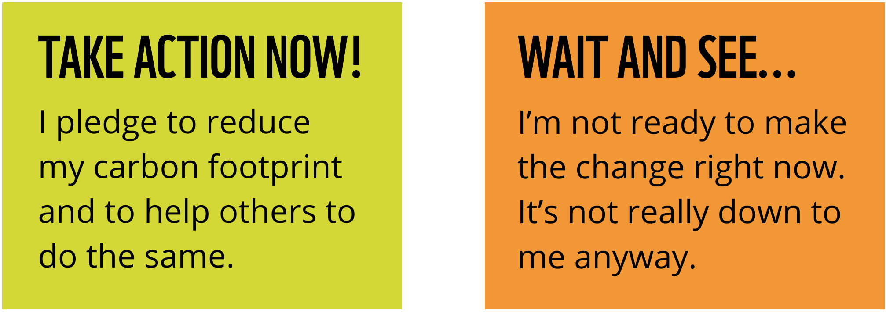
What will you choose?
Notes:
The Big Debate, resources created by WWF

Slide 18
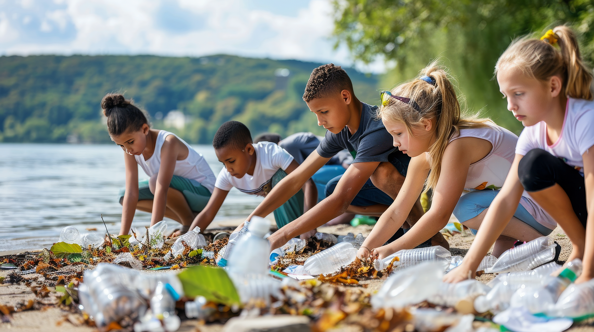
Stewardship is everyone’s responsibility

