Slide 1
Community and Participation
EYFS Assembly

Slide 2
Story Time!
Notes:
Read the story of The Enormous Turnip to demonstrate the fact that the challenge the character faced was overcome when more and more people came to help. Then they could all enjoy. Explain that this is an example of living in community; doing things together for the benefit of everyone.

Slide 3
Catholic Social Teaching

Slide 4
Show and Tell…
Have you ever done something at home or at school that has helped another person?
Has someone at home or at school ever helped you?
Notes:
Children to share their experiences. Remind the children that if so, they are doing exactly what God calls us to do.

Slide 5
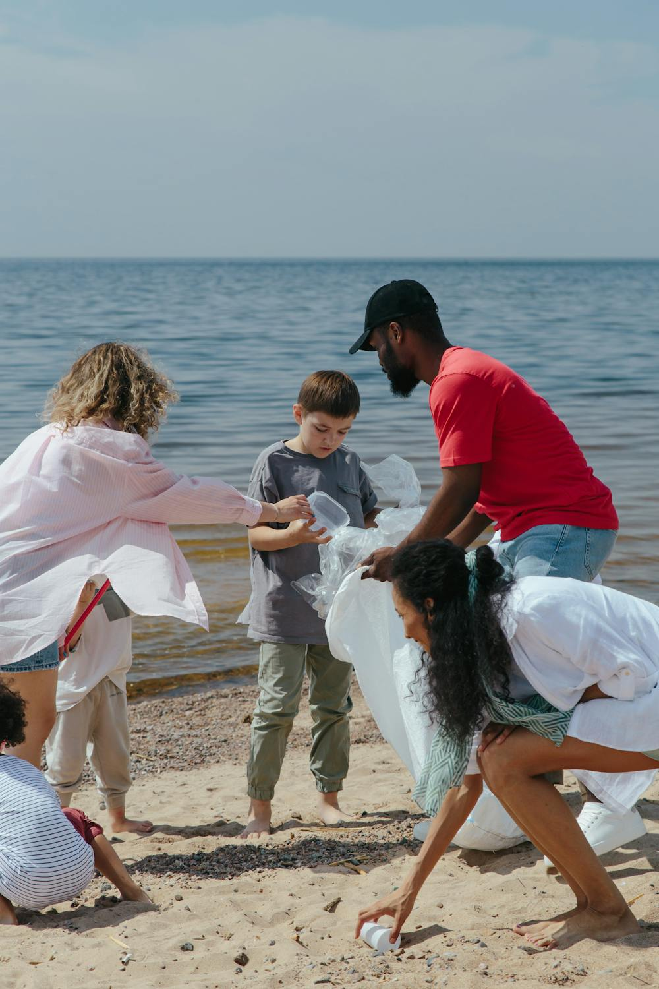
Show and Tell…
What are they doing?
How/Who are they helping?

Slide 6
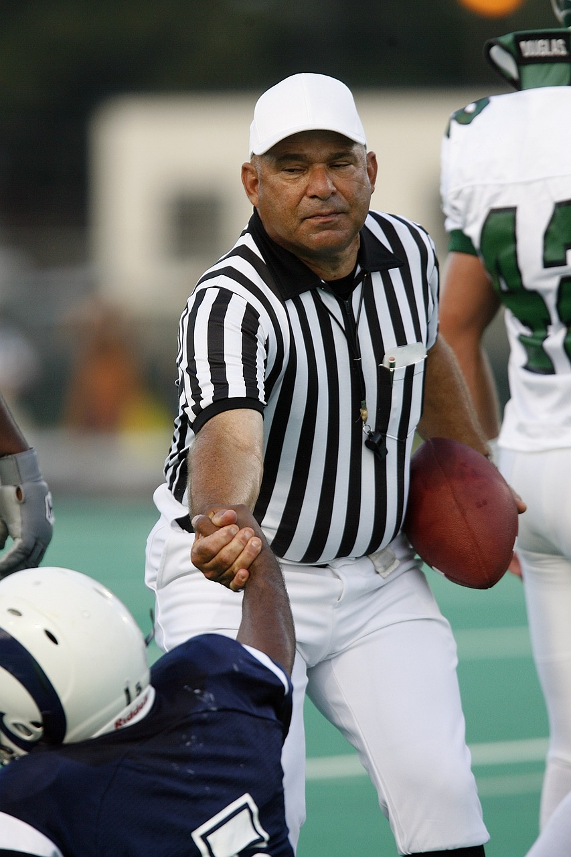
Show and Tell…
What are they doing?
How/Who are they helping?

Slide 7
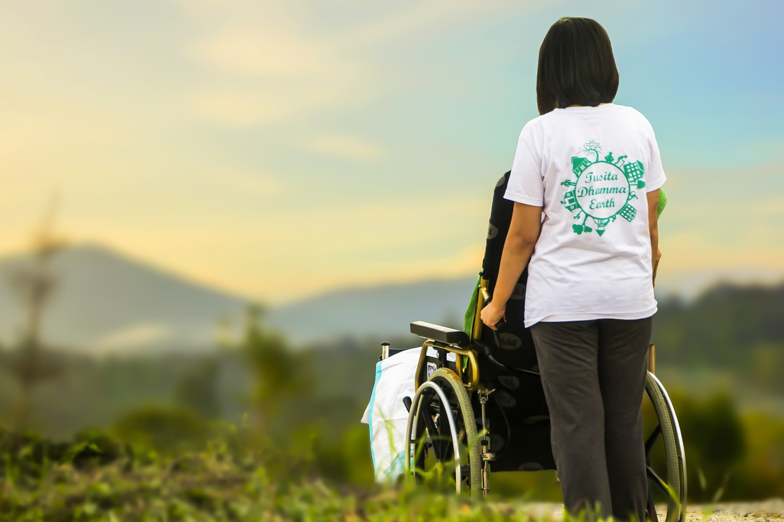
Show and Tell…
What are they doing?
How/Who are they helping?

Slide 8
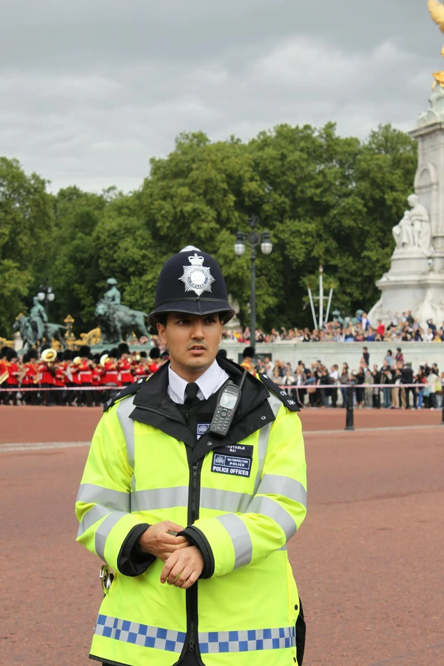
Show and Tell…
What are they doing?
How/Who are they helping?

Slide 9
Community and Participation
God wants us to be part of a community and help others.
How do we know this?
Notes:
Explain that we know what God wants from us through the bible/the Word of God.

Slide 10
Community and Participation
‘Love one another: just as I have loved you ... By this all people will know that you are my disciples.’
John 13:34-35

Slide 11
Community and Participation
When you helped someone else at school or at home, you were doing exactly what God wants!
You showed love to others.

Slide 12
Community and Participation
Let Us Pray…

Slide 13
Community and Participation
Loving God,
Thank you for our communities. You created us to live with each other and show Your love to those in need.
We thank you for the joy that our communities bring us. We ask You to help us make our communities better.

Slide 14
Community and Participation
We pray for those who do not feel a part of their communities.
O God, help us to show love to those who feel unloved.

Slide 15
Community and Participation
We pray for those who do not know how to ask for help.
O God, help us to reach out our hands to those in need.

Slide 16
Community and Participation
We pray that everyone feels comfortable, supported and loved in our communities.
O God, help us to spread Your love.

Slide 17
Community and Participation
We pray that we may be able to make our communities better places for all who live in them.
O God, help us to use the gifts You gave us for the benefit of others.

Slide 18
Community and Participation
Amen

Slide 19
Your ‘Community and Participation’ Mission
Become a helper in your home community:
Tidy up your toys
Help set the table
Water plants
Put away shoes/coats
Help a friend/sibling with something
What will you do?

Slide 20
Care of Creation
Notes:
Option to sing a fun Catholic pop song about The Greatest Commandment (linked to image)

