Slide 1
Solidarity and Peace
EYFS Assembly

Slide 2
Starter

Slide 4
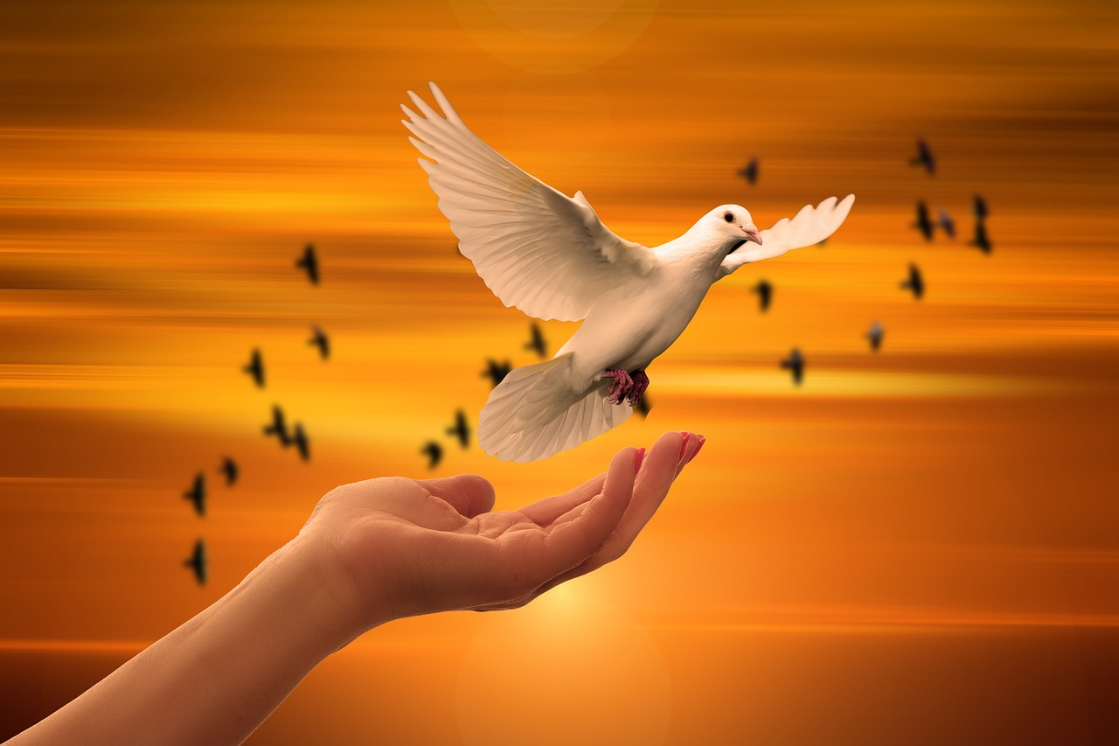
Peace
Notes:
What can children see in the picture? E.g. birds flying, someone letting the bird go. Discuss the fact the birds are free. Explain to the children that this is a dove and it is a symbol of peace. What does ‘peace’ mean?

Slide 5
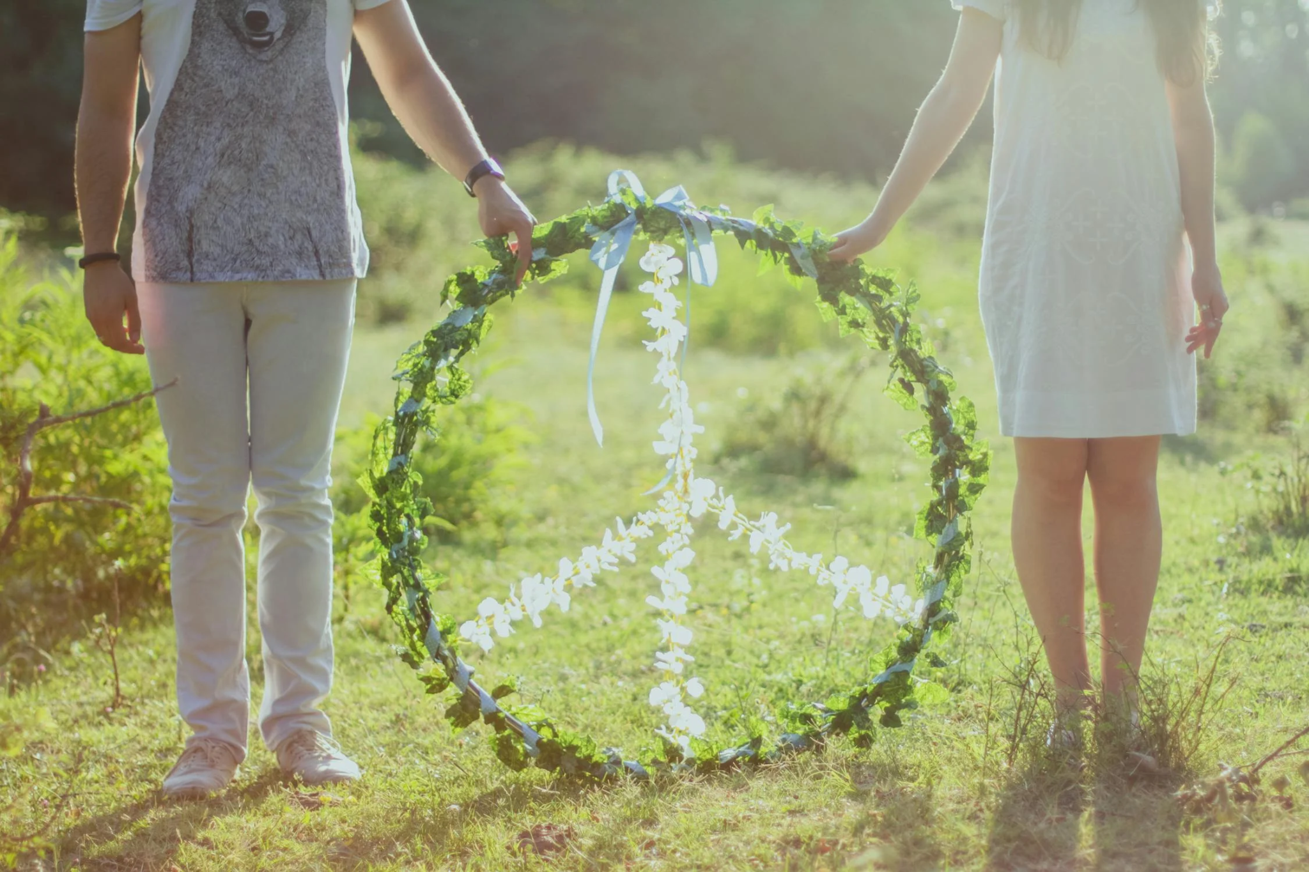
Peace
When have you felt peaceful?
Why do we want peace?
Is the world peaceful?
Notes:
Have children share what they understand peace to mean and continue discussion with these questions.

Slide 6
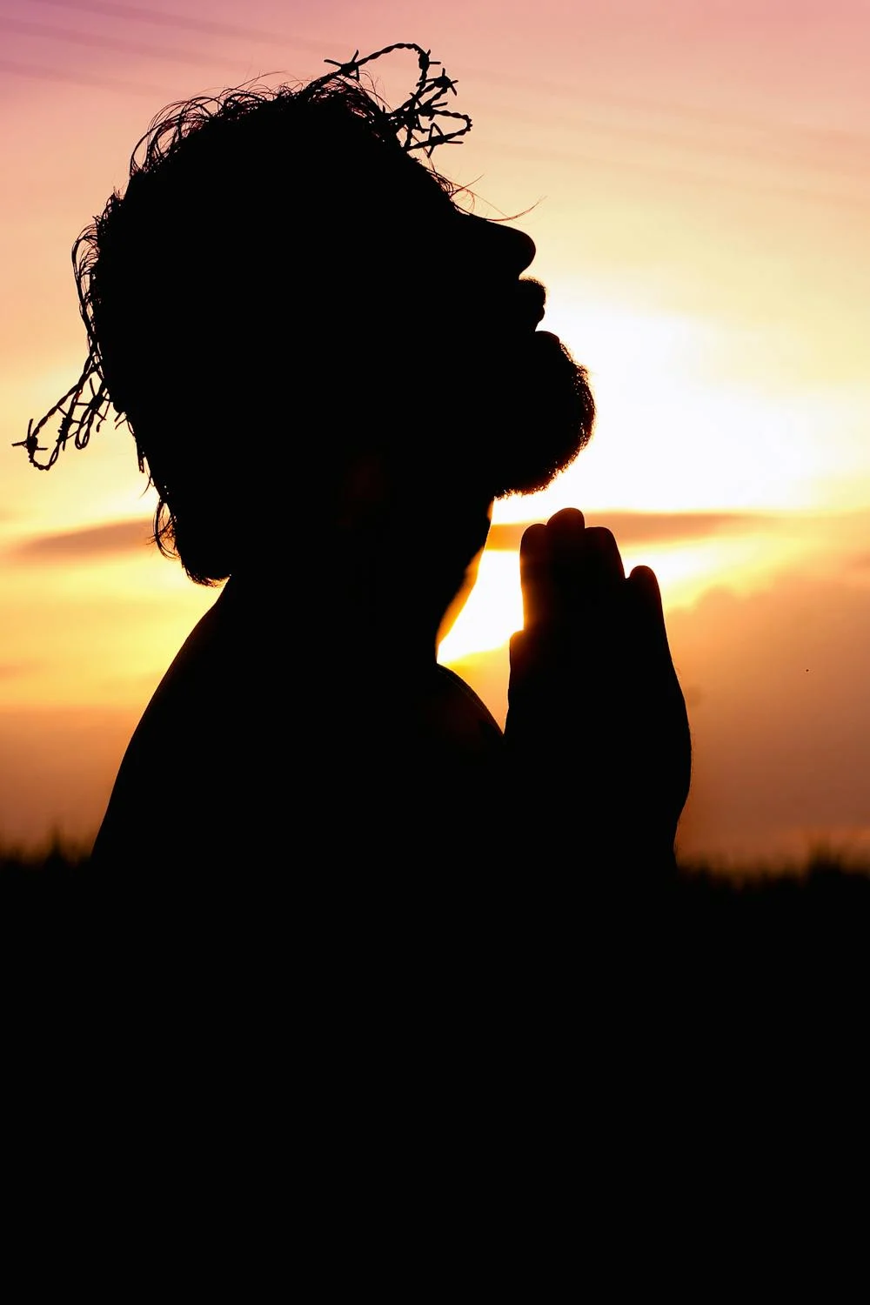
Peace
Jesus teaches us about peace in the bible.

Slide 7
Peace
‘Blessed are the peacemakers.’
Matthew 5: 9
Notes:
Give children some ideas of who peacemakers in today’s society might be.

Slide 8
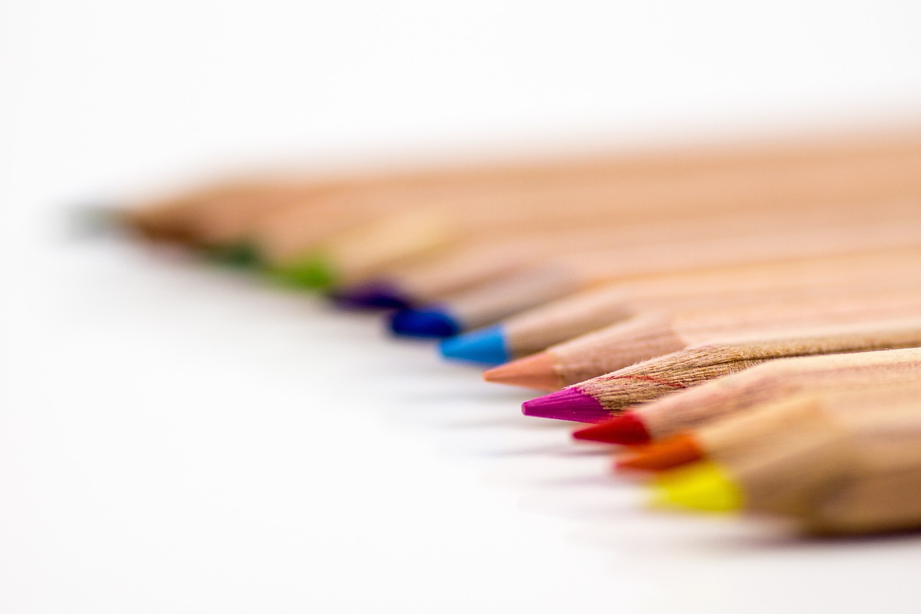
Peace
What does peace look like in our school?
How might we make our school more peaceful?

Slide 9
Peace
Let Us Pray…

Slide 10
CAFOD’s Prayer for Peace
Notes:
Click on the image to lead children in CAFOD’s prayer for peace

Slide 11
Peace
Amen

Slide 12
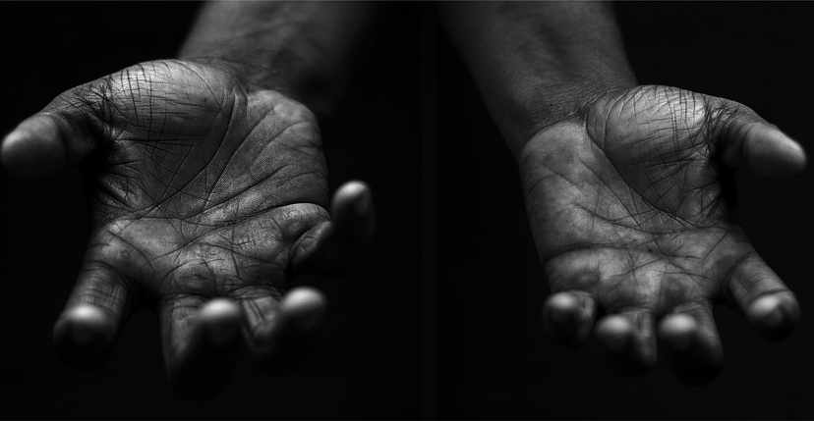
Peace
Your Mission
Notes:
Using the Prayer Toolkit model, the mission ‘tasks’ on the following slide can be amended or supplemented as required.

Slide 13
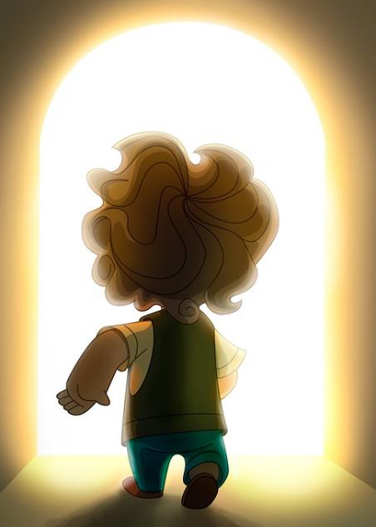
Peace
Actions:
Shake hands with someone in school who you don’t know so well
Smile at someone

Slide 14
Care of Creation
Notes:
Click the image to redirect to Missio’s ‘Peace is flowing like a river’ hymn to sing with children

