Slide 1
Community and Participation
EYFS

Slide 2
Starter
Notes:
Pie is for sharing story

Slide 3
Catholic Social Teaching

Slide 4
Catholic Social Teaching

Slide 5
Community and Participation
What communities are you a part of?

Slide 6
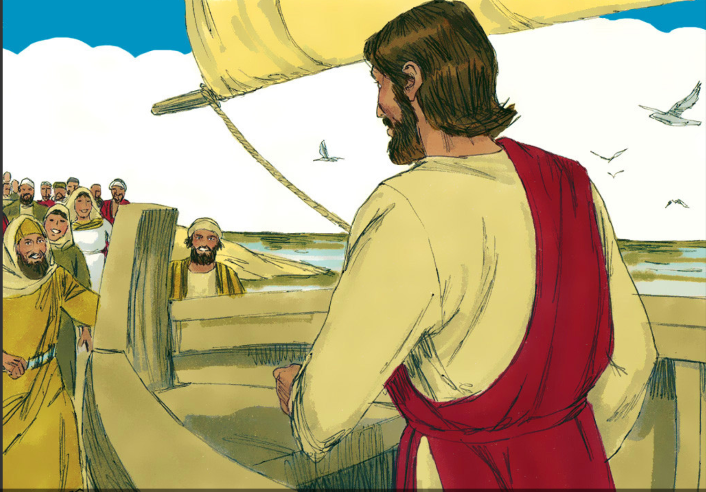
Community and Participation
Notes:
Jesus was part of a community. Share story of ‘Jesus Feeds 5000’. What did Jesus share in the story? Why did he do this?

Slide 7
Plenary
Why is community important?

