Slide 1
Solidarity and Peace
KS1 Assembly

Slide 2
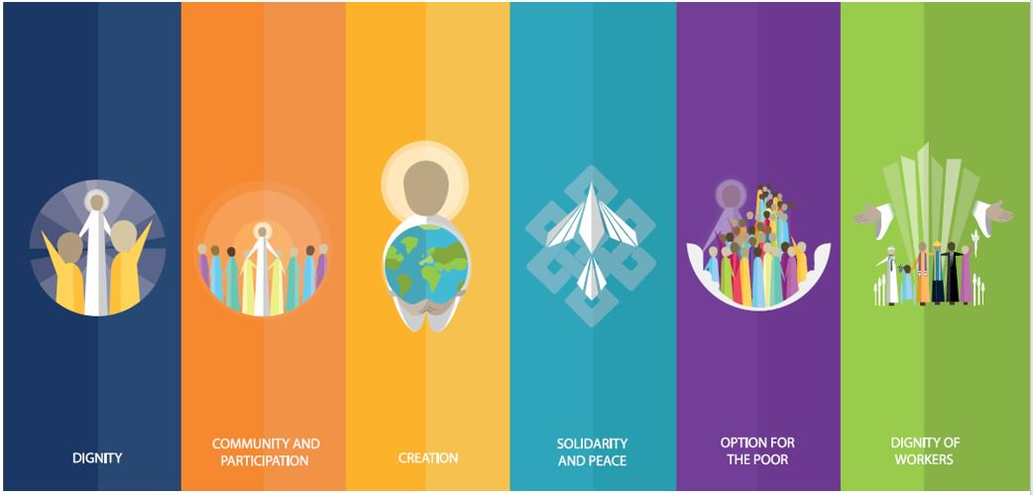
Starter

Slide 4
Peace
Notes:
Ask children to shake hands with the person on either side of them. How does it feel? Remind children that this, in church, in a ‘Sign of Peace.’ Why do the children think this is a sign of peace? When else do people shake hands?

Slide 5
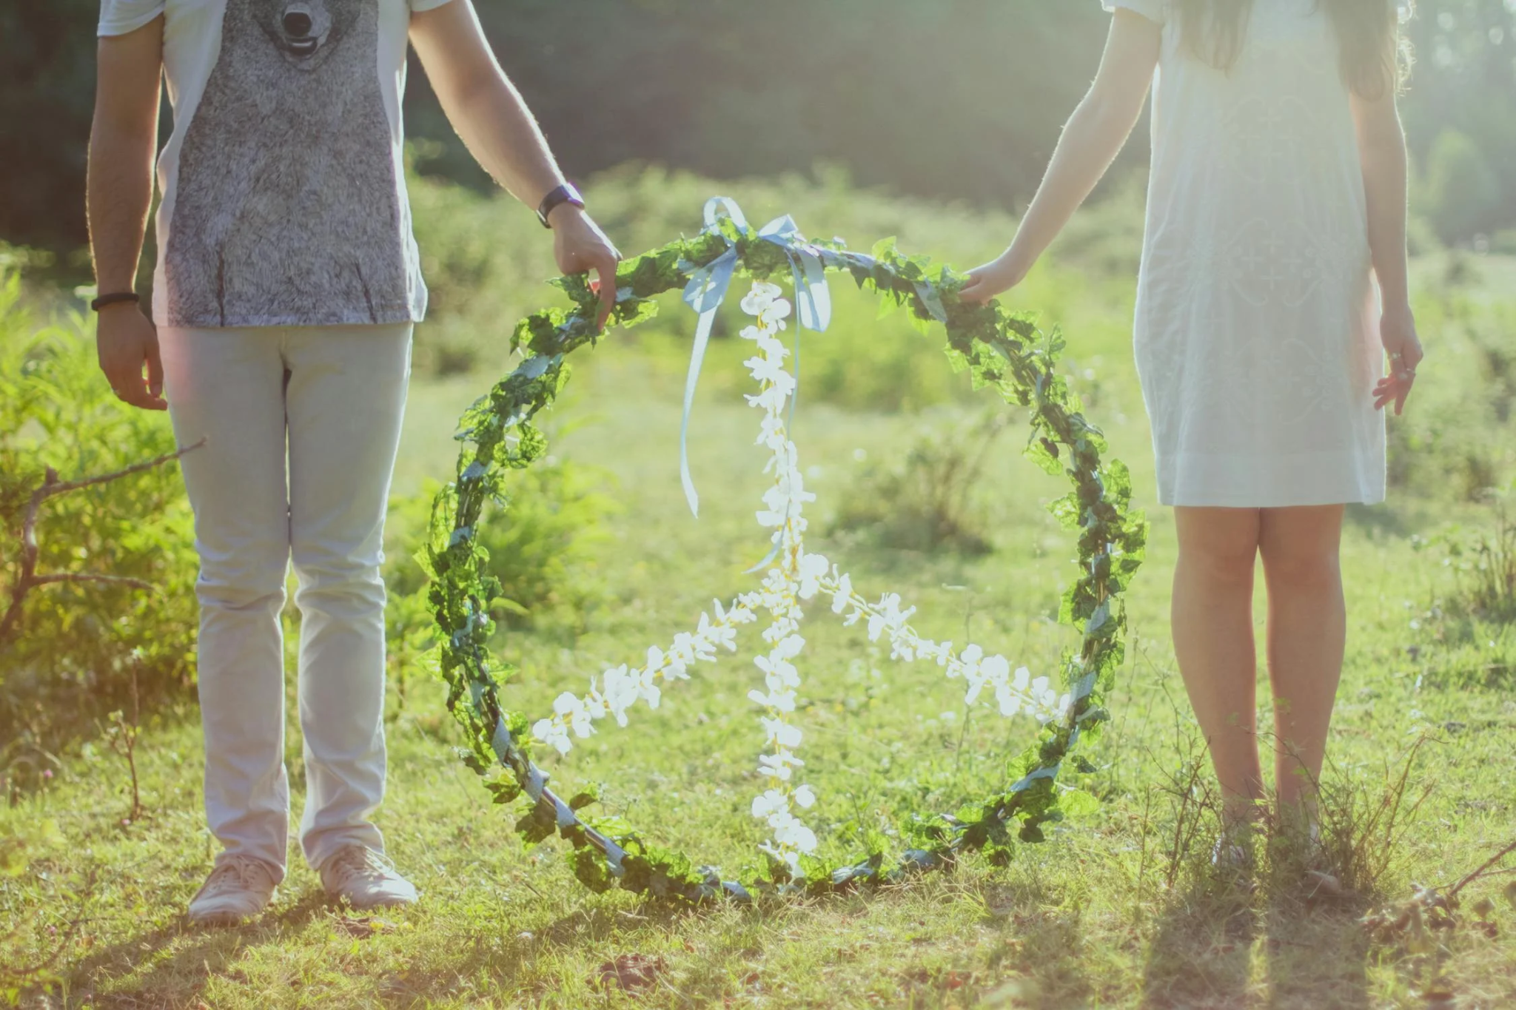
Peace
When have you felt peaceful?
Why do we want peace?
Is the world peaceful?

Slide 6
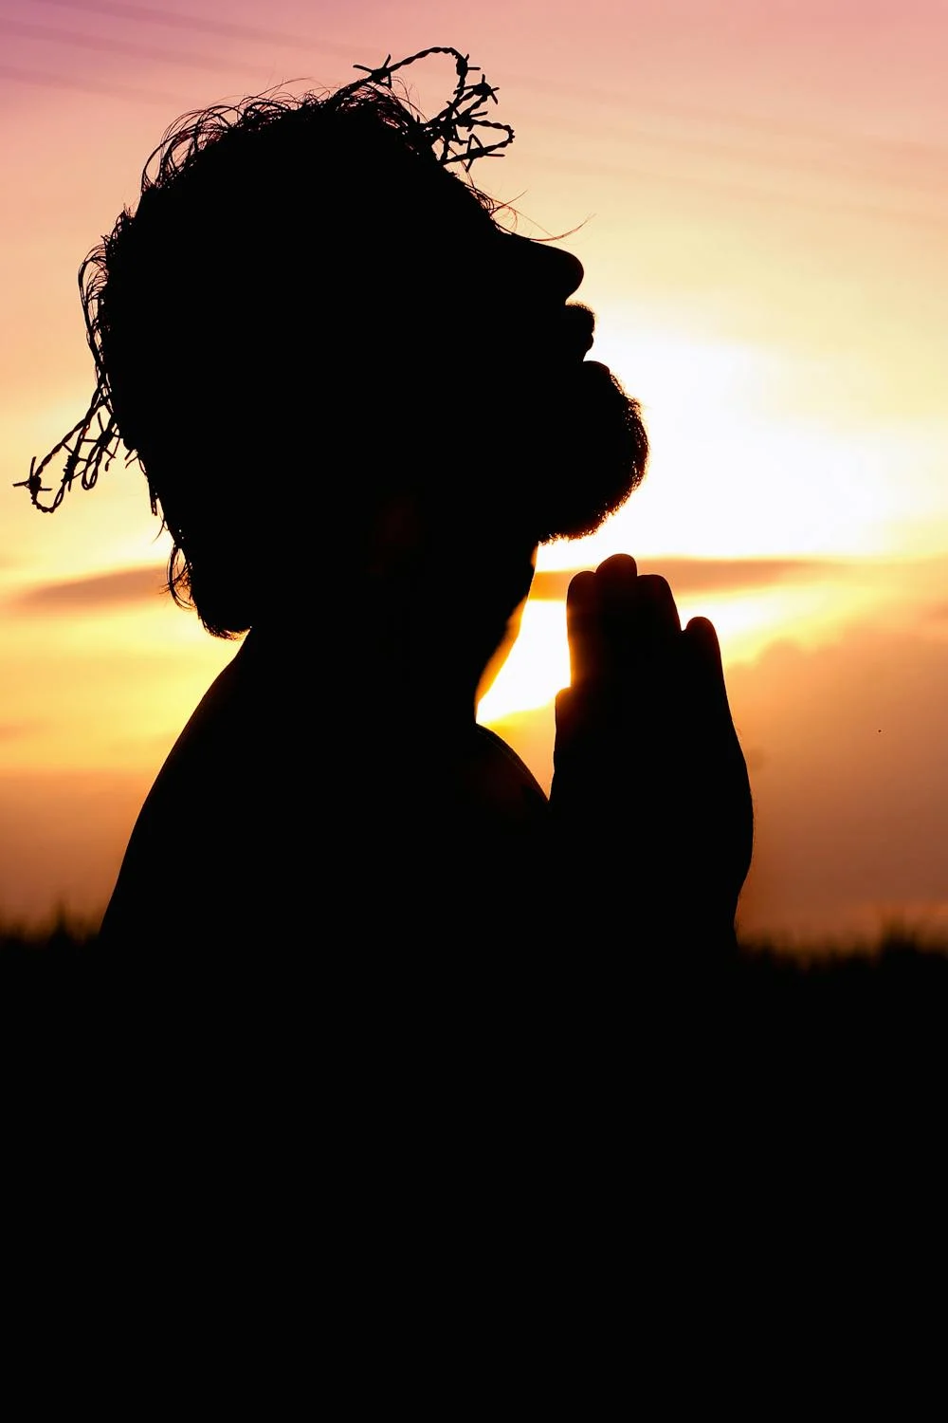
Peace
Jesus teaches us about peace in the bible.

Slide 7
Peace
‘Blessed are the peacemakers.’
Matthew 5: 9

Slide 8
Peace
‘Peace I leave with you. My peace I give to you.’
John 14: 27

Slide 9
Peace
Think about the things Jesus did.
How did he show us what peace looks like?
What does peace look like in our school?
Can we make our school more peaceful?

Slide 10
Peace
“I think that…”
Notes:
Holding slide for discussion/feedback if required.

Slide 11
Peace
Let Us Pray…

Slide 12
Peace
We pray for those who are unable to live lives of peace.
O God, help us to stand in solidarity with them.

Slide 13
Peace
We pray for those in power, that they may make the right choices to better promote peace in our world.
O God, help those in power to serve their people.

Slide 14
Peace
We pray for those who cannot speak for themselves.
O God, help us to recognise what we can do for others.

Slide 15
Peace
We pray that everyone in our world may one day be able to thrive, not just survive.
O God, help us to spread Your love.

Slide 16
Peace
Amen

Slide 17
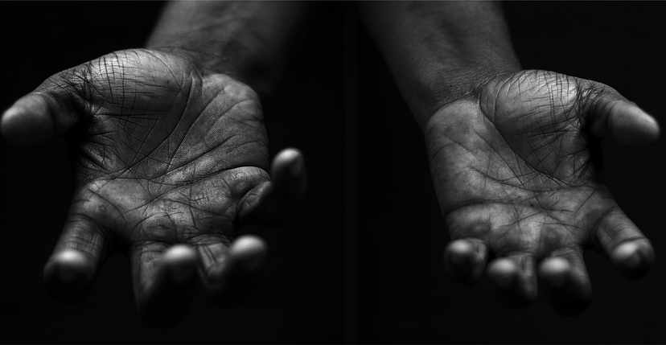
Peace
Your Mission
Notes:
Using the Prayer Toolkit model, the mission ‘tasks’ on the following slide can be amended or supplemented as required.

Slide 18
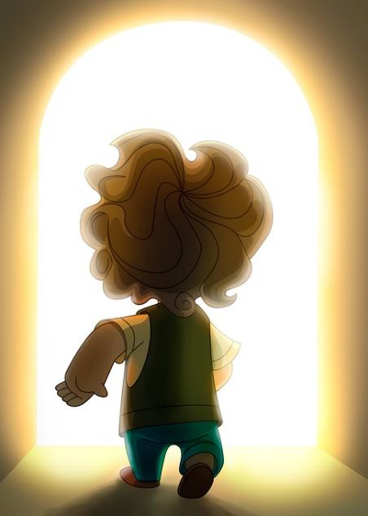
Peace
Actions:
Shake hands with someone in school who you don’t know so well
Give or ask for forgiveness
Tell someone how Jesus shows peace

Slide 19
Care of Creation
Notes:
Click the image to redirect to ‘Make me a channel of your peace’ hymn to sing with children

