Slide 1
Community and Participation
KS1 Assembly

Slide 2
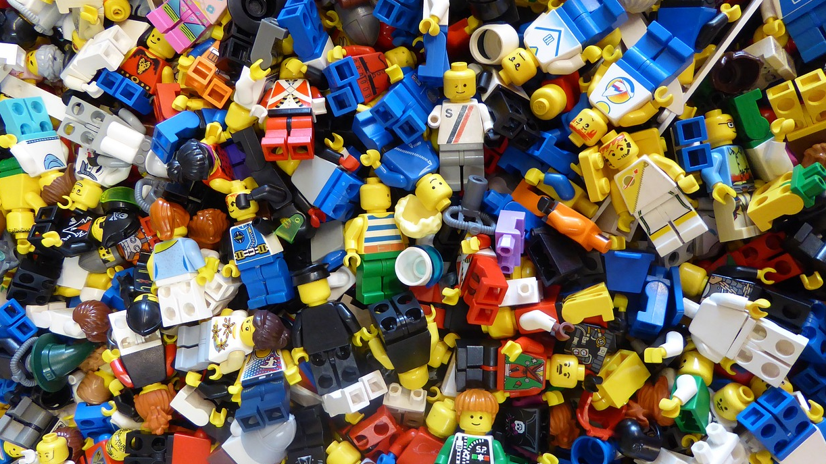
Community and Participation
Notes:
Have a ‘mess’ and invite one volunteer up to clean it up. It should feel like it’s taking a long time. Ask the volunteer to pause and have the children suggest that adding more people to help with get the job done quicker. Invite more volunteers up and clean the mess quickly.

Slide 3
Catholic Social Teaching
Notes:
Explain that the children will be learning about community. What is community? How did the clean-up at the beginning demonstrate the benefits of community?

Slide 4
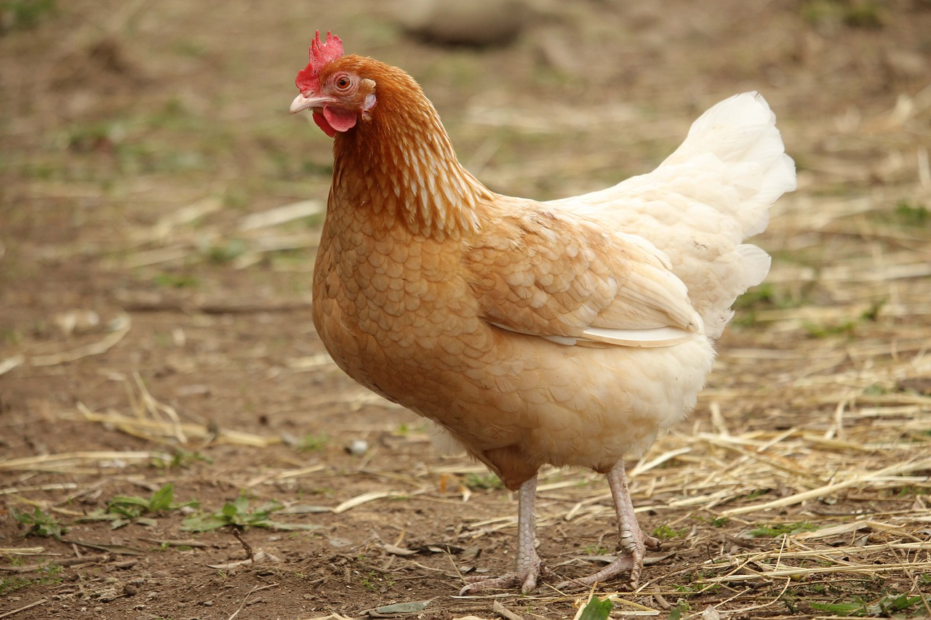
Community and Participation
Notes:
Share the story of The Little Red Hen and discuss what the other animals should have done and why. The children should see that if everyone participated in the work, it woud have made a big difference.

Slide 5
Community and Participation
God calls us to live in community.
Is this because God wants us to get the work done quickly?
Notes:
Have the children see that community isn’t just about getting work done but it’s about togetherness and doing this for the benefit of others, not just ourselves. Give examples of communities and groups you belong to and then ask the children to share their communities.

Slide 6
Community and Participation
Your community:
-How have they looked after you?
-How have you looked after them?
Notes:
Share an example of when you were supported/you supported your community and ask the children to think about their own experiences and feedback.

Slide 7
Community and Participation
Let us now listen to the Word of God.

Slide 8
Community and Participation
‘Love one another: just as I have loved you ... By this all people will know that you are my disciples.’
John 13:34-35
Notes:
If we continue to look after and be supported by our communities, we are truly living out The Greatest Commandment.

Slide 9
Community and Participation
Let Us Pray…

Slide 10
Community and Participation
Loving God,
We come together to thank you for our communities. You created us to live with each other and show Your love to those in need.
Let us give thanks for the joy that our communities bring us and ask You to help us make our communities better.

Slide 11
Community and Participation
We pray for those who do not feel a part of their communities.
O God, help us to show love to those who feel unloved.

Slide 12
Community and Participation
We pray for those who do not know how to ask for help.
O God, help us to reach out our hands to those in need.

Slide 13
Community and Participation
We pray that everyone feels comfortable, supported and loved in our communities.
O God, help us to spread Your love.

Slide 14
Community and Participation
We pray that we may be able to make our communities better places for all who live in them.
O God, help us to use the gifts You gave us for the benefit of others.

Slide 15
Community and Participation
Amen

Slide 16
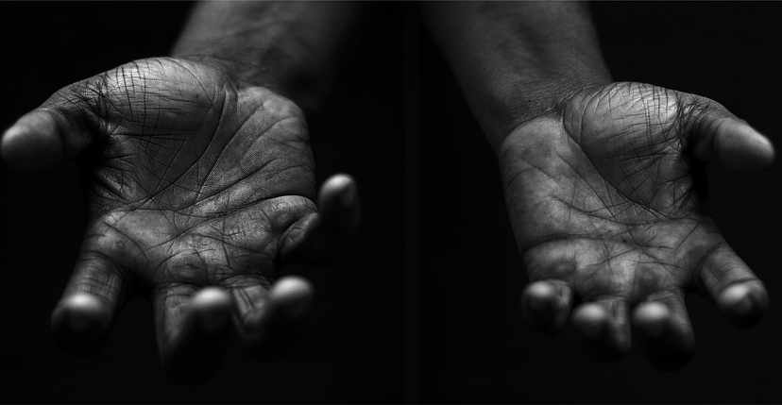
Community and Participation
Your Mission
Notes:
Using the Prayer Toolkit model, the mission ‘tasks’ on the following slide can be amended or supplemented as required.

Slide 17
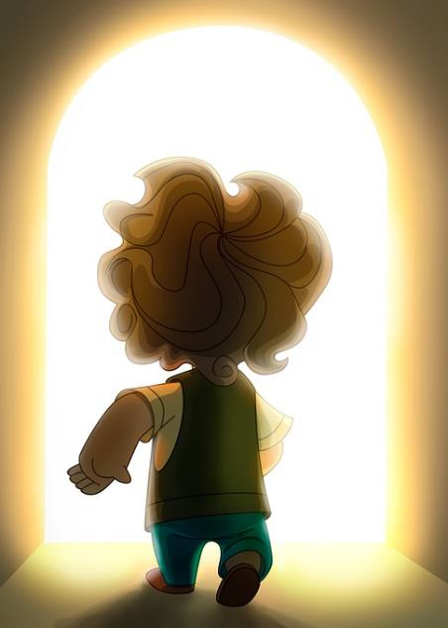
Community Pledge
What will you do for your community?
I will try to walk/cycle/scoot to places.
I will help someone carry their heavy shopping bags.
I will…
Notes:
CAFOD Family Fast Day is always the 2nd Friday in Lent, and often well-promoted in parishes. People are encouraged to give up a treat, or eat a simpler meal, and give the money to support CAFOD’s work with some of the poorest people in the world.

Slide 18
Care of Creation
Notes:
Option to sing a fun, Catholic pop song about The Greatest Commandment with the children (linked in video)

