Slide 1
Community and Participation
LKS2 Assembly

Slide 2
Community and Participation
Notes:
Invite 5 or 6 volunteers up if they have ideas of how they participate in their community. Throw one the ball while holding on to the end. Ask them to say one way they participate. They must hold on to their section before passing the ball on. At the end, the web will show how everyone’s contributions strengthen the community.

Slide 3
Starter

Slide 4
Catholic Social Teaching

Slide 5
Community and Participation
Notes:
Share the story of Lily and the Bake Sale. Discuss what Lily learnt by the end of it: everyone participates, even in small ways and together we can achieve a great deal.

Slide 6
Community and Participation
God call us to use our God-given gifts and talents and use them to make our communities better!
How did the people in Lily’s story do this?
Notes:
Encourage children to see that even if Lily wasn’t a confident baker, she was caring enough to not let that stop her. She used her gift of communication to make sure she too could join in and do her bit.

Slide 7
Community and Participation
Think of a time when you felt supported by the people in your community.
What did they do that made you feel that way?
What could you do to make other people feel supported by you?

Slide 8
Community and Participation
Let us now listen to the Word of God.
Notes:
How do these passages relate to community and participation?

Slide 9
Community and Participation
‘Love one another: just as I have loved you ... By this all people will know that you are my disciples.’
John 13:34-35

Slide 10
Community and Participation
‘You shall love the Lord your God with all your heart, and with all your soul, and with all your mind. This is the first and greatest commandment. And the second is you shall love your neighbour as yourself.’
Matthew 22:37-39

Slide 11
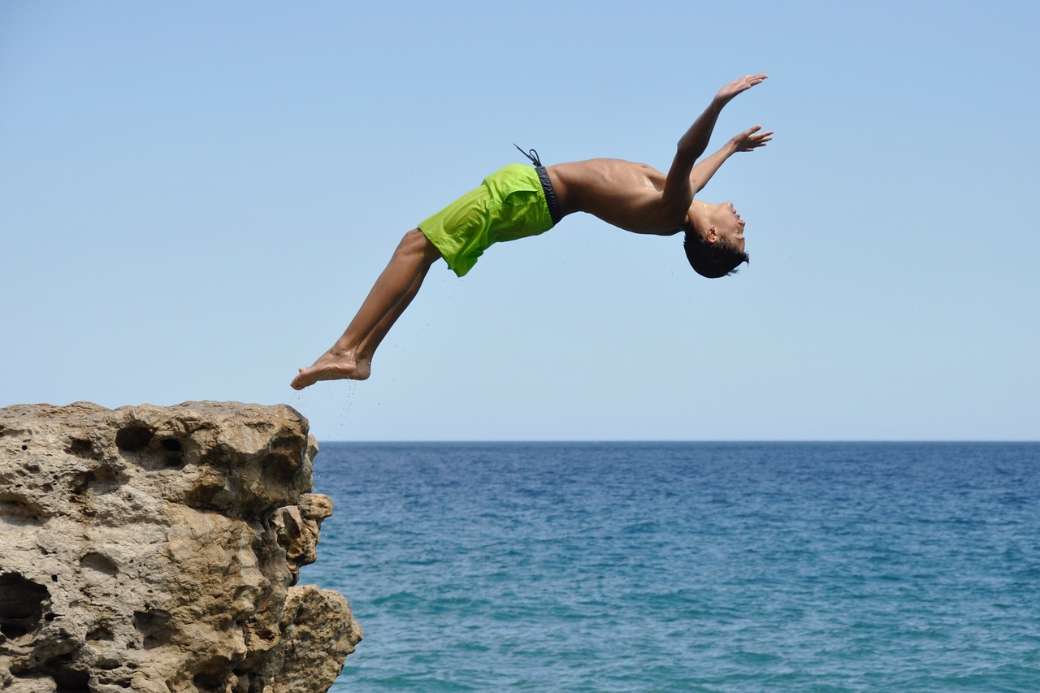
Community and Participation
‘Don’t be observers, but immerse yourself in the reality of life, as Jesus did.’
Pope Francis, World Youth Day, 2013
Notes:
What does Pope Francis mean by immersing ourselves in life? Can children give examples. Encourage children to make sure their ‘immersive’ actions are always considering others.

Slide 12
Community and Participation
Let Us Pray…

Slide 13
Community and Participation
Loving God,
We come together to thank you for our communities. You created us to live with each other and show Your love to those in need.
Let us give thanks for the joy that our communities bring us and ask You to help us make our communities better.

Slide 14
Community and Participation
We pray for those who do not feel a part of their communities.
O God, help us to show love to those who feel unloved.

Slide 15
Community and Participation
We pray for those who do not know how to ask for help.
O God, help us to reach out our hands to those in need.

Slide 16
Community and Participation
We pray that everyone feels comfortable, supported and loved in our communities.
O God, help us to spread Your love.

Slide 17
Community and Participation
We pray that we may be able to make our communities better places for all who live in them.
O God, help us to use the gifts You gave us for the benefit of others.

Slide 18
Community and Participation
Amen

Slide 19
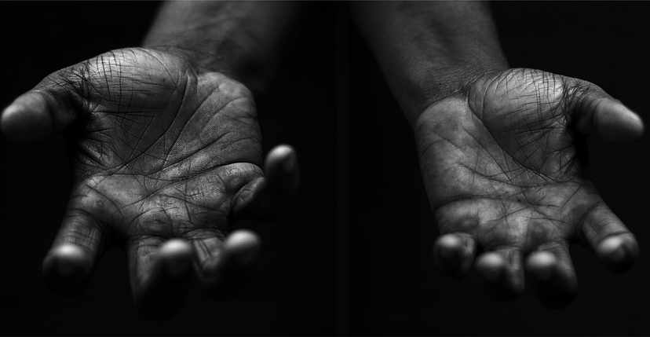
Community and Participation
Your Mission
Notes:
Using the Prayer Toolkit model, the mission ‘tasks’ on the following slide can be amended or supplemented as required.

Slide 20
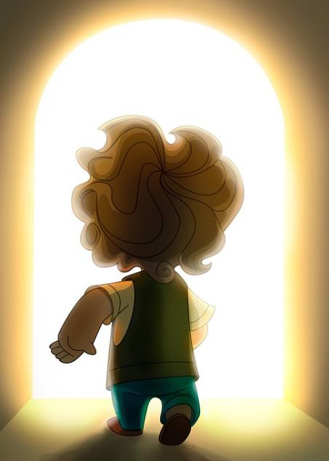
Community and Participation
Think about what you could do to support those in need in your community during Lent.
Research:
CAFOD Family Fast Day (14th Feb 2025)
Notes:
CAFOD Family Fast Day is always the 2nd Friday in Lent, and often well-promoted in parishes. People are encouraged to give up a treat and too often this is self-serving. Can we make a Lenten promise that is for the benefit of others and our community e.g. giving

Slide 21
Care of Creation
Notes:
Children can join in with this hymn: Building a Kingdom

