Slide 1
Solidarity and Peace
LKS2 Assembly

Slide 2
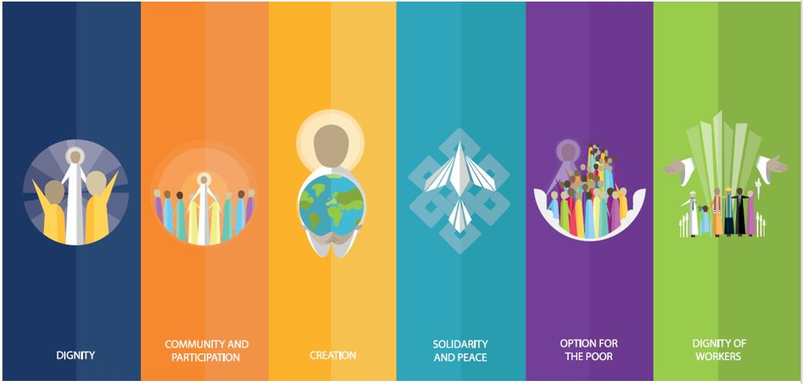
Starter

Slide 3
Notes:
What do you think of when you hear the word peace?

Slide 4
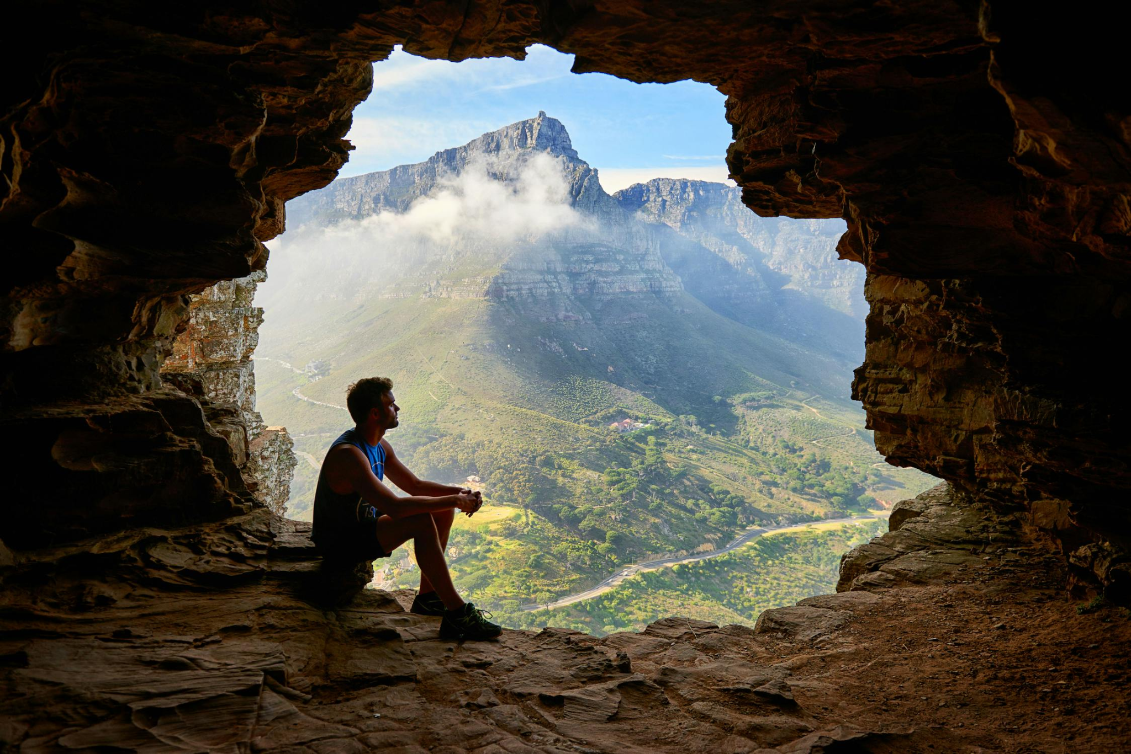
Solidarity and Peace

Slide 5
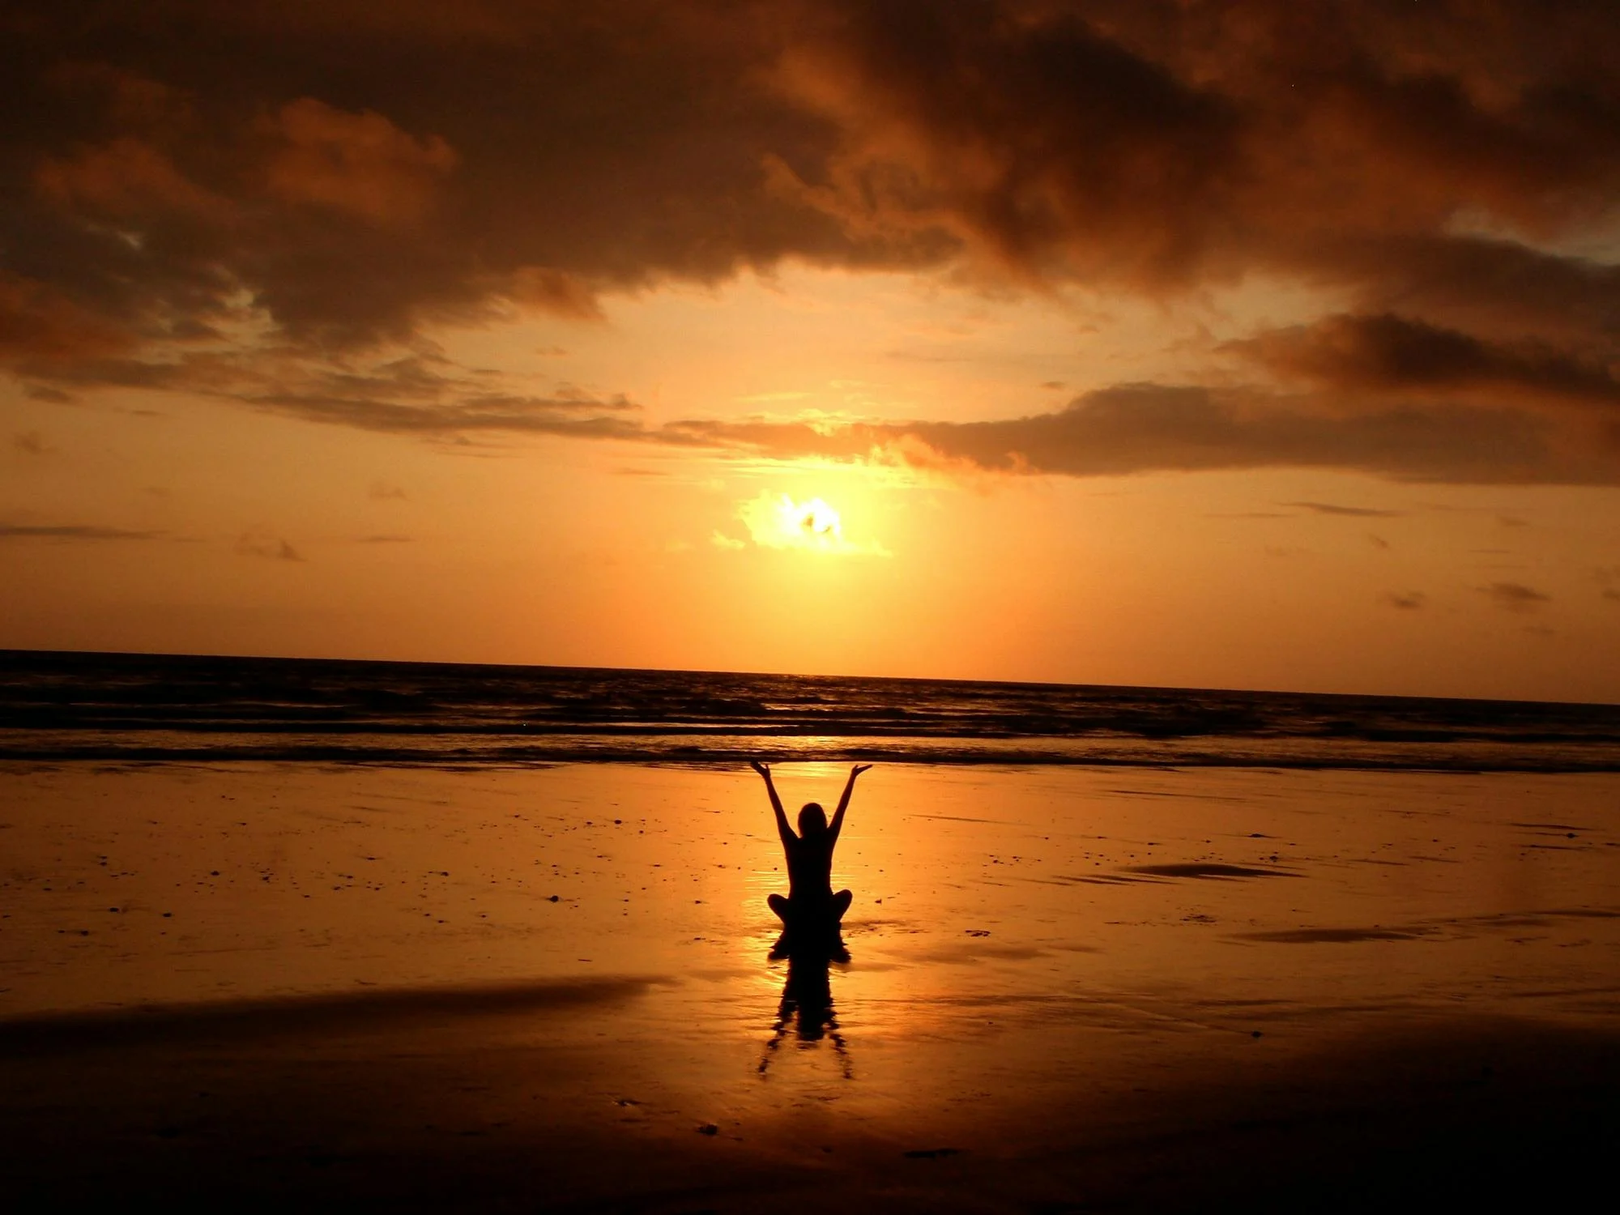
Solidarity and Peace

Slide 6
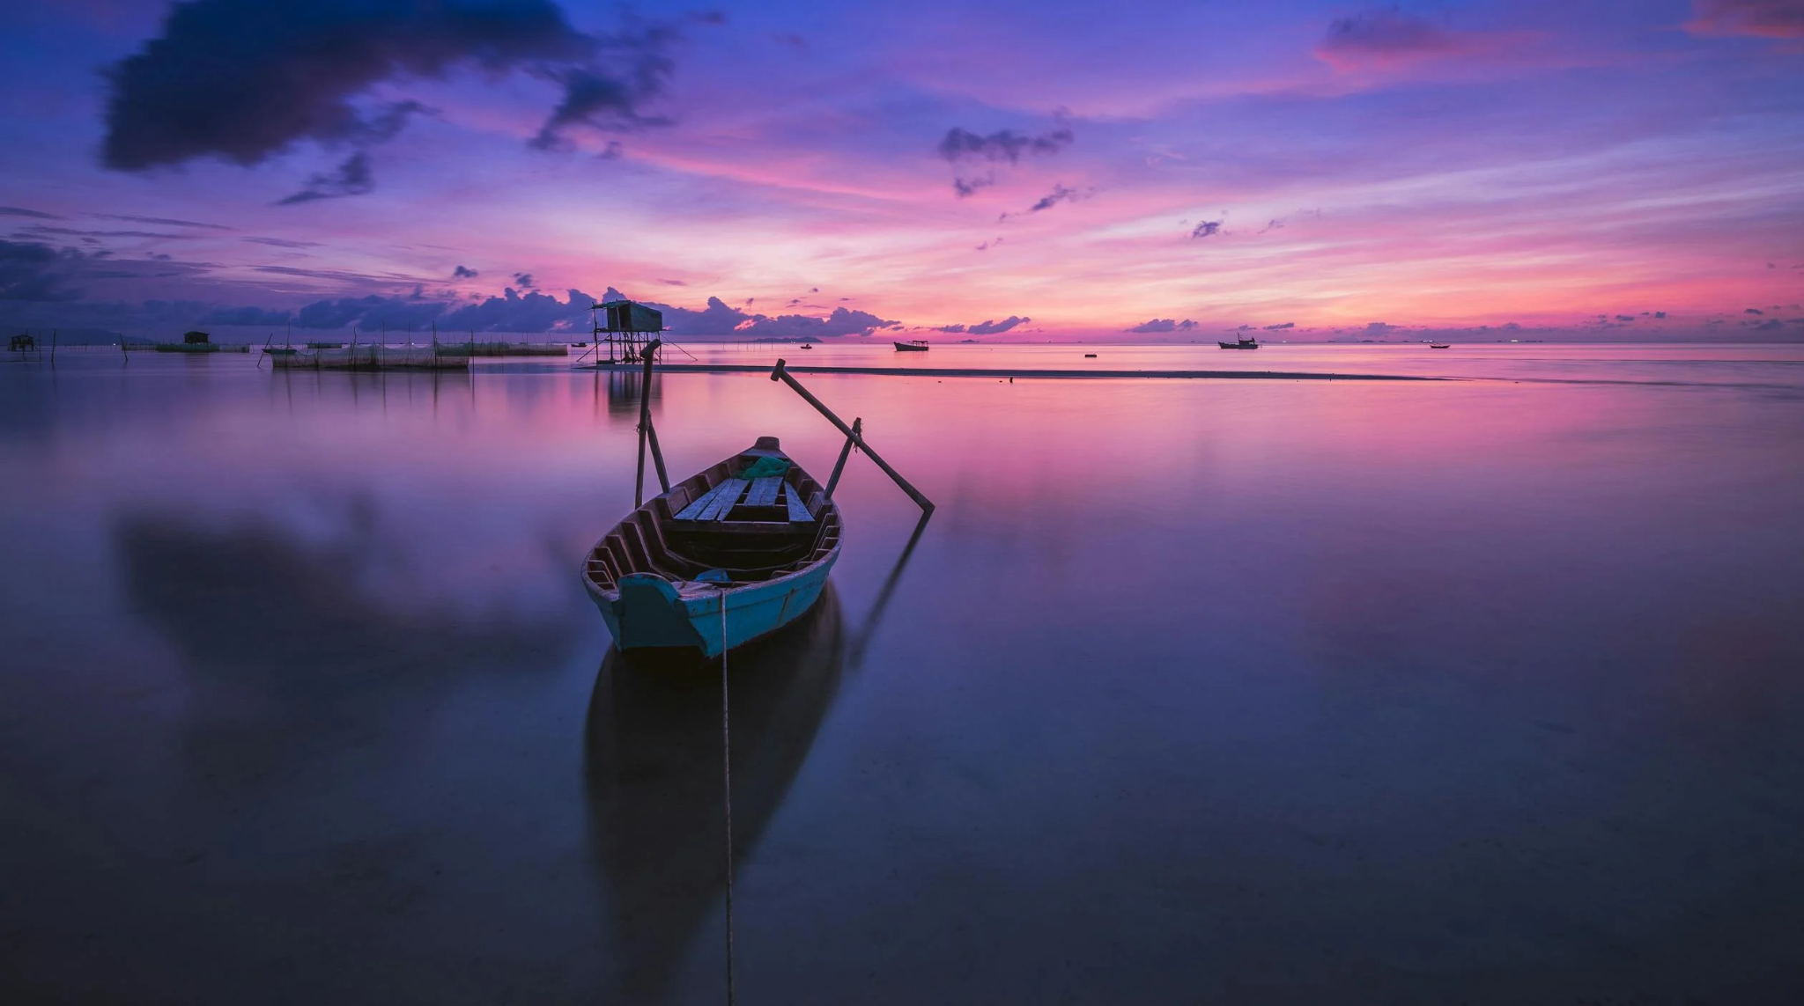
Solidarity and Peace
Notes:
Are these the kinds of things you think of when you hear the word ‘peace’? Is this an accurate representation of the world at the moment? Is the world a peaceful place? Invite children to share their opinions.

Slide 7
Notes:
What do you think of when you hear the word solidarity?

Slide 8
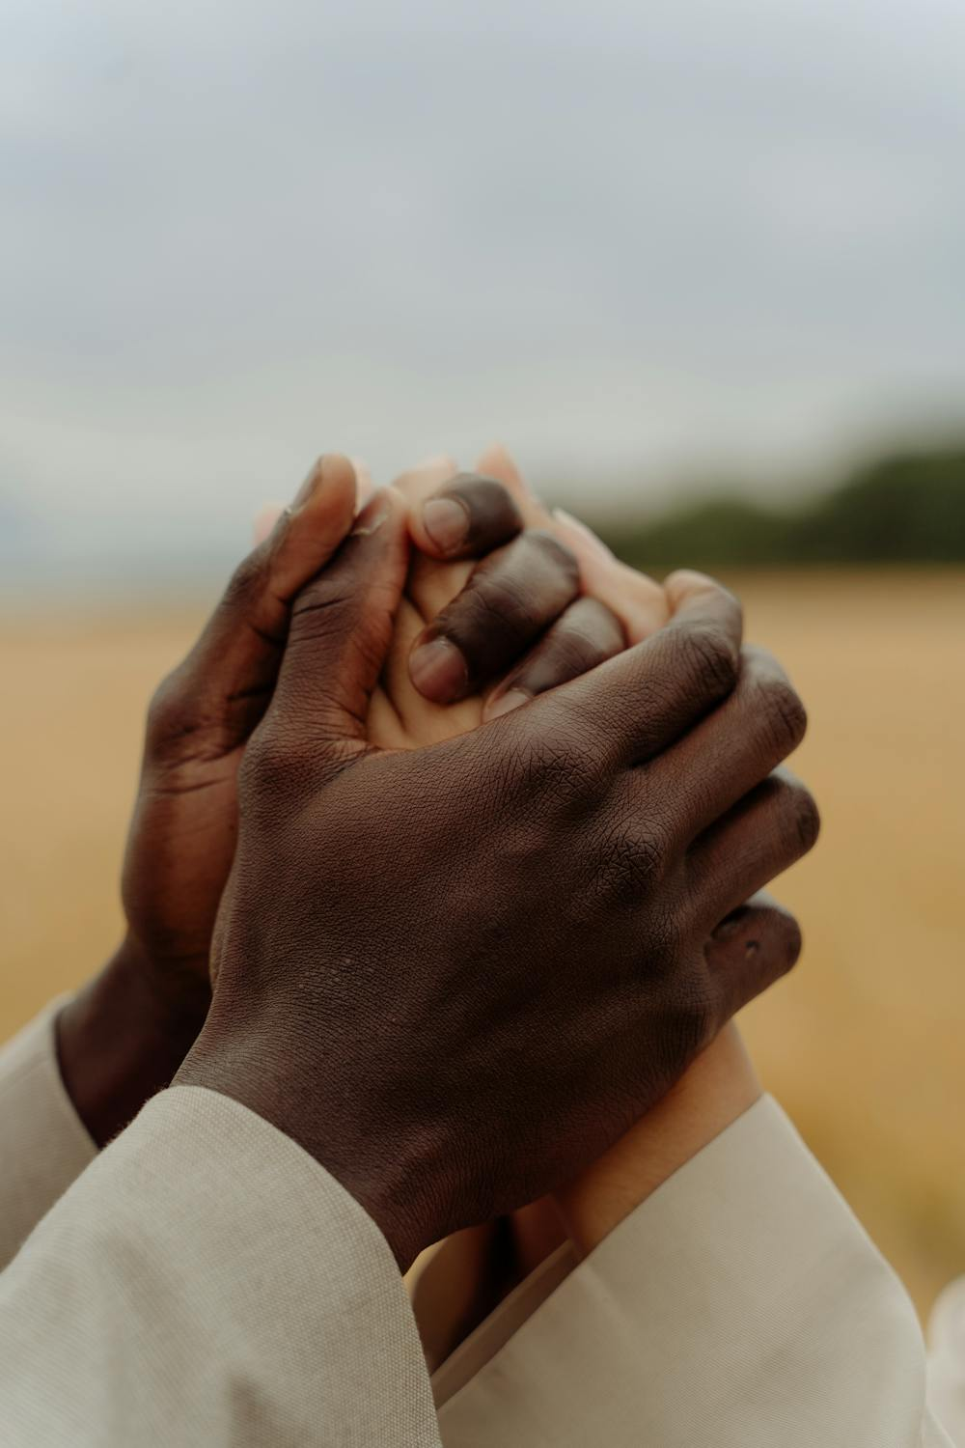
Solidarity and Peace

Slide 9
Solidarity and Peace

Slide 10
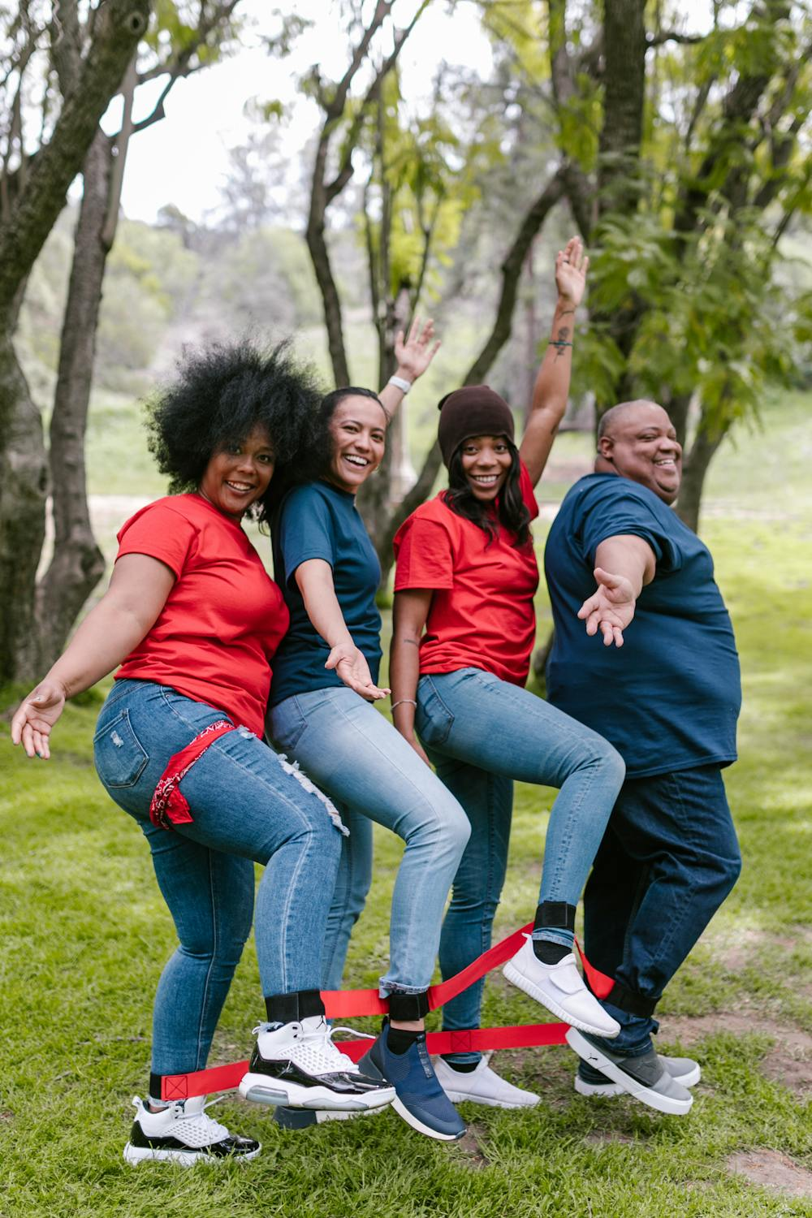
Solidarity and Peace
Notes:
Are these the kinds of things you think of when you hear ‘solidarity’? Can you think of examples where people have shown solidarity e.g. protests; supporting a cause etc.

Slide 11
Solidarity and Peace
‘We are all one human family, whatever our [...] differences.’
USCCB
“If you want peace, work for justice.” Pope Paul VI
Notes:
Do the children agree? What does it mean to work for justice? Can children think of any organisations that work for justice?

Slide 12
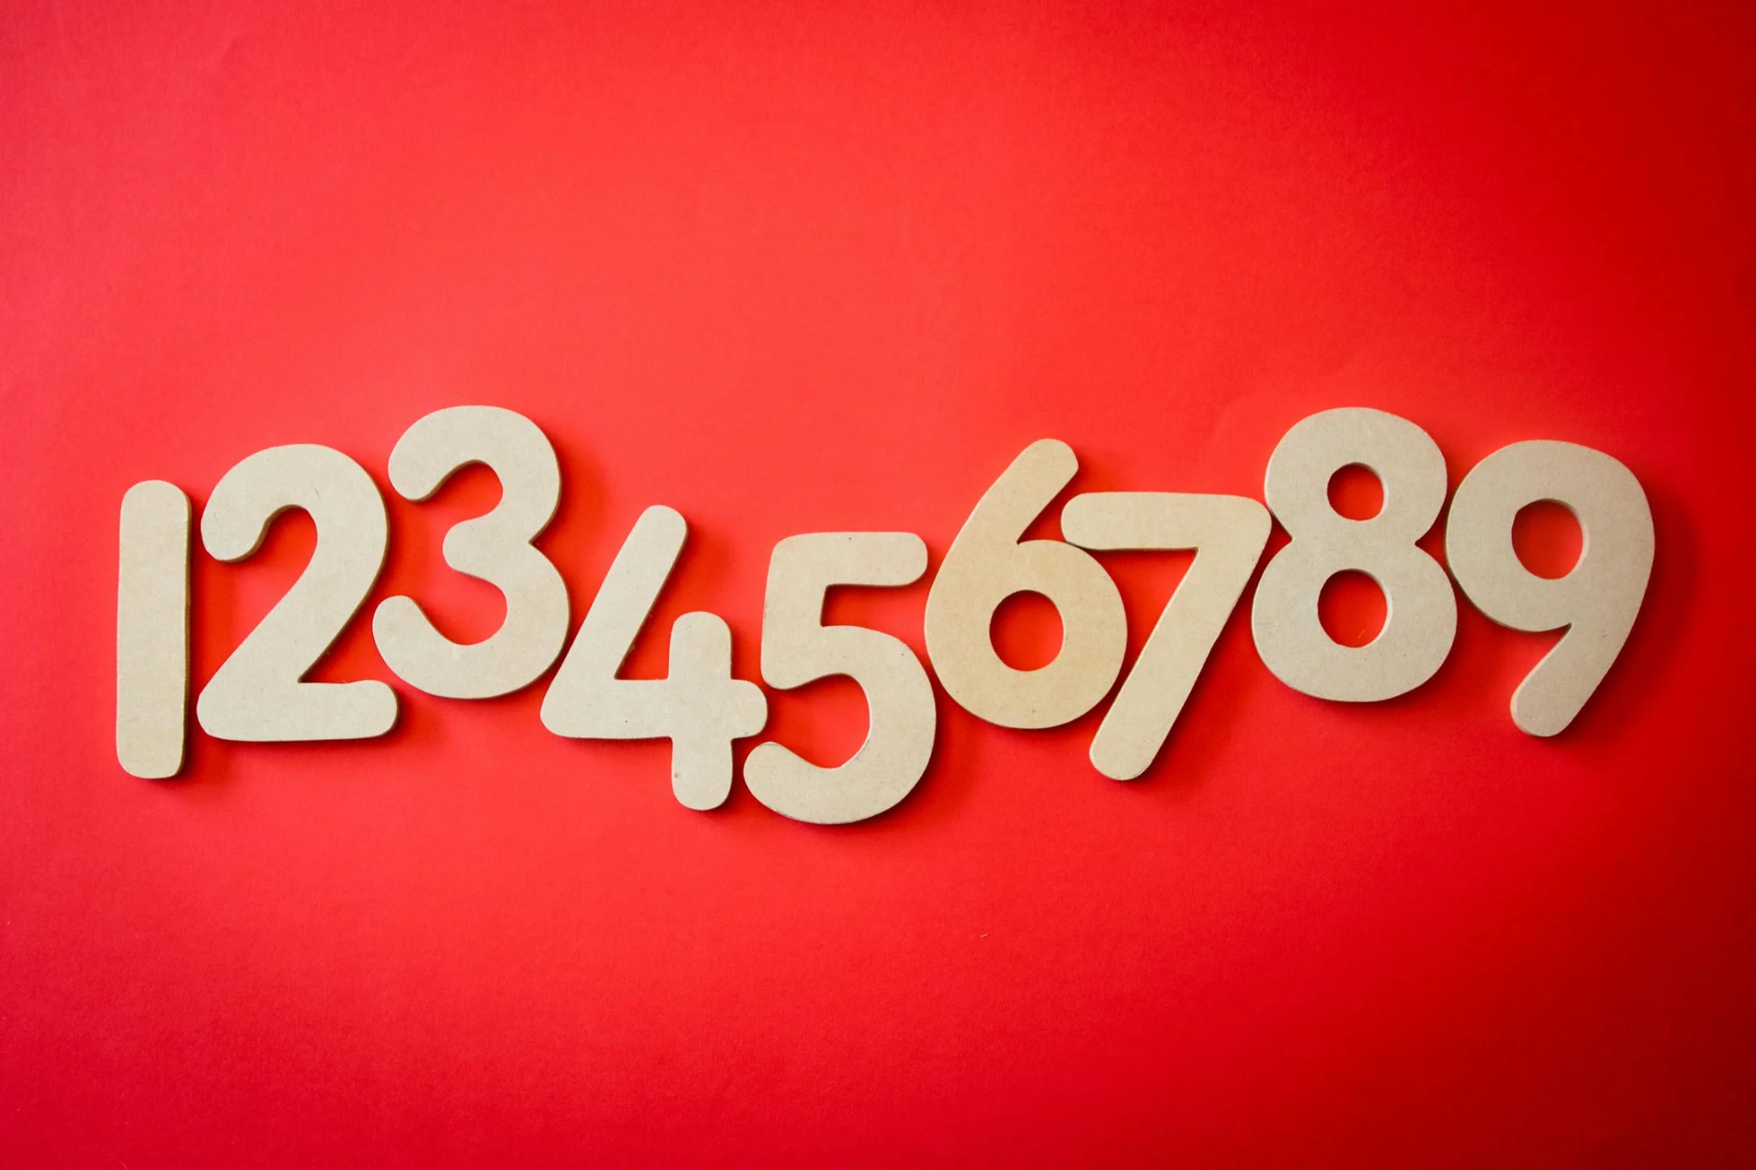
Notes:
Have children stand in groups (classes/houses within classes to make groups smaller). The group should try and count to 20 without one person saying a number at the same time as another. After the activity, discuss how this game can demonstrate the importance of working together to achieve a common goal- just like those organisations do who work for peace and solidarity.

Slide 13
Solidarity and Peace
What do we do as a school to promote solidarity and peace already?
What could we do in addition to this?

Slide 14
Solidarity and Peace
Let us now listen to the Word of God.
Notes:
Play some reflective music and you silently click through Scripture.

Slide 15
Solidarity and Peace
‘I appeal to you, [...] that all of you agree, and that there be no divisions among you...’
1 Corinthians 1:10
Notes:
Play some reflective music and you silently click through Scripture.

Slide 16
Solidarity and Peace
‘If one person suffers, all suffer together; if one member is honoured, all rejoice together.’
1 Corinthians 12:26
Notes:
Play some reflective music and you silently click through Scripture.

Slide 17
Solidarity and Peace
Can you think of a time when someone had something really great happen and you all rejoiced with them?
Notes:
Children to share their ideas. Encourage them to see that that is solidarity!

Slide 18
Solidarity and Peace
Let Us Pray…
Notes:
Have your prayer/chaplaincy team lead the prayer.

Slide 19
Solidarity and Peace
Loving God,
Help us to ‘Be in Solidarity’ – to stand shoulder to shoulder with the voiceless, the powerless, the homeless and the helpless.

Slide 20
Solidarity and Peace
We pray for those who are unable to live lives of peace.
O God, help us to stand in solidarity with them.

Slide 21
Solidarity and Peace
We pray for those in power, that they may make the right choices to better promote peace in our world.
O God, help those in power to serve their people.

Slide 22
Solidarity and Peace
We pray for those who cannot speak for themselves.
O God, help us to recognise what we can do for others.

Slide 23
Solidarity and Peace
We pray that everyone in our world may one day be able to thrive, not just survive.
O God, help us to spread Your love.
Notes:
Discuss meaning of ‘thrive’ for children and give examples of someone thriving in their life (living a life devoted to faith and love).

Slide 24
Solidarity and Peace
Amen

Slide 25
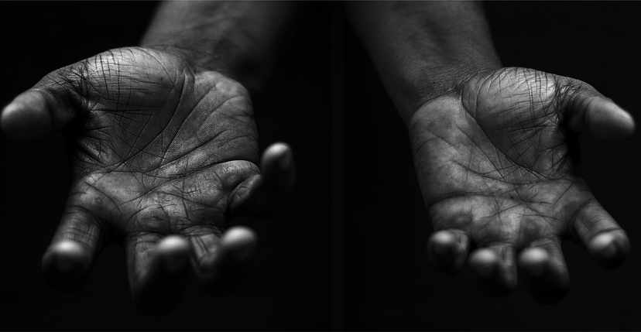
Solidarity and Peace
Your Mission
Notes:
Using the Prayer Toolkit model, the mission ‘tasks’ on the following slide can be amended or supplemented as required.

Slide 26
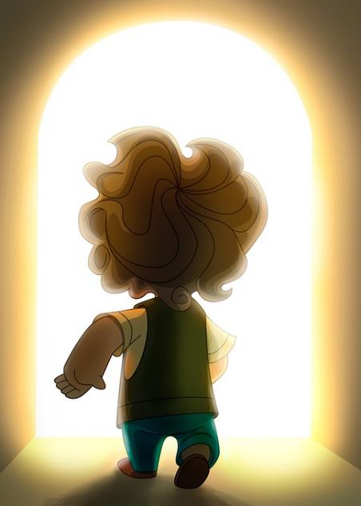
Solidarity and Peace
Find out about:
World Day of Peace (1st January)
Actions:
If there is someone you could forgive, do so.
If there is someone you need to make amends with, do so and shake their hand.
Notes:
Can children suggest their own missions that are directly in relation to showing peace and solidarity to one another/people in their community?

Slide 27
Care of Creation
Notes:
Click on image to open up ‘Let there be peace shared among us’ hymn to sing together

