Slide 1
Community and Participation
UKS2 Assembly

Slide 2
Starter

Slide 3
Catholic Social Teaching

Slide 4
What’s going on in this image?
Notes:
Use this to prompt a discussion about not being present or observant of the world around you and not being an active participant. Life is beautiful so notice it and join in!

Slide 5
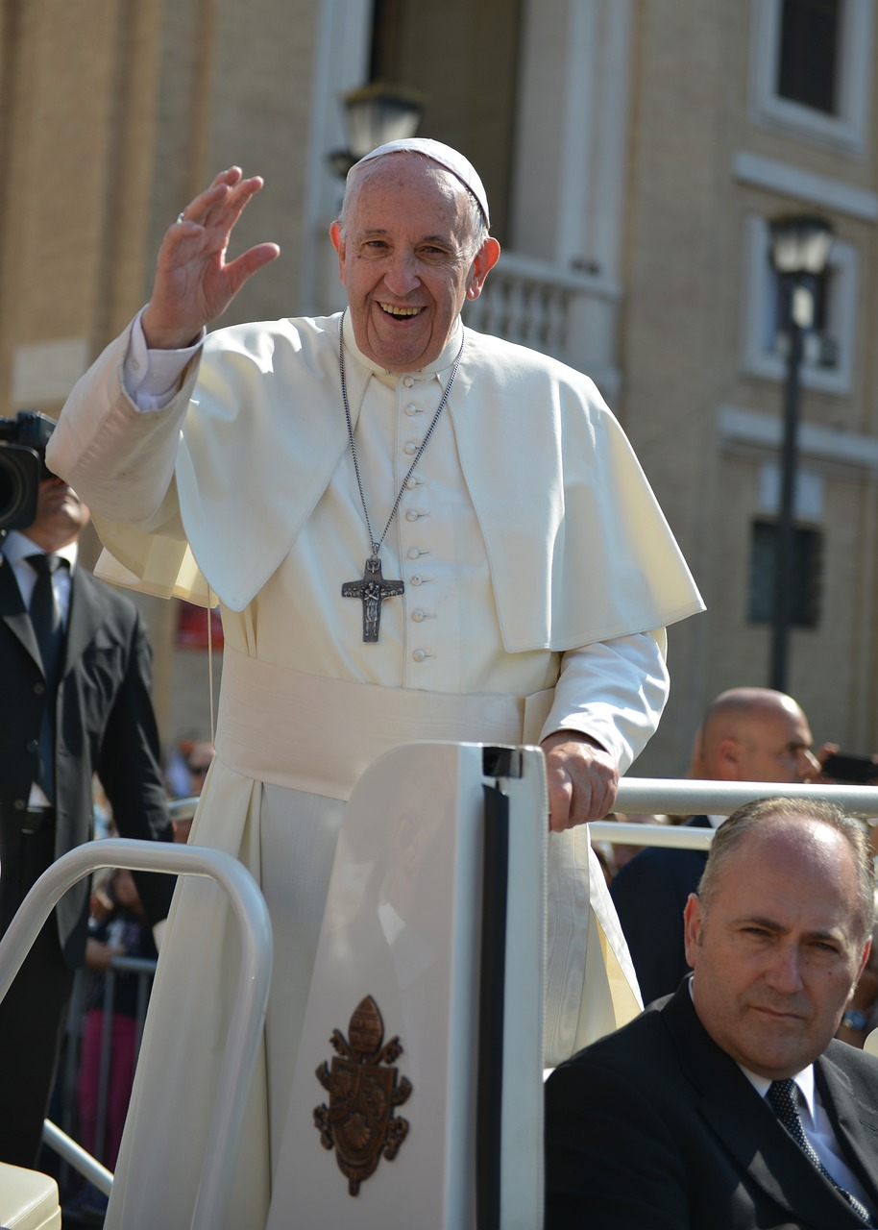
Community and Participation
‘Don’t be observers, but immerse yourself in the reality of life, as Jesus did.’
Pope Francis, World Youth Day, 2013
Notes:
Pope Francis reminds us to go one step further- don’t just observe, join in! What might it mean to immerse yourself in the reality of life?

Slide 6
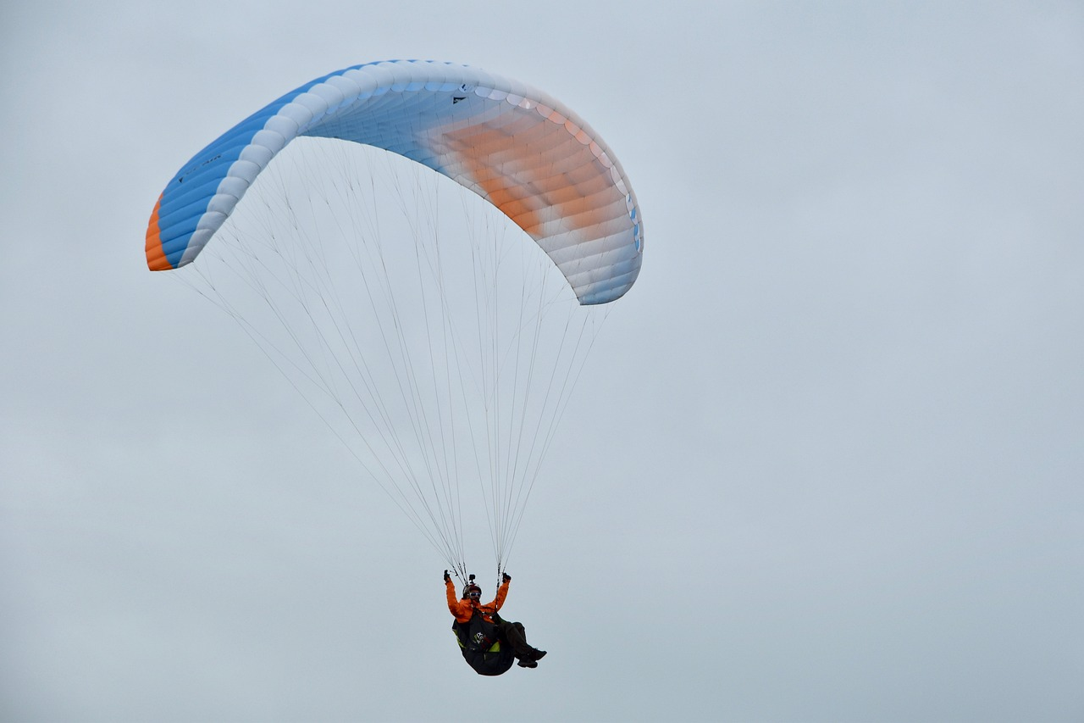
Notes:
Pope Francis reminds us to go one step further- don’t just observe, join in! What might it mean to immerse yourself in the reality of life?

Slide 7
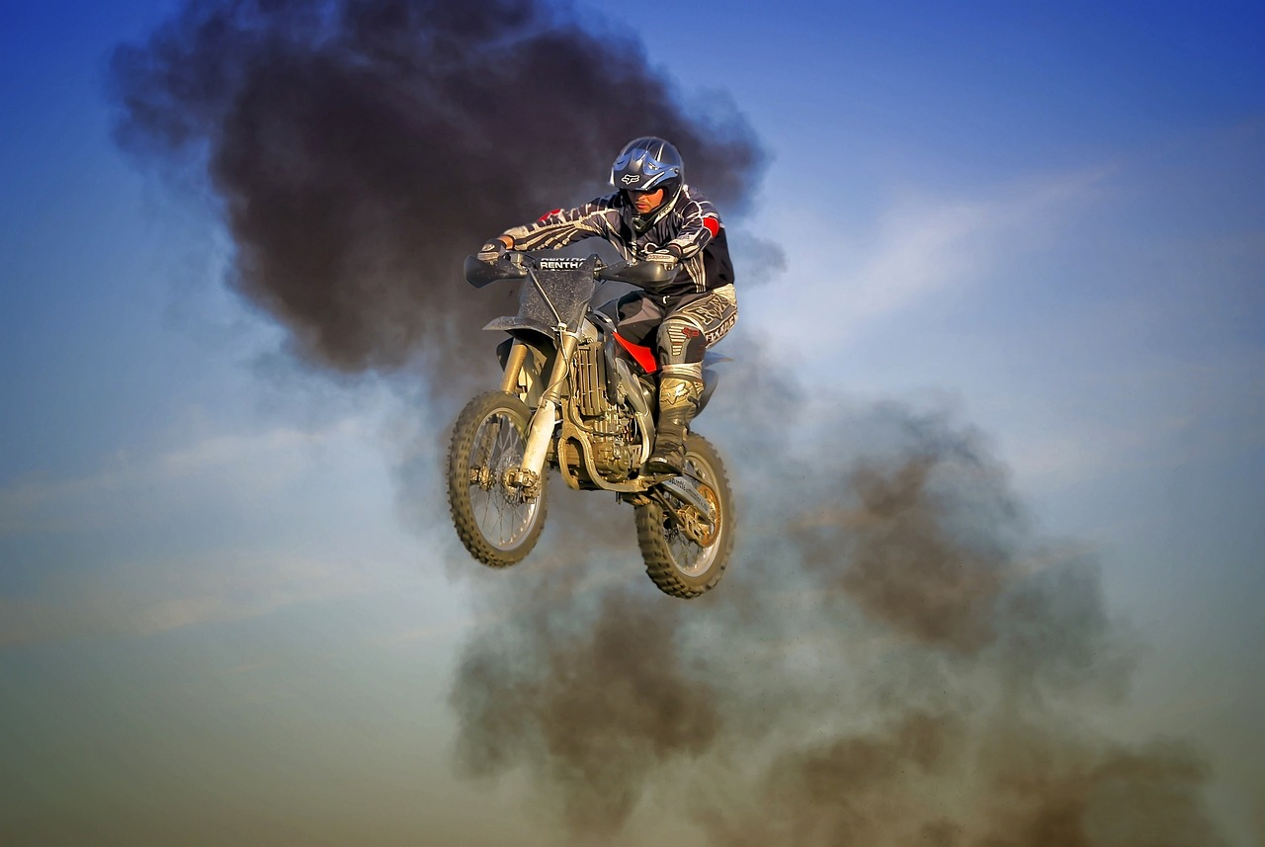
Notes:
Pope Francis reminds us to go one step further- don’t just observe, join in! What might it mean to immerse yourself in the reality of life?

Slide 8
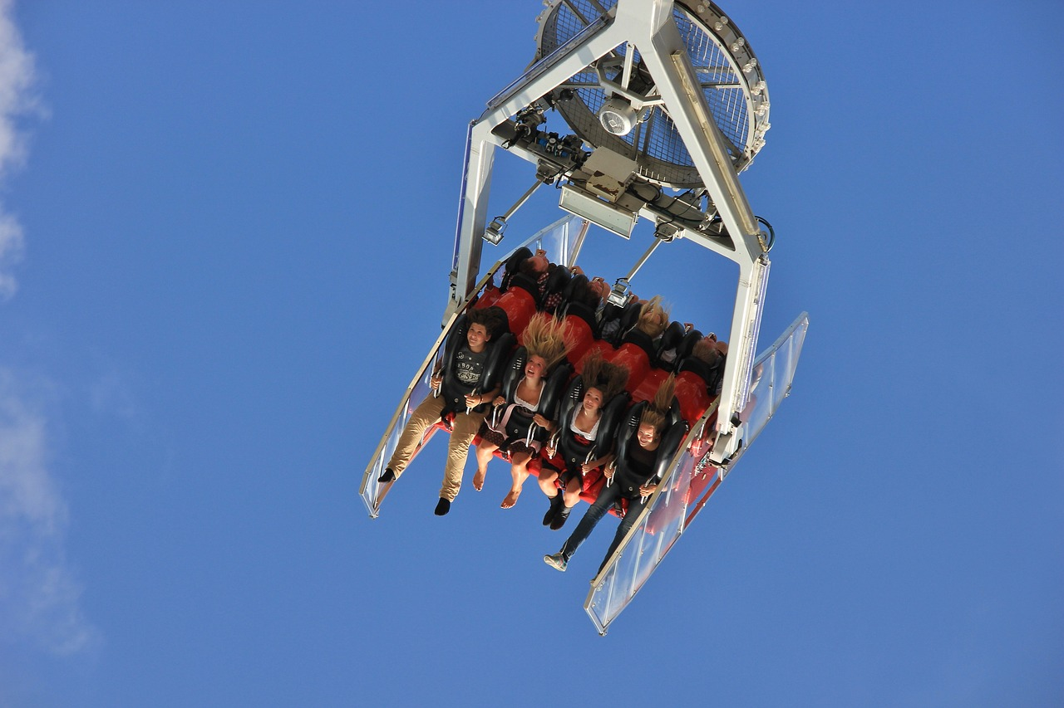
Notes:
Pope Francis reminds us to go one step further- don’t just observe, join in! What might it mean to immerse yourself in the reality of life?

Slide 9
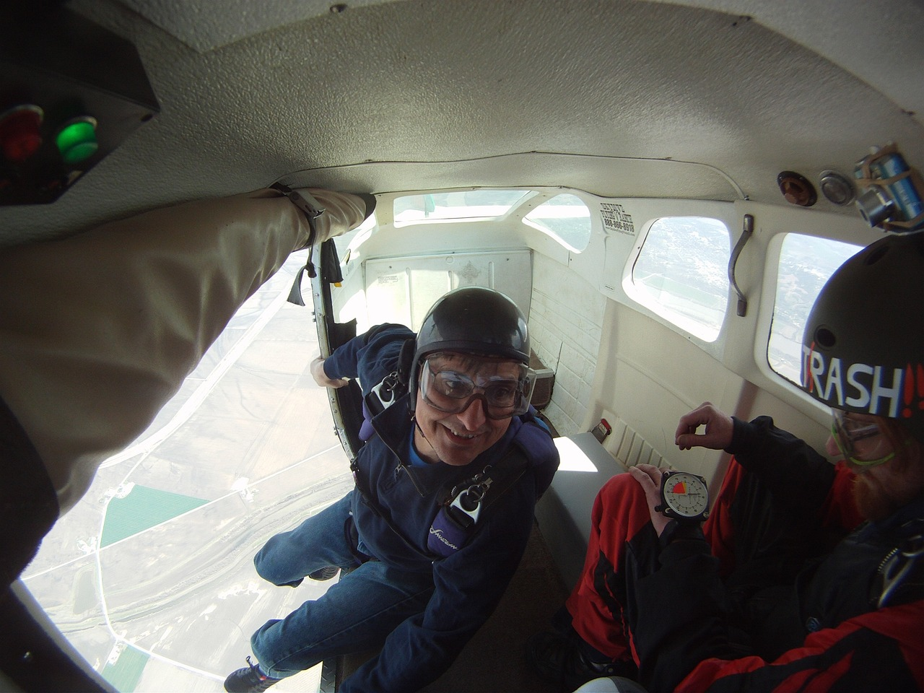
Notes:
Do you think this is what Pope Francis means?

Slide 10
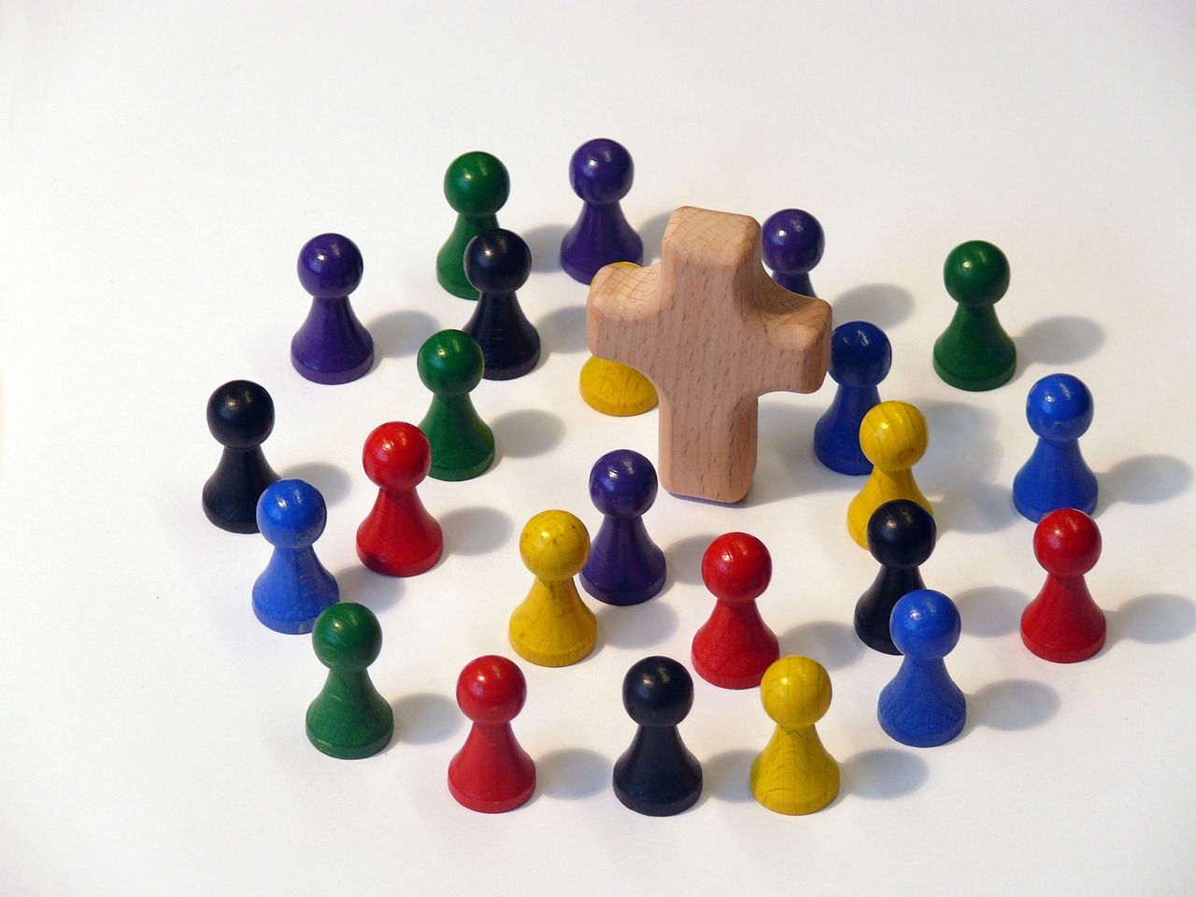
Notes:
Immersing ourselves in life is about living in community, looking out for others and loving them as God loves us. What are good examples of this? Are there times when people forget this? Discussion around times of conflict but finding hope in communities that form trying to help.

Slide 11
Community and Participation
‘Do we open ourselves to the Holy Spirit, so as to be an active part of our communities, or do we close in on ourselves, saying 'I have so many things to do, that's not my job’?’
Pope Francis​
Notes:
Have pupil chaplains act out a scenario where someone in their community is in need and they complain they are too busy to help. Discuss the likelihood of this happening, in all our lives and how we can work to always be open to helping others.

Slide 12
Community and Participation
Living in community with others is more than simply living near people.
We need to recognise the dignity in other people and treat them as such.
We are also called to recognise our own gifts and talents and use them to make our communities better!
Notes:
Ask children to share their gifts/talents. Then ask them to think about when they’ve used them to help their communities e.g. I am a confident communicator so I was a member of the school council, communicating the thoughts of my class to work for change in our school community.

Slide 13
Community and Participation
Think of a time when you felt supported by the people in your community.
What did they do that made you feel that way?
What could you do to make other people feel supported by you?

Slide 14
Community and Participation
Let us now listen to the Word of God.

Slide 15
Community and Participation
Read through one of more of the bible passages on the next few slides.
As a class, think about and discuss the meaning of each.​
How do the passages relate to Community and Participation?

Slide 16
Community and Participation
‘Love one another: just as I have loved you ... By this all people will know that you are my disciples.’
John 13:34-35

Slide 17
Community and Participation
‘You shall love the Lord your God with all your heart, and with all your soul, and with all your mind. This is the first and greatest commandment. And the second is you shall love your neighbour as yourself.’
Matthew 22:37-39

Slide 18
Community and Participation
What do these bible passages and quote from Pope Francis tell you about how we should live in community?
How do we know that God wants us to act in this way?

Slide 19
Community and Participation
“I think that…”
Notes:
Holding slide for discussion/feedback if required.

Slide 20
Community and Participation
Let Us Pray…

Slide 21
Community and Participation
Loving God,
We come together to thank you for our communities. You created us to live with each other and show Your love to those in need.
Let us give thanks for the joy that our communities bring us and ask You to help us make our communities better.

Slide 22
Community and Participation
We pray for those who do not feel a part of their communities.
O God, help us to show love to those who feel unloved.

Slide 23
Community and Participation
We pray for those who do not know how to ask for help.
O God, help us to reach out our hands to those in need.

Slide 24
Community and Participation
We pray that everyone feels comfortable, supported and loved in our communities.
O God, help us to spread Your love.

Slide 25
Community and Participation
We pray that we may be able to make our communities better places for all who live in them.
O God, help us to use the gifts You gave us for the benefit of others.

Slide 26
Community and Participation
Amen
Notes:
Image links to modern, upbeat worship song: All Are Welcome that children can sing along with

Slide 27
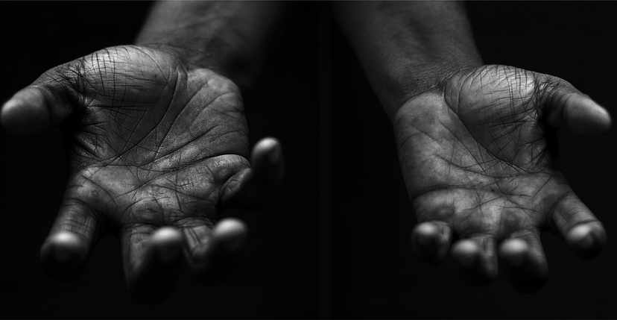
Community and Participation
Your Mission
Notes:
Using the Prayer Toolkit model, the mission ‘tasks’ on the following slide can be amended or supplemented as required.

Slide 28
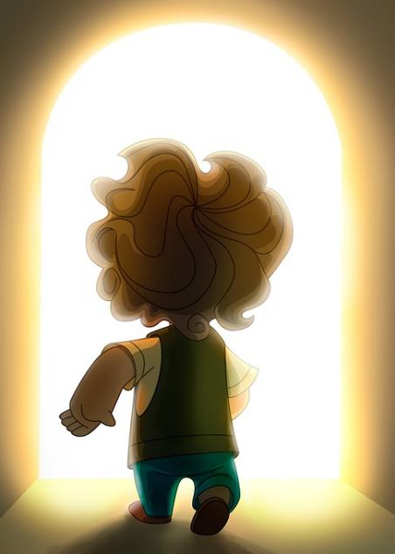
Community and Participation
Find out more about St Vincent de Paul.
Think about what you could do to support those in need in your community during Lent.
Research:
CAFOD Lent Family Fast Day (14th March 2025)
Notes:
CAFOD Family Fast Day is always the 2nd Friday in Lent, and often well-promoted in parishes. People are encouraged to give up a treat, or eat a simpler meal, and give the money to support CAFOD’s work with some of the poorest people in the world.

Slide 29
Care of Creation

