Slide 1
Solidarity and Peace
UKS2 Assembly

Slide 2
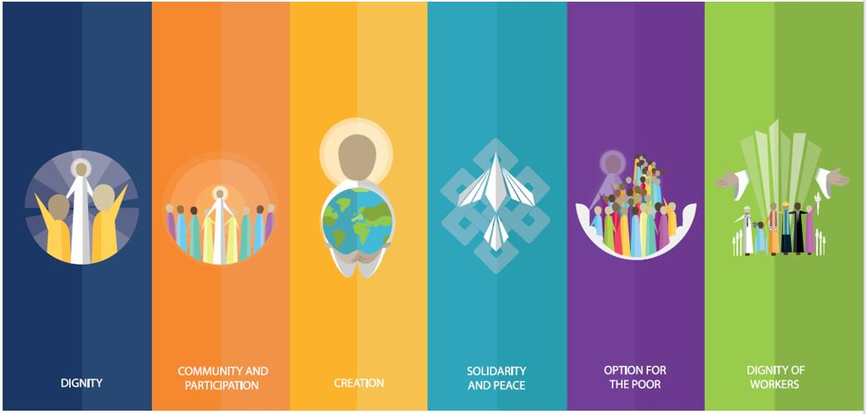
Starter

Slide 3
Notes:
What do you think of when you hear the word peace?

Slide 4
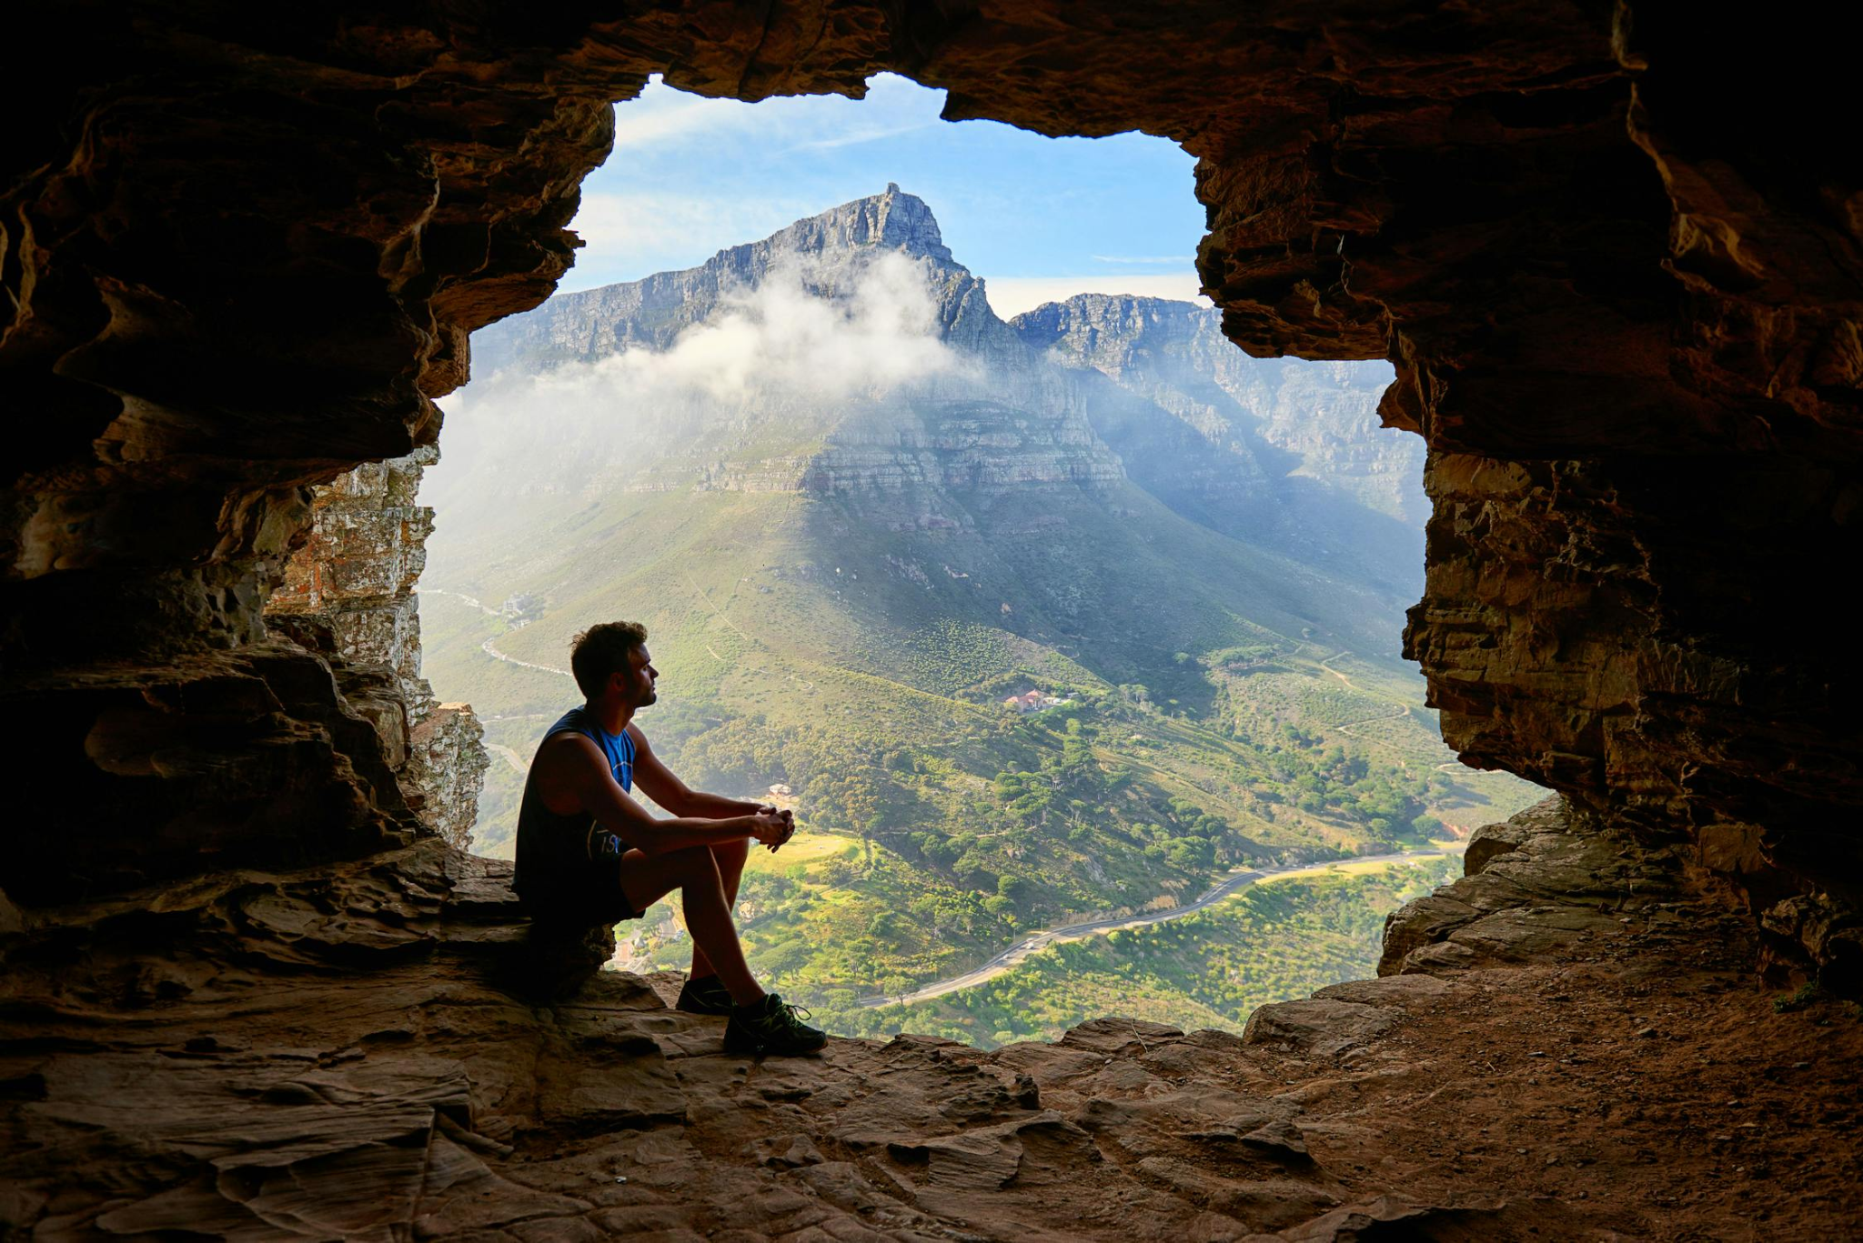
Solidarity and Peace

Slide 5
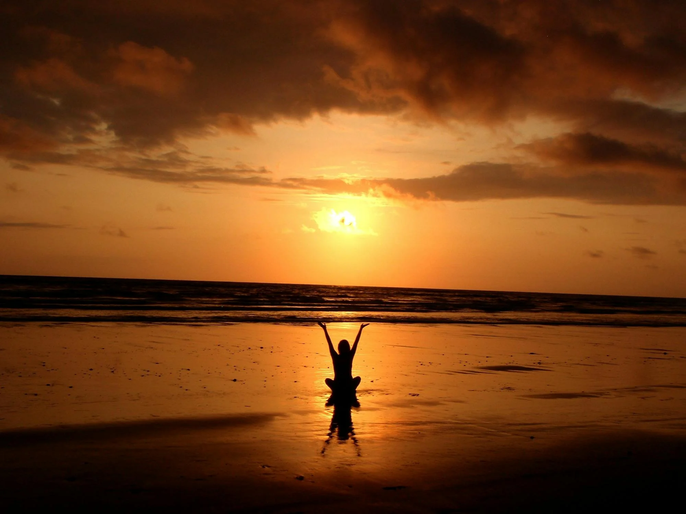
Solidarity and Peace

Slide 6
Solidarity and Peace
Notes:
Are these the kinds of things you think of when you hear the word ‘peace’? Is this an accurate representation of the world at the moment? Is the world a peaceful place? Invite children to share their opinions.

Slide 7
Notes:
What do you think of when you hear the word solidarity?

Slide 8
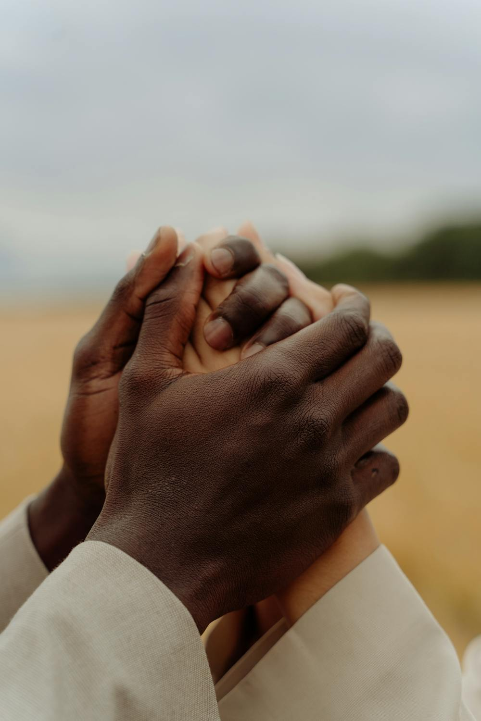
Solidarity and Peace

Slide 9
Solidarity and Peace

Slide 10
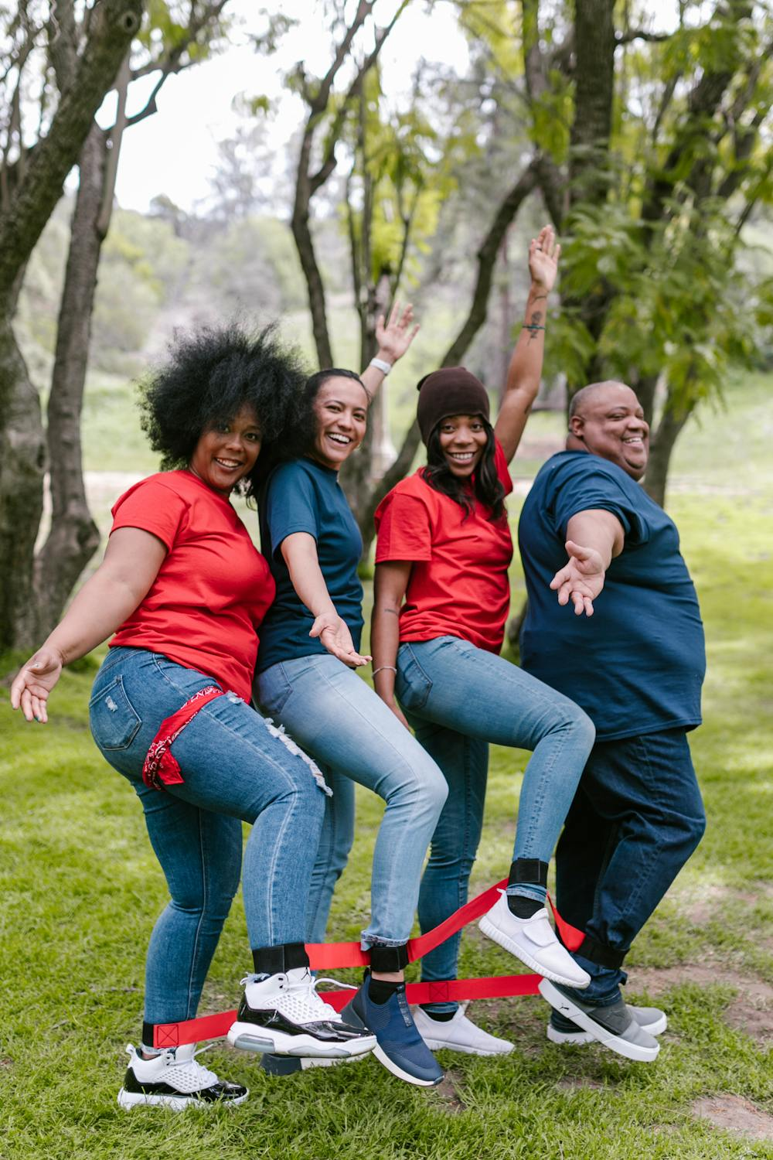
Solidarity and Peace
Notes:
Are these the kinds of things you think of when you hear ‘solidarity’? Can you think of examples where people have shown solidarity e.g. protests; supporting a cause etc.

Slide 11
Solidarity and Peace
‘The paths of peace are paths of solidarity, for no one can be saved alone. We live in a world so interconnected that, in the end, the actions of each person affect everyone.’
Pope Francis

Slide 12
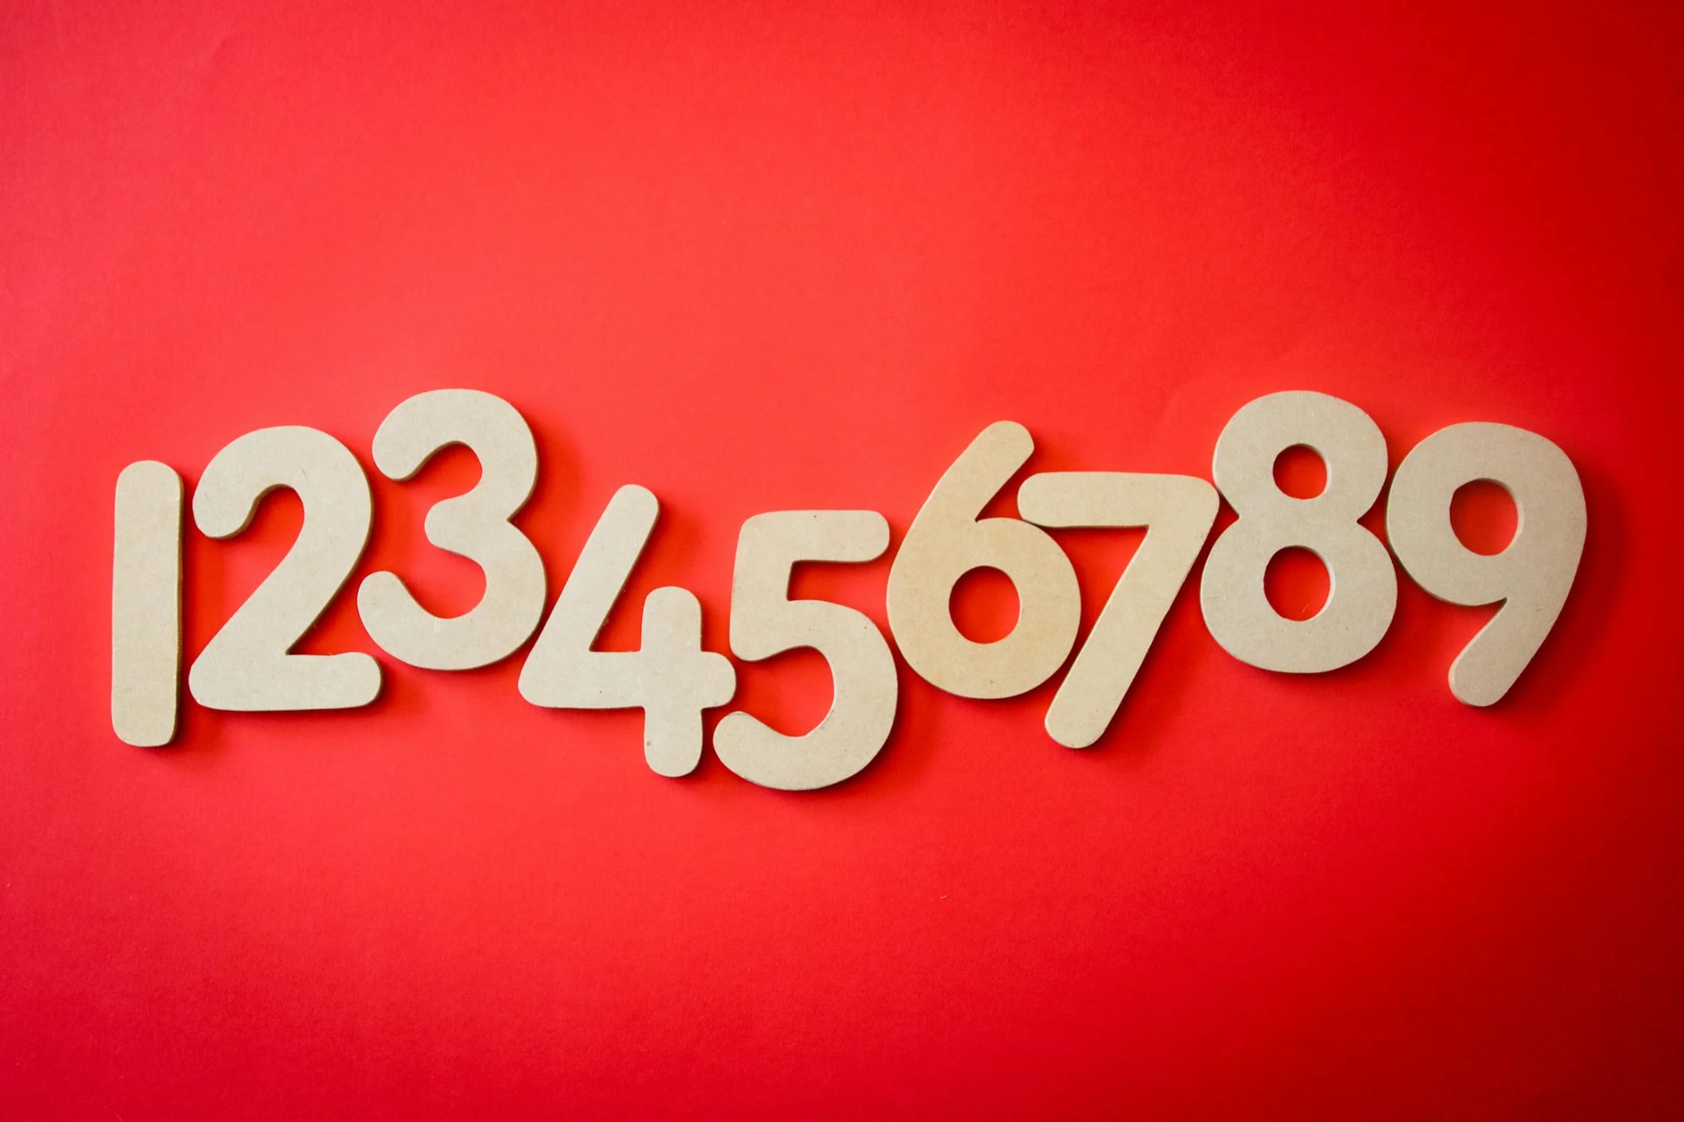
Notes:
Have children stand in groups (classes/houses within classes to make groups smaller). The group should try and count to 20 without one person saying a number at the same time as another. After the activity, discuss how this game can demonstrate Pope Francis’ point that the actions of everyone affect everyone for we are all interconnected.

Slide 13
Solidarity and Peace
What do we do as a school to promote solidarity and peace already?
What could we do in addition to this?

Slide 14
Solidarity and Peace
Let us now listen to the Word of God.

Slide 15
Solidarity and Peace
How do the passages relate to Solidarity and Peace?

Slide 16
Solidarity and Peace
‘Live in harmony with one another. Do not be proud, but associate with those in need.’
Romans 12:16
Notes:
Play some reflective music and you silently click through Scripture.

Slide 17
Solidarity and Peace
‘I appeal to you, sisters and brothers, by the name of our Lord Jesus Christ, that all of you agree, and that there be no divisions among you, but that you be united in the same mind and the same judgment.’
1 Corinthians 1:10
Notes:
Play some reflective music and you silently click through Scripture.

Slide 18
Solidarity and Peace
‘If one person suffers, all suffer together; if one member is honoured, all rejoice together.’
1 Corinthians 12:26
Notes:
Play some reflective music and you silently click through Scripture.

Slide 19
Solidarity and Peace
‘Bear with each other and forgive one another. Forgive as the Lord forgave you. And over all these virtues put on love, which binds them all together in perfect unity.’
Colossians 3:13-14
Notes:
Play some reflective music and you silently click through Scripture.

Slide 20
Solidarity and Peace
Which passage resonated with you most? Why?
Notes:
Encourage children to reflect on issues going on in the world now and how these Scriptures could encourage the people involved to work for peace and solidarity.

Slide 21
Solidarity and Peace
Let Us Pray…
Notes:
Have your prayer/chaplaincy team lead the prayer.

Slide 22
Solidarity and Peace
Loving God,
We come together to thank you for our human family. You created our world so that we may live in harmony with one another.
Help us to follow the example of Your Son, Jesus Christ, by spreading Your peace and by standing in solidarity with those who cannot speak for themselves.

Slide 23
Solidarity and Peace
We pray for those who are unable to live lives of peace.
O God, help us to stand in solidarity with them.

Slide 24
Solidarity and Peace
We pray for those in power, that they may make the right choices to better promote peace in our world.
O God, help those in power to serve their people.

Slide 25
Solidarity and Peace
We pray for those who cannot speak for themselves.
O God, help us to recognise what we can do for others.

Slide 26
Solidarity and Peace
We pray that everyone in our world may one day be able to thrive, not just survive.
O God, help us to spread Your love.

Slide 27
Solidarity and Peace
Amen

Slide 28
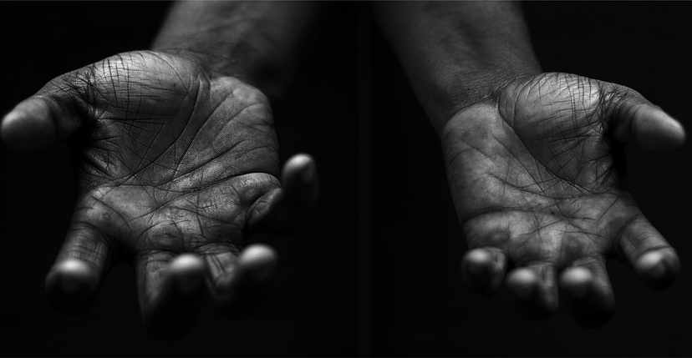
Solidarity and Peace
Your Mission
Notes:
Using the Prayer Toolkit model, the mission ‘tasks’ on the following slide can be amended or supplemented as required.

Slide 29
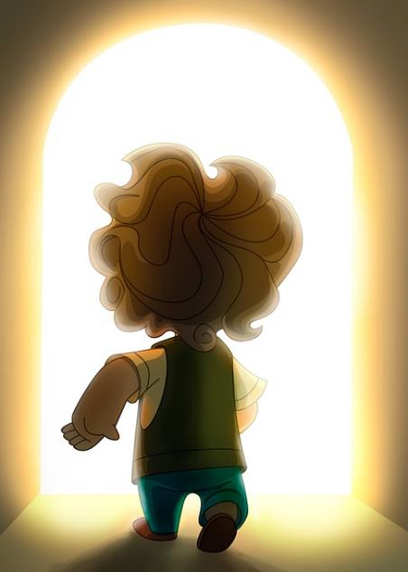
Solidarity and Peace
Find out more about St John Paul II and his calls for World Peace.
Research:
World Day of Peace (1st January) International Day of Human Fraternity (4th February)
Notes:
Can children suggest their own missions that are directly in relation to showing peace and solidarity to one another/people in their community?

Slide 30
Care of Creation
Notes:
Click on image to open to ‘Peace Perfect Peace’ hymn to sing together.

