Slide 1
Community and Participation
Year 1

Slide 2
Starter
How do you help your communities?

Slide 3
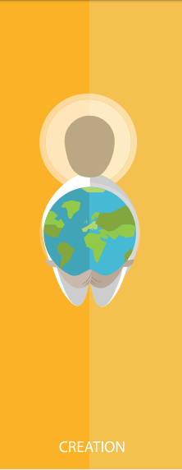
Catholic Social Teaching

Slide 4
Catholic Social Teaching

Slide 5
Community and Participation
Think of one of the communities from the starter. What do you like about being a part of it?

Slide 6
Community and Participation
God loves us all.
He wants us to show that love to each other too.

Slide 7
Community and Participation
‘Love one another: just as I have loved you ... By this all people will know that you are my disciples.’
John 13:34-35

Slide 8
Community and Participation
‘You shall love your neighbour as yourself.’
Matthew 22:37-39

Slide 9
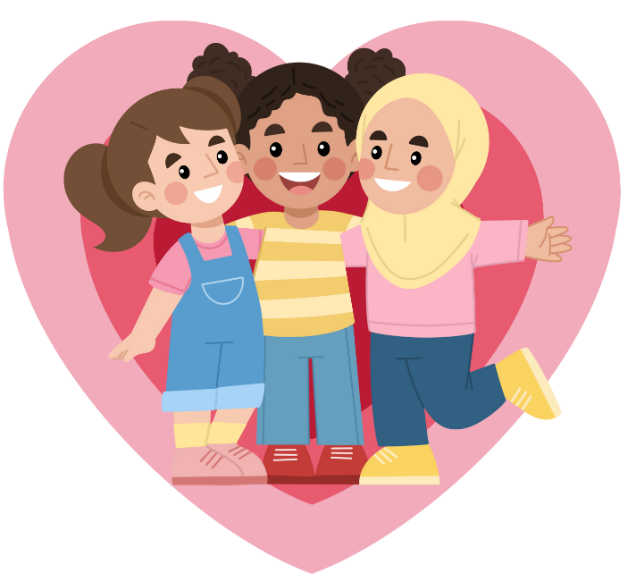
Community and Participation
Who is your neighbour?
When was the last time you did something kind for them?

Slide 10
Main Activity 1
In the person, draw or write the names of your neighbours.
Around it, draw or write ways that you could help those people.
Think about your friends, family, people in your school, people in your after school clubs.
Notes:
We would love to see the work your pupils produce (with permissions if necessary). Please email their work to: eduril@rcdow.org.uk

Slide 11
Main Activity 2
Think about one of the communities you belong to that you could show more love and participation to.
Write a pledge, indicating what you will do.
Why is it important to show love and participate in your community? Remember to refer to Matthew 22.
Notes:
We would love to see the work your pupils produce (with permissions if necessary). Please email their work to: eduril@rcdow.org.uk

Slide 12
Plenary
‘Help others when they are sad or angry – this is what Jesus wants you to do.’
Galatians 6:2
Why do you think Jesus wants this from us?
How did Jesus show us this through his actions?

