Slide 1
Solidarity and Peace
Year 2

Slide 2
Jubilee Year 2025
Pope Francis has declared this year’s Jubilee theme to be: Pilgrims of Hope
In what way is Solidarity and Peace linked to Hope?
Notes:
Pope Francis opened the Holy Door of St Peter’s Basilica on Christmas Eve 2024, marking the beginning of this jubilee year. Pope Francis has called for people of faith to pray for and have deep faith, lively hope and active charity. Explain to the children why this jubilee year is a great time to be very active in charity, which is what we’re working towards in our CST lessons.

Slide 3
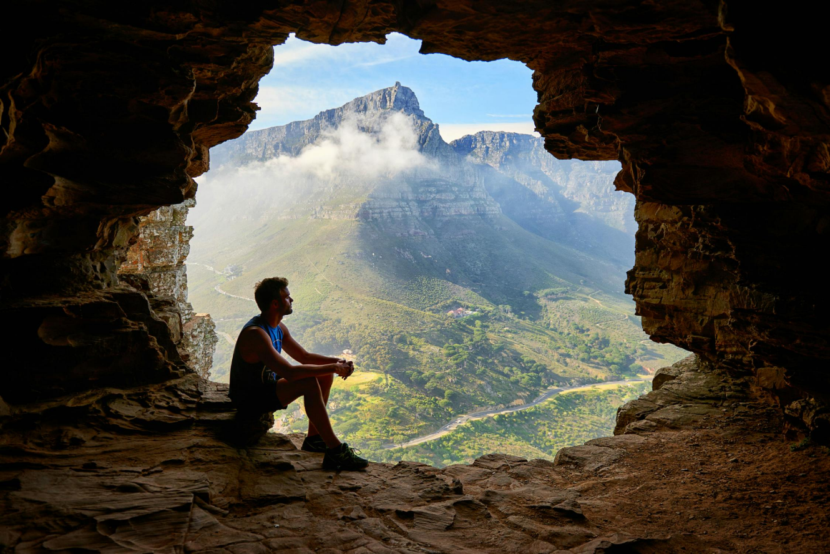
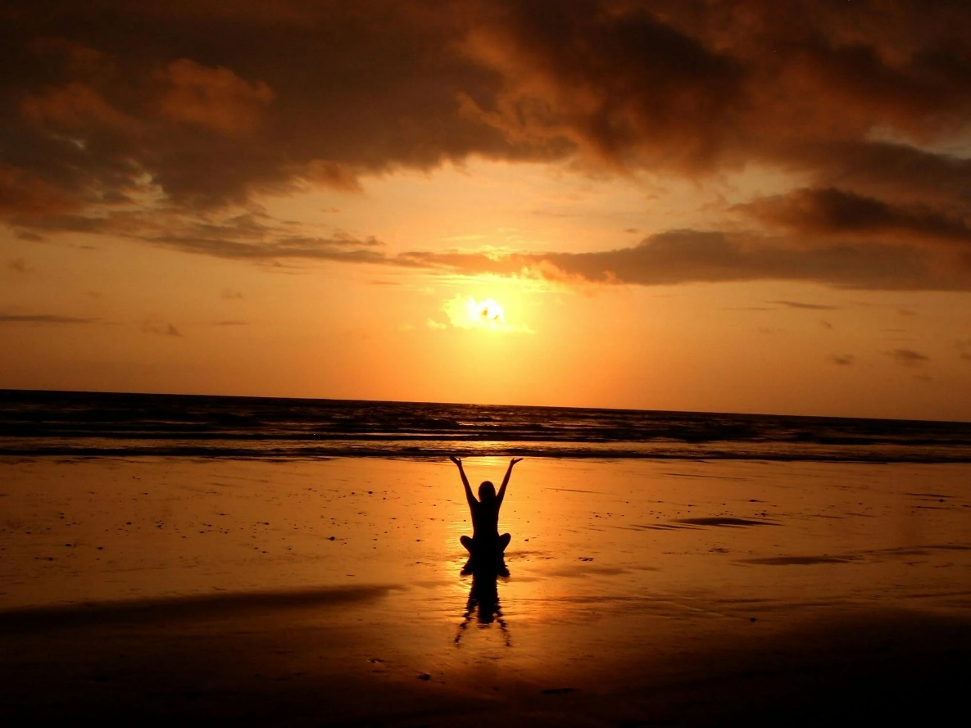
Starter
Notes:
What do all these pictures have in common? What does peace mean? When have you felt like this?

Slide 4
Catholic Social Teaching

Slide 5
Catholic Social Teaching

Slide 6
Solidarity and Peace
Notes:
Is our world a peaceful place?

Slide 7
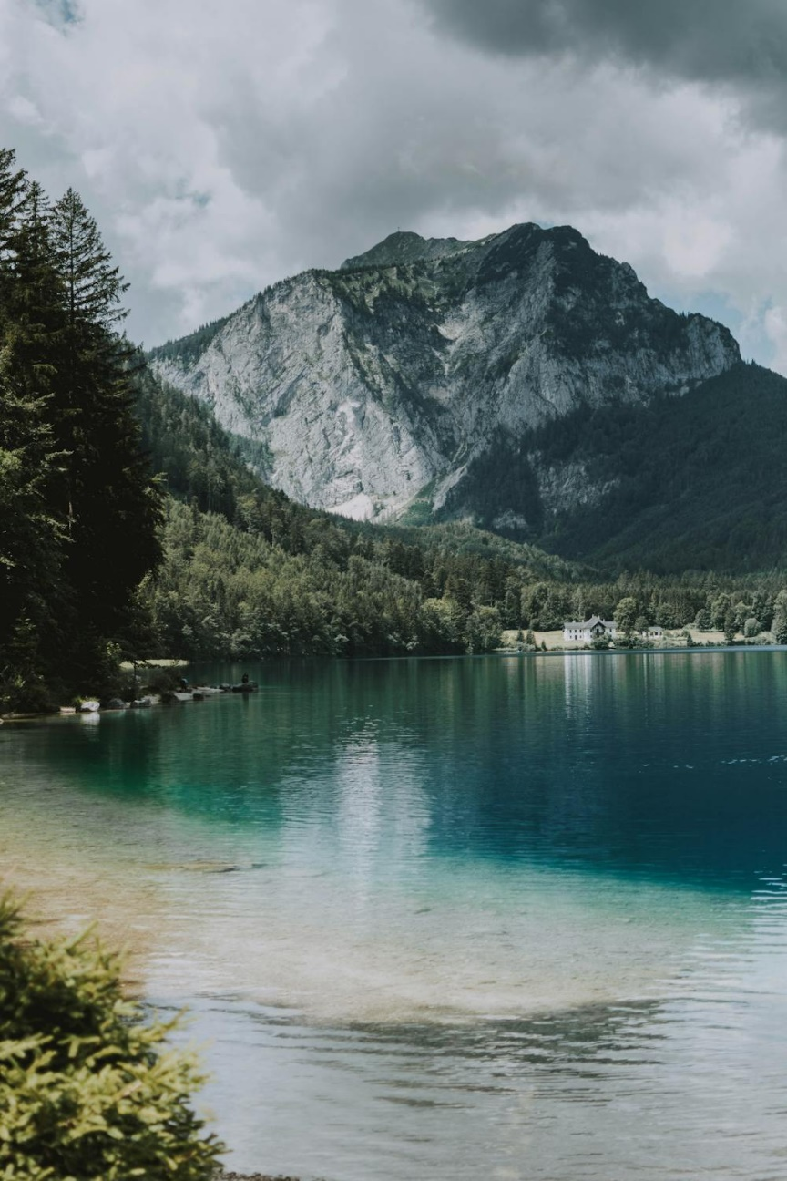
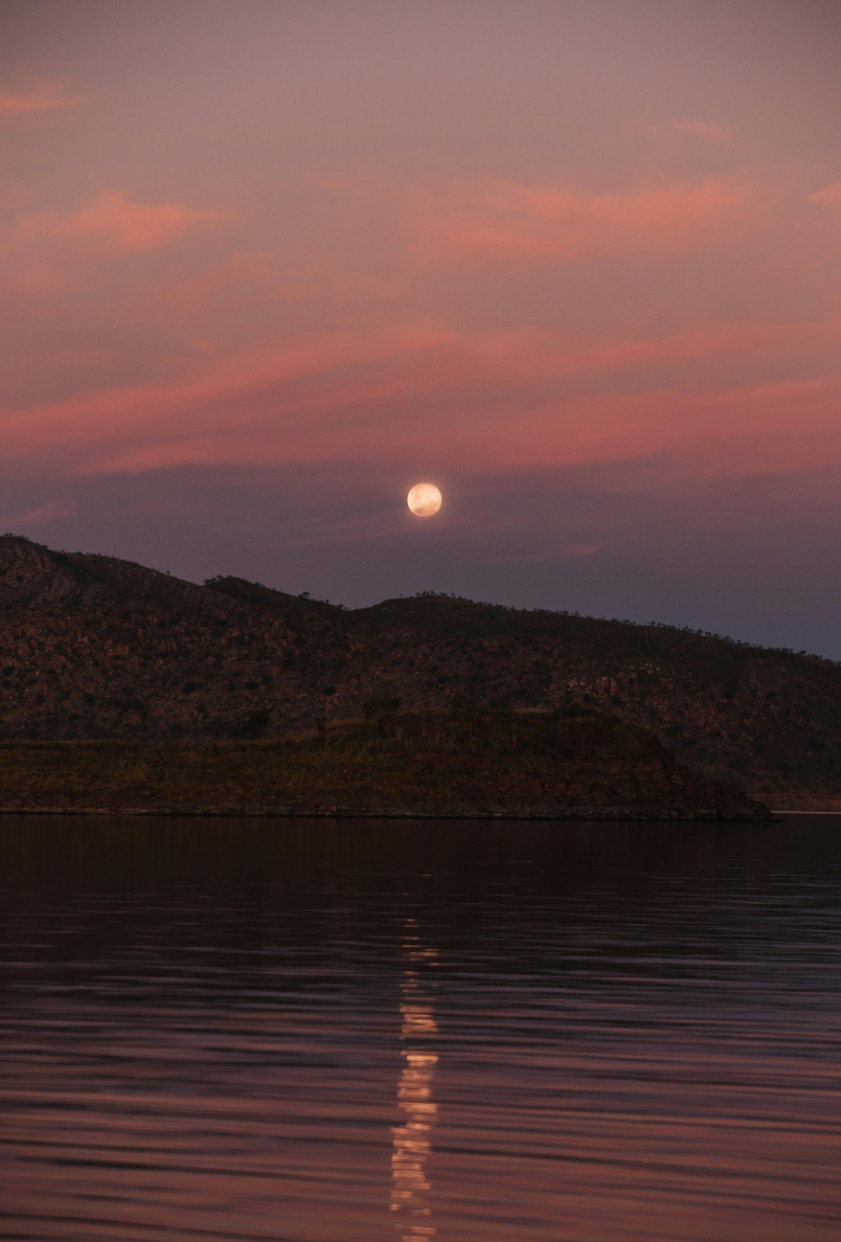
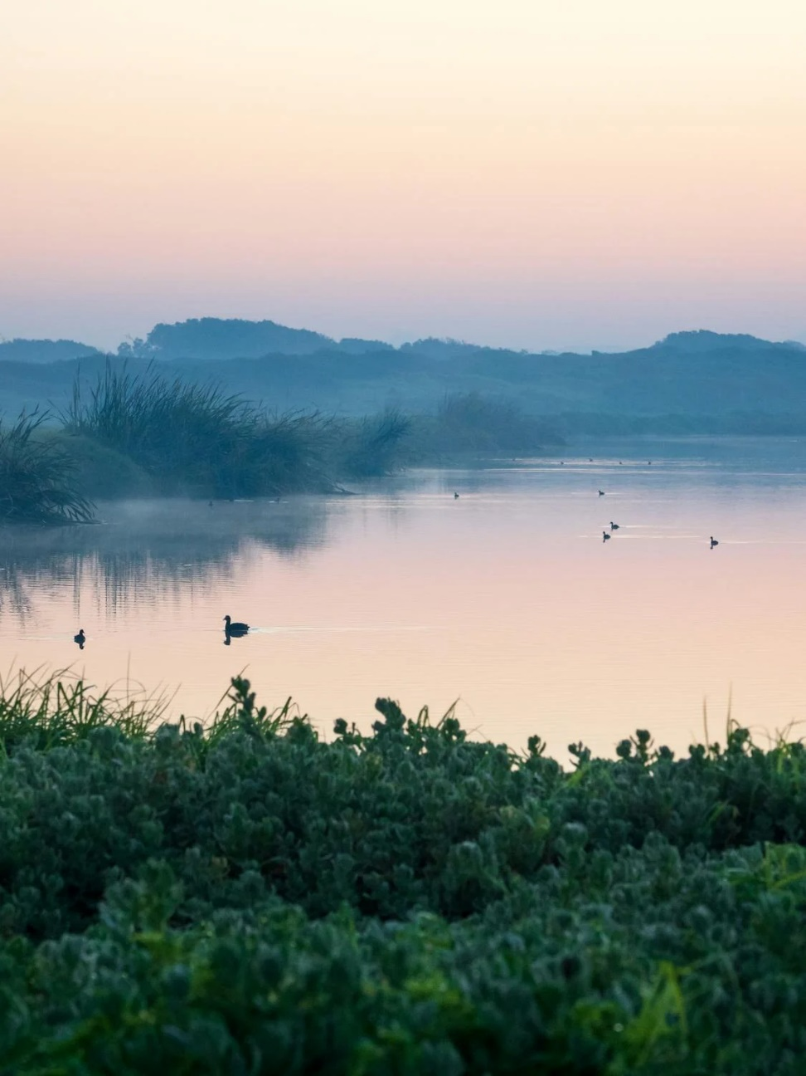
Solidarity and Peace
Notes:
Is our world a peaceful place?

Slide 8
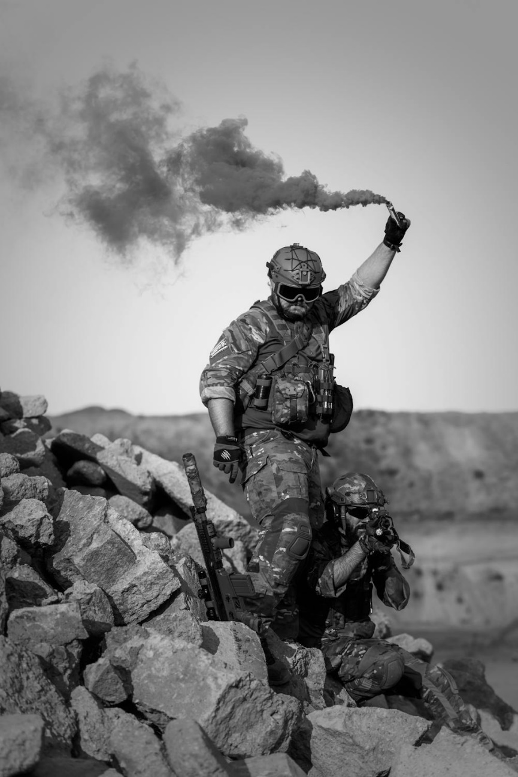
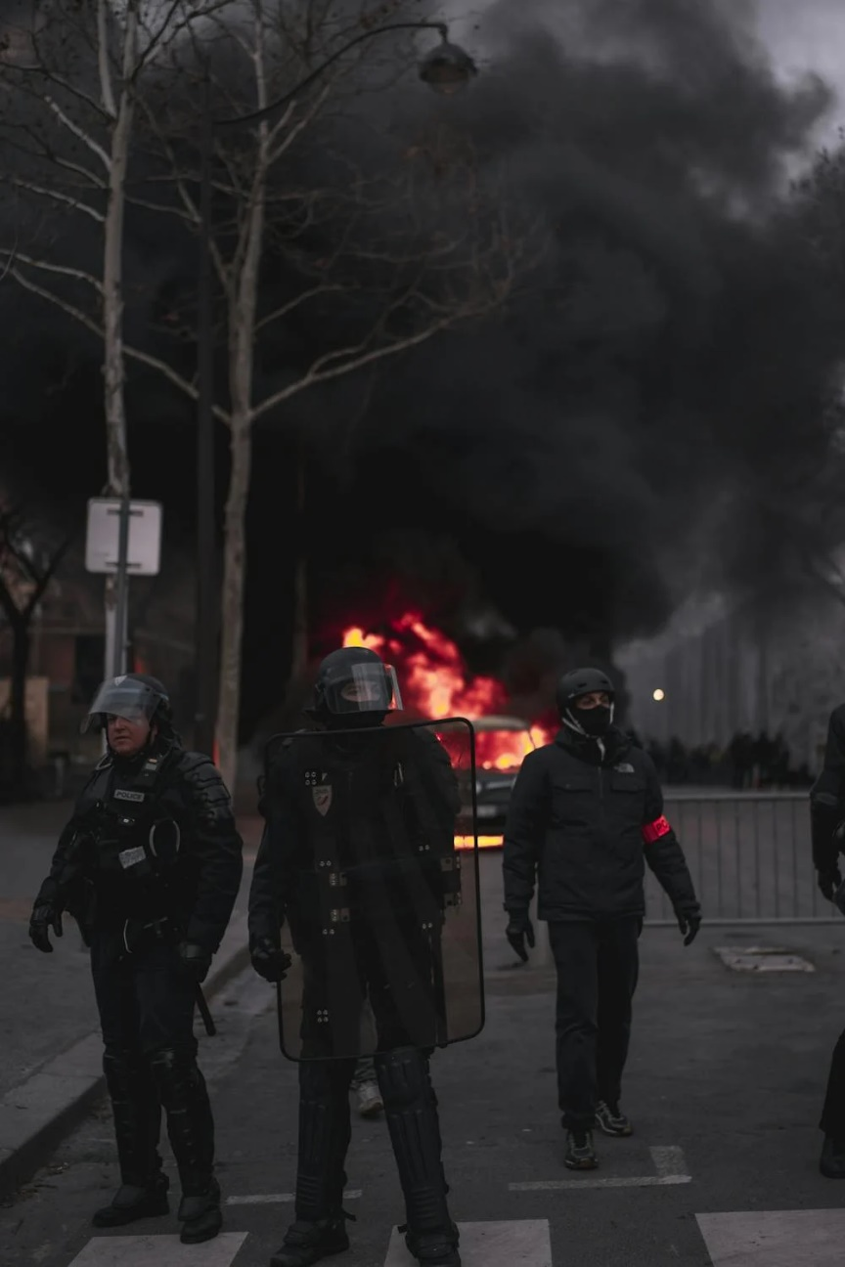
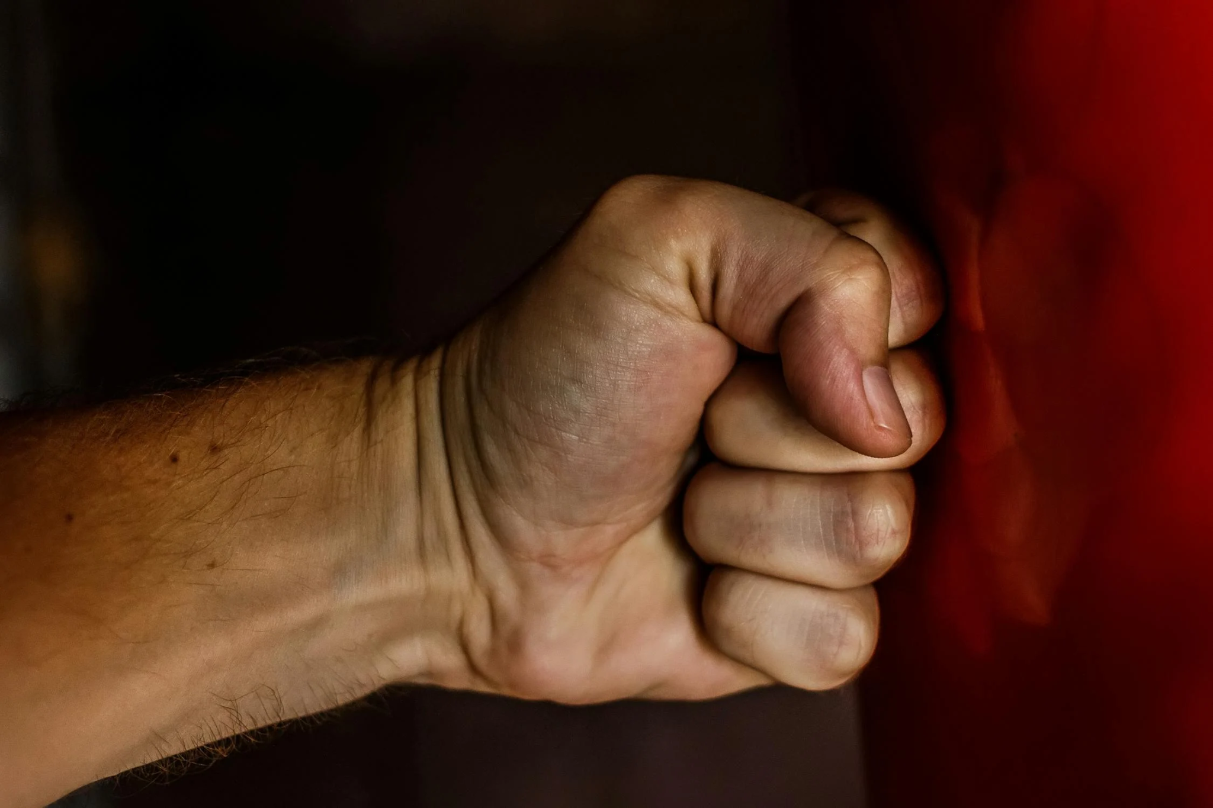
Solidarity and Peace
Notes:
Is our world a peaceful place?

Slide 9
Solidarity and Peace
‘Live in harmony with one another. Help those in need.’
Romans 12:16
Notes:
How do we know God wants us to make their world a peaceful place? (Scripture!)

Slide 10
Solidarity and Peace
‘Blessed are the peacemakers, for they will be called sons and daughters of God.’
Matthew 5:9
Who do you think ‘the peacemakers’ are?
Notes:
Can you think of anyone you know who is a peacemaker?

Slide 11
Solidarity and Peace
Peacemakers are people who are trying to make the world more peaceful.
They help people in need and help people to stop arguing.

Slide 12
The Peace Book by Todd Parr
Notes:
Click image for link

Slide 13
Activities
1. Which of the book’s peacemaking actions have you done? Draw yourself doing this action and write what peace means to you.
2. Write several lines of a poem repeating the line: ‘I have been a peacemaker for Jesus when I…
Underneath your poem, finish this sentence: ‘I know this is what Jesus wants because the bible says…’
Notes:
WT and WA activities
We would love to see the work your pupils produce (with permissions if necessary). Please email their work to: eduril@rcdow.org.uk

Slide 14
Activities
‘Live in harmony with one another. Help those in need.’
Romans 12:16
3. Write an acrostic poem (P.E.A.C.E) about living in harmony with people different from you
P is for pausing to listen to someone who has a different opinion
E is for expecting…
A is for…
C…
E…
Notes:
GD activity. Print and stick (or have children write) bible quote into their books, above their poem.
We would love to see the work your pupils produce (with permissions if necessary). Please email their work to: eduril@rcdow.org.uk

Slide 15
Plenary
‘Peace I leave with you; my peace I give you.’
John 14:27
What might the world be like if everyone strived for peace?

