Slide 1
Community and Participation
Year 3

Slide 2
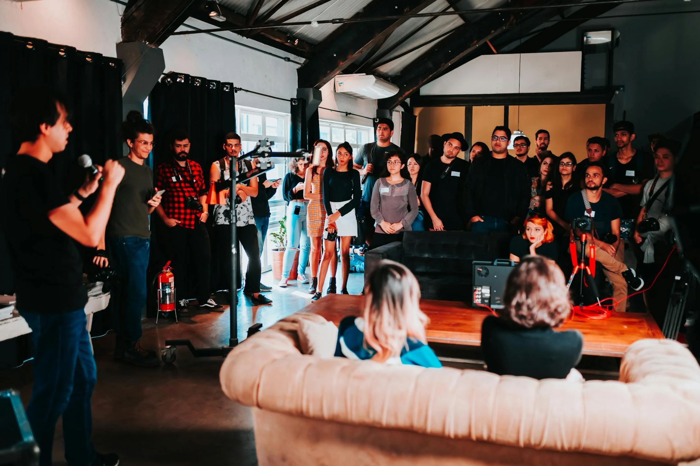
What do these images have in common?
Notes:
Talk partners for 3 minutes
Gather responses

Slide 3
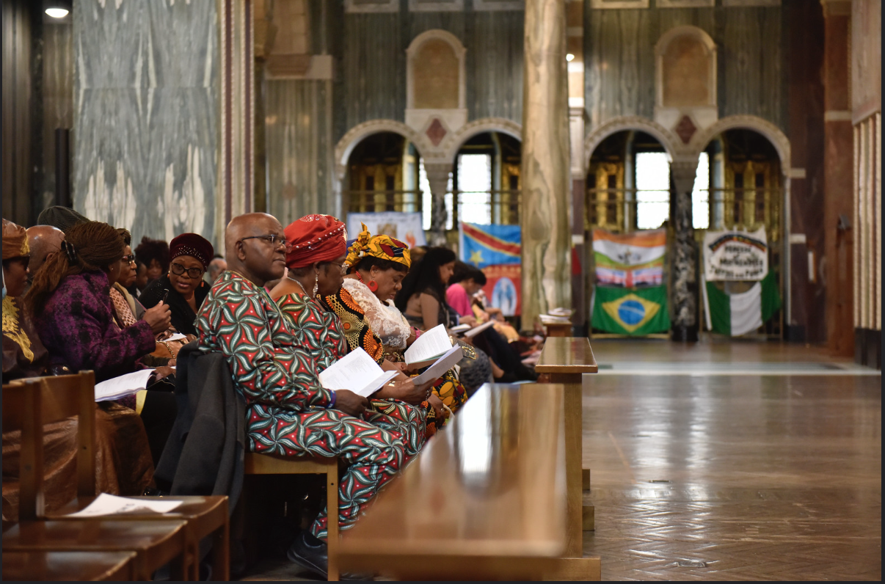
What do these images have in common?
Notes:
Talk partners for 3 minutes
Gather responses

Slide 4
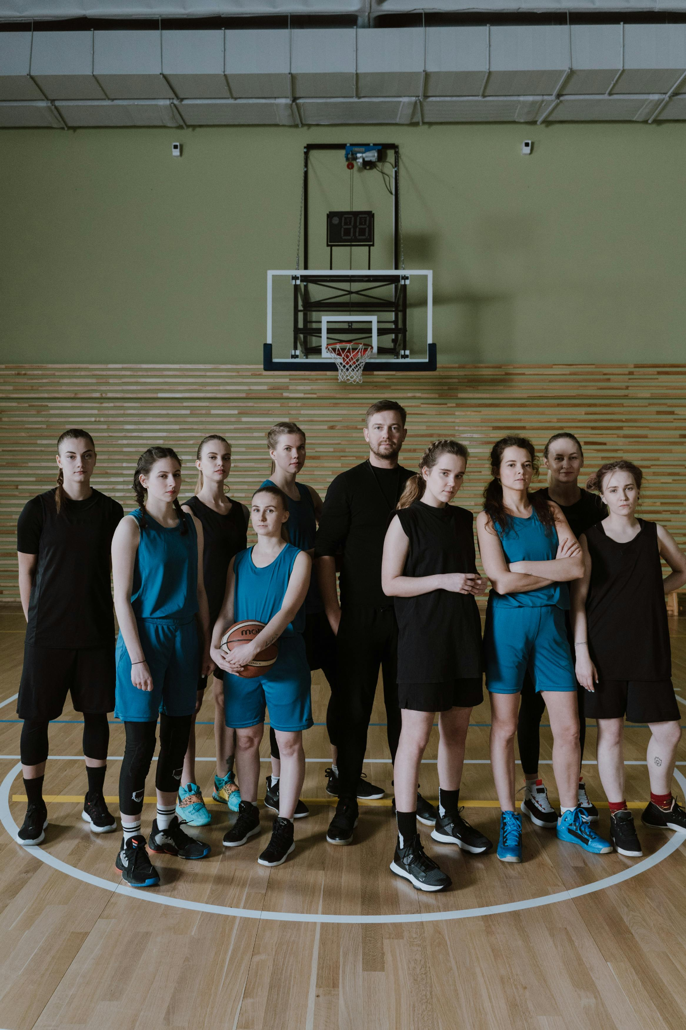
What do these images have in common?
Notes:
Talk partners for 3 minutes
Gather responses

Slide 5
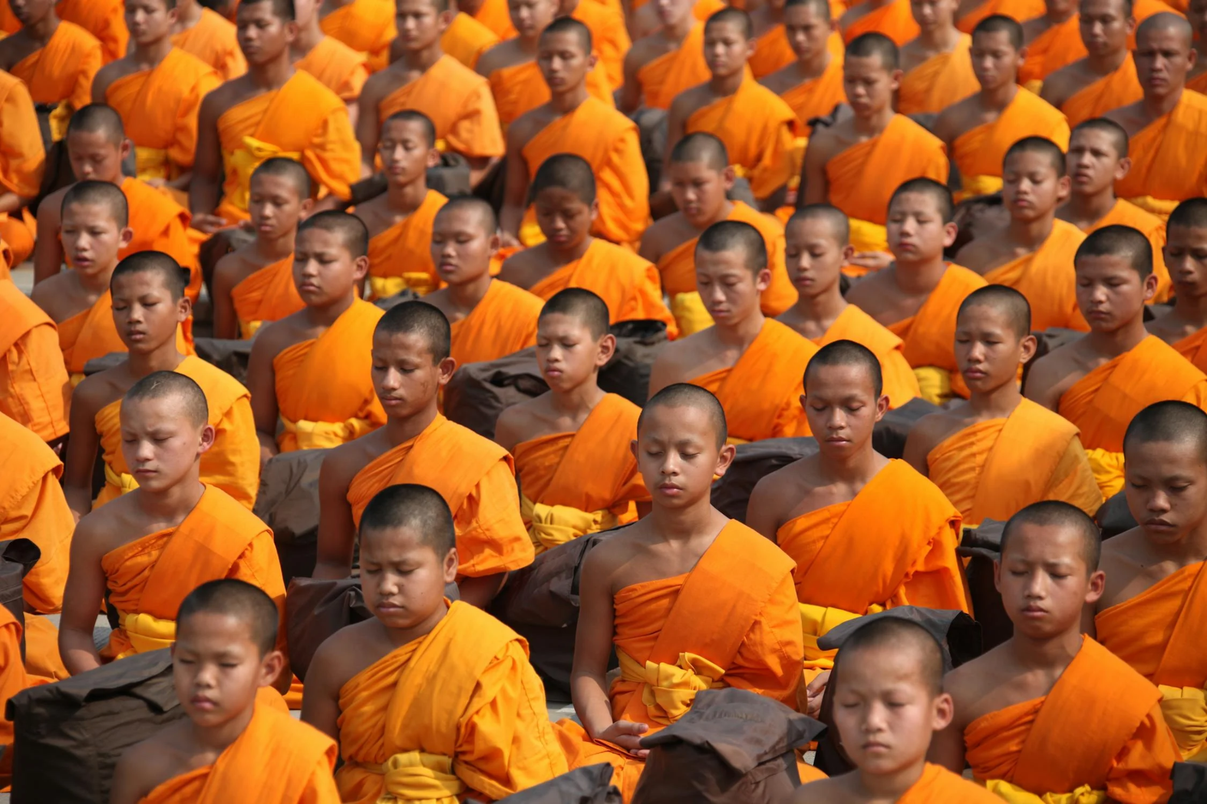
What do these images have in common?
Notes:
Talk partners for 3 minutes
Gather responses

Slide 6
Community
What does community mean to you?
Notes:
Talk partners for 3 minutes
Gather responses

Slide 7
Catholic Social Teaching

Slide 8
Catholic Social Teaching

Slide 9
Community and Participation
A community is group of people who live, work or otherwise spend time together.
What communities are you a part of?
Why might people want to join certain communities?

Slide 10
Community and Participation
As Christians, we are called to live in community with one another.
This means loving and taking care of those around us.

Slide 11
Community and Participation
‘I am my brother’s and sister’s keeper’
(Genesis 4: 8-15)
Notes:
What does this mean; who are your brothers/sisters? How might you be their keeper?

Slide 12
Main Activity
Think about your talents, skills and interests.
Draw your ‘perfect community’
Make sure to show:
People participating
Evidence of ‘being your brother/sister’s keeper’
Notes:
We would love to see the work your pupils produce (with permissions if necessary). Please email their work to: eduril@rcdow.org.uk

Slide 13
Main Activity
Think about your talents, skills and interests.
Draw your ‘perfect community’
Look through Scripture passages about community. Reflect some of them in your drawing.
Label parts of your drawing and explain how this is showing certain Scripture passages in action.
Notes:
We would love to see the work your pupils produce (with permissions if necessary). Please email their work to: eduril@rcdow.org.uk

Slide 14
Extra Challenge
Think about your school community. Is it a ‘perfect community’ where people are participating, in the way Jesus teaches us?
Write a piece for the newsletter to give tips on working towards the ‘perfect community.’
Refer to the Scripture passages and give examples of ways people’s actions might reflect them e.g. including people who are feeling left out; finding patience when your classroom partner frustrates you; losing graciously.
Notes:
We would love to see the work your pupils produce (with permissions if necessary). Please email their work to: eduril@rcdow.org.uk

Slide 15
Plenary
‘Those who love God must love their brothers and sisters’
1 John 4: 19-21
Does the perfect community exist?
Notes:
Encourage thoughtful responses from the children, challenging them to explain and justify their thinking.

