Slide 1
Solidarity and Peace
Year 3

Slide 2
Jubilee Year 2025
Pope Francis has declared this year’s Jubilee theme to be: Pilgrims of Hope
In what way is Solidarity and Peace linked to Hope?
Notes:
Pope Francis opened the Holy Door of St Peter’s Basilica on Christmas Eve 2024, marking the beginning of this jubilee year. Pope Francis has called for people of faith to pray for and have deep faith, lively hope and active charity. Explain to the children why this jubilee year is a great time to be very active in charity, which is what we’re working towards in our CST lessons.

Slide 3
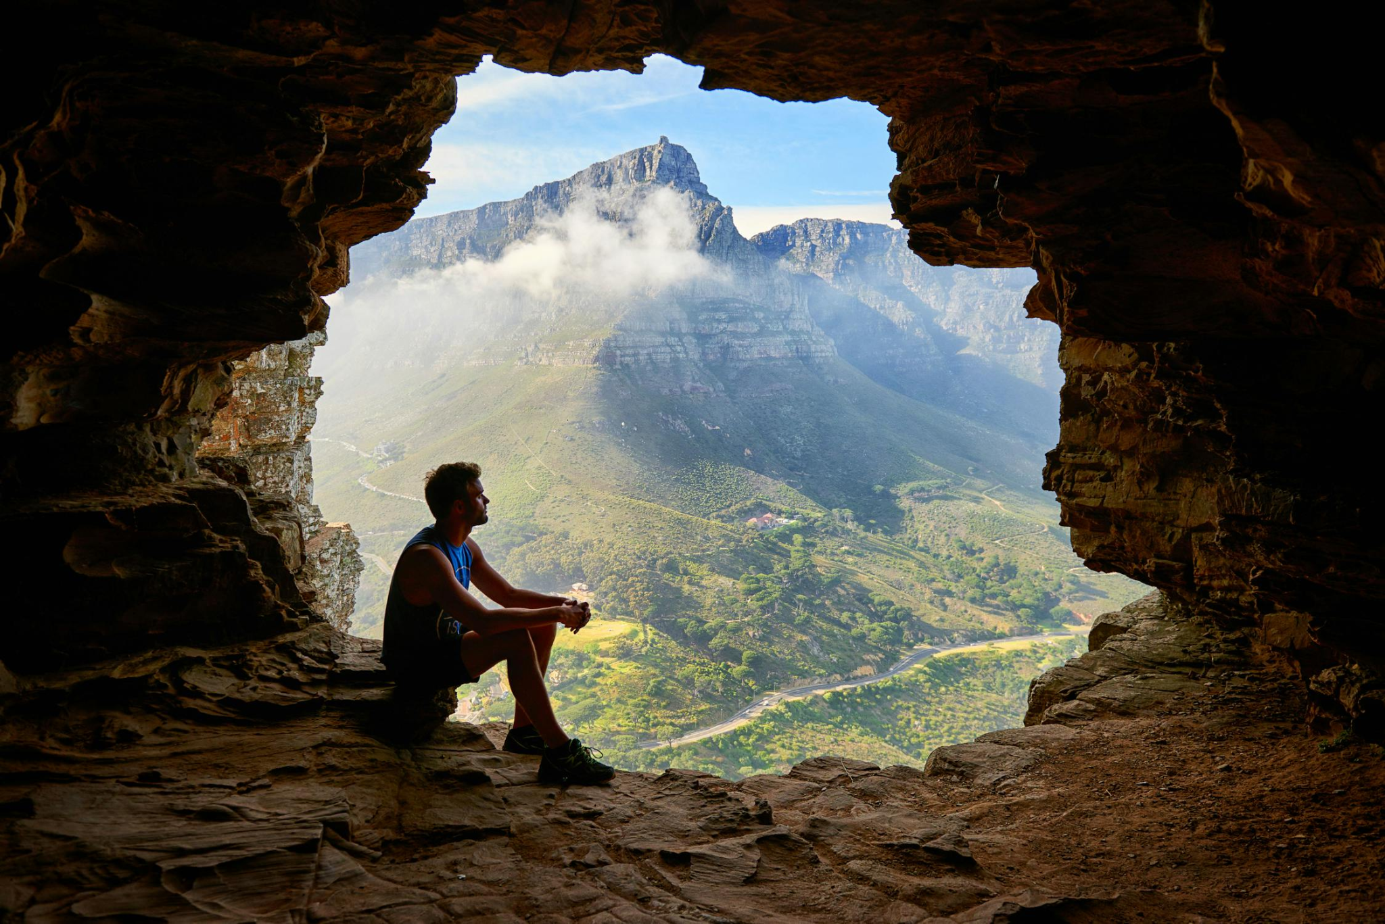
Starter
Notes:
What do you think of when you hear the word ‘peace’? Think of a time when you felt at peace.

Slide 4
Catholic Social Teaching

Slide 5
Catholic Social Teaching

Slide 6
Solidarity and Peace
‘Blessed are the peacemakers, for they will be called sons and daughters of God.’
Matthew 5:9
Who do you think ‘the peacemakers’ are?
Notes:
What does it mean to be a peacemaker? Who are the peacemakers in our world today?

Slide 7
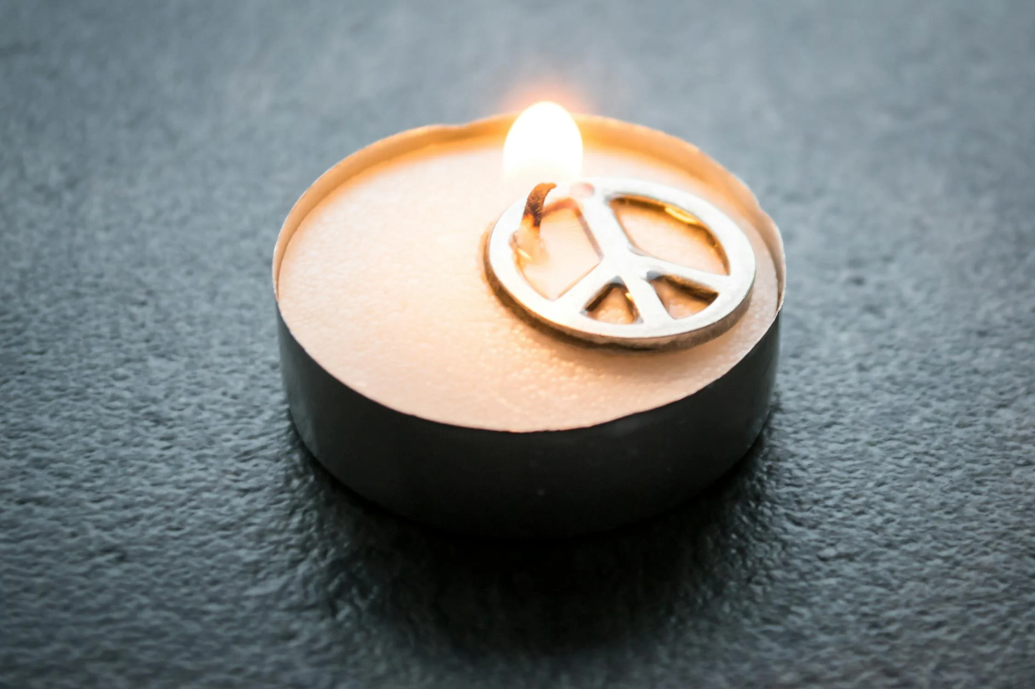
Peacemakers
Dalai Lama
Mother Teresa
Martin Luther King Jr
Malala Yousafi
Archbishop Desmond Tutu
Mahatma Gandhi
Jane Goodall
John Hume
Notes:
What does it mean to be a peacemaker? Who are the peacemakers in our world today?

Slide 8
Solidarity and Peace
Peacemakers are people who dedicate their lives and work to making the world more peaceful.
They help reconcile people with God and with one another.

Slide 9
Solidarity and Peace
What do you think ‘solidarity’ means?

Slide 10
Solidarity and Peace
Solidarity means to stand up for each other.
If we stand up for and speak out on behalf of those in need in our world, we can make the world a fairer and more peaceful place.
Notes:
Do these famous peacemakers also show solidarity? How?

Slide 11
What the bible says…
‘Living in right relationship with others brings peace’
Psalms 72
Notes:
Remind children that Scripture is our first teacher in the way of peacemaking, the prophets of the Old Testament, Jesus and his apostles. Go through these passages as ‘proof’.

Slide 12
What the bible says…
‘These are the things you should do: Speak truth, judge well, make peace.’
Zechariah 8:16

Slide 13
What the bible says…
‘Be reconciled to one another before coming to the altar.’
Matthew 5: 21-24

Slide 14
What the bible says…
‘If one member of Christ’s body suffers, all suffer. If one member is honoured, all rejoice.’
1 Corinthians 12: 12-26

Slide 15
What the bible says…
‘Above all, clothe yourself with love and let the peace of Christ reign in your hearts.’
Colossians 3: 9-17

Slide 16
Activities
1. Create a factfile on one of the famous peacemakers.
2. Add to your factfile by including links between this person’s devotion to peace and what Scripture teaches us.
3.Someone aspires to be a peacemaker. Create an action plan, showing them the action they need to take to become one. Use the life of one of the famous peacemakers as a guide. Include links to Scripture to show Jesus as the first teacher of solidarity and peace.
Notes:
We would love to see the work your pupils produce (with permissions if necessary). Please email their work to: eduril@rcdow.org.uk

Slide 17
Plenary
‘Live in harmony with one another. Do not be proud, but associate with those in need.’
Romans 12:16
Notes:
Are you a peacemaker? Discuss.

