Slide 1
Community and Participation
Year 4

Slide 2
Starter
‘For where two or three gather in my name, there am I with them.’
Matthew 18:20
What do you think Jesus meant by this?
Notes:
Is Jesus with us? How can we tell?

Slide 3
Catholic Social Teaching

Slide 4
Catholic Social Teaching

Slide 5
Community and Participation
A community is group of people who live, work or otherwise spend time together.
Have you been a part of a community today? Have you participated in that community?
Notes:
Ask children generally what communities they are a part of and write some ideas on the board

Slide 6
Community and Participation
As Christians, we are called to live in community with one another.
This means loving and taking care of those around us.

Slide 7
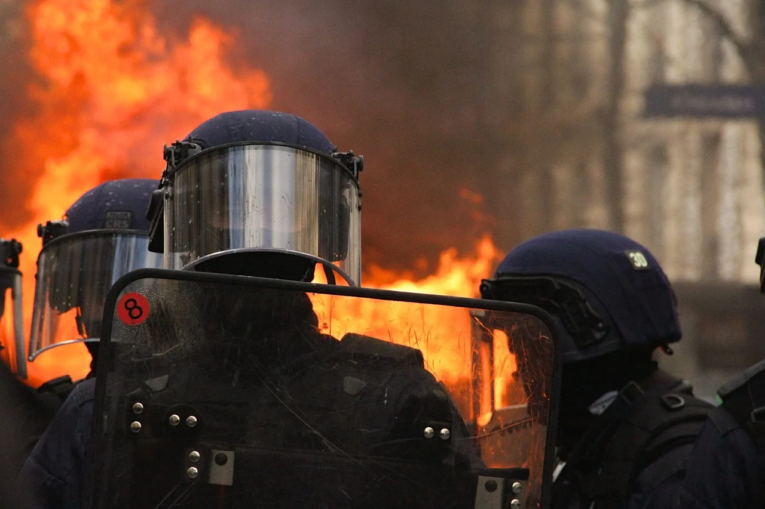
Community and Participation
Notes:
Are these images an example of community? Why? Why not?

Slide 8
Community and Participation
‘Love one another: just as I have loved you ... By this all people will know that you are my disciples.’
John 13:34-35

Slide 9
Community and Participation
‘Lord, when was it that we saw you hungry and gave you food, or thirsty and gave you something to drink? And when was it that we saw you a stranger and welcomed you, or naked and gave you clothing? And when was it that we saw you sick or in prison and visited you?”
And the King will answer them: “Truly I tell you, just as you did it to one of the least of these who are members of my family, you did it to me.”’
Matthew 25:31-46

Slide 10
Community and Participation
‘You shall love the Lord your God with all your heart, and with all your soul, and with all your mind. This is the first and greatest commandment. And the second is you shall love your neighbour as yourself.’
Matthew 22:37-39
Who is your neighbour?

Slide 11
Main Activity
Create a poster to encourage people to join a community that you love being a part of.
Include:
What the community is about;
Why you go;
How you participate;
Why community is important;
How it supports the lessons Scripture teaches.
Notes:
We would love to see the work your pupils produce (with permissions if necessary). Please email their work to: eduril@rcdow.org.uk

Slide 12
Main Activity: Extra Challenge
Look up your community’s history.
Who started it? What inspired them? How have they influenced others?
What figures from Scripture grew communities in a similar way?
- St Paul’s letters
-St Peter
-Disciples
-Gospel writers
Notes:
We would love to see the work your pupils produce (with permissions if necessary). Please email their work to: eduril@rcdow.org.uk

Slide 13
Plenary
‘Serve one another with the gifts you have received’
1 Peter 4: 8-11
How does this relate to ‘Community and Participation’?

