Slide 1
Solidarity and Peace
Year 4

Slide 2
Jubilee Year 2025
Pope Francis has declared this year’s Jubilee theme to be: Pilgrims of Hope
In what way is Solidarity and Peace linked to Hope?
Notes:
Pope Francis opened the Holy Door of St Peter’s Basilica on Christmas Eve 2024, marking the beginning of this jubilee year. Pope Francis has called for people of faith to pray for and have deep faith, lively hope and active charity. Explain to the children why this jubilee year is a great time to be very active in charity, which is what we’re working towards in our CST lessons.

Slide 3
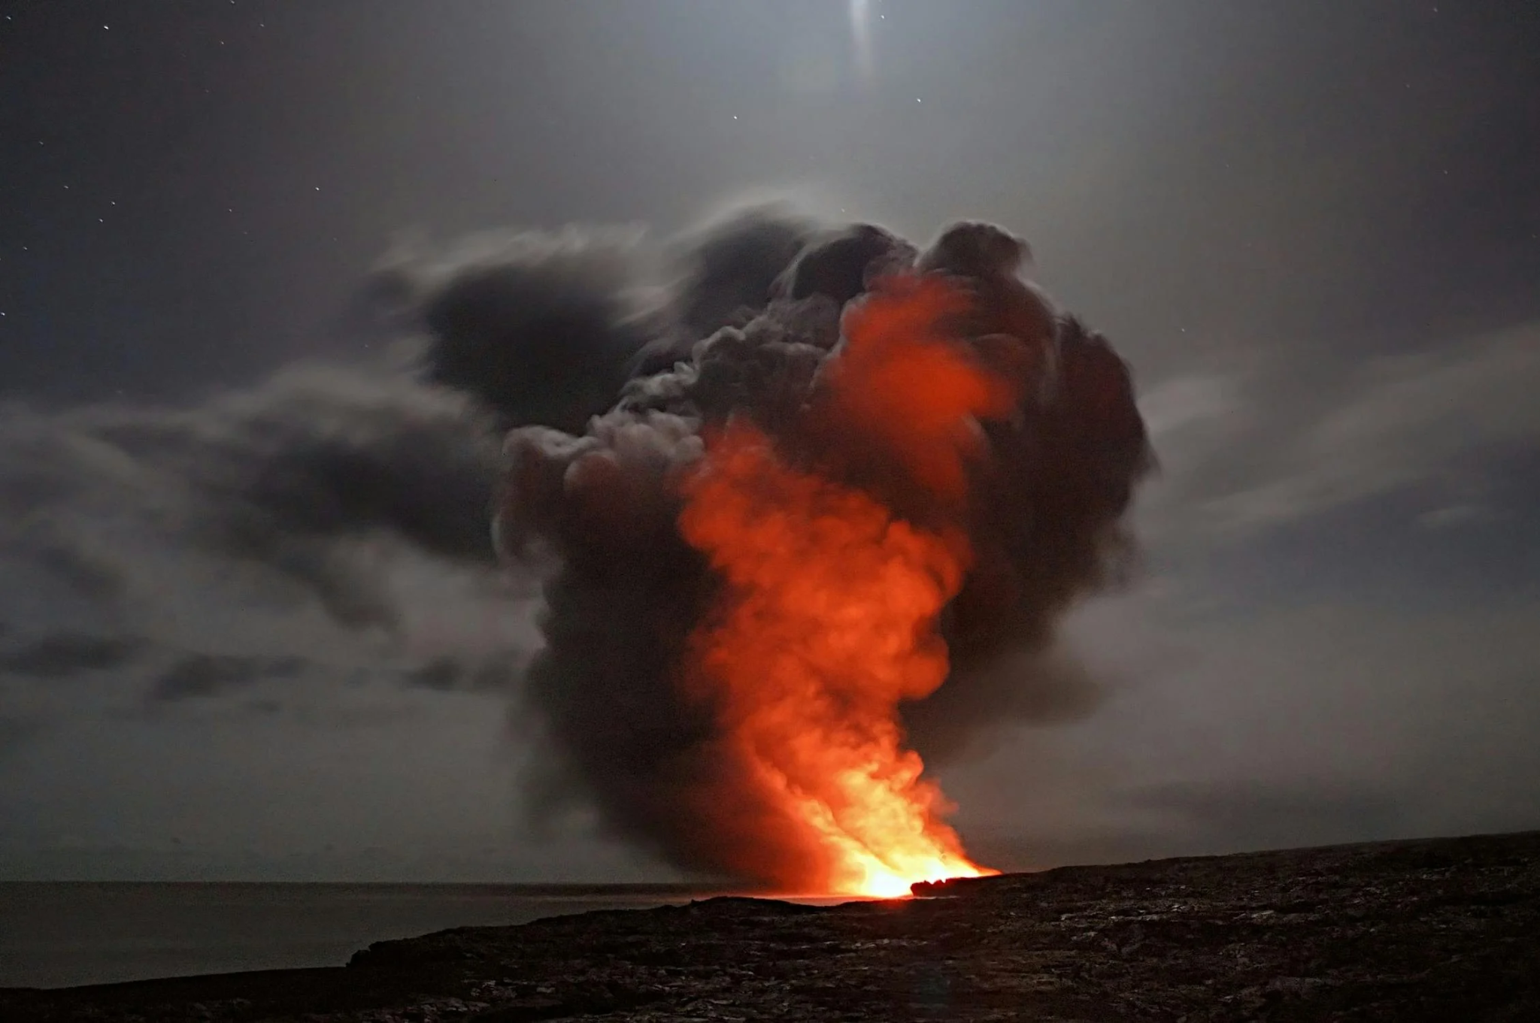
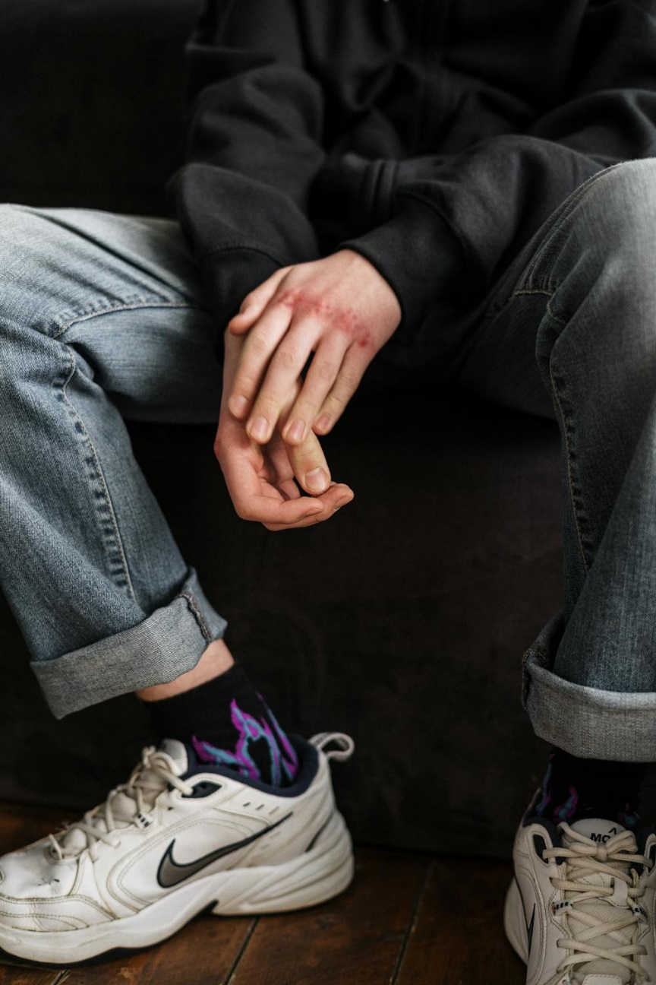
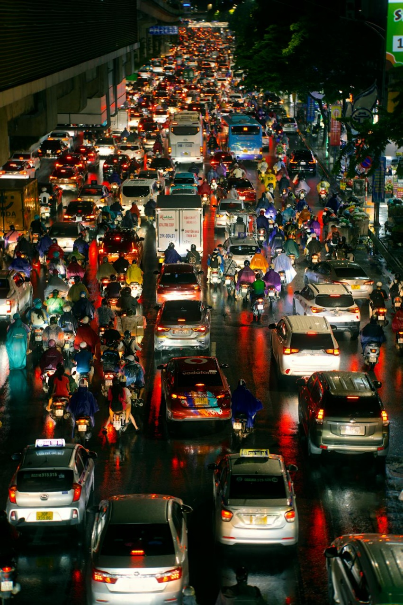
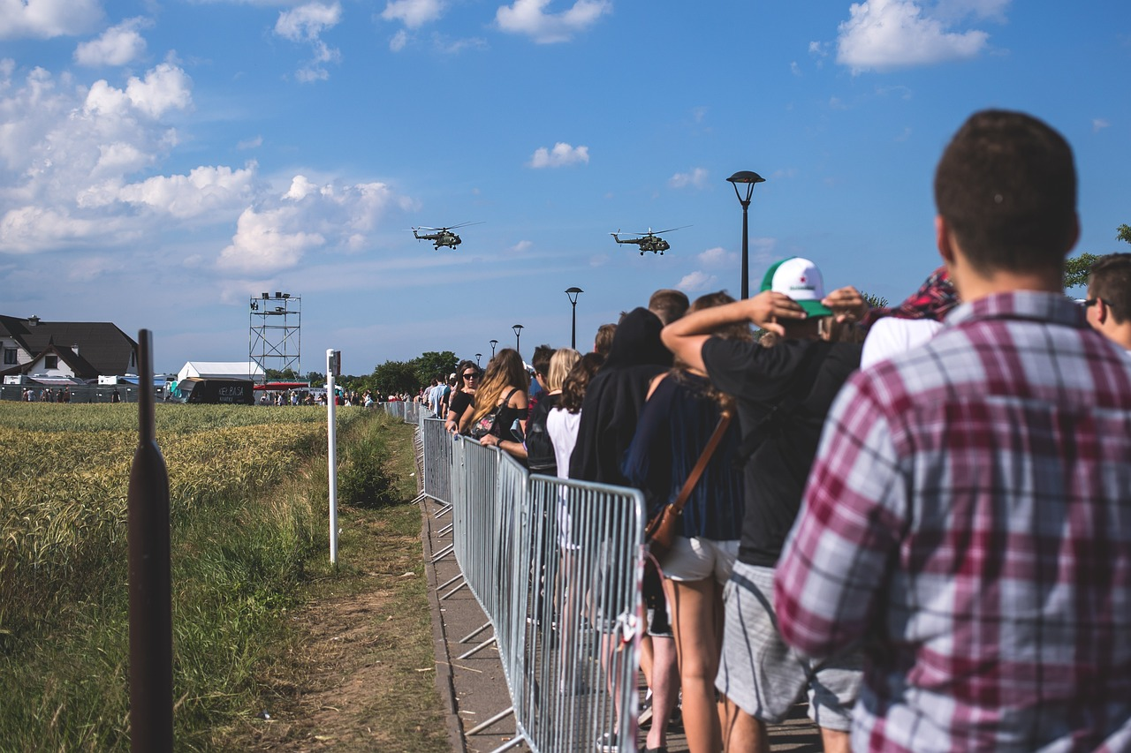
Notes:
STARTER: Encourage children to see all these images lack a sense of peace. From the extremes of war and violence to the chaos of crowds, queueing and a stressful day. Use this as a way to understand what peace means and the fact it can have a range of meanings. Ask children to think of lots of different interpretations of what peace is.

Slide 4
Catholic Social Teaching

Slide 5
Catholic Social Teaching

Slide 6
Solidarity and Peace
What do you think ‘solidarity’ means?
Notes:
Discuss in relation to peace (see plan). Ask chn to sketch a symbol for solidarity on whiteboards and explain their decisions to their partner.

Slide 7
Solidarity and Peace
‘Blessed are the peacemakers, for they will be called sons and daughters of God.’
Matthew 5:9
Who do you think ‘the peacemakers’ are?
Notes:
Who might the peacemakers have been in Jesus’ time? Who are the peacemakers around us today? Can you be a peacemaker? How?

Slide 8
Solidarity and Peace
‘Live in harmony with one another. Do not be proud, but associate with those in need.’
Romans 12:16
Notes:
What does it mean to live in harmony? Why are being warned not to be proud? Can you think of an example when someone might be too ‘proud’ to engage with someone in need?

Slide 9
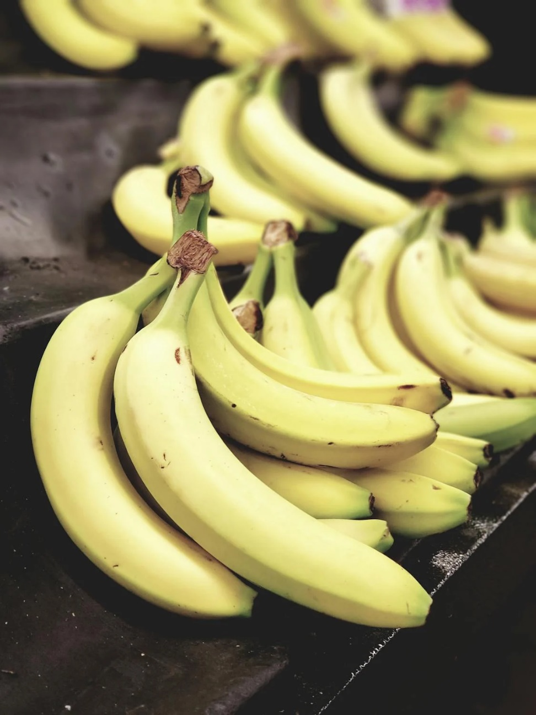
Solidarity and Peace
Notes:
How might these items be linked to our CST theme? Introduce concept of Fairtrade. Find out what the children already know.

Slide 10
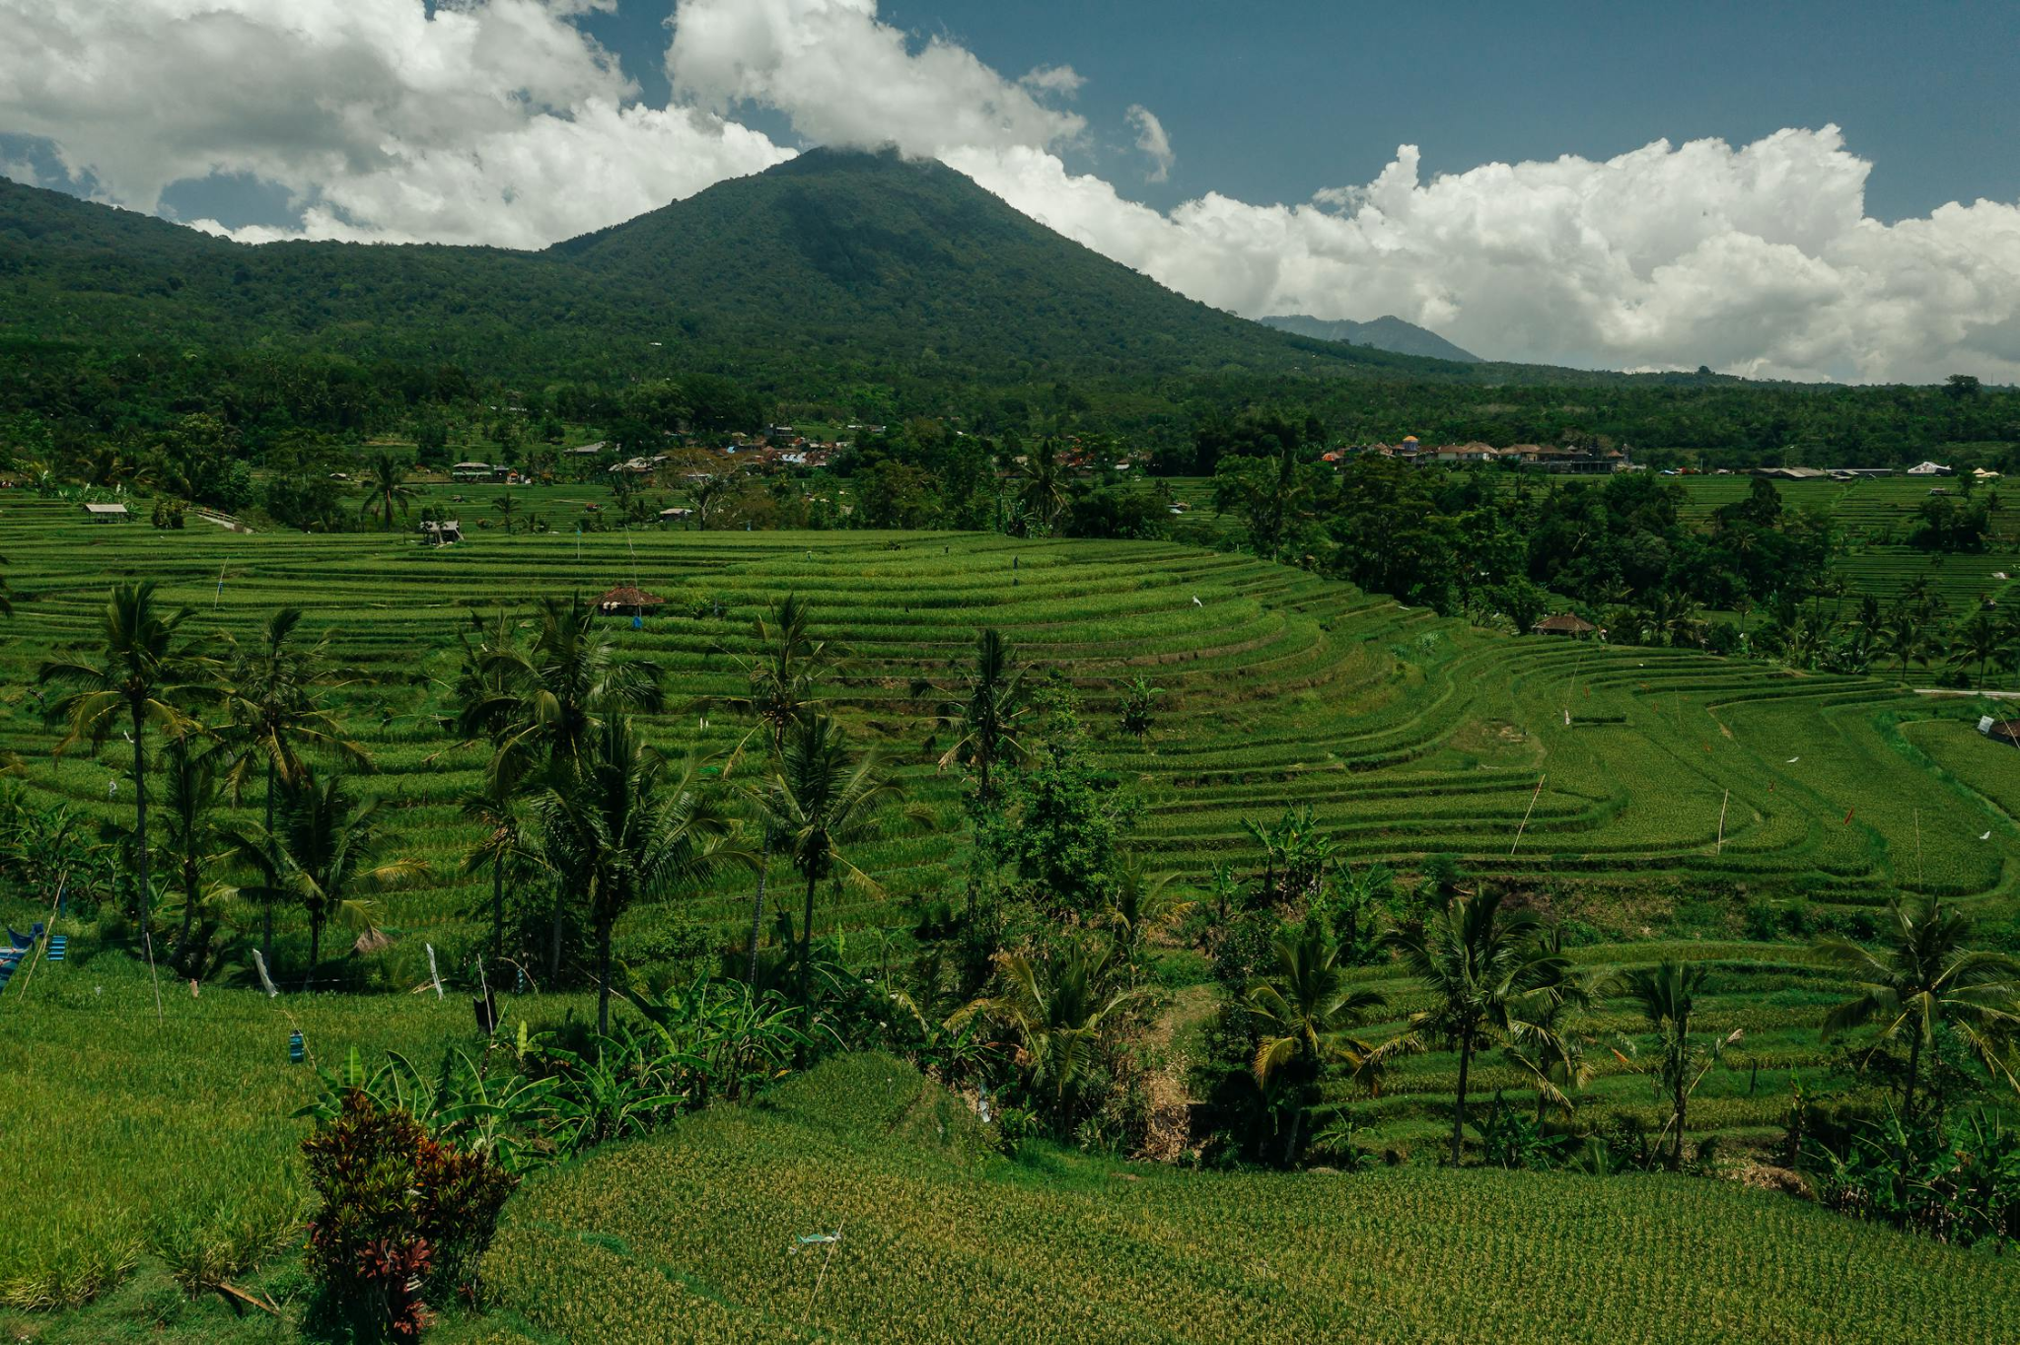
Solidarity and Peace
Notes:
How might these items be linked to our CST theme? Introduce concept of Fairtrade. Find out what the children already know.

Slide 11
Activities
Carry out an audit of Fairtrade products in your school.
Write to your headteacher, asking them to only allow fairtrade versions of certain products.
Organise a Fairtrade fundraiser like a cake sale, tuck shop, read/spell/sport-a-thon!
Notes:
We would love to see the work your pupils produce (with permissions if necessary). Please email their work to: eduril@rcdow.org.uk

Slide 12
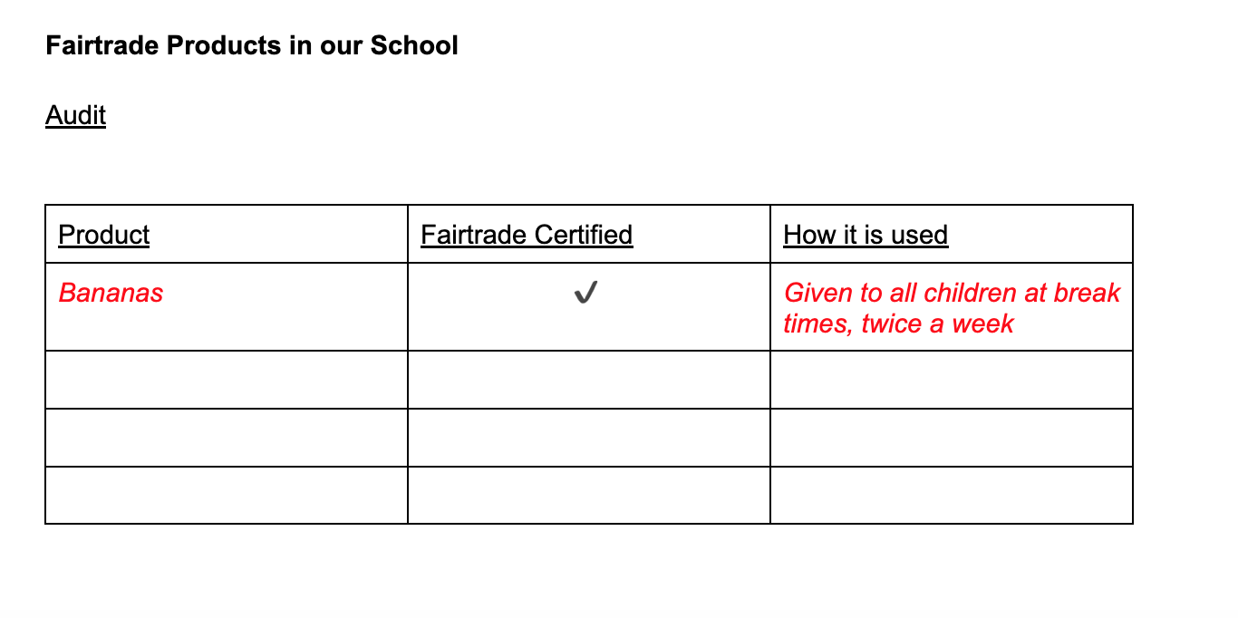
Fairtrade Audit

Slide 13
Written Follow-Up Activities
Audit: As Christians, why is Fairtrade so important to us?
Letter to your headteacher: How does supporting Fairtrade work towards solidarity and peace? How did Jesus set this example in Scripture?
Fundraiser: Why is Fairtrade important? Whose responsibility is it? How do certain Scripture passages teach us that supporting something like Fairtrade is what God expects of us?
Notes:
We would love to see the work your pupils produce (with permissions if necessary). Please email their work to: eduril@rcdow.org.uk

Slide 14
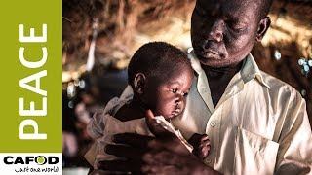
Let us pray
Notes:
Give children time to pray for their own peaceful intentions.

