Slide 1
Community and Participation
Year 5

Slide 2
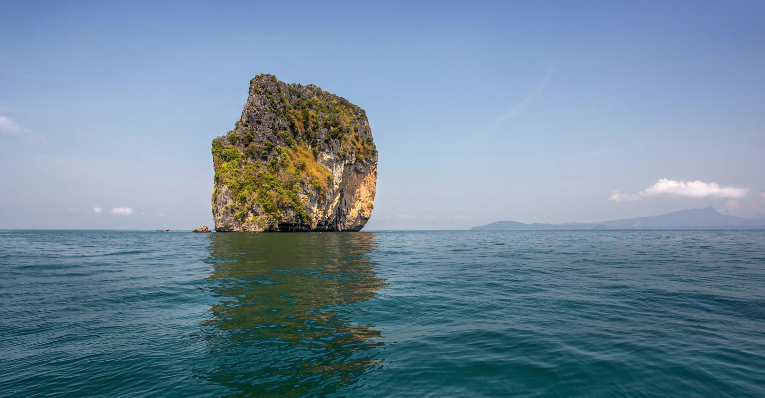
Starter
‘No man is an island’
-John Donne
Notes:
Talk partners for 3 minutes
Gather responses

Slide 3
Catholic Social Teaching

Slide 4
Catholic Social Teaching

Slide 5
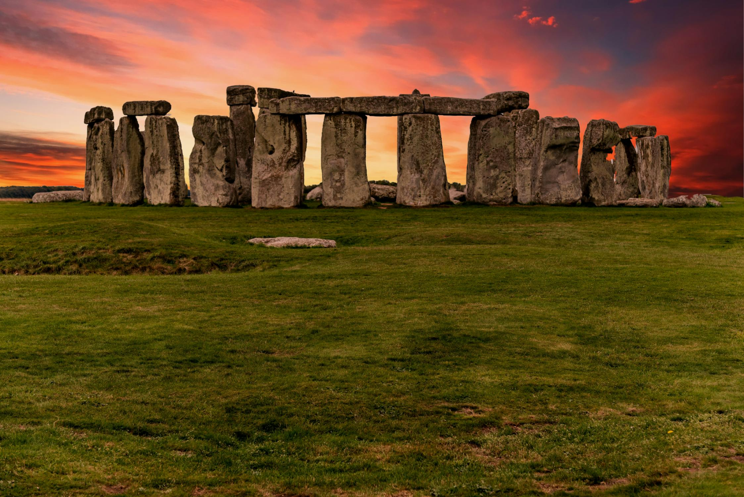
Community and Participation
Community isn’t a new idea
Notes:
Archaeologists have discovered artefacts that prove the earliest humans lived in community- living, eating, working together to achieve a common goal.

Slide 6
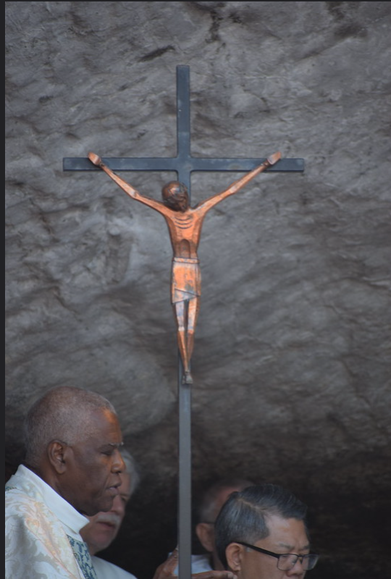
Only through community can we build God’s Kingdom
Notes:
Remind chn that the Kingdom of God is something we can witness on earth; where the Gospel values are lived through everyone.

Slide 7
Community and Participation
‘Love one another: just as I have loved you ... By this all people will know that you are my disciples.’
John 13:34-35

Slide 8
Community and Participation
‘You shall love the Lord your God with all your heart, and with all your soul, and with all your mind. This is the first and greatest commandment. And the second is you shall love your neighbour as yourself.’
Matthew 22:37-39
Who is your neighbour?

Slide 9
Community and Participation
‘Lord, when was it that we saw you hungry and gave you food, or thirsty and gave you something to drink? And when was it that we saw you a stranger and welcomed you, or naked and gave you clothing? And when was it that we saw you sick or in prison and visited you?”
And the King will answer them: “Truly I tell you, just as you did it to one of the least of these who are members of my family, you did it to me.”’
Matthew 25:31-46

Slide 10
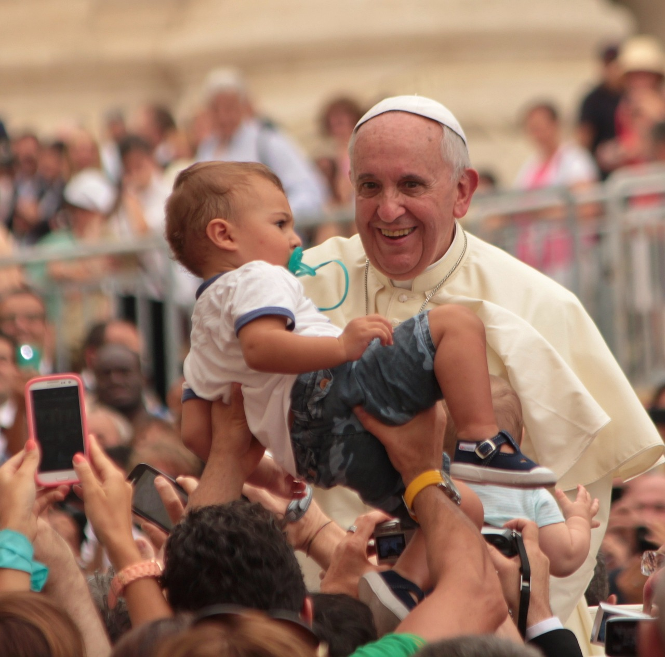
Community and Participation
‘Don’t be observers, but immerse yourself in the reality of life, as Jesus did.’
Pope Francis, World Youth Day, 2013
What do you think Pope Francis meant by ‘immerse yourself in life’?

Slide 11
Starter
‘No man is an island’
-John Donne
Notes:
Can chn think of anyone in their local community who may not feel like they belong or that they too have a right to feel part of a community?

Slide 12
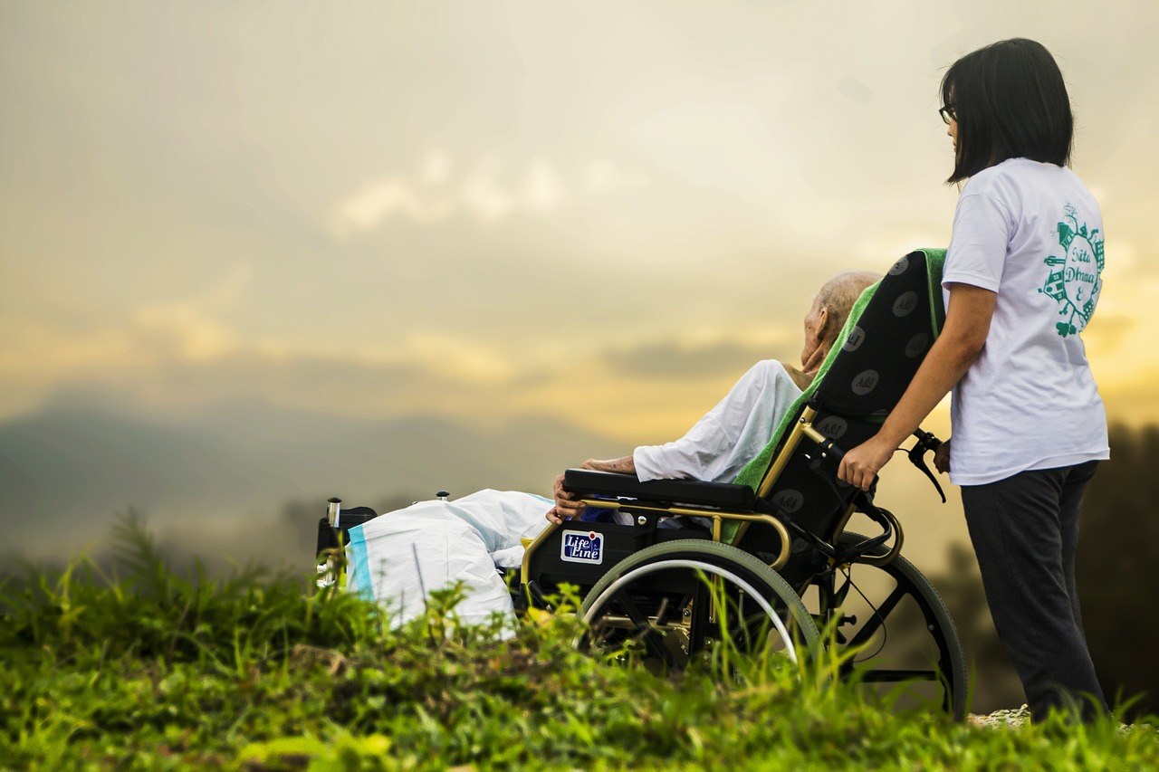
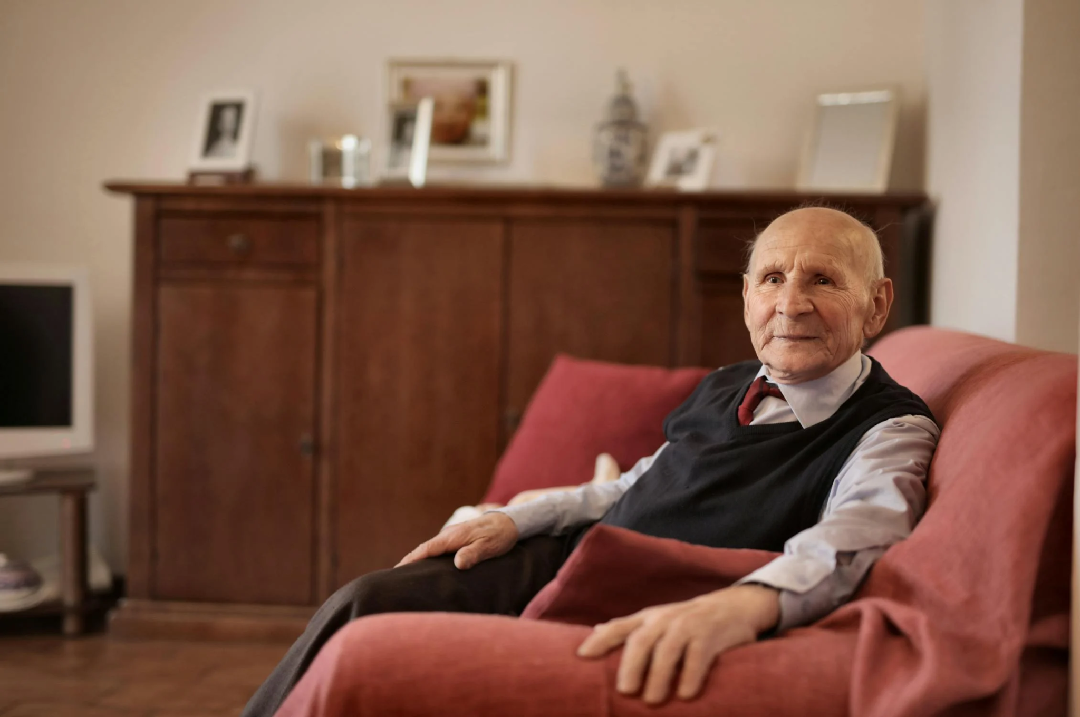
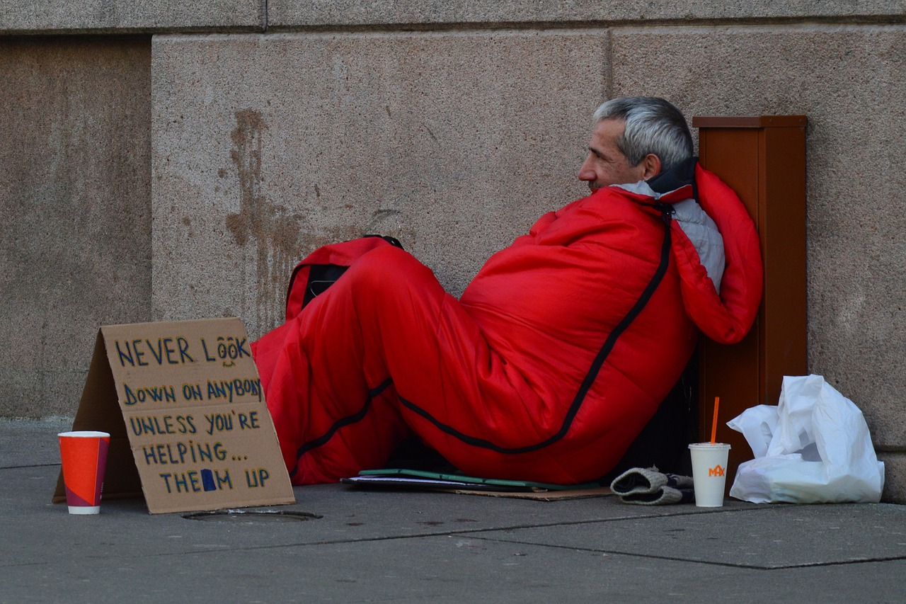
Community Groups/Organisations
Notes:
Who in our community might be lonely and isolated? What community groups exist to support them?

Slide 13
Main Activity: Preparing Questions
Prepare thoughtful, high-level questions to ask the community representative when they come in and talk to us about what they do and why.
Think about:
Why community is important to you (learning from Scripture)?
What impact does your work have?
What more would your organisation like to achieve?
How can we help?
Notes:
Although these organisations might not have a religious character, encourage the chn to use their Christian faith as their foundation for wanting to participate in community.
We would love to see the work your pupils produce (with permissions if necessary). Please email their work to: eduril@rcdow.org.uk

Slide 14
Main Activity: Follow-Up
Now you know how to help, let’s make a plan of action to do some good for our local community
Think about:
What the organisation want from us;
How we will get the message out to our school community;
Where we will store donations;
How we will arrange for donations to be collected?
Notes:
We would love to see the work your pupils produce (with permissions if necessary). Please email their work to: eduril@rcdow.org.uk

Slide 15
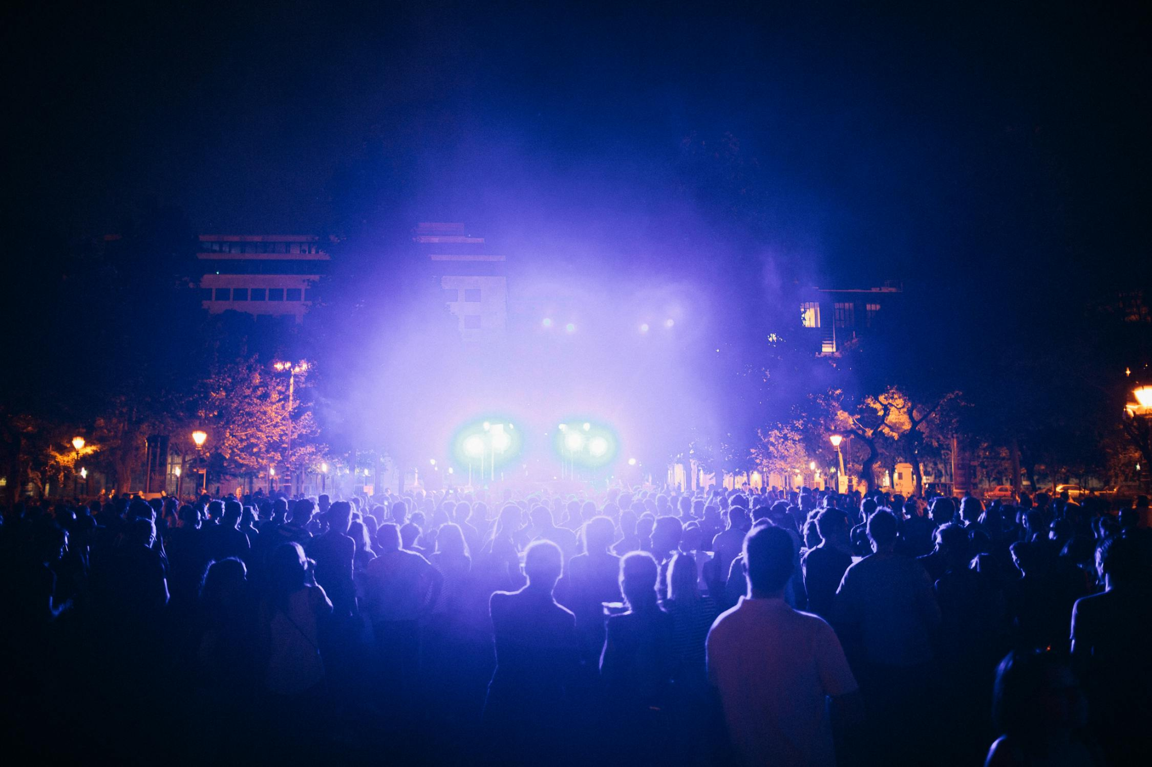
Plenary
‘It is not good for man to be alone.’
Gen 2: 18
Notice where this appears in Scripture.
How did Jesus’ actions and life teach us the truth of this verse?
Notes:
Remind chn of Jesus needing his apostles around him who made disciples of people around them. Community is necessary for survival.

