Slide 1
Solidarity and Peace
Year 5

Slide 2
Jubilee Year 2025
Pope Francis has declared this year’s Jubilee theme to be: Pilgrims of Hope
In what way is Solidarity and Peace linked to Hope?
Notes:
Pope Francis opened the Holy Door of St Peter’s Basilica on Christmas Eve 2024, marking the beginning of this jubilee year. Pope Francis has called for people of faith to pray for and have deep faith, lively hope and active charity. Explain to the children why this jubilee year is a great time to be very active in charity, which is what we’re working towards in our CST lessons.

Slide 3
Starter
Notes:
Discuss a time when you felt at peace. Explain peace can mean different things to different people.

Slide 4
Catholic Social Teaching

Slide 5
Catholic Social Teaching

Slide 6
Solidarity and Peace
There are many ways to define peace.
Freedom from disturbance – freedom to live your life as you wish
Free from anxiety or distress – being happy and calm
Make peace – forgiving others when they have done things wrong
At peace with the world – to live in a state of harmony with others all around us

Slide 7
What the bible says…
‘Living in right relationship with others brings peace’
Psalms 72
Notes:
Go through these passages silently, asking children to read it themselves and reflect on what it means to them.

Slide 8
What the bible says…
‘These are the things you should do: Speak truth, judge well, make peace.’
Zechariah 8:16

Slide 9
What the bible says…
‘Be reconciled to one another before coming to the altar.’
Matthew 5: 21-24

Slide 10
What the bible says…
‘If one member of Christ’s body suffers, all suffer. If one member is honoured, all rejoice.’
1 Corinthians 12: 12-26

Slide 11
What the bible says…
‘Above all, clothe yourself with love and let the peace of Christ reign in your hearts.’
Colossians 3: 9-17

Slide 12
Solidarity and Peace
‘Blessed are the peacemakers, for they will be called sons and daughters of God.’
Matthew 5:9
Who do you think ‘the peacemakers’ are? Who are peacemakers in today’s world?
Notes:
Pause the silent reflection and focus on this passage, discussing questions

Slide 13
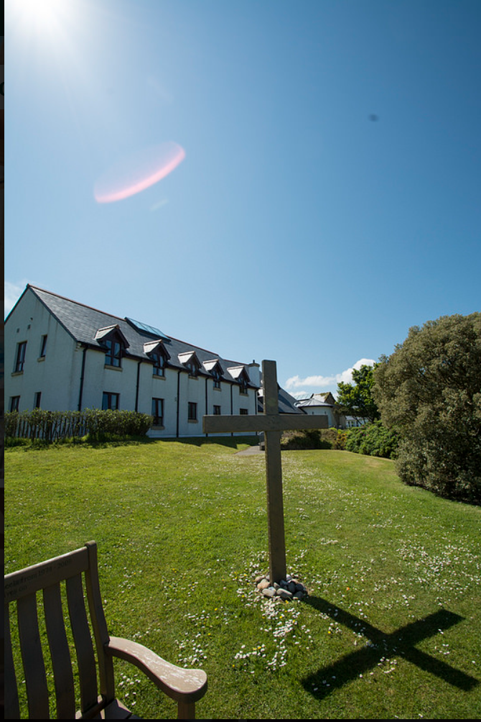
Solidarity and Peace: Corrymeela
Notes:
Introduce Corrymeela and explain this place exists to promote solidarity and peace by bringing different groups of people together. Discuss meaning of solidarity and how it links to peace.

Slide 14
Corrymeela: Knowledge Harvest
Notes:
Children collect information from sheets around the room and add to their table’s sugarpaper.

Slide 15
Activities
1. Create an information poster about the Corrymeela Community.
2. Prepare a speech to inform your school about Corrymeela and their work. Include: What they do; why is this important (bible references); where is peace needed in the world now; a prayer of hope for peace.
Notes:
Children collect information from sheets around the room and add to their table’s sugarpaper.
We would love to see the work your pupils produce (with permissions if necessary). Please email their work to: eduril@rcdow.org.uk

Slide 16
Plenary
‘Peace I leave with you; my peace I give you. I do not give to you as the world gives. Do not let your hearts be troubled and do not be afraid.’
John 14:27
What is meant by this?

